Slide 1
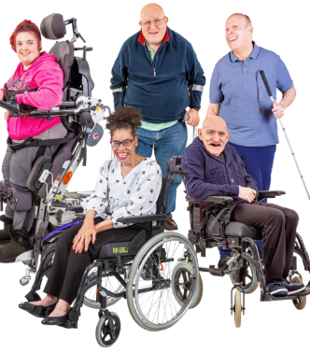
marta coates Strategic health facilitator (RNLD) Arun Sandhu Expert by experience
Working in partnership to improve health outcomes for people with a learning disability
Team email:
shfthealthfacilitators@southernhealth.nhs.uk
Amy George email:
Amy.george@southernhealth.nhs.uk
Notes:
General practice can play a vital role in improving holistic person-centred care for people with a learning disability to enable them to live their ambition of fulfilled lives in the community.

Slide 2
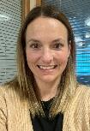
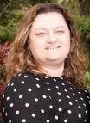
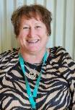
Learning Disability Health Service
North and Mid Hants LD team
Marta Coates
West Hants LD team
Alison Good
Southampton LD team
Louise Bradbury
East Hants LD team
Amy George
Strategic Health Facilitator
Health Facilitator
Strategic Health Facilitator
Health Facilitator

Slide 3
Arun Sandhu
Expert by experience
Member of the Learning Disability Partnership Board
Works for Hampshire County Council

Slide 4
All deaths of people with learning disabilities and autistic people 18+ must be notified to LeDeR.
Report the death of someone with a learning disability/ Autism (leder.nhs.uk)
(For under 18 follow Child death review process)
Example: Learning Disabilities must never be the documented reason for DNA CPR
Notes:
Reports usually come out annually- now based on the year of death, not year when death was reviewed.
Reporting now includes autistic people as we as people with learning disabilities.
Primary care staff may be asked to provide information that would support reviewes.

Slide 5
LeDeR 2022- Spot the difference report
2022 LeDeR report foreword from the Staying Alive and Well group - YouTube
5:17
Notes:
Service User involvement with this report has led to it being called the “spot the difference report” as they feel not a lot has changed so they are comparing 2022 deaths to those from 2018-2022
Unique death means- Some deaths get reported twice so where were more deaths reported but only 3648 were unique.

Slide 6
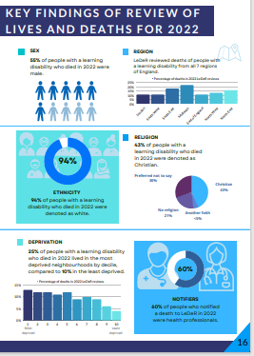
LEDER Reports
Short report:
Master LeDeR 2023 (2022 report) (kcl.ac.uk)
Full report:
kcl.ac.uk/ioppn/assets/fans-dept/leder-2022-v2.0.pdf

Slide 7
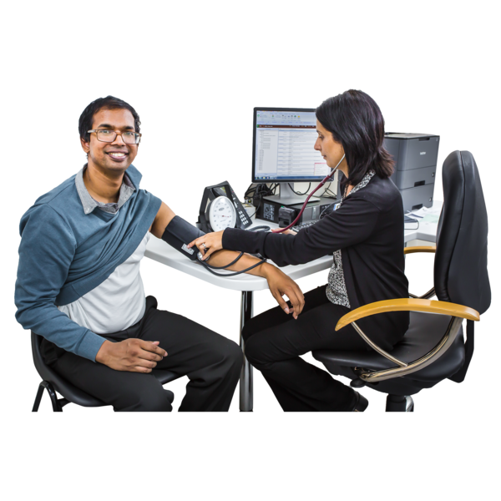
Annual Health Checks

Slide 8
What should be covered in the Learning Disability AHC? MINIMUM REQUIREMENT
Collaborative review with the patient and carer (where applicable) of physical and mental health with referral through the usual practice routes if health problems are identified, including:
- health promotion
- chronic illness and systems enquiry
- physical examination
- epilepsy
- dysphagia
- behaviour and mental health
- specific syndrome check
Medication review (incl. STAMP/ STOMP)
Vaccinations and immunisations
Review coordination of care with secondary care
Transition (where appropriate)
Reasonable adjustments (for primary and secondary health care)
Communication needs, including communicating pain or distress
Review of family carer needs
Information in a format the patient understands, to support the patient to make decisions about their health and healthcare
Easy read Health Action Plan
DES GMS contract 2018
DES GMS contract (2015)
Notes:
The reason this is comprehensive is that these health checks have been designed as a proactive assessment which would identify unmet health needs early.

Slide 9
Discuss below:
Unable to read and write
Seen in clinic- BMI 44
Reportedly hardly drank anything today
60 yr old lost weight unintentionally again/ BP 170/85
Does not see dentist/ very poor oral hygiene/ teeth falling out
not seen as did not respond to letters
No action needed
Had enough fluid/ no concerns
No action required
Nothing abnormal seen/ no action needed
Patient has a severe learning disability – patient able to consent to assessment and treatment

Slide 10
LD Annual Health Check- Key Points:
14 years and older
(please encourage the uptake in those 14-17 year old)
Face to face
Deliver health checks all year round
Use Ardens template
Provide patient/ carer with health check action plan
Follow up DNAs
AHCs to be completed by appropriately trained practitioner (s)
Annual Health Checks are part of patient journey
Notes:
Transition – AHC check info leaflet for young people 13+/ parents

Slide 11
People with lived experience said to us recently
We like it when:
Doctors and nurses talk to us and our carers
Staff are nice to us
We are listened to
Information is in easy read
We are given more reassurance
We are offered home visits when needed (even if we are not housebound)
We are given Action plans/ notes
We have Blood tests/ “proper” health checks
We can speak to reception if we can’t check in on
a computer
10. We don’t have to use e-consult (it is difficult)
11. You look at forms we bring in

Slide 12
Local Annual Health Check Resources
Information for Primary Care
Information for Primary Care staff :: Southern Health NHS Foundation Trust
Health Information Easy Read
Health information :: Southern Health NHS Foundation Trust

Slide 13
The Equality Act 2010
Please record RAs within AHC, and this will be added as a flag on EMIS (if using Ardens template)
Flag is ready, information will be shared across healthcare computer systems.
Reasonable adjustment free text and category selection
Saved onto national spine
Reasonable Adjustment Digital Flag training now available - elearning for healthcare (e-lfh.org.uk)
Notes:
Ask what reasonable adjustments they have in place already?
Be proactive/Find out information from the
patient, carer and family
Ensure effective team communication
Check if Hospital Passport in place and Use it!
Use The Hospital Communication book if needed
Be open minded / Think outside the box
Make reasonable adjustments
Advocate on behalf of the person with LD
Understand consent and MCA (Refer to IMCA if needed)
Ensure the patient has been reviewed HOLISTICALLY prior to discharge
Ensure patient discharged with equipment as needed
Ensure patients with LD are flagged on hospital system
Consider Care plans for frequent attenders

Slide 14
Learning Disability Friendly Practice
Part of Transforming Care Programme
Some examples of success criteria:
75% uptake of learning disability annual health checks
Up to date learning disability register
Evidence of reasonable adjustments
Learning disability champion
Flagging carers
Evidence of person-centred care
Reasonable adjustments
Assessed and confirmed by the Strategic Health Facilitation team

Slide 15
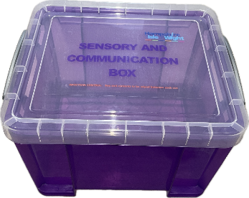
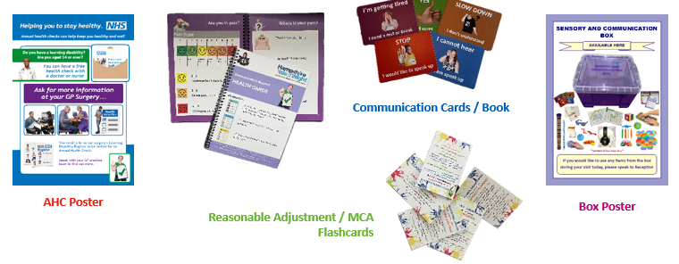
Sensory items
Communication box

Slide 16
Case study
Pam is a 44 year old lady with moderate to severe learning disability. Pam loves going out for walks in nature, occasionally she may visit shops but only during “quiet hours”. Pam lives with 24/7 support and has not had her health check for last 6 years.
Tom is a 23 year old gentleman with moderate learning disability who came in for his health check. Tom is happy to have most of his physical examinations done but refuses testicular exam.
Sue, 32 year old lady with severe learning disability requires depo
injection as she doesn’t tolerate bleeding. She lives in residential
setting; she has a sister that visits her every fortnight.

Slide 17
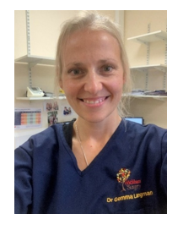
“If you would like to explore ideas / thoughts for improvements or provide any additional feedback / suggestions, please do not hesitate to contact myself or the Learning Disability and Autism Programme team at hiowicb-hsi.hiowldap@nhs.net.”
Dr Gemma Langman
GP at Wickham Surgery and Clinical Champion for Learning Disability and Autism Programme, Hampshire and Isle of Wight Integrated Care Board

Slide 18
Additional ref
New review identifies poorer care and lower life expectancy for ethnic minorities with a learning disability - NHS – Race and Health Observatory (nhsrho.org)
We deserve better: Ethnic minorities with a learning disability and access to healthcare - Race Equality Foundation

