Slide 1
Greener Prescribing in Diabetes – Insulin Pens
Developed by
The North East & Yorkshire
Diabetes Environmental and Sustainability Impacts Group
And
Primary Care Development Nurses South Yorkshire ICB
Notes:
Standard title slide

Slide 2
Aims of this presentation
To raise awareness of the environmental issues of prescribing insulin in a safe way
To highlight the different devices available to administer insulin in the community
To sign post to learning opportunities including videos demonstrating insulin administration
Share visual examples of the pens and cartridges available for insulin
Enable you to give patients an informed choice about their insulin devices suitability and its potential impact on the environment

Slide 3
The history of insulin & pen devices
Insulin was first discovered over 100 years ago.
Insulin was the first medication to be discovered for diabetes and is still the most potent glucose-lowering therapy.
Insulin delivery devices have rapidly advanced in the past 2 decades. Devices used to administer insulin are largely pens and pumps.
All patients living with type 1 diabetes and many with type 2 diabetes will require insulin.
The prevalence of diabetes continues to increase*
Source: National Library of Medicine May 2020 and *NDA Quarterly Dashboard comparing 21/22 with 22/23. December 2023

Slide 4
The history of insulin & pen devices
Source: National Library of Medicine May 2020.

Slide 5
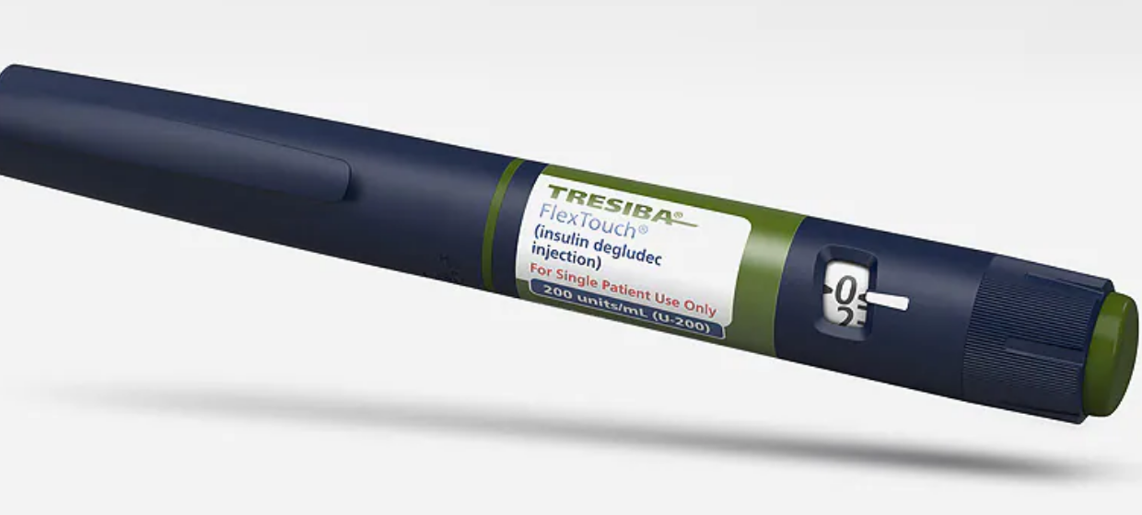
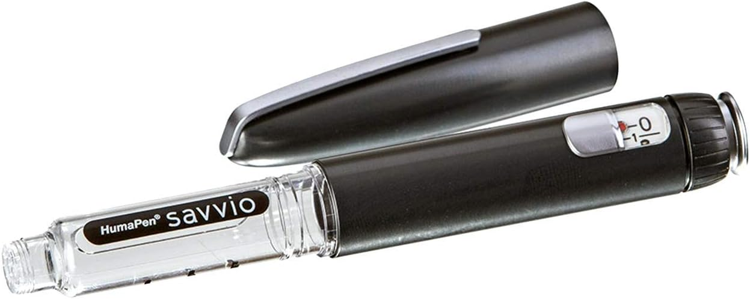
Pen options for Insulin Users
Disposable pens
Reuseable cartridge pens
These pens are only used once.
Environmentally unfriendly as the plastic waste is far greater for this device.
The whole pen is placed in the yellow sharps bin as the pen cannot/should not be dismantled.
If there are dexterity issues patients may be better with this pen than a re-usable. If this type of pen is required, patient should be advised to recycle where possible.
NOVO - Pens Home | PenCycle (pen-cycle.co.uk)
Sanofi - Pens https://www.mysanofiinsulin.co.uk/repen/
Reusable pens last for several years so less plastic is needed for manufacture of the device.
Patients simply unscrew and add/change the insulin penfill cartridge.
Only the small glass penfill cartridge needs to be changed and disposed of in the yellow sharps bin taking far less space in the bin.
Less packaging & less plastic waste than disposable pens.
Some reusable cartridge pens have Smart Technology that shows when the last dose was given and more.

Slide 6
The Environmental Impact of Pen Choices

Slide 7
Comparing Carbon Footprints of Insulin Pens
Source: The information above and carbon footprints have been obtained from Novo Nordisk (2021) lifecycle analysis of their pens. This information and their calculations are referred to throughout this presentation. Novo rapid is the insulin included in the figures above.
Notes:
Plain slide with subhead and bullets

Slide 8
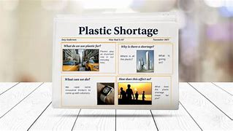
Impact of Plastic shortage in diabetes
The shortage of disposable insulin pens is due to the limited availability of the plastic pen NOT the insulin!
Massive increases in the use of GLP1s in disposable pens is an issue too – demanding more medical grade plastic
Reduce the need for plastic
Disposable pens are single use but cartridge pens last for years.
So plastic waste is much lower using cartridge pens
Disposable pens fill up sharps bins faster, hence more plastic waste
Currently only Sanofi and Novo have a recycling scheme for their own branded pens
Notes:
In high Demand - GLP1 shortage (caused by the unavailability of pens rather than the drug). The pen for the new weight loss drug is the same as that used for disposable insulin pens – due to the demand for the weight loss drug/pen this has led to a shortage of the pens. Those using reusable cartridge pens are not affected by this shortage as they only require cartridges to refill their pens rather than the whole pen.

Slide 9
Financial costs of prescribing choices
In addition to the environmental cost there is a financial cost of destroying waste in insulin administration.
The use of disposable insulin pens creates far more waste, which is paid for by the NHS to destroy:
Flex- Touch Disposable Pen or kwikpen | Penfill Cartridge
28 grams (empty) | 5 grams (empty)
6 per 0.5L sharps bin | 26 per 0.5L sharps bin
1 tonne of clinical waste costs an ICB approximately £1000 per tonne to destroy. Using the above (approximate) information the use of disposable pens would create 1 tonne of clinical waste 4 times faster than the use of cartridge pens
All insulin cartridge pens can use generic insulin needles, the same as the disposable, so no financial impact

Slide 10
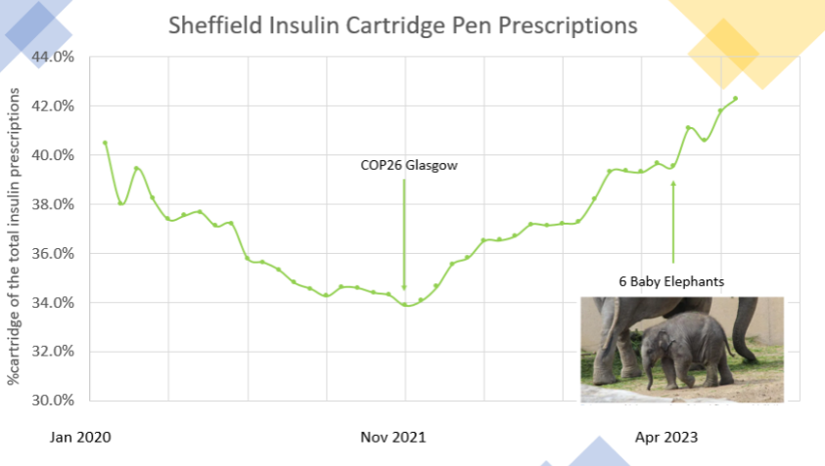
STH has already started the switch to cartridge pens
to tackle environmental impact
In 2021 Sheffield Teaching Hospitals Diabetes Centre began to switch suitable patients from disposable to cartridge pens
This reversed the decline in cartridge prescriptions across Sheffield place
By April 2023 the amount of plastic waste saved was equivalent to the weight of 6 baby elephants !
cartridge pens as a % of the total insulin prescriptions
Notes:
Plain slide with subhead and bullets

Slide 11
Getting the right pen for both the patient and the environment

Slide 12
The environment is important
BUT
In some cases disposable pens are the right choice
Example of when disposable pens should be used in preference to cartridge:
Patient requires higher strength insulins where pen fill cartridges are not available.
Patient is under the care of Community / District nurses. Use disposable pens and safety needles.
Patient has dexterity issues.
Some patients who live in assisted living.
Patient chooses disposable pens as their preference.
Patient is at risk of mixing up insulin cartridges i.e. learning disability, cognitive impairment etc.

Slide 13
Build confidence to switch
Get sample pens and feel confident in using them before you speak to patients about switching, or sit in with your local Diabetes Specialist Nurse.
Consider printing or using the Online Chart (coming up next)
Check out these links for hints: Novo Nordisk, Sanofi and Lilly
Watch this video by Sheffield Community Diabetes Specialist Nurses Sheffield Community DSNS - Pen switch video
Remember only switch if you are confident – ask your local DSN for support if in any doubt.

Slide 14
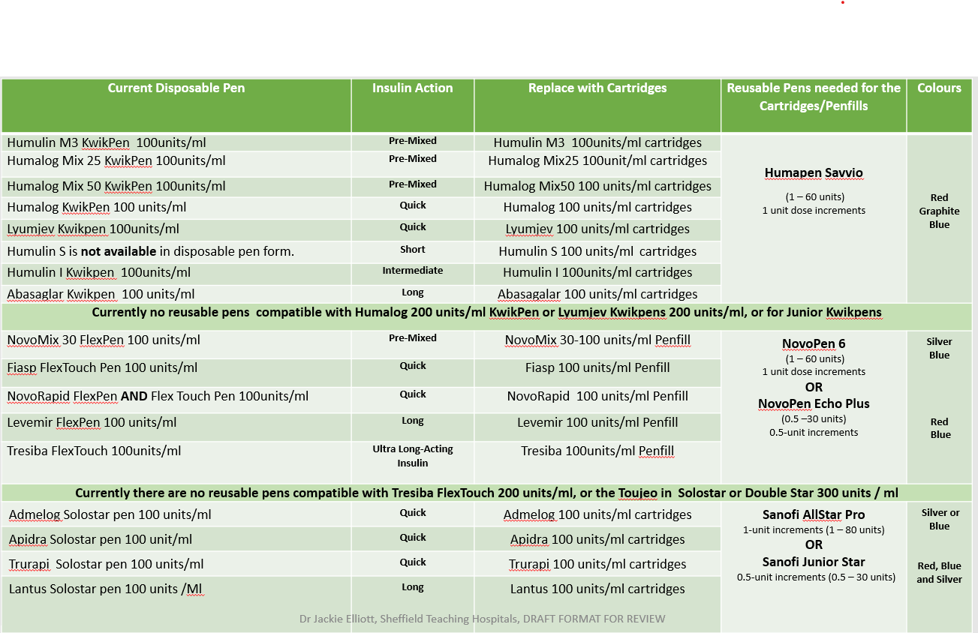
Making the switch from disposable. Which insulin cartridge for which re-usable pen
If you are based in South Yorkshire all the Green Prescribing and other diabetes information is available on the SY ICB Practice Nurse Hub. Diabetes Resources and Links (sharepoint.com). Be aware this information is hosted by Sheffield based PCDN Team and will have many Sheffield Protocols.

Slide 15
Keep patients safe and allow informed choice
Only switch an insulin pen if this is the right thing for that patient
Never switch if a patient is better suited to a disposable pen. For instance, if dexterity issues or they may get confused by the change
Inform them of the impact of their choice of pen on the environment
You must be competent and confident to switch insulin pens.
You must be able to discuss confidently with your patient how to use the pen and ensure they are in an informed position to make the decision whether to switch pens.
If you can’t do this, do NOT switch.
NEVER draw up insulin from a pen device or cartridge. This is dangerous as creates an infection risk and potential dosing errors.
Cartridges as the name suggests should be administered only via an insulin cartridge pen of the same brand.
Notes:
Plain slide with subhead and bullets

Slide 16
Summary:
Prescribing reusable cartridge pens results in lower:
Plastic use - cartridge pens last years
Sharps bins use
Carbon footprint
Cartridge Pens are better for the environment
However:
Only suggest switching a patient to a reusable cartridge pen if it’s the right thing for them.

