Slide 1
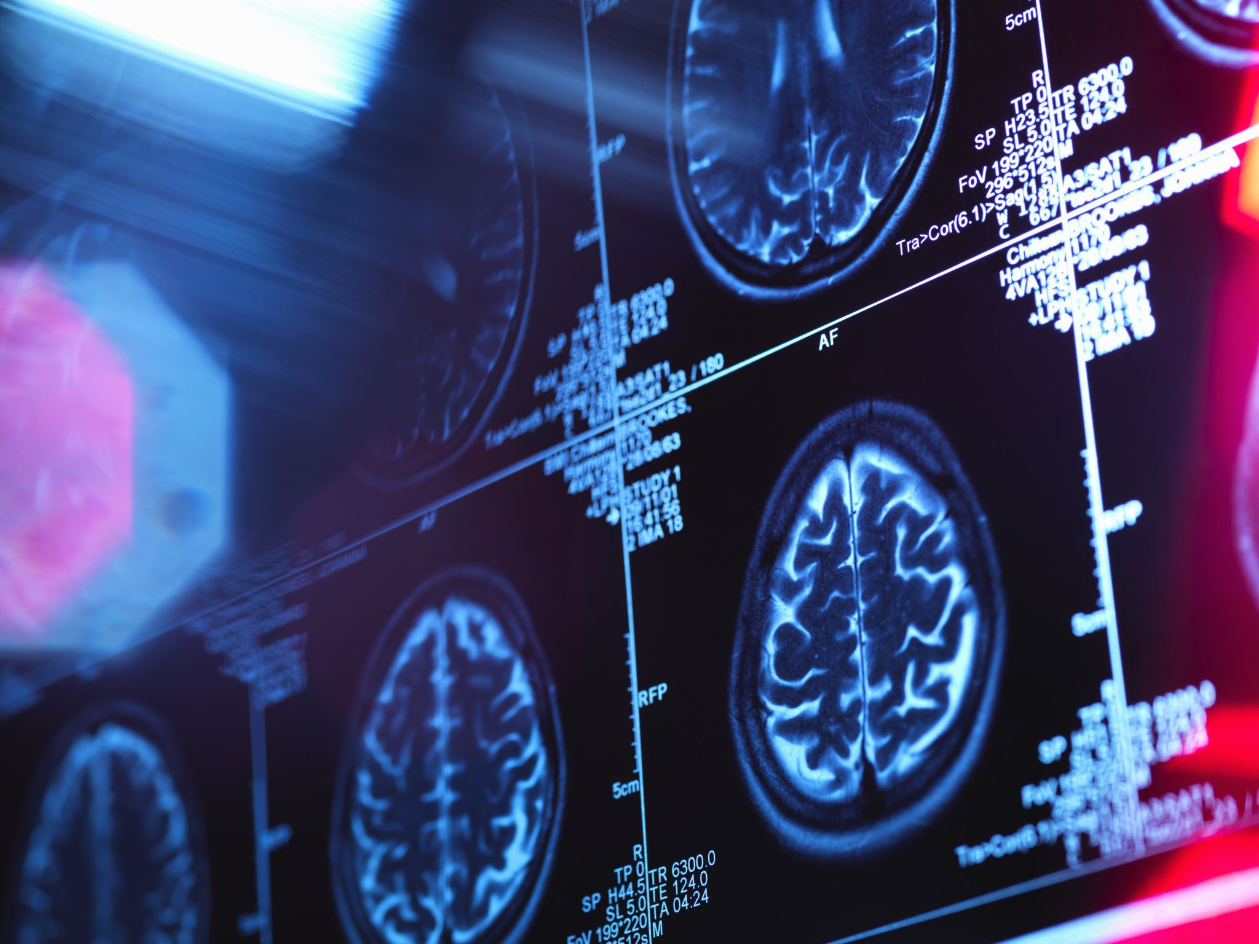
The role of imaging in primary care
Rachael O’Leary, Sam Dixon, Owen McCaughan
Clinical Physiotherapy Specialist

Slide 2
Within Specialist MSk services we have access to Xray , MRI and USS
.. ..GP/FCP practice may be limited to Xray….
…. this can be really useful in the early management of MSk patients and invaluable as a starting point of their MSk journey.

Slide 3
Shoulder imaging

Slide 4
X-ray views of the shoulder
Rule of 2s, 2 views perpendicular to each other,
AP (anterior posterior) view and an Axillary lateral view (Axial)
Occasionally a Scapula Y view (Lateral) can be used for scapula pain or dislocations

Slide 5
BESS/BOA guidelines for Management of shoulder pain in Primary care
BESS shoulder pain pathway PCPs all.pdf

Slide 6
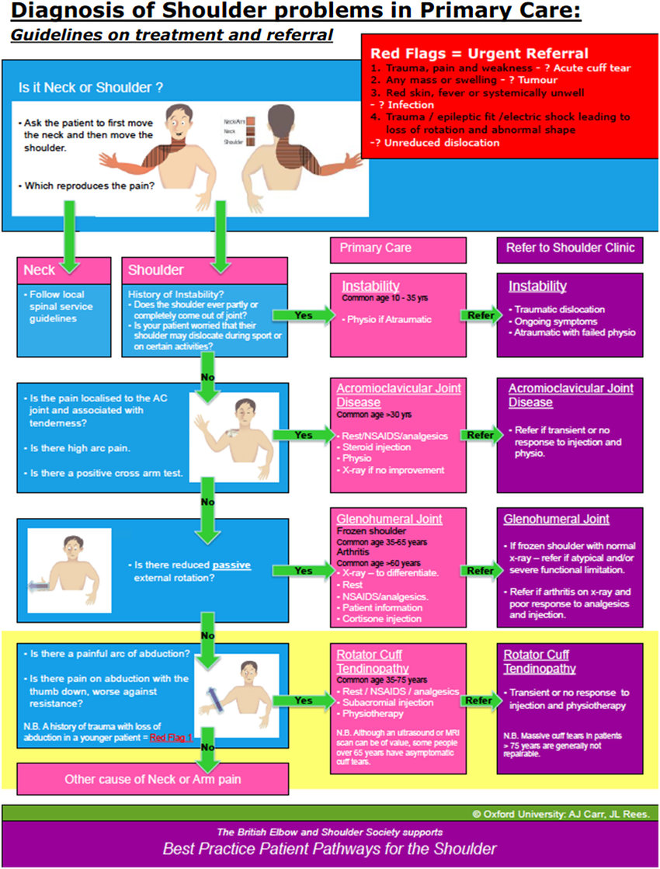

Slide 7
Indications for imaging around the Shoulder
Trauma
Exhausted consvervative management
Loss of ROM
Night pain
Severity of pain
History (known risk factors)
Pre injection

Slide 8
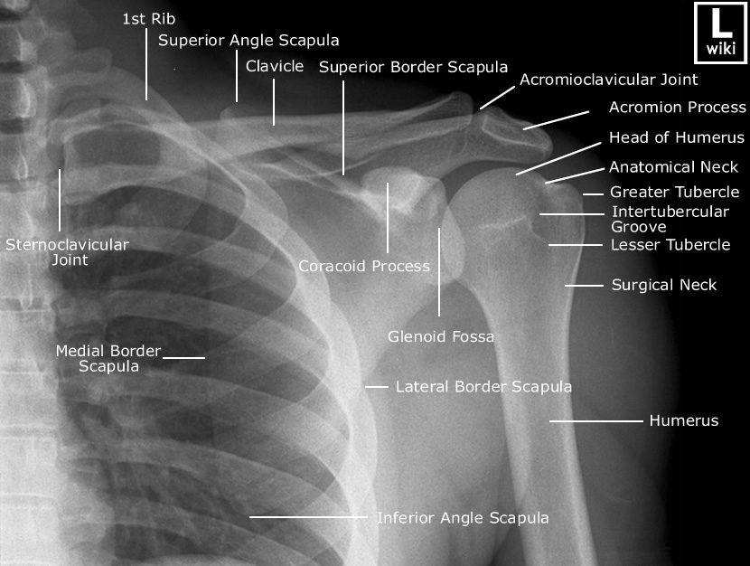
AP view

Slide 9
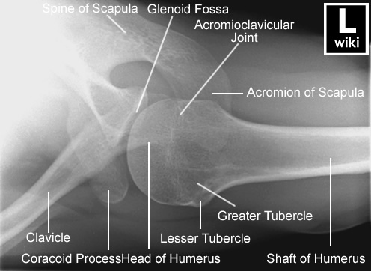
Axillary Lateral / Axial view

Slide 10
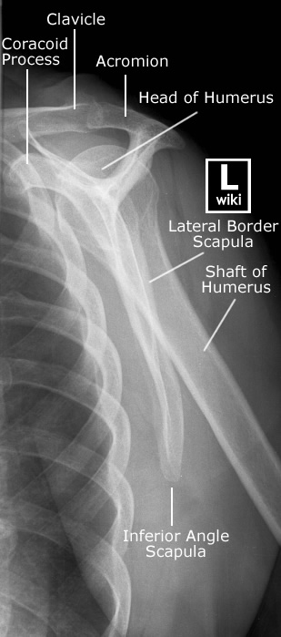
Scapula Y/ Lateral view

Slide 11
Rotator Cuff related pain
Os acromiale
Calcific tendonopathy
Degenerative Greater tuberosity
Greater tuberosity fracture
Massive cuff tear – upward migration of the humeral head

Slide 12
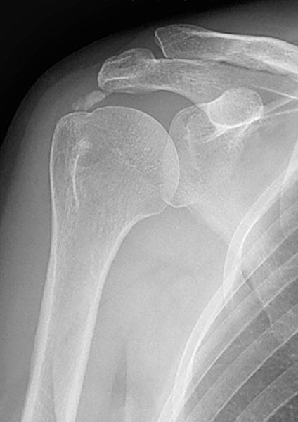
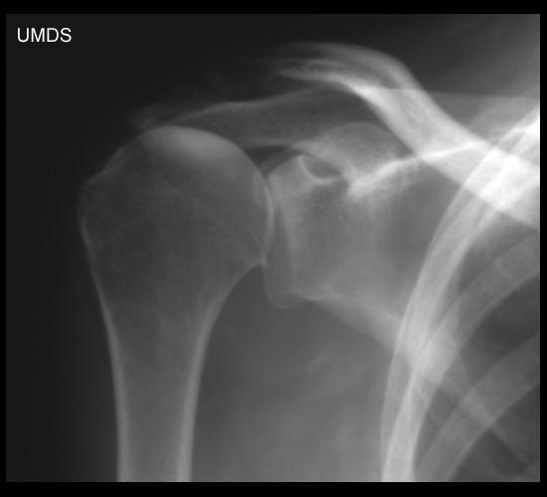

Slide 13
Stiffness at the GHJ
OA
Calcific tendonopathy
Bone pathology/lesion/mass
AVN
Infection
Fracture

Slide 14
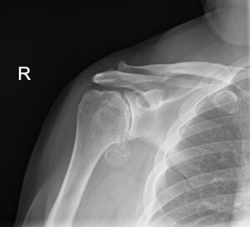

Slide 15
ACJ
OA
Osteolysis
Instability
Poor sensitivity to symptoms/clinical relevance disputable

Slide 16
SCJ
Studies have shown poor sensitivity to SCJ pathology with plain Xray
CT scan recommended

Slide 17
Instablity/dislocation
Trauma?
Structural lesion
Hyperlaxity or muscle patterning
Ant/post/MDI
Joint alignment
Hillsachs lesion/ Bony bankart

Slide 18
Scapula
Snapping scapula
Scapula pain
? Serious pathology

Slide 19
Lower Limb Hip and Knee

Slide 20
Imaging in presence of Trauma + Ottawa
Sports injuries
Sudden onset
Impact or twisting relating
Immediate pain
Large effusion
Suspected Meniscal or ligamentous injury
If not meeting Ottawa guidelines then urgent onward referral appropriate
No imaging required
Ottawa
Inability to weight bear both immediately and during the consultation for four steps (inability to transfer weight twice onto each lower limb regardless of limping).
Inability to flex the knee to 90 degrees.
Tenderness of the head of the fibula.
Isolated tenderness of the patella (no bone tenderness of the knee other than the patella).
Age 55 years or older.
Arrange an x-ray to rule out a fracture if any of the above features are present.

Slide 21
Atraumatic Knee Pain
The knee is the second most common site of musculoskeletal complaint (after back pain) in adults [Jordan, 2010; Khan, 2020].
Osteoarthritis is the most common cause of knee pain in those over the age of 45 [Khan, 2020].

Slide 22
Atraumatic Knee Pain
Gradual onset
Innocuous incident ie sit to stand, turning round, lifting an object
Often in middle aged to older population ie 45 yrs +
The guideline on osteoarthritis from the National Institute for Health and Care Excellence (NICE) states that osteoarthritis may be diagnosed clinically if a person:
Is aged 45 years or more
Has activity-related joint pain, and
Has either no morning joint-related stiffness or morning stiffness that lasts no longer than 30 minutes.

Slide 23
Imaging in primary care Plain radiographs are invaluable to us and often first line investigation for degenerate knee pain (NICE guidelines and ESSKA Meniscus Consensus Project)
KEY POINTS:
Weight bearing views important
AP and lateral standard views are often sufficient
We may request additional Skyline or Rosenberg (Notch) views

Slide 24
What can it help diagnose ? Degenerate changes – Joint spaces/ osteophytes Loose body Chondrocalcinosis/CPPD Alignment Swelling Exclude sinister pathology

Slide 25
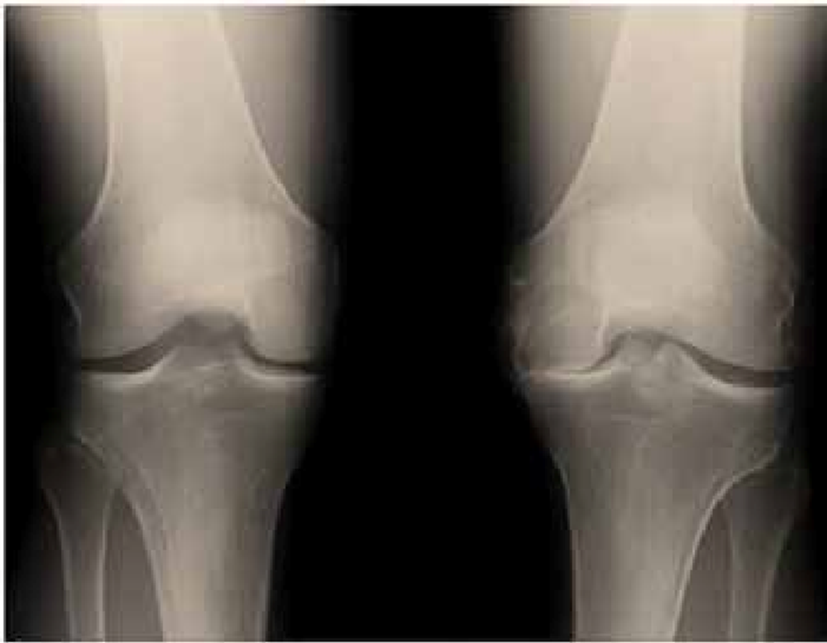
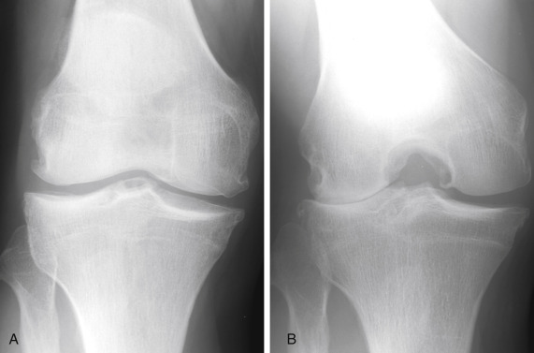
AP views V’s Rosenberg Views

Slide 26
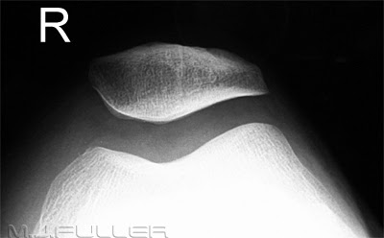
Skyline Views

Slide 27
What about the degenerative meniscus?
ESSKA Meniscus Consensus Project: Degenerative meniscus lesions
What is the prevalence of degenerative meniscus lesions? The prevalence of meniscus lesions in the general population (intrameniscal signal extending to surface according to the two-slice touch rule) has been evaluated as follows:
• Age 50-59 years ≈ 25%
• 60-69 years ≈ 35%
• 70-79 years ≈ 45%
• Patients with knee osteoarthritis ≈ 75-95%
***European Society for Sports Traumatology, Knee Surgery and Arthroscopy.

Slide 28
Knee MRI is typically not indicated in the first line work up of middle-aged or older patients with knee joint symptoms. However, knee MRI may be indicated in selected patients with refractory symptoms or in the presence of ‘warning flags’ or localized symptoms indicating more rare disease

Slide 29
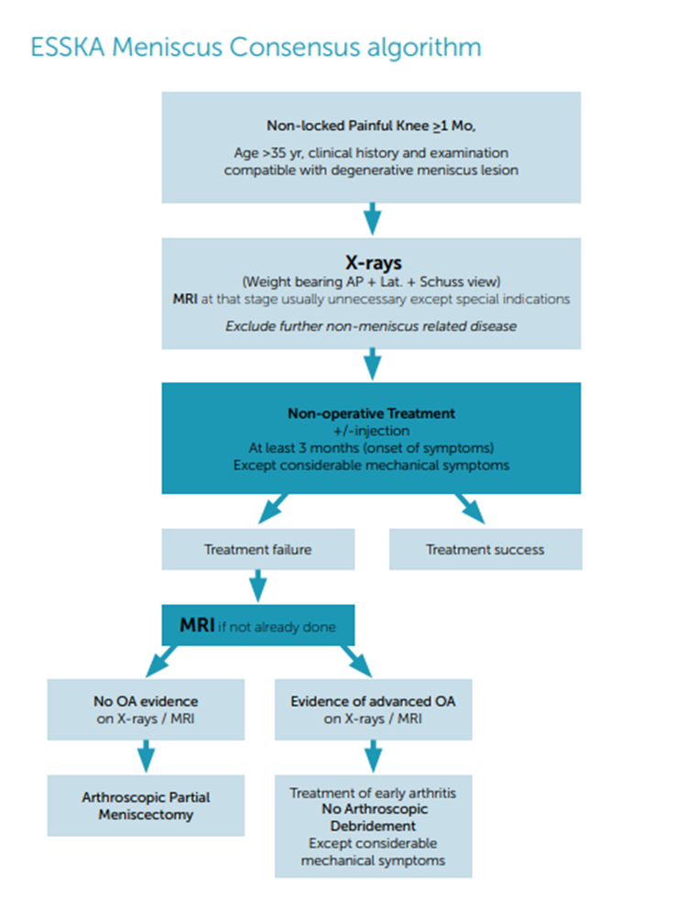

Slide 30
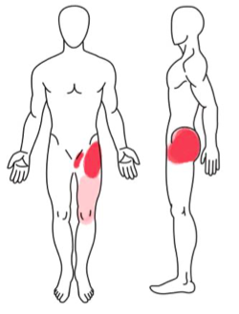
Hips
******Location of hip pain*******
C-sign pattern
Groin pain
Buttock pain may be if more posterior joint OA with restricted External rotation
Countless referrals stating CLBP hip pain but normal x-ray and pt then point to their buttocks – likely to Lx spine related

Slide 31
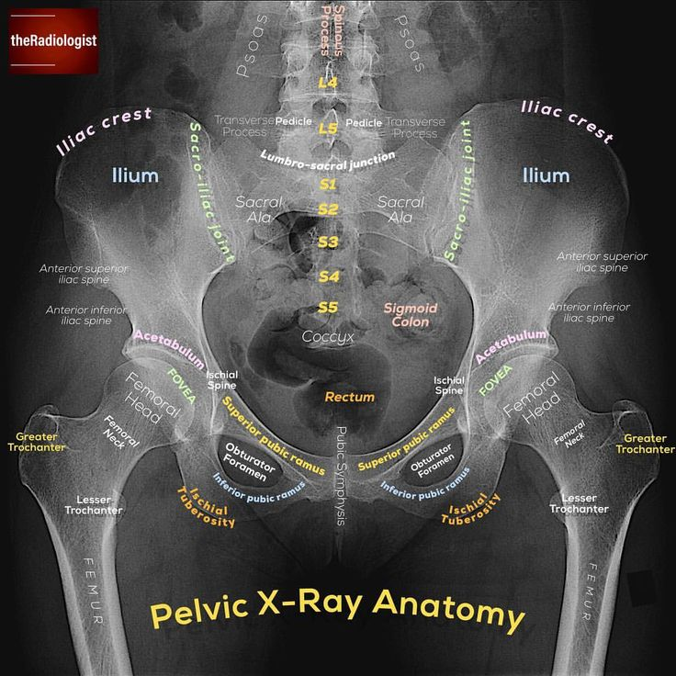
Value of X-ray pelvis:
OA
protrusio
FAI – in younger patients
Anterior/ posterior jt lines, crossover sign, coxa valgus/ varus
Dysplasia
Centre edge angle
Calcification – grt troch/ vascular
Sinister pathology
Would want as a bare minimum for consideration of lat hip pain – classically females over age 45 – therefore high incidence of OA
**We may request lateral hip views if we suspect posterior joint changes**

Slide 32
USS
Knee – unlikely to assist with diagnosis in majority of cases
X-ray more valuable and if NAD then likely to need MRI
Hip – valuable with lateral hip pain to identify if there is an inflammatory pathology ie differentiate between Bursitis and Gluteal tendinopathy

Slide 33
Thank you and Questions

