Slide 1
Children and Young People’s Asthma Update
Emma Ray RN BSc (hons) MRes Clinical Practice Educator: CYP asthma Respiratory Nurse Specialist: Primary Care

Slide 2
Content
CYP National Asthma Care Bundle
Asthma diagnosis
Wessex Asthma Guidelines
Medication factors
Chronic disease management
Community Childrens teams
Referrals
Further education and training
HIOW CYP asthma network
Questions

Slide 3
Asthma in UK
Approx 1:10 children have asthma
UK has highest rates of hospital admissions and deaths in Europe
National Review of Asthma deaths 2014, most deaths were avoidable
Over-reliance on salbutamol was a clear driver
Care was in-adequate in ~50% cases
Socio-economic deprivation and family stress associated with poor outcomes
10 years on, death rates have not decreased

Slide 4
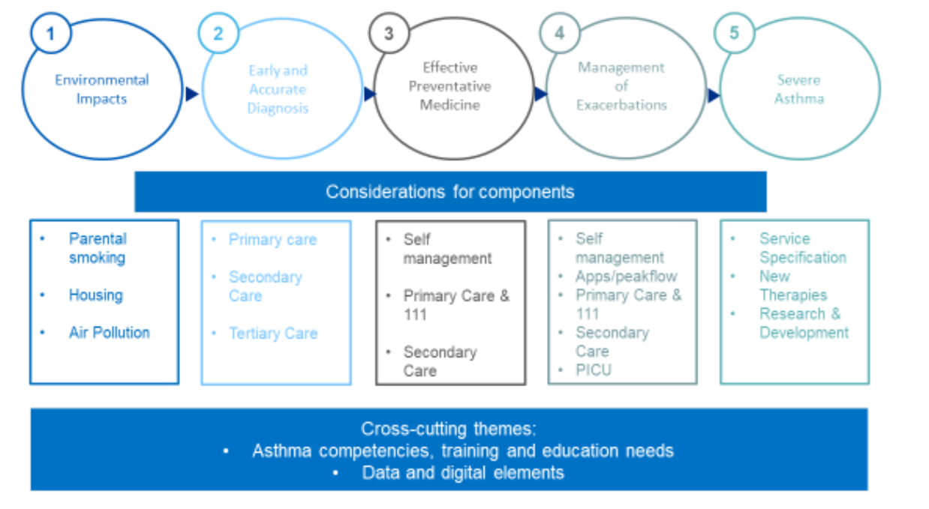
National Bundle of Care for CYP asthma
Set of standards of care – available online
Whole system approach aimed at improving outcomes: preventing deaths, reducing admissions, improving quality of life
Delivered by the ICB
Clinical lead for each ICB – Prof Gary Connett, UHS

Slide 5
When to suspect asthma
Variable symptoms – may resolve spontaneously or with treatment
Interval symptoms – in between viruses
If >1 of the following symptoms are occurring ≥ 3 times a week, or if severe or causing waking at night:
Cough
Shortness of breath
Chest tightness
Wheeze
https://youtu.be/T4qNgi4Vrvo
Multiple triggers/irritants will cause symptoms

Slide 6
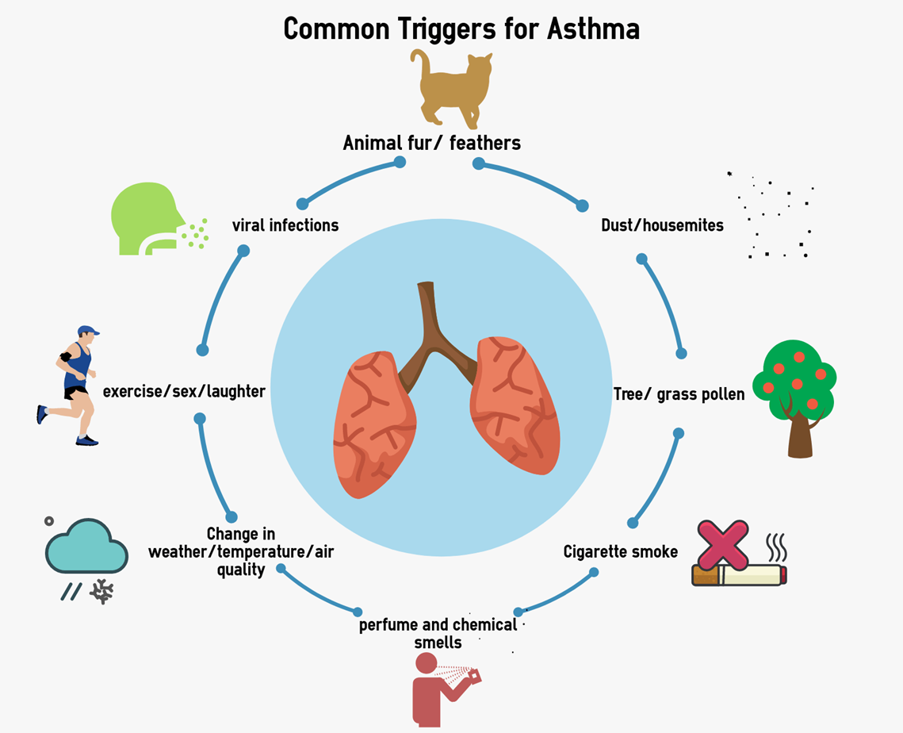
Emotional Stress
Clean air champion programme
Royal College Paediatrics and Child Health
https://www.rcpch.ac.uk/resources/climate-change-resources-for-health-professionals#education-and-training
Global Action Plan
Clean Air Knowledge Hub for the Health Sector (actionforcleanair.org.uk)

Slide 7
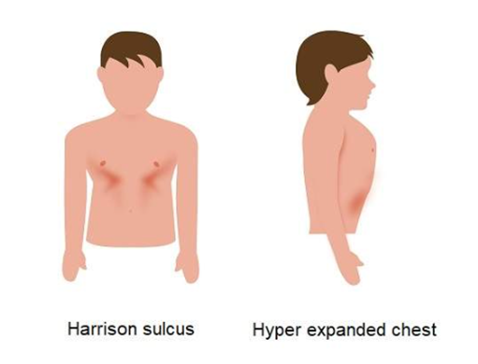
Taking a history
Time, duration and onset of symptoms
What helps
Triggers
Any blood results available
Allergies – HDM, cat, dog, pollen
Eczema
Family history of atopy/asthma
Premature or low birth weight
Previous lung disease/surgeries
Exposure to indoor/outdoor air pollution (e.g. tobacco smoke, mould, traffic)
Maternal/emotional stress
Occupation (adults)
Physical examination
Auscultation
Chest shape
Finger clubbing
Mouth breathing

Slide 8
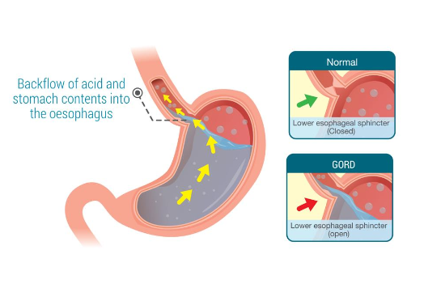
What else could it be?
Viral induced wheeze – wheeze action plan
Upper respiratory tract infections
Gastroesophageal Reflux
Obesity
De-conditioning
Dysfunction breathing
Anxiety/stress
Inducible Laryngeal Obstruction
Bronchiectasis
Primary Ciliary Dyskinesia
Cystic Fibrosis
Protracted bacterial bronchitis
In adults: COPD, lung cancer, side effects to drugs, cardiac disease

Slide 9
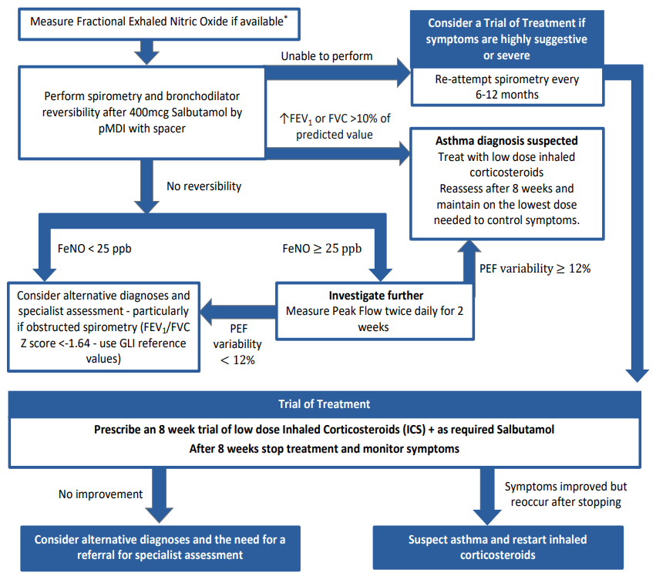

Slide 10
Asthma Guidelines for 6-11 years
RightBreathe Inhaler website for primary care

Slide 11
Recurrent pre-school wheeze

Slide 12
Asthma Guidelines 12 years +

Slide 13
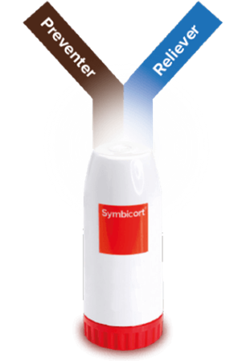
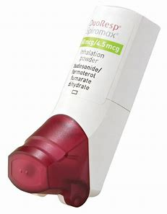
AIR and MART
Green credentials – no CFCs, easier to recycle
Easier to use
No spacer needed
Dose counter
Effort dependant – stationary drug
Whistles and placebo
Available as:
Separate inhaled corticosteroid and short acting bronchodilator
Anti-inflammatory Reliever (AIR) therapy (currently adolescents and adults only)
Maintenance and Reliever Therapy (MART) (combination inhaler)

Slide 14
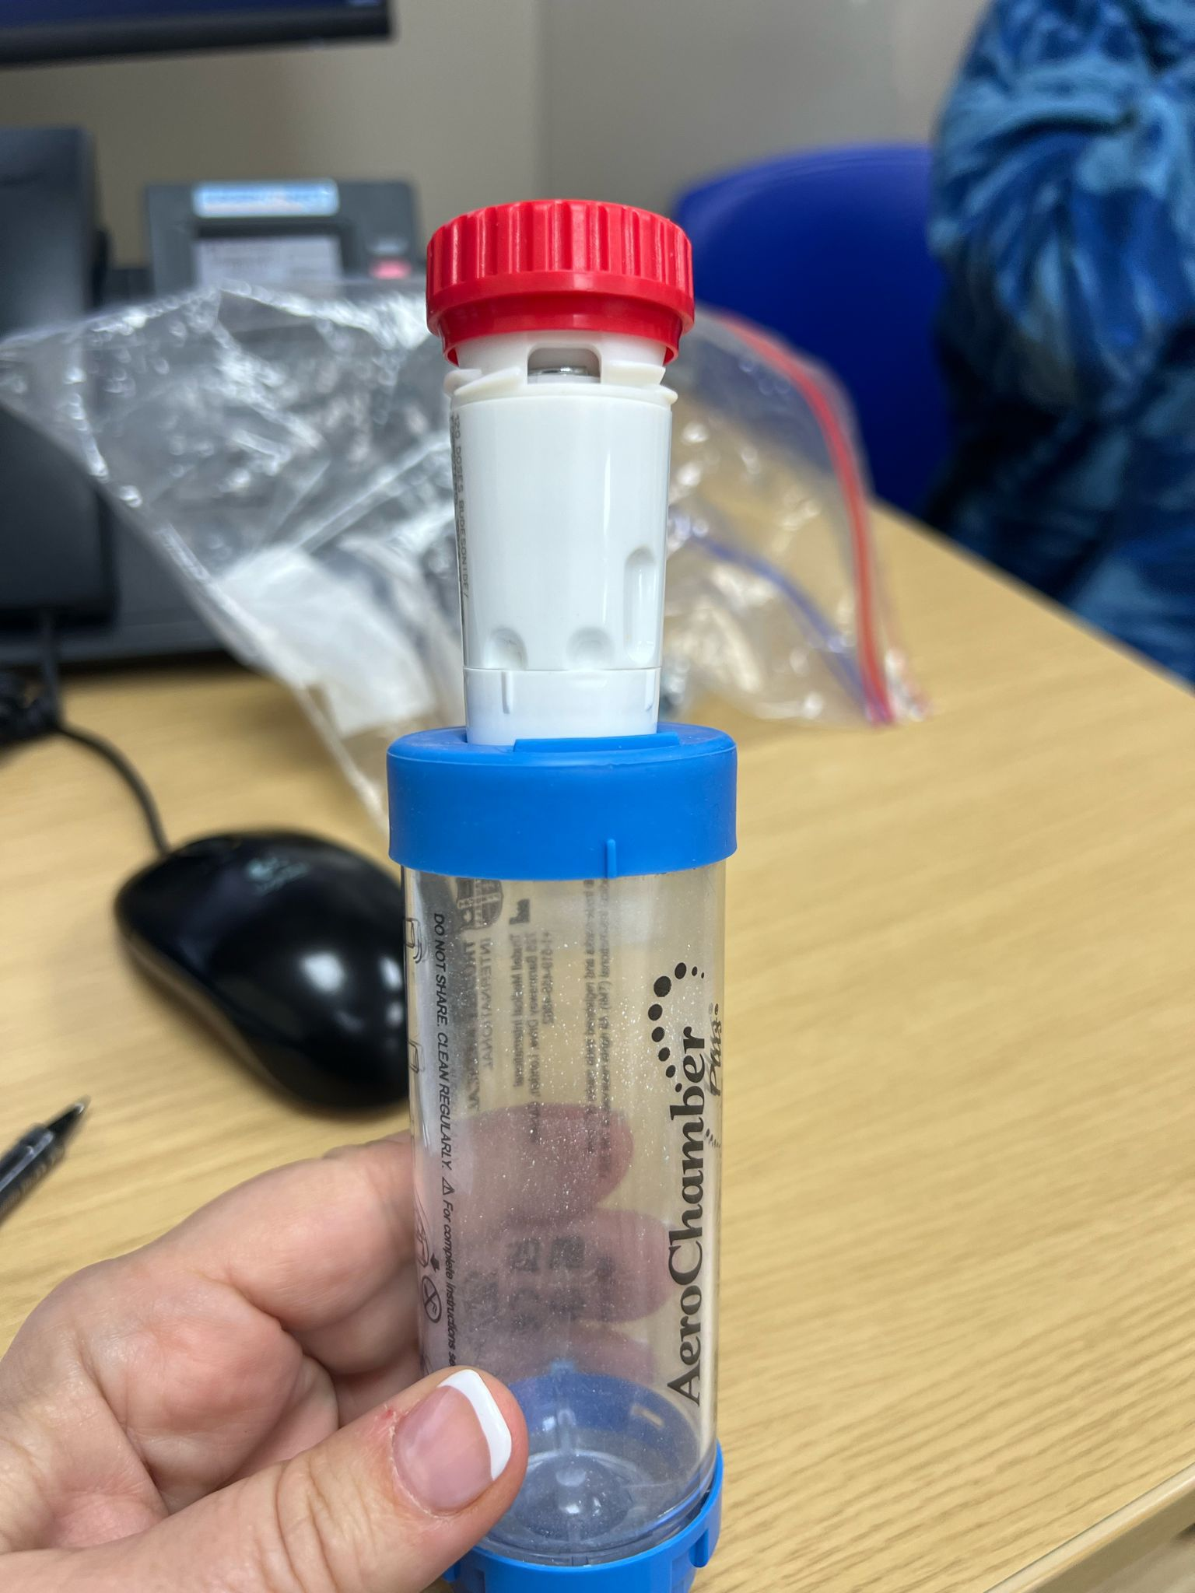
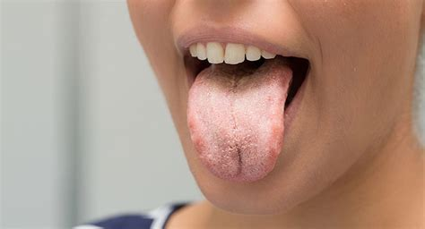
Considerations with all inhalers
Double check dose is correct and follow guidelines
AIR (adolescents and adults only) or MART
Patient factors
Can they use the inhaler? Dexterity and mental capacity
Do they understand when to use it? Adherence
Have you discussed side effects? Oral care
Cumulative effect of steroids
Asthma action plans

Slide 15
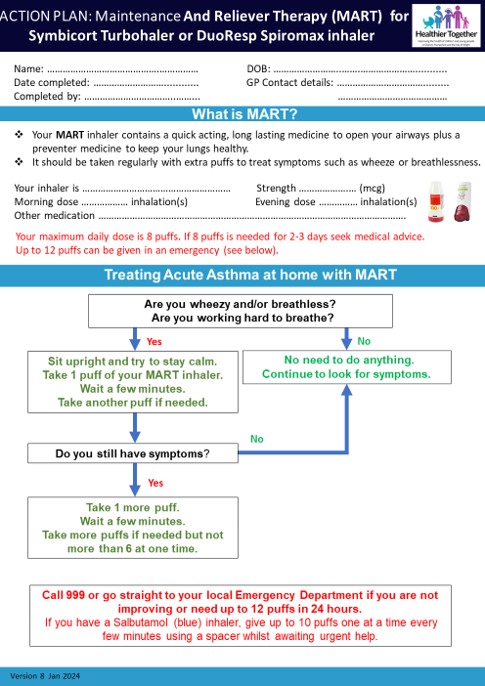
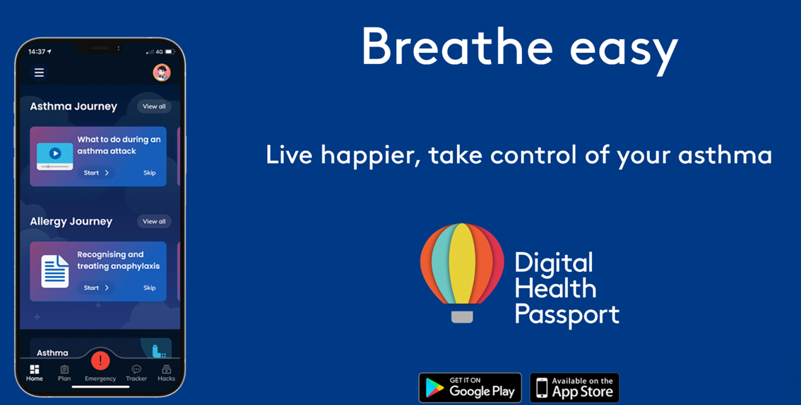
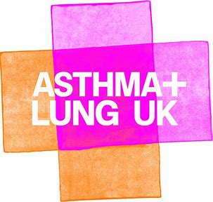

Slide 16
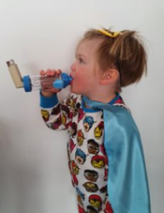
Chronic disease management
Review diagnosis at each visit
Asthma should be managed on the lowest possible dose ICS
Consider stepping down treatment if no asthma symptoms for 3 + months
Check adherence
Inhaler technique
Support and education
Review expectations
Empower to self-management
Address comorbidities
Address psychosocial factors
Review indoor and outdoor air pollution
Transitioning to adult care

Slide 17
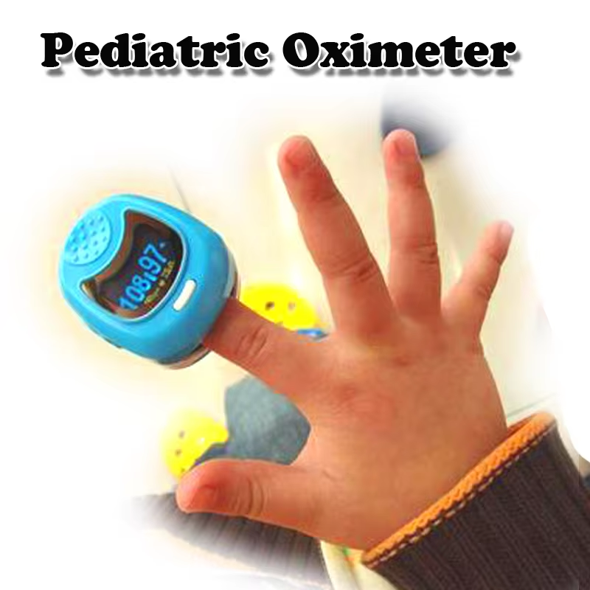
SPO2 <92% = Bad
Follow up review

Slide 18
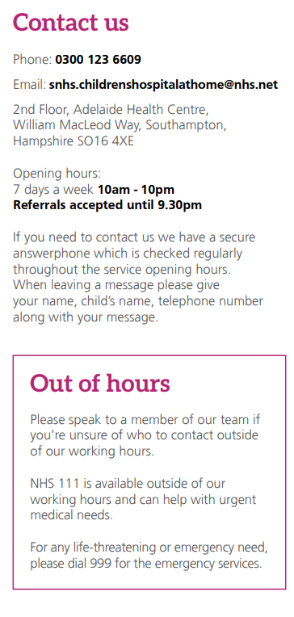
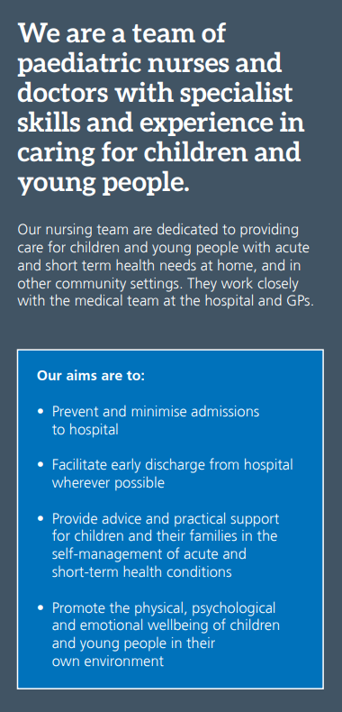

Slide 19
Draft criteria for referral from primary care to secondary care for specialist assessment
Recurrent severe exacerbations:
➢ ≥2 courses oral corticosteroids per year.
➢ >1 hospital admission or ED attendance per year
➢ persistent chronic symptoms (most days for >3 months) or worsening of symptoms
The use of >6 SABA inhalers per year (to note, CYP may have inhalers in different locations such as family homes, schools, clubs etc, therefore this might still be a trigger for a review and discussion)
Asthma Control Test (ACT) / Childhood Asthma Control Test (C-ACT) score of despite trial of appropriate management strategies in primary care following Wessex Asthma Guidelines
Poor asthma control despite optimizing all modifiable risk factors and treatment as per Wessex Asthma Guidelines
Persistent psychosocial concerns despite appropriate support.
Persistent uncontrolled asthma with safeguarding concerns after referral to social services following local safeguarding pathway.
Persistent airflow obstruction after optimizing treatment (FEV₁ 80% or less or FEV1/FVC <1.645) or restriction (FVC -1.645)
Parental concern

Slide 20
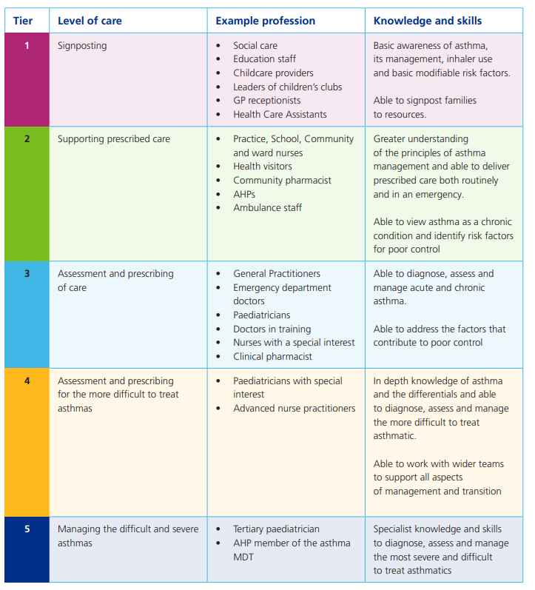
Education and training
National Capabilities Framework
Non-clinical staff (Tier 1- 45mins)
Supporting Children's Health and Young People with Asthma (educationforhealth.org)
Clinical Staff (Tier 2-5)
Asthma (Children and young people) - elearning for healthcare (e-lfh.org.uk)

Slide 21
The HIOW CYP Asthma Network – get involved
Ambition: To improve the health and lives of children and young people with asthma in Hampshire and Isle of Wight
Oversight, cohesion and guidance to help deliver the care bundle
Draws together key stakeholders to co-develop strategies
Members will contribute to an overall vision
Communicating issues and progress
Terms of reference shared

Slide 22
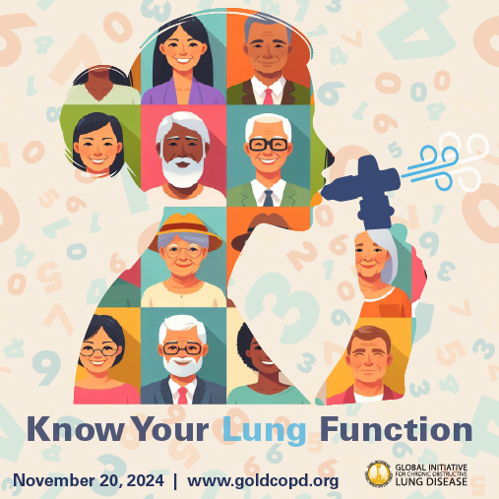
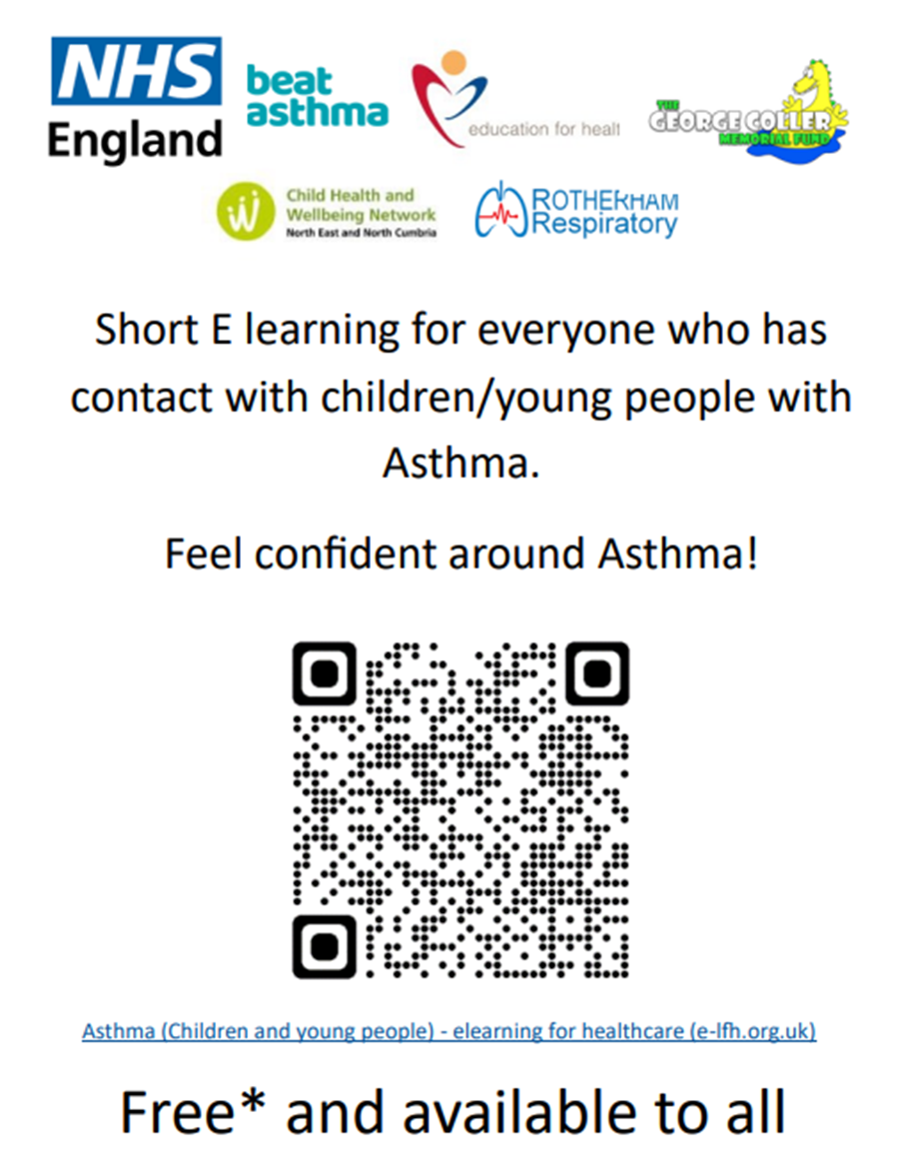
Thank you Any questions Contact: emma.ray@uhs.nhs.uk
Southampton City Airway Forum
Education meeting
Spirometry and COPD diagnostics
Date: Weds 20th Nov
Time: 18:30pm
Location: Chilworth Manor Hotel, Southampton, Hampshire, SO16 7PT

