Slide 1

Cancer Red Flags in the Treatment
Room
Dr Julie Smallwood & Dr Nicola Robinson
Wessex Cancer Alliance GP
Lucy Pickup
WCA Non-clinical Primary Care Lead
Notes:
Richard

Slide 2


Session outline
Importance of early cancer diagnosis
Screening
Red flags in the treatment room
Cases for discussion
Clinical decision support tools & further support

Slide 3
How Important is Cancer?
2011 – Cancer became the leading cause of death in UK

Slide 4
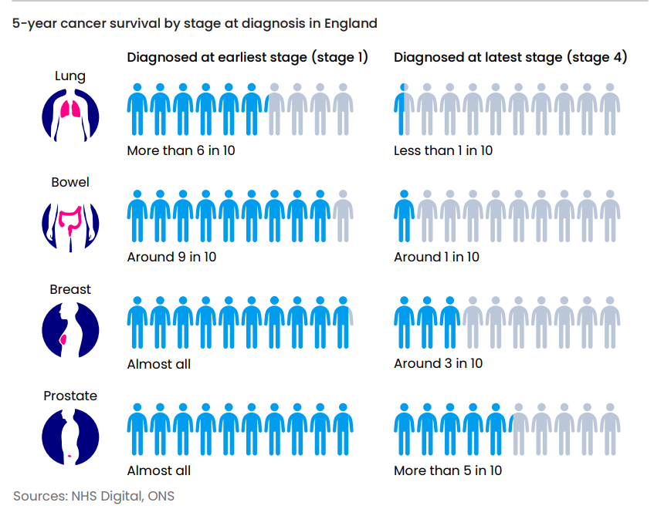
Improving Cancer Outcomes

Slide 5
Cancer Screening

Slide 6
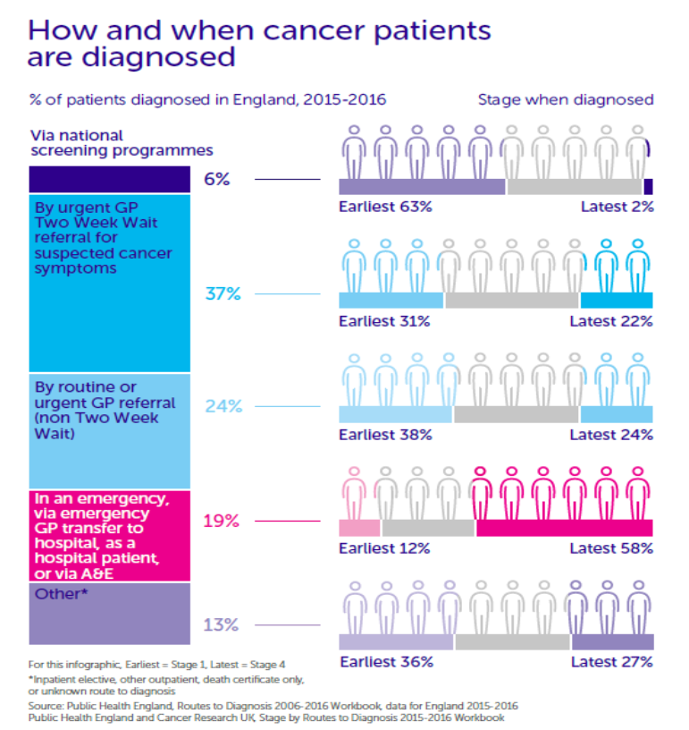
Why is screening important?
Screening reduces the number of people dying from cancer by:
Detecting cancer early
  63% of cancers detected through screening are at the earliest stage (stage I) and only 2 % at stage IV.
Preventing cancer
  Bowel and cervical screening can prevent cancer
  For every 1 cancer detected in bowel cancer screening, 6 adenomas are detected

Slide 7
England screening programmes
Bowel screening
Everyone aged
54–74yrs, every 2 years
Over 74, can request a kit
FIT (faecal immunochemical test) kit received/sent back in the post
Breast screening
Women/people with breasts aged 50-70yrs, every 3 years
Over 70, can request screening
Mammography
Cervical screening
Women/people with cervix aged 25-64yrs, every 3 years (25-49yrs), every 5 years (50-64yrs), every year if HPV +ve
HPV triage, with cytology if positive
New: Lung Screening
Roll out started in England in 2022
Plan is to reach 100% of eligible population by 2030
Diagnosing early stage (curable) lung cancer
Men and Women, ex or current smokers, 55-74yrs
Risk assessment and low dose CT chest if high risk
Notes:
uptake 70% (bowel), 62% (breast), 70% cervical in 2021/22
Bowel rolling out to age 50yrs
Fit threshold 120mcg
screening_programmes_at_a_glance_v4.pdf (ctfassets.net)

Slide 8
Ways you can address screening during consultations
Making every contact count
Opportunistic educating/informing and signposting
Re-iterating verbal information with leaflets
SystmOne- check home page for alerts and encourage to engage. Similar with Emis
Myth busting especially around FIT testing
Other ideas-
During a smear appointment ask if they do breast self-examination, if no inform and advise and signpost to Coppafeel
Educate reception team about difference between symptomatic FIT and screening programme FIT
Either over the phone or F2F consultation with travellers we check that had HPV given at school. If still with age range of PGD then we order and give
Notes:
Any ideas from them- what do they do in their practice
Anything they have done

Slide 9
Case example
54 year old woman- wife, carer, daughter, sister, auntie and friend.
Medical History:
COPD; Pernicious Anaemia; Depression; Anxiety; BMI 21; Smoker, 20 per day
Attended with PN for Vit B12 3 monthly injection
Checked alerts on home page and cervical smear reminders had been sent over the last 6 months
Discussed and admitted to health anxiety around procedure and fear of result, how would she cope being a carer if she needed looking after herself
Actions:
  PN explained procedure and used visual support.
  Booked for longer appointment at a time that she would be able to bring a friend

Slide 10
Cancer in the treatment room
….what does that mean?
Notes:
How often in a day/ week see things that are possibly cancer?
Built that up over time, and so will they
Today going to discuss red flags, when to be aware, how to increase knowledge and confidence, who to escalate to
Use some cases to demonstrate this

Slide 11
Red Flags
All clinicians have a part in the team in early detection recognising red flags for cancer
A red flag is an alarm/warning sign
Identifying patients and referring them promptly to the relevant healthcare professional
Engaging in conversation to inspire patients to share, open dialog
Anything presenting as not normal for the patient should be considered
Ask when did you notice change/timeline.
What has changed/symptoms?
What is it that you are worried about?
Be aware of resistance to seek help: Perception of wasting time.
Worried about findings.
Apparent immunity " couldn't happen to me "
Ignorance
You are not expected to have all the answers, a clear escalation pathway is paramount for yourself and patient confidence of what will happen next and that something will.

Slide 12
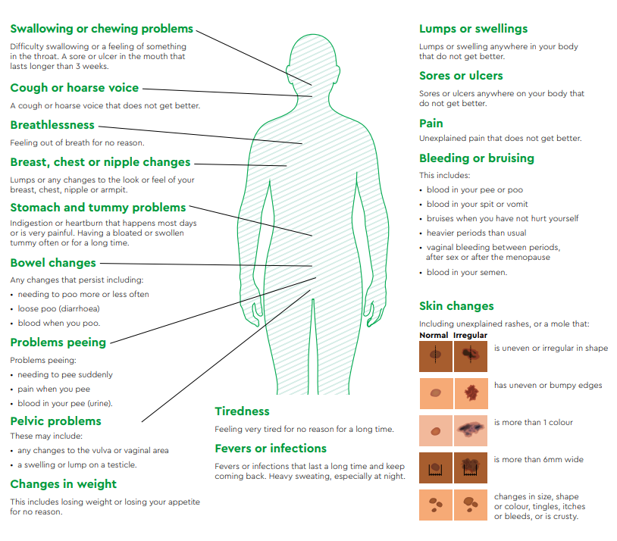

Slide 13
Annual reviews
Diabetic review
  aged >60 with weight loss
  AND any of the following…
  diarrhoea, back pain, abdominal pain, nausea, vomiting, constipation, new onset diabetes
COPD review
  Persistent cough for >3 weeks
  Haemoptysis
  Weight loss
  Fatigue
  Recurrent infections
Unexplained weight loss at any review

Slide 14
Pathway
Same day concern: Talk to triage team ACP/GP.
Use blocked appt.
Ensure precise documentation and if skin related then take photo..
ASAP concern: Talk to ACP/GP.
Book into embargoed appointment.
If patient is reluctant to wait/come back and/or commitments prevent them from doing that then record this and book telephone consultation for either same day or asap.
Notes:
Reassure that it is ok to ask GPs/ACPs for advice- talk about what they do, give them the confidence to speak out
Good action would be to go back and find out who to talk to in your practice

Slide 15
Case Study 1
87-year-old woman
Widower, member of WI
Medical history: COPD
Hypertension
Infrequent attender in the treatment room, seen on and off for phlebotomy and skin tears, but does attend annual reviews
Wonderful character, sort of non-compliant, does her own thing but is willing to ask for guidance

Slide 16
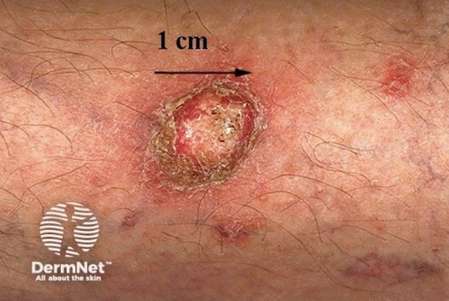
Case Study 1
Presented to PN for advice about an open area left shin.
* Noted 10 weeks ago, thinks caught on something in garden but not sure
* Pain at 0, nil analgesia
* Cleaning with salt water and applying germolene cream and cotton lint OD.
No exudate but occasional blood-stained fluid with nil odour
O/E.
*2cm width x 1.1cm length, no real depth
* Irregular edges and crusty center
*Surrounding skin intact although dry and thin
*Nil swelling/inflammation
*No heat to skin
* No feet swelling
Notes:
What would you do?

Slide 17
Case Study 1
At that appointment PN took photo, applied dressing ( with compromise with patient) and booked follow up
with self and GP 3/7
Attended that FU and although had original primary dressing the other had been replaced with gauze lint
Referred for 2ww but she was going to think about going, did have bloods done
Compromised with dressing in meantime and appointments PN to encourage relationship and encouragement to
attend Dermatology
Outcome
*Diagnosed SCC and offered surgical excision*
She did agree to proceed and did not require a skin graft.
Saw PN for suture removal and declined Dermatology FU.
Notes:
What would you do?

Slide 18
Case study 2
3-month cancer care review , f2f , for husband.
Towards end of appointment time, I asked " what matters to you"
His reply : " My wife, she is not eating and feels sick all the time.
She is tired and not her normal self."
Her reply : " This isn't my appointment; I'll see how I go; Pam hasn't got time.
You shouldn't have said anything, it will just be stress.
Pam knows that is what it will be."
My reply : " I do know you well however it will be safe practice to ask you a few more
questions to get a clear picture of your symptoms."
Notes:
Doesn’t matter that it wasn’t cancer-
Gps refer lots that isn’t but still did right thing

Slide 19
Case study 2
62-year-old woman
Wife, now carer role, mother, sister and friend.
Not employed.
PMHx- TAH, Vitamin B12 deficiency, Diverticular disease, PE., Depression, Anxiety, Acute grief reaction, death of son.
BMI 35.
Family History- Father IHD, Sister CVA
Has engaged with FIT/breast and cervical screening.
Onset 10/52 ago of intermittent loss of appetite, not interested in food and heartburn
Took Gaviscon and seemed to help but not completely
For the 2/52 symptoms are persistent and all the time, feels as though food getting stuck now. Swallowing as usual
Feels as though has lost weight but knows this is because her husband's diagnosis ( bladder cancer) has triggered grief reaction
Bowels and urine as normal, nil change
Consent to check weight/bp/pulse/SATS
7lb weight loss from previous documentation in Jan 24
BP raised slightly, pulse and SATS as her normal
Notes:
Put to group for thoughts- what would they be worried about, what would they do?

Slide 20
Case study 2
Actions
  Advised to see ACP/GP same day but other commitment so agreed to next day F2F for ACP and phlebotomist.
  Referred 2ww Gastroenterology
Outcome
  Gastroscopy reports Hiatus Hernia
Notes:
Doesn’t matter that it wasn’t cancer-
Gps refer lots that isn’t but still did right thing

Slide 21
Case study 3
62 year old male attending appt with HCA for bloods prior to NHS health check ( which will be with same person.)
He asked her who he needed to see for advice about new urinary symptoms noticed over the last 6/52
Frequency and 2-3 times nocturia and altered flow.
Notes:
Pam
Questions- what would you have done in first place if it had been you rather than HCA
What would you have advised the HCA? Have you had anything similar?

Slide 22
Case study 3
She added a PSA to bloods after asking his consent and asked for a mid stream urine.
She discussed with PN what she had done and checked if anything else needed that day and a plan moving forward for the patient.
Brief check of health history: Hiatus hernia.
Blood ++, nil else in urine.
Notes:
What are your concerns?

Slide 23
Case study 3
Booked for next day F2F ACP.
Enlarged prostate felt,firm and nodular.
Fast track referral for suspected Urological cancer

Slide 24
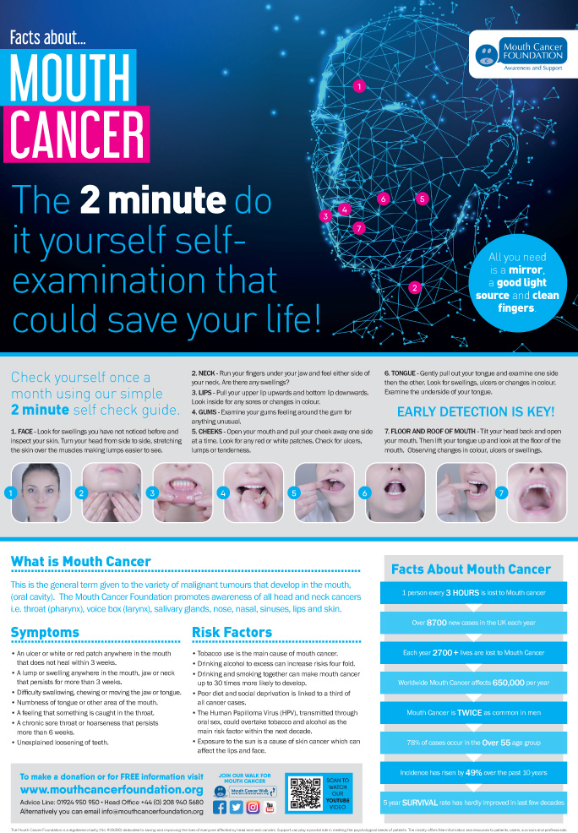
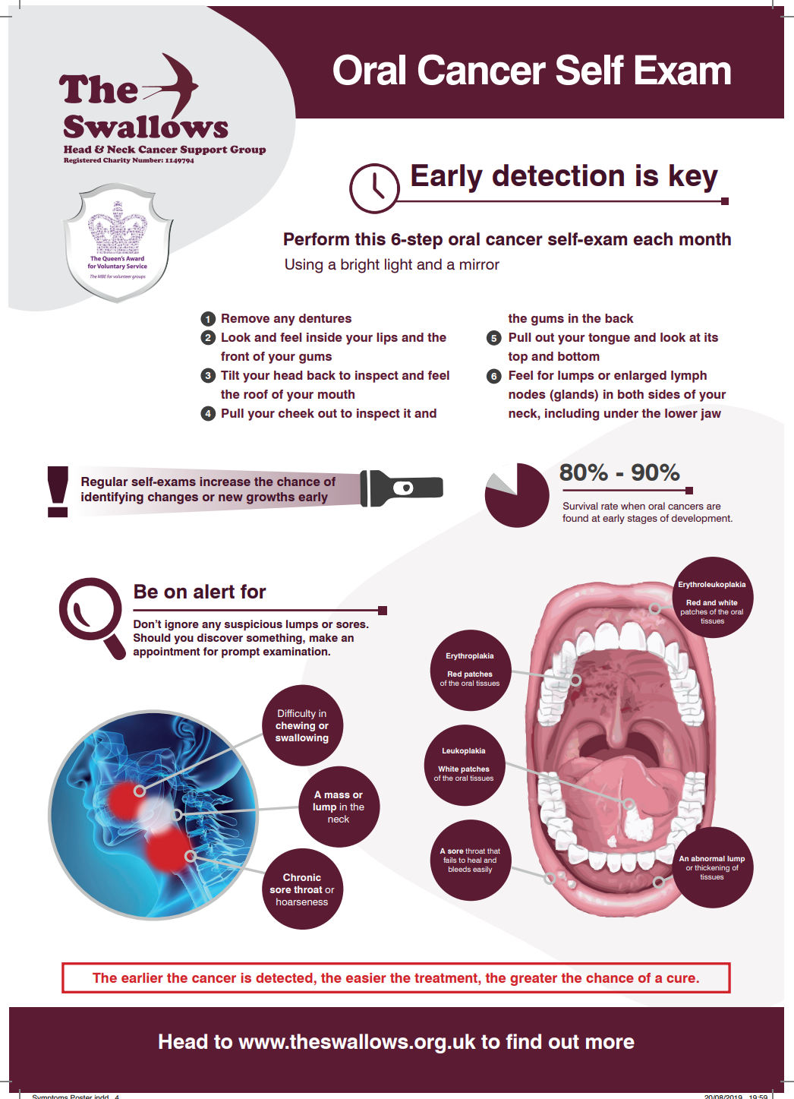
Oral Cancer Awareness
Oral Cancer awareness month is November
Reduced access to dental appointments resulting in
less screening and later diagnosis
Posters - The Swallows
Mouth Cancer Foundation | Helpline: 01924 950 950

Slide 25
Clinical Decision Support tools
Notes:
Debs

Slide 26
Clinical decision support tools
Clinical Decision Support (CDS) tools are designed to support health professionals to recognise potential cancer signs and symptoms and manage patients appropriately.
CDS tools do not replace clinical judgement.
  Provide further guidance to inform patient management decisions.
  This may be to refer, to safety net, or it may support the decision on which pathway is most appropriate.
Notes:
Debs

Slide 27
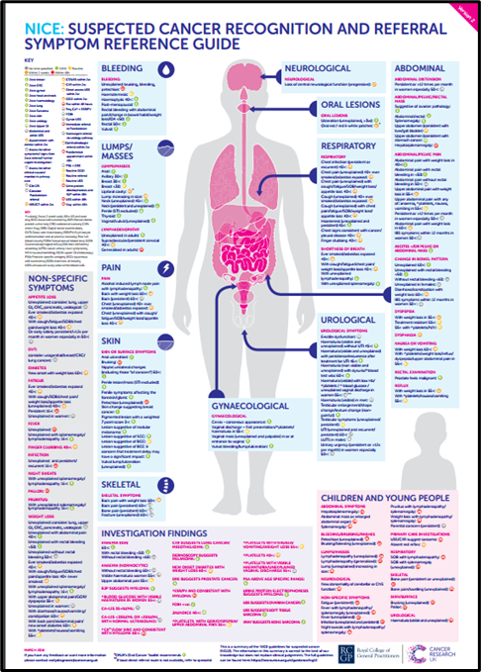

Body Maps
Notes:
Debs

Slide 28
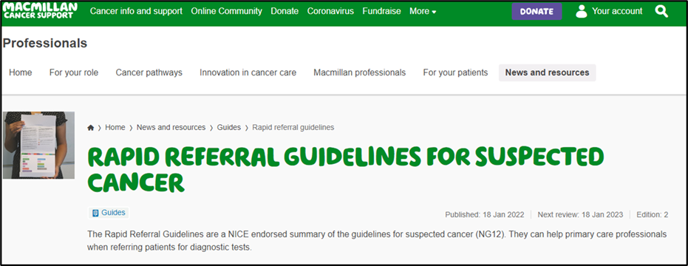
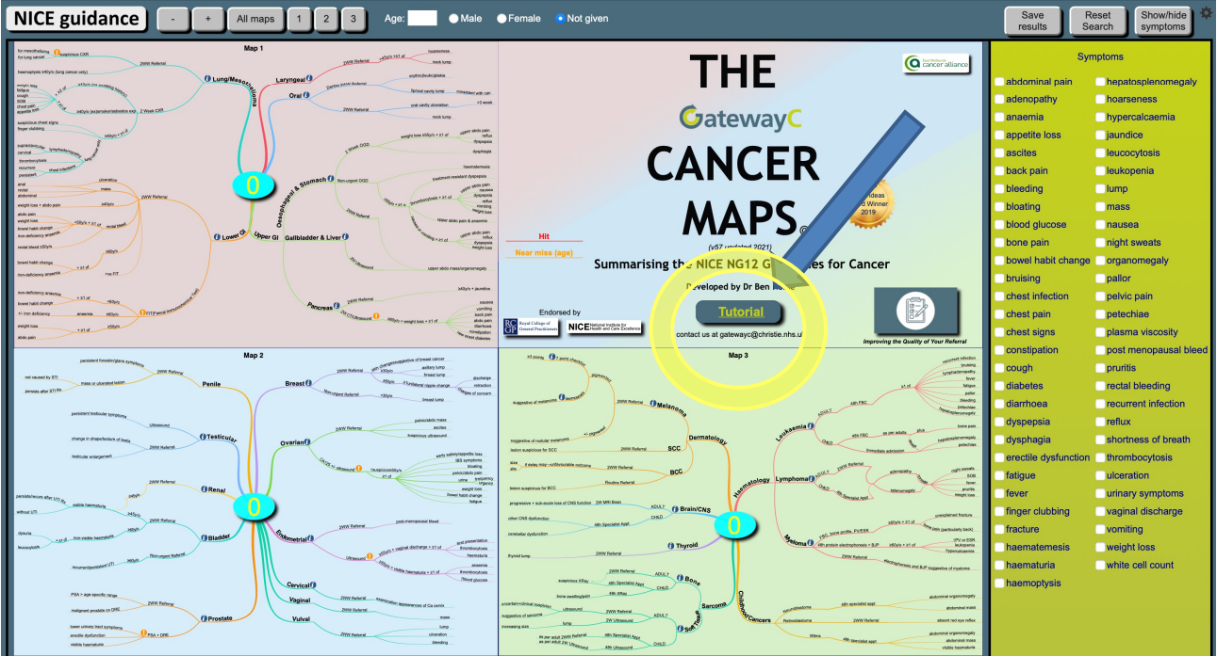
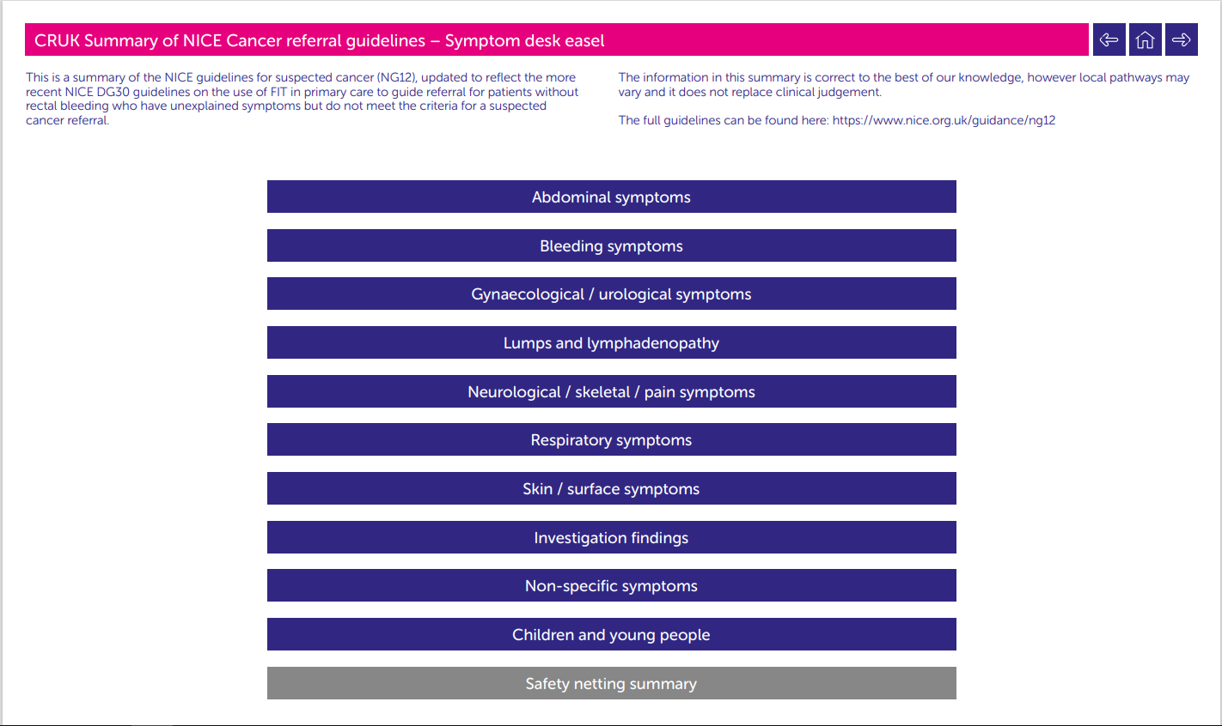
Interactive online tools
Notes:
Debs

Slide 29
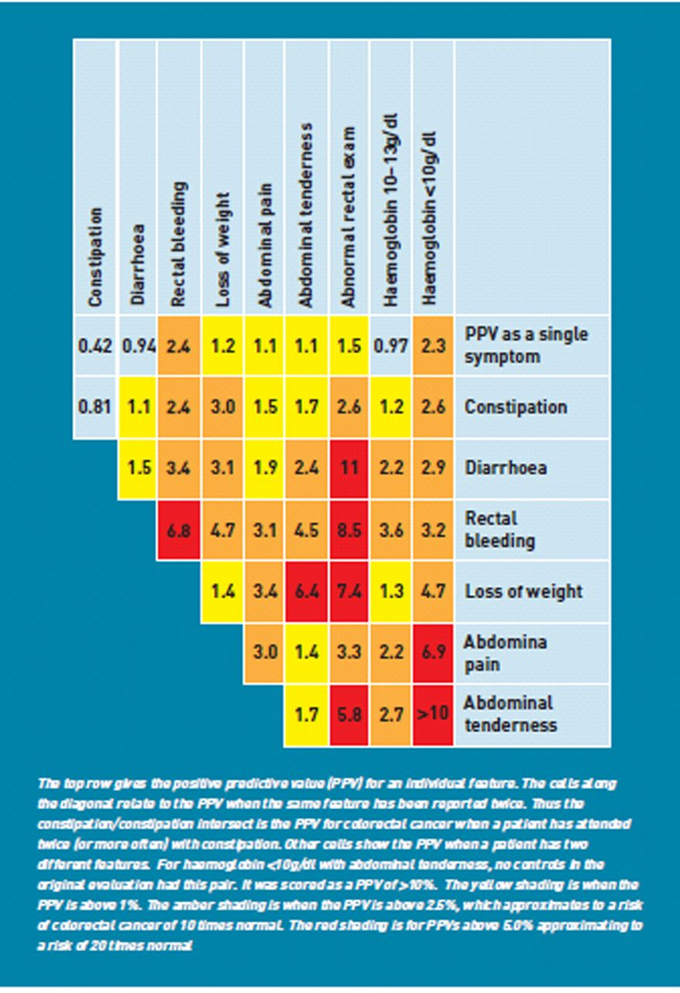
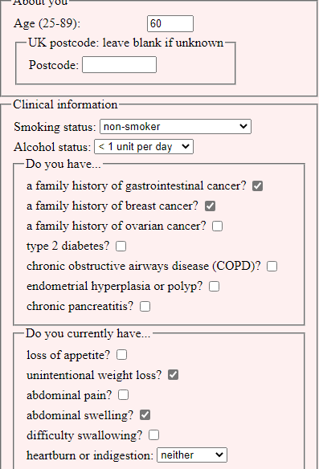
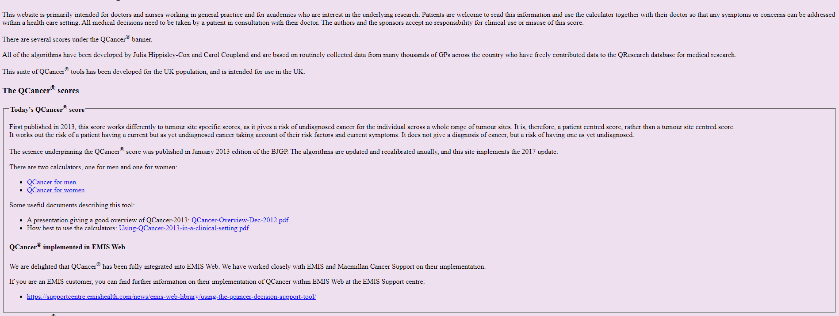
Risk assessment tools
Notes:
Debs

Slide 30
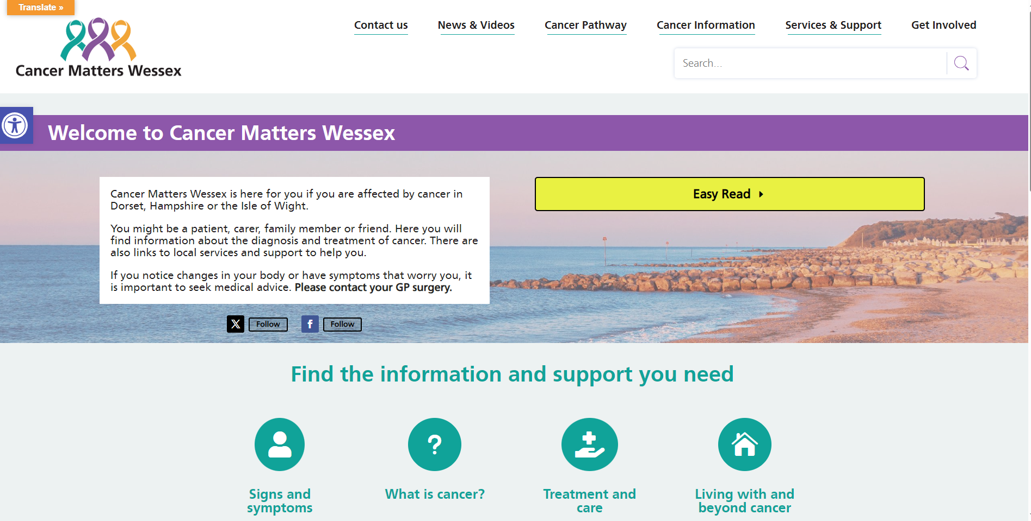
Support for patients
Welcome to Cancer Matters Wessex - Cancer Matters Wessex
Notes:
Debs

Slide 31
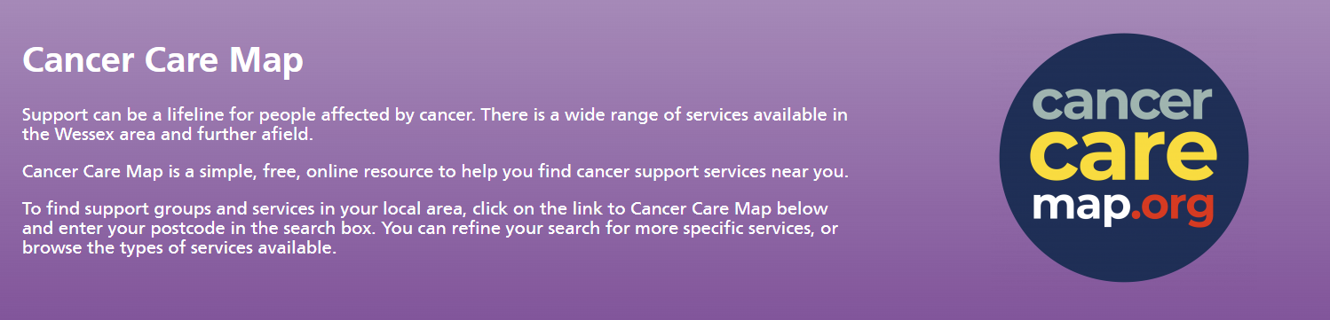
Support
Notes:
Debs

Slide 32

‘Know the Signs’ Campaign
Notes:
Debs

Slide 33

Resources
Notes:
Debs

Slide 34
Smoking cessation advice
Very Brief Advice ‘VBA’
NCSCT e-learning
Notes:
Debs

Slide 35
Any Questions?

