Slide 1
TARGET EVENT CKD UPDATE 2024
Dr Kirsty Armstrong
Clinical Lead for Nephrology and AKI at UHS
Clinical Governance Lead, WKC
Young persons’ Clinical Lead, WKC

Slide 2
Overview of presentation
CKD – the size of the problem and why is it important?
Back to basics
What is new
NICE / KDIGO guidelines
“New kids on the block” – SGL2 inhibitors, finerenone,
What is my approach to CKD management

Slide 3
Facts and Figures
7.2 million adults have CKD (all stages) - > 10% of the entire population
1 million will be undiagnosed
3.63 million adults have CKD (stages 3-5).
30,000 on dialysis
3,000 people receive a kidney transplant / annum
5000 on transplant waiting list
Average wait of 2-3 years
Notes:
The number of people with end-stage kidney disease (ESKD) requiring kidney replacement therapy (KRT) has been increasing worldwide
4.3 million by 2030
5000 on waiting list
Average wait of 2-3 years

Slide 4
Chronic kidney disease (CKD) is a significant health burden in the UK¹
Premature deaths each year in people with CKD¹
The annual cost of CKD to the NHS¹ >50% spent on ESRD
Hospitalisation events² Each stay 35% longer than average patient¹
.
NHS. Chronic Kidney Disease in England: The Human and Financial Cost:
National Chronic Kidney Disease Audit // National Report: Part 2 December 2017.
Notes:
Huge impact upon patient quality of quality of life
Huge economic burden on the NHS

Slide 5
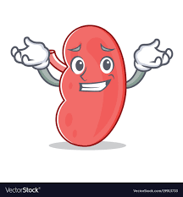
What to do?
Early diagnosis
Delay progression
Reduce CV risk
Notes:
Delay progression both of CKD and CVD

Slide 6
Back to Basics…
Notes:
Complications arise from what the kidneys do

Slide 7
Complications

Slide 8
Complications
Hypertension
Anaemia
CKD-MBD
CVD

Slide 9
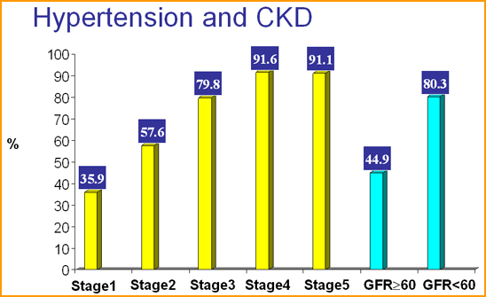
Conmplications of CKD
Notes:
Hypertension is multifactorial
Activation of renin-angiotensin system
Activation of sympathetic nervous system
Impaired nitric oxide synthesis and endothelium- mediated vasodilatation
Salt and fluid retention
Aortic stiffness

Slide 10
Conmplications of CKD
ANAEMIA AND CKD

Slide 11
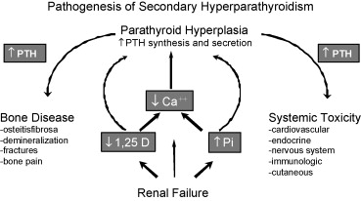
Renal Bone Disease - 3
Notes:
IN renal failure, reduced phosphate excretion, reduced activation of vitamin d => low calcium=> increased PTH
PTH - Mobilises skeletal calcium, Reduces calcium excretion, enhances phosphate excretion, Increases Vitamin D production
Vitamin D=>Enhances calcium and phosphate absorption from gut, Reduces PTH secretion, Enhances calcium and phosphate reasorption in kidney
High PTH =>LVH and cardiac fibrosis, Extraskeletal calcification, Peripheral neuropathy and impotence, Bone pain, arthralgia, deformity and fractures
Muscle weakness, Pruritis, Marrow fibrosis and EPO resistance
Aim is to normalise calcium and phosphate and maintain appropriate PTH
Hyperphosphataemia
Hypocalcaemia
Calcium supplements / Vitamin D analogues
Suppress PTH / Parathyroidectomy

Slide 12
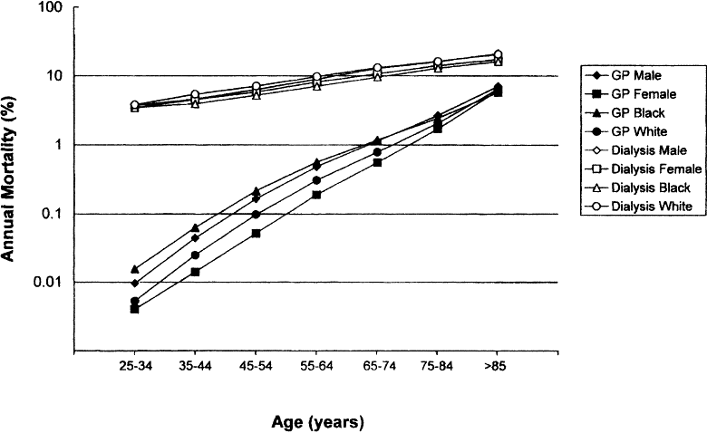
KDOQI Clinical Practice Guidelines for Chronic Kidney Disease: Evaluation, Classification, and Stratification 2002
Notes:
The 1998 Report of the NKF Task Force on Cardiovascular Disease in Chronic Renal Disease drew attention to cardiovascular disease as an outcome of chronic kidney disease.9 The Task Force recommended that patients with chronic kidney disease be considered in the “highest risk group” for subsequent cardiovascular disease (CVD) events. The excess risk of cardiovascular disease is due, in part, to a higher prevalence of conditions that are recognized as risk factors for cardiovascular disease in the general population (“traditional” CVD risk factors) and to hemodynamic and metabolic factors characteristic of chronic kidney disease (“CKD-related” CVD risk factors).
“atherogenic milieu”
CVD is the leading cause of morbidity and mortality in patients with CKD:
40-50% deaths in CKD patients
50% deaths in RTR
80% pts starting dialysis already have CVD
CVD mortality in dialysis pts is 10-20 times higher than the general population
Majority of patients with CKD have stable or slowly progressive disease and never reach dialysis dependence or die before they do

Slide 14
Management of CKD – primary prevention
Early diagnosis
Delay progression
Reduce CV risk

Slide 15
CKD Management Guidelines
Notes:
Kidney disease improving global outcomes

Slide 16
Notes:
Nice cg 182 PUBLISHED 2008, revised July 2014 revised 2021 guidance included advice on SGL2 inhibitors, Include risk equation
Most recent is the Uk eCKD guide Feb 2024 from UKKA

Slide 17
Notes:
Nice cg 182 PUBLISHED July 2014
2021 guidance included advice on SGL2 inhibitors
Include risk equation, information on SGL2I

Slide 18
2021 NICE GUIDANCE – what is new?
Classification of CKD based on eGFR and albuminuria category
Blood pressure management guidance
SGLT2 inhibitors.
Kidney Risk equation to estimate 5 risk of needing renal replacement.
Visual guides on CKD identification, phosphate binders and proteinuria management
Lifestyle modifications (diet, exercise, low salt, smoking cessation)
Statins in patients with CKD with a GFR < 60 and / or with albuminuria.
Patients should have their renal function monitored for at least 3 yrs after an episode of AKI
NICE GUIDANCE NG23 (2021) CHRONIC KIDNEY DISEASE ASSESSMENT AND MANAGEMENT

Slide 19
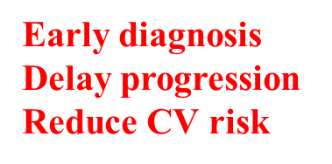
Definition of CKD
Two eGFR estimations <60 mL/min/1.73 m2 over a period not less than 90 days
AND / OR
ACR >3 mg/mmol
NICE GUIDANCE NG23 (2021) CHRONIC KIDNEY DISEASE ASSESSMENT AND MANAGEMENT
Notes:
2008 NICE guidelines introduced the eGFR to practice. The entry requirement for CKD registers currently established in GP practices is to be an adult with an eGFR <60mls/min. 2014 NICE guidelines aim to draw attention to albuminuria as an important marker of significant renal disease, which is just as valuable as eGFR in detecting people at risk (see next slide)

Slide 20
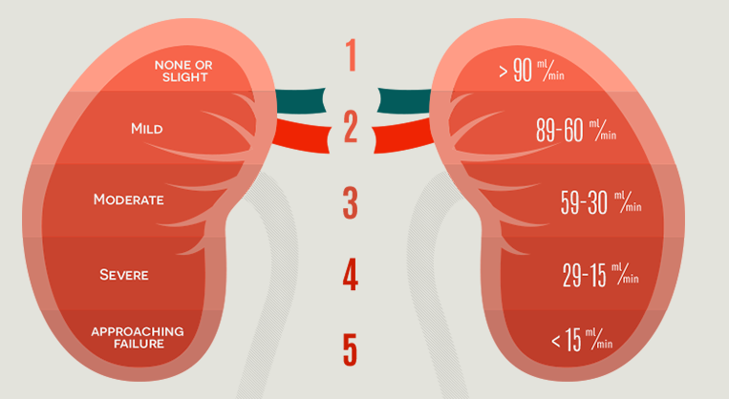
CKD is classified into 5 stages of severity based on the GFR and the presence or absence of other markers of kidney disease
Micoralbuminuria or proteinuria
Haematuira
Structural abnormalities diagnosed on USS
Biopsy proven glomerulonephoritis
• All-cause mortality
• CV mortality
• ESRD
• AKI
• Progressive CKD
NICE GUIDANCE NG23 (2021) CHRONIC KIDNEY DISEASE ASSESSMENT AND MANAGEMENT
Notes:
2021 G/L took it one step further and expanded ACR categories
CKD is defined as abnormaliies of kidney structure of function present for at least 3 months with implications for health.
CKD is classified base on cause ©, GFR (G) and Albuminuria categeora A1-A3
Why is ACR important??
CKD is defined by abnormalities of kidney structure of function, present for a minimum of 3 months with implaicatsion for health
CKD is classified based on cause, Glomerular filtration rate category (G1-G5) and albuminuria category (A1 to A3), abbreviated as CGA
CKD / Prevalence
1 (3.3)
2 (3.0)
3 (4.3)
4 (0.2)
5 (0.2)

Slide 21
Notes:
Epidemiological population data (KDIGO 2024) support retaining the threshold GFR of 60 ml/min/1.73 m2 for diagnosis of CKD in older adults, even in the absence of significant albuminuria, with consistently elevated and increasing relative risk of adverse outcomes below this threshold ie NOT just the physiological impact of loss of kidney function with ageing All cause mortality, MI, CV mortality, stroke, ESKD, HF, AKI, AT, hospitalization and PVD

Slide 22
Screening for CKD→ Early diagnosis
Diabetes
Hypertension
Known cardiovascular disease
Long-term nephrotoxic drugs (lithium, omeprazole, NSAIDs)
Episode of acute kidney injury in last 3 years
Conditions known to affect the kidneys (e.g. kidney stones, prostatic enlargement, lupus, sarcoidosis)
Family history of inherited kidney disease
Early diagnosis
Delay progression
Reduce CV risk
NICE GUIDANCE NG23 (2021) CHRONIC KIDNEY DISEASE ASSESSMENT AND MANAGEMENT
Notes:
If you don’t look for it you wont find it…..we already know that 1 million people have undiagnosed CKD

Slide 23
Blood pressure control in CKD
RAS inhibitors to be titrated to maximum advised or tolerated dose
CKD and ACR<70mg/mmol | <140/90 mmHg
CKD and ACR >70 mg/mmol | <130/80 mmHg
Diabetes and an ACR of 3 mg/mmol or more
Hypertension and an ACR of 30 mg/mmol or more
An ACR of 70 mg/mmol or more
NICE guidelines recommend offering a low‑cost renin–angiotensin system antagonist to people with CKD and:
NICE GUIDANCE NG23 (2021) CHRONIC KIDNEY DISEASE ASSESSMENT AND MANAGEMENT
Notes:
TIn adults with CKD and an ACR < 70 mg/mmol, aim for a clinic systolic blood pressure < 140 mmHg (target range 120 to 139 mmHg) and a clinic diastolic blood pressure < 90 mmHg
In adults with CKD and an ACR > 70 mg/mmol, aim for a clinic systolic blood pressure < 130 mmHg (target range 120 to 129 mmHg) and a clinic diastolic blood pressure < 80 mmHg.
argets described by NICE are shown. Benefit derived from blood pressure control in people with diabetes can be shown to a level of 130/80. This should therefore be considered the ideal BP in people with hypertension and diabetes. However, this target may not be applicable to all, particularly the elderly. Once again, some clinical judgement is required in deciding how stringent to be with BP targets.
RAAS inhibition with an ACE-inhibitor or Angiotensin receptor blocker at the highest tolerable dose improves outcomes in CKD

Slide 24
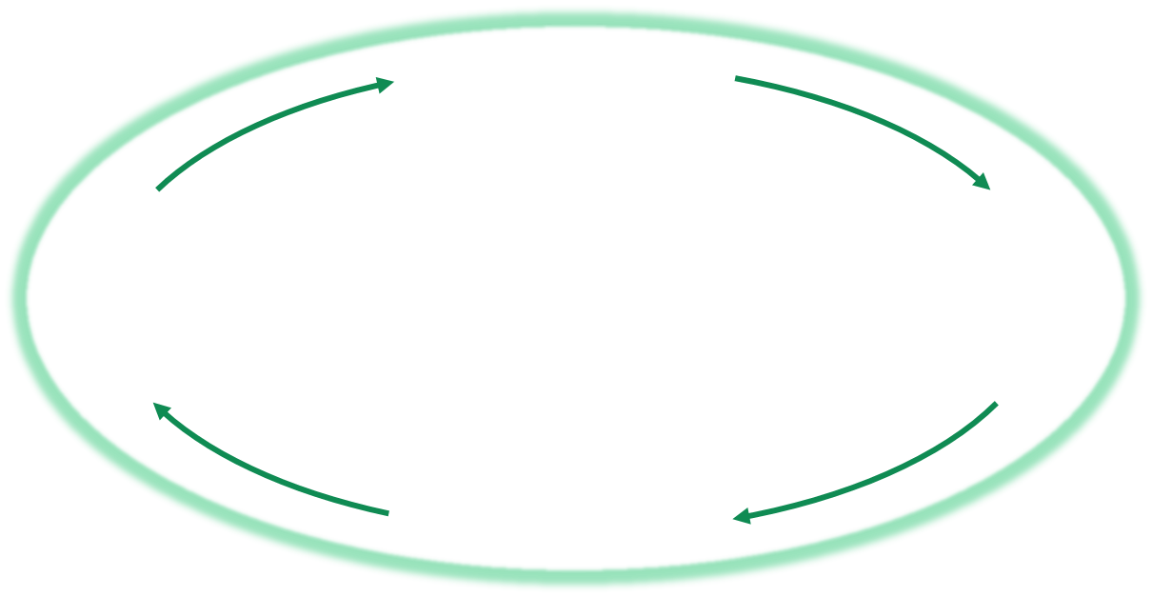
Progression of CKD is largely driven by renal haemodynamics
Glomerulosclerosis
Proteinuria
Renal impairment
Loss of renal mass
Reduction in number
of functioning glomeruli
Intraglomerular
hypertension
Increased blood flow to
remaining nephrons
Notes:
Progression of CKD, once established, is self-perpetuating. Reduction in the number of glomeruli able to cleanse the blood (due to damage of any cause), leads to a cycle of decline characterised by intraglomerular hypertension, damage to the glomerular arteriole and ultimately sclerosis. This drop-out of damaged glomeruli puts greater demands on those that remain, thus accelerating their decline. Gradually the kidney runs out of functioning glomerlui and organ failure results.

Slide 25
Progression of CKD is largely driven by renal haemodynamics
Glomerulosclerosis
RAS blockade
Proteinuria
Renal impairment
Loss of renal mass
Reduction in number
of functioning glomeruli
Intraglomerular
hypertension
Increased blood flow to
remaining nephrons
Notes:
ACE-inhibitors and ARBs break (or at least slow down) this cycle by causing dilatation of the efferent glomerular arteriole, thus reducing intraglomerular blood pressure and slowing damage.

Slide 26
Guidelines for initiation and monitoring of RASI
NICE GUIDANCE NG23 (2021) CHRONIC KIDNEY DISEASE ASSESSMENT AND MANAGEMENT
Notes:
Initial dips in eGFR are expected following initiation of hemodynamically active therapies, including both RASI and SGLT2i. GFR reductions of ≥30% from baseline exceed the expected variability and warrant evaluation.
Challenge for us is asking GPs to uptitrate – mixed bag

Slide 27
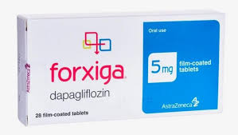
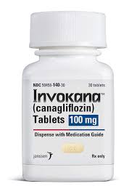
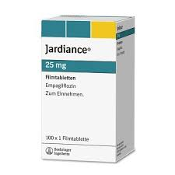
SGLT2 INHIBITORS
Notes:
Next centre stage are the SLGT2

Slide 28
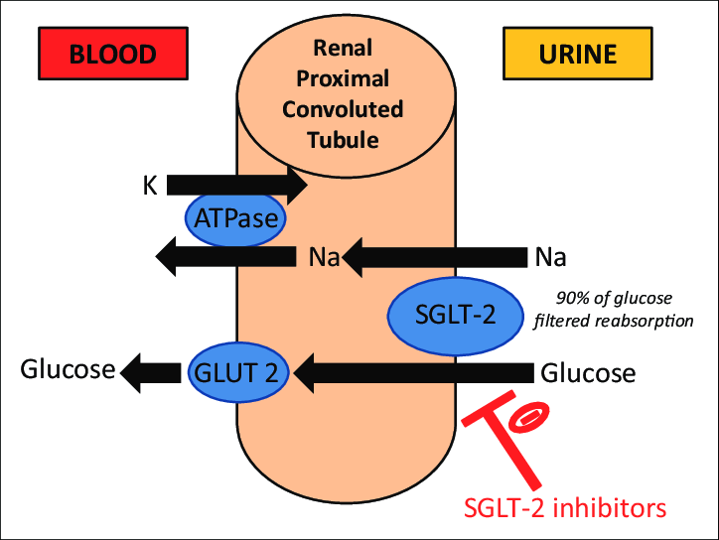
EFFECTS OF SGLT2 INHIBITORS ON THE KIDNEY
Originally conceived as glucose lowering drugs
Prevent absorption of glucose and sodium from PCT→ glycosuria and natriuresis → weight loss, osmotic diuresis and drop in BP
Notes:
Independent effects on kidney and heart

Slide 29
EFFECTS OF SGLT2 INHIBITORS ON THE KIDNEY
Originally conceived as glucose lowering drugs
Prevent absorption of glucose and sodium from PCT→ glycosuria and natriuresis → weight loss, osmotic diuresis and drop in BP
DAPA-CKD and EMPA-KIDNEY
Notes:
Independent effects on kidney and heart

Slide 30
Notes:
DAPA-CKD was a randomised, double-blind, placebo-controlled, multicenter clinical trial of 4304 adults with CKD, randomly assigned to receive FORXIGA 10 mg OD (n=2152) or matching placebo for a median follow-up of 2.4 years
32% without T2DM
68% with T2DM
97% of patients received ACEi/ARB therapy at maximum toerated dose

Slide 31
Notes:
EMPA-KIDNEY is the largest dedicated SGLT2i trial in CKD1
The EMPA-KIDNEY trial is the ONLY dedicated SGLT2i CKD trial to include a population of patients with low eGFR and without albuminuria
6609 patients T2D: 44.5% No T2D: 55.5%
Randomised to placebo or empagloflozin
Randomized, double-blind, placebo-controlled study in people with or without T2D with evidence of CKD at risk of progression, defined based on measurements at ≥3 months before, and at, screening visit of
eGFR 45 to <90 mL/min/1.73m2 with uACR ≥200 mg/g (≥22.6 mg/mmol) OR eGFR 20 to <45 mL/min/1.73m2 regardless of albuminuria
Empagliflozin demonstrated consistent results across a range of baseline characteristics including all types of renal disease (Dapa excluded transplant etcT)
Recuded hospitalisation, all cause mortality, CV mortality, CKD progression

Slide 32
What dose NICE say?
Dapagliflozin is recommended as an option for treating CKD in adults. It is recommended only if:
it is an add-on to optimised standard care including the highest tolerated licenced dose of RASI unless these are contraindicated, and
eGFR of:
25 ml/min -75 ml/min at the start of treatment and
T2DM or uACR of 22.6 mg/mmol or more
Notes:
Note: NICE guidance NG203 recommends that SGLT2-inhibitors should be offered to people with CKD and type 2 diabetes who:-
Are taking an ACE-I or ARB titrated to the highest tolerable dose
Have an ACR>30mg/mmol

Slide 33
What dose NICE say?
Empagliflozin is recommended as an option for CKD in adults, only if:
It is an add-on to optimised standard care including the highest tolerated licenced dose of RASI, unless these are contraindicated and
eGFR of:
20 ml/min to <45 ml/min or
45 ml/min- 90 ml/min and either:
a UACR ≥ 22.6 mg/mmol or T2DM.
Notes:
Empagloflozin can be used down to 20ml/min and albuminuria is NOT an essential prequisite

Slide 34
CONTRAINDICATIONS AND CAUTIONS WITH SGLT2-I
Previous DKA or high risk of hyperglycaemia
Ketogenic diet / eating disorder – risk of ketogenesis
Excess alcohol consumption / IVDU
Acutely unwell, AKI etc
History of complicated / recurrent UTIs
Significant history of mycotic genital tract infections,
Recurrent AKI or at risk of significant volume depletion (elderly)
“Sick day rule” advice
Notes:
Contraindicated in T1DM as can promote ketosis
Rare side effect of Fournieres gangrene
Interaction with insulin / sulphonylureas - hupogycaemia

Slide 35
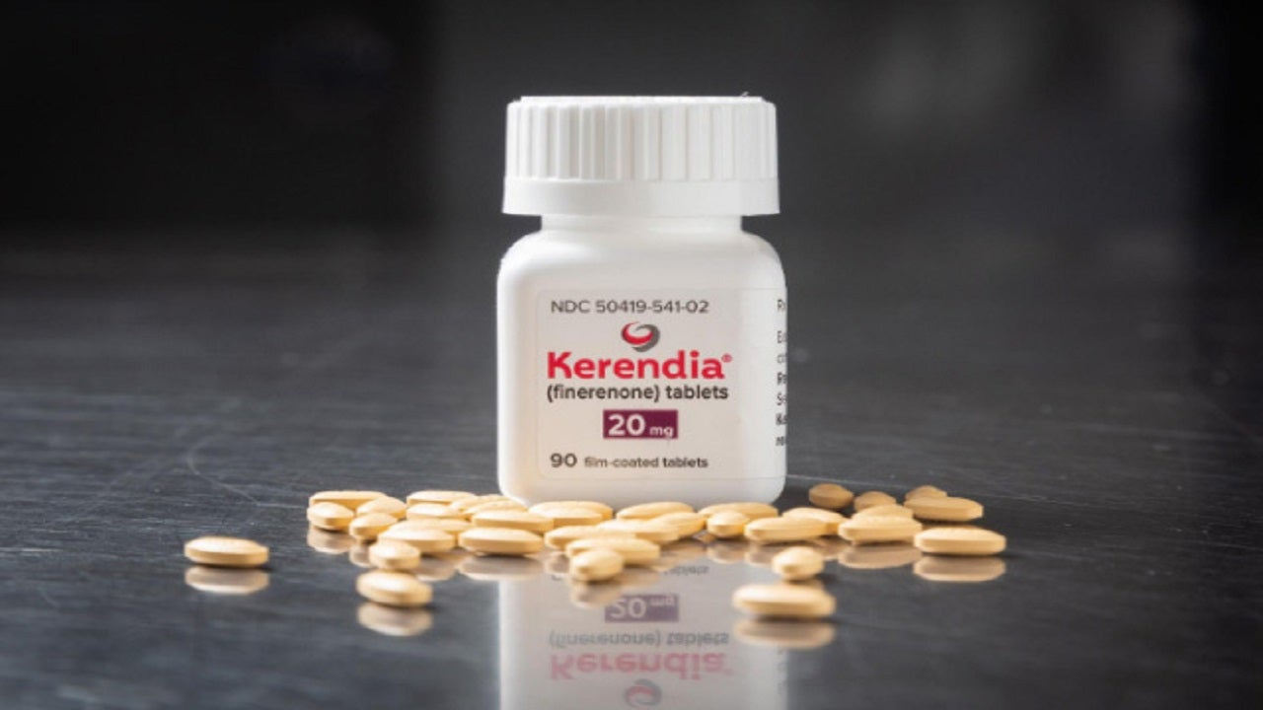
FINERENONE
Notes:
Next one – finerenone
Latest guidance – not really embedded in our practice yet

Slide 36
Finerenone
3rd generation non-steroidal MR antagonist
Higher affinity for MR receptor cf spironolactone
No active metabolites
Reduced potassium retention
Stronger anti-inflammatory and antifibrotic effects
Mineralocorticoid receptors are found on tubular epithelial cells, mesangial cells and podocytes
Excess MR activation→interstitial fibrosis and CKD progression

Slide 37
Notes:
The New England Journal of Medicine December 3rd, 2020
George L. Bakris et al.
2020 FIDELIO-DKD Phase III Study Effect of Finerenone on CKD Outcomes in T2D
Patients were well matched in terms of baseline characteristics
Excluded patients with significant non-diabetic CKD and chronic heart failure
A statistically significant difference in favour of finerenone versus placebo was shown for the primary composite endpoint
Primary composite outcome of kidney failure*, a sustained decrease of ≥40% in eGFR from baseline over a period of at least 4 weeks, or death from renal causes
Limitations: Most patients had advanced CKD (mean eGFR 44.3 ml/min/1.73 m2), Patients with non-albuminuric CKD and CKD not due to type 2 diabetes were excluded, Low numbers of patients identified as black (4.7%) which may restrict generalisability
Of note: no appreciative change in eGFR or K over 44 months of follow up

Slide 38
What dose NICE say?
Finerenone is recommended as an option for treating stage 3 and 4 CKD (with albuminuria) associated with T2DM in adults. It is recommended only if:
it is an add-on to optimised standard care – RASI and SGLT2 inhibitors
an eGFR of ≥ 25 ml/min

Slide 39
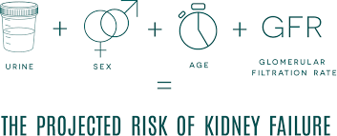
KIDNEY RISK EQUATION
Give adults with CKD and their family members or carers (as appropriate) information about their 5-year risk of needing renal replacement therapy (measured using the 4-variable Kidney Failure Risk Equation).
NICE GUIDANCE NG23 (2021) CHRONIC KIDNEY DISEASE ASSESSMENT AND MANAGEMENT
Notes:
The 4-variable kidney failure risk equation (KFRE) allows for the prediction of chronic kidney disease (CKD) progression using age, sex, estimated glomerular filtration rate, and urine albumin/creatinine ratio. The KFRE was developed and underwent validation in 31 CKD cohorts from 30 countries including over 700,000 individuals and 23,000 KRT cases. The statistical performance to predict KRT was found to be good to excellent in all cohorts. T
The four and eight variable equations accurately predict the 2 and 5 year probability of treated kidney failure (dialysis or transplantation) for a potential patient with CKD Stage 3 to 5. Predicted risks may differ from observed risks in clinical populations with lower and higher observed risks than the study population, and a calibration factor for non-North American cohorts has been added.

Slide 41
Notes:
199 page document

Slide 42
Treat people with CKD with a comprehensive treatment strategy to reduce risks of progression of CKD and its associated complications encompassing education, lifestyle, exercise, smoking cessation, diet, and medications, where indicated.
KDIGO 2024 Clinical Practice Guideline for the Evaluation and Management of CKD
Notes:
So, management of CKD involves a Multifaceted approach aimed at:
manage CKD and its complications
reduce risk of CKD progression
Reduce risk of CVD
Lifestyle factors
Individualised BP control
Optimise use of reno-protective medications – RASI, SGLT2-I, (finerenone)
Primary / secondary CV protections – statins, aspirin, glycaemic management
Optimise other medications
Timely referral to renal services
Adopting a healthy and diverse diet with a higher consumption of plant-based foods compared to animal-based foods and a lower consumption of ultra-processed foods has the potential to benefit complications related to progressive CKD such as acidosis, hyperkalemia, and hyperphosphatemia with less risk of protein energy-wasting.
Individualize BP-lowering therapy and treatment targets in people with frailty, high risk of falls, very limited life expectancy, or symptomatic postural hypotension.
Treatments that delay progression of CKD with a strong evidence base include RASi and SGLT2i.

Slide 43
Consider frequency of monitoring depending on GFR category
KDIGO 2024 Clinical Practice Guideline for the Evaluation and Management of CKD
Notes:
Frequency of monitoring

Slide 44
Management of CKD – putting it all together
Management of CKD involves:
Early diagnosis
Delaying progression
RASI / SGLT2i /finerenone
Reducing cardiovascular risk
cholesterol, glycaemic control, exercise, non-smoking, weight management, low salt, aspirin etc
RASI / SGLT2i / finerenone
Treating complications (anaemia, hypertension, CKD MBD)
Timely referral for renal replacement therapy
Transplant, dialysis, best supportive care
Notes:
Bearing in mind that if you are over the age of 80 then dialysis is unlike to confer survival or quality of life benefit

Slide 45
Move from eGFR-based criteria to risk-based-criteria to facilitate early referral to renal services
KDIGO 2024 Clinical Practice Guideline for the Evaluation and Management of CKD

Slide 46
Concept of shared decision making with advanced care planning for those choosing supportive care
KDIGO 2024 Clinical Practice Guideline for the Evaluation and Management of CKD
Notes:
I would argue that age must be taken into consideration when deciding when to refer

Slide 47
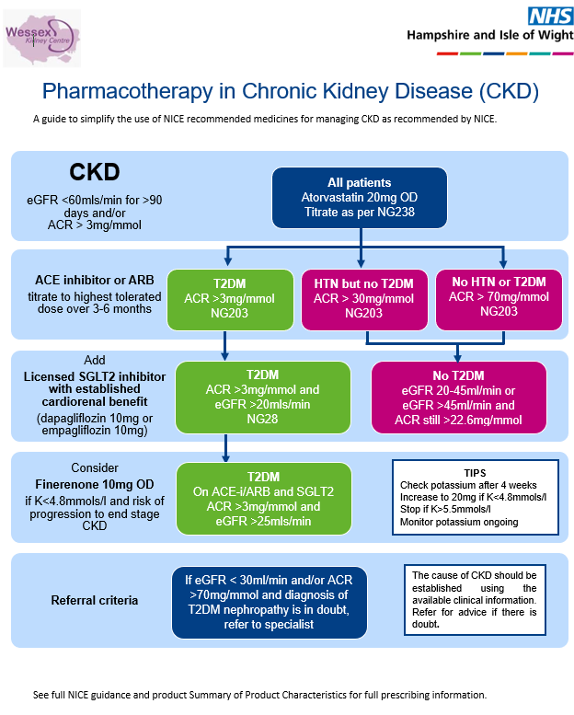

Slide 48
My personal practice
Individualised approach
Consider age, eGFR (current and trend) and risk of progression
Focus on lifestyle factors
Medications as per NICE / KDIGO guidance
If discharged – clear guidance to GP about re-referral criteria
Early discussion about management options
Early referral for transplant work up if suitable
Pragmatic approach to RRT in > 80 - low threshold for best supportive care
Escalation plan in event of progression to ESKD / AKI precipitating hospitalisation
Patient education and engagement aids empowerment – PIL, educational resources, MyRenalCare

Slide 49
UHS/WKC: Relationship between UHS and Wessex Kidney Centre, PHT

Slide 50
Population Statistics – WKC / UHS
Population | Region | UHS postcode | Percentage
Total | 2.2m | 600,000 | 11%
Dialysis / Tx | 1976 | 510 | 26%
Dialysis | 845 | 232 | 27%
Transplant | 1131 | 278 | 24%

Slide 51
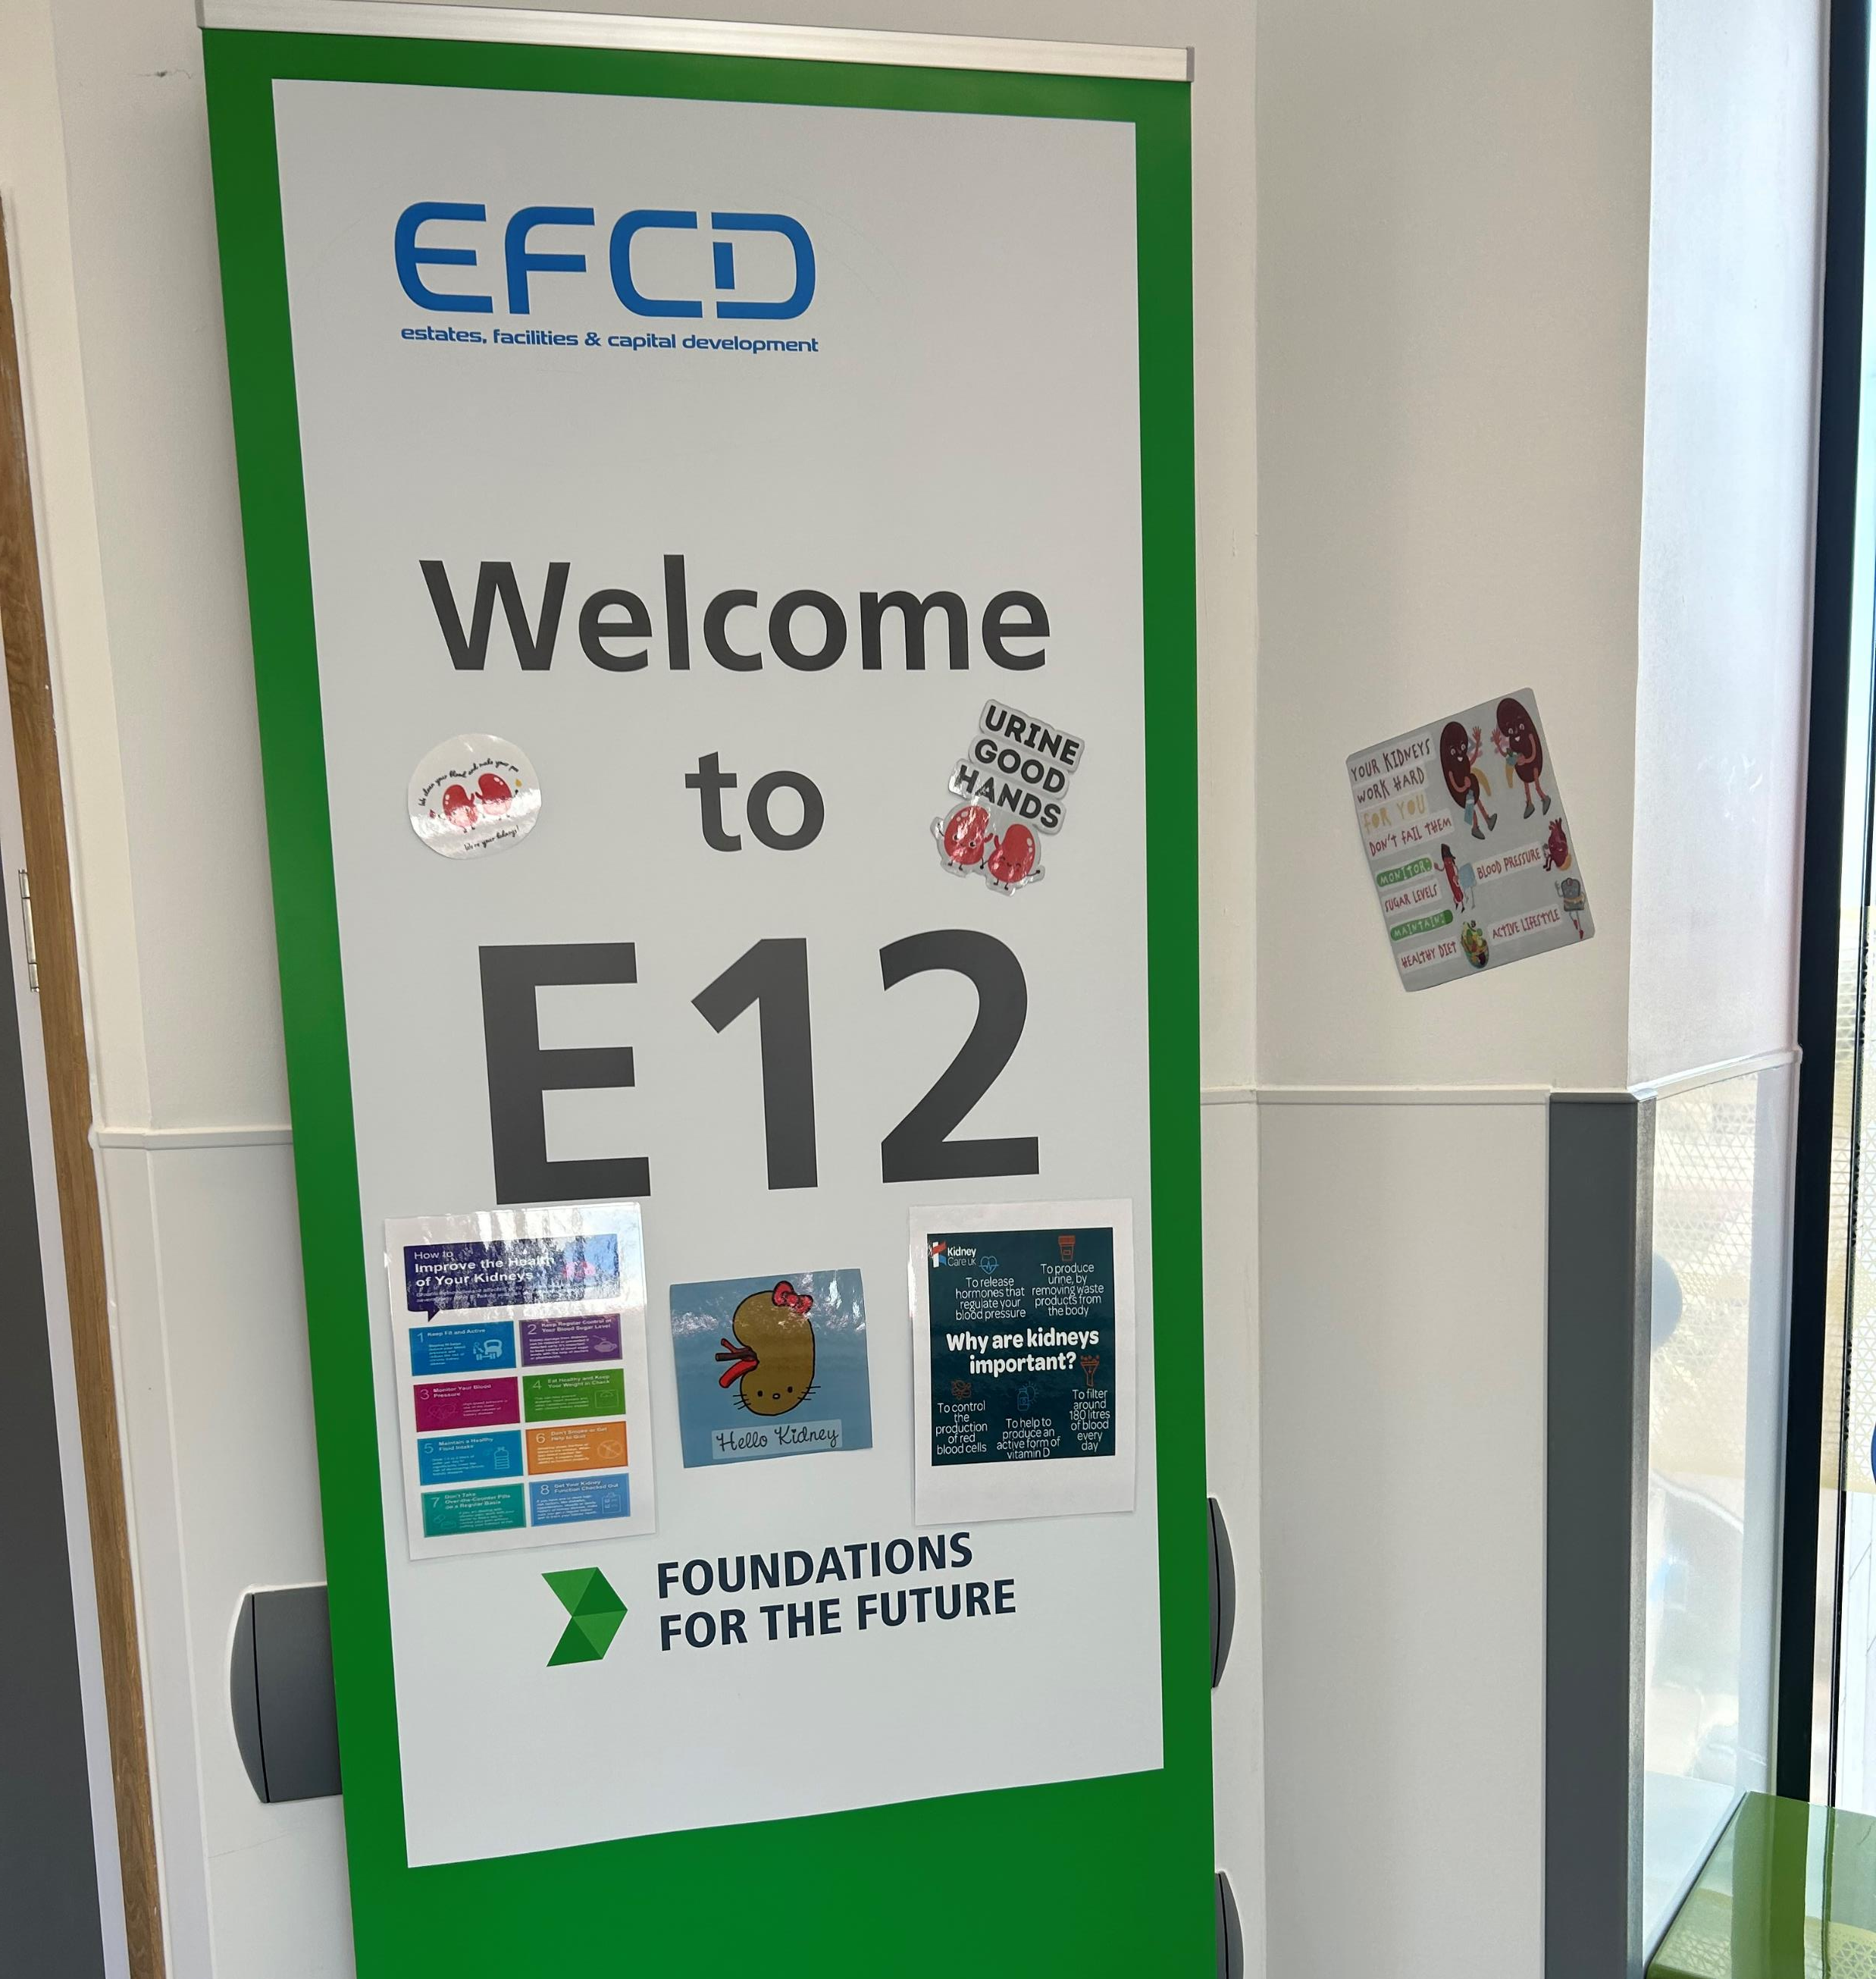
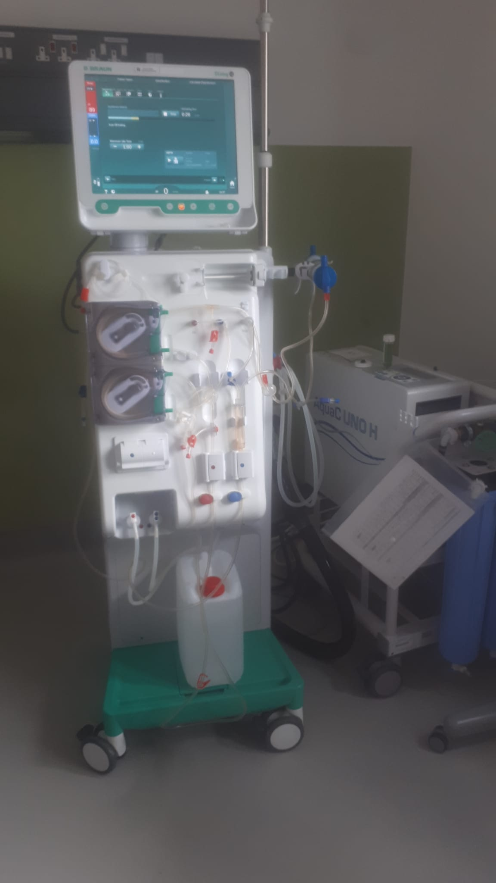
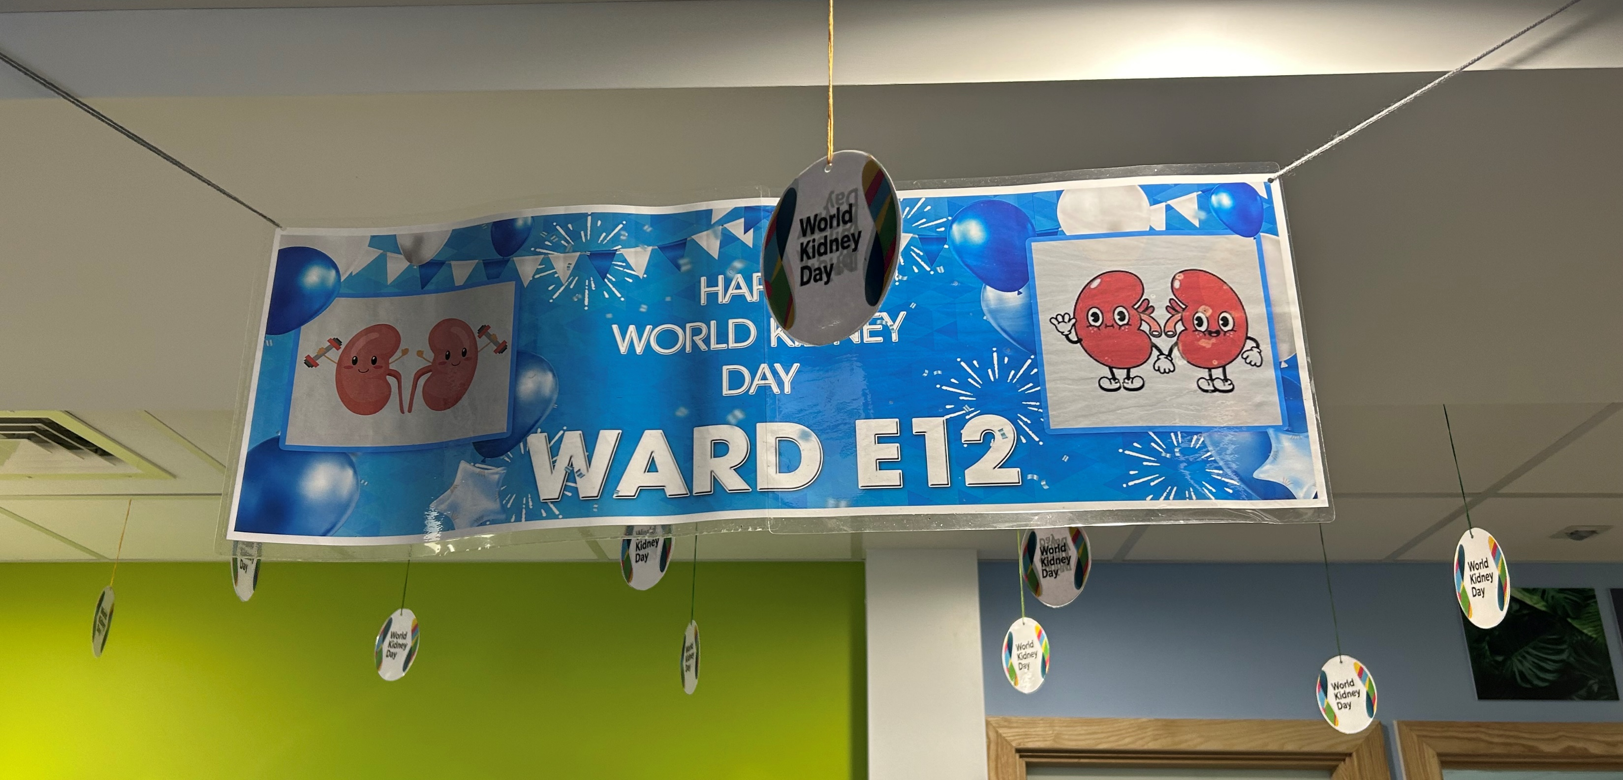
E12; 5 days
2 nurses/day
6 sessions / day
30 sessions/week

Slide 52
Any Questions?

Slide 53
RESERVE SLIDES

Slide 54
Refer adults with CKD for specialist assessment (taking into account their wishes and comorbidities) if they have any of the following:
a 5-year risk of needing renal replacement therapy of greater than 5% (measured using the 4-variable Kidney Failure Risk Equation)
an ACR of 70 mg/mmol or more, unless known to be caused by diabetes and already appropriately treated (see recommendations 1.6.6 and 1.6.7)
an ACR of more than 30 mg/mmol (ACR category A3), together with haematuria
a sustained decrease in eGFR of 25% or more and a change in eGFR category within 12 months
a sustained decrease in eGFR of 15 ml/min/1.73 m² or more per year
hypertension that remains poorly controlled (above the person's individual target) despite the use of at least 4 antihypertensive medicines at therapeutic doses (see also NICE's guideline on hypertension in adults)
known or suspected rare or genetic causes of CKD
suspected renal artery stenosis. [2021]

Slide 55
CKD TALK

Slide 56
NICE GUIDANCE NG23 (2021) CHRONIC KIDNEY DISEASE ASSESSMENT AND MANAGEMENT

Slide 57
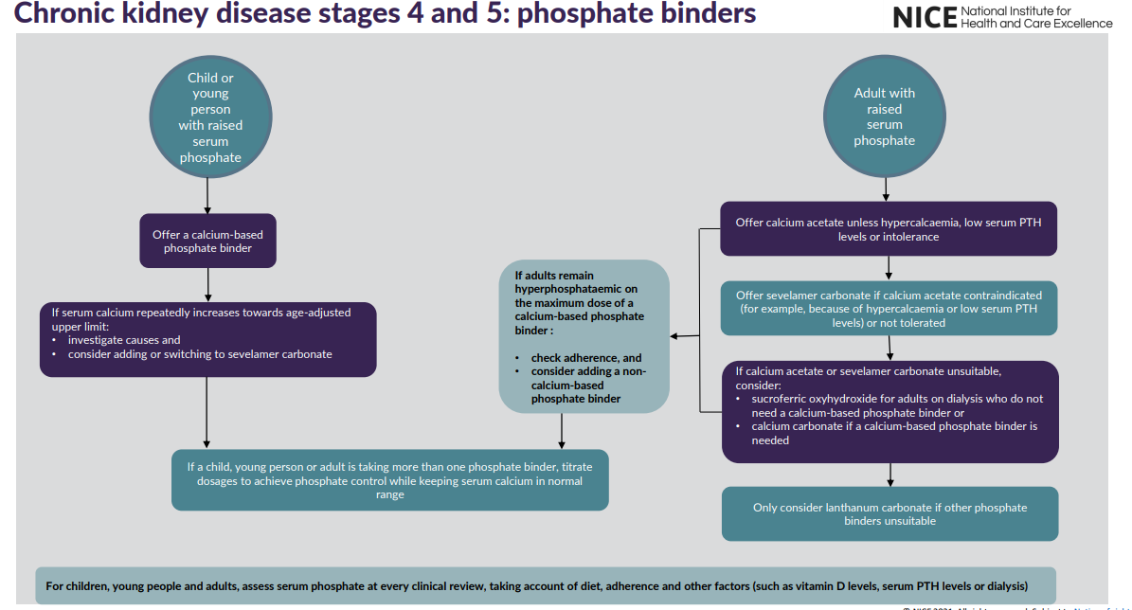
NICE GUIDANCE NG23 (2021) CHRONIC KIDNEY DISEASE ASSESSMENT AND MANAGEMENT

Slide 58
NICE GUIDANCE NG23 (2021) CHRONIC KIDNEY DISEASE ASSESSMENT AND MANAGEMENT

Slide 59
