Slide 1
MSK Primary Care Workshop – Fort Southwick (Boardroom)
27 June 2024 14.30-16.30pm

Slide 2
MSK Primary Care Workshop Agenda
27th June 2024 14.30-16.30pm
Timing | Item | Speaker
14:30 – 14:40 | Welcome and Setting the Scene | Zaid Hirmiz, Clinical Director Transformation
14:40 – 14:50 | National context/model | Andy Bennett GIRFT Clinical Advisor
14:50 – 16:20 | Breakout group Discussions Access/Triage/Referral optimisation/First Contact Practitioner (FCP) role Integration/Interface with community and secondary care Digital solution/Self-management/Shared Decision Making (SDM) | 3 tables with facilitator 30 min per session
16:20 – 16:30 | Wrap up and Next Steps | Lyn Darby, Director Acute (ICB)

Slide 3
Welcome and Setting the Scene
Dr. Zaid Hirmiz, Deputy CMO and Clinical Director Transformation

Slide 4
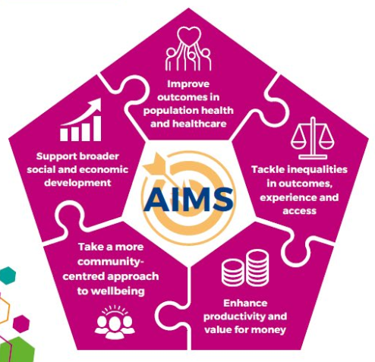
Setting the Scene – Dr. Zaid Hirmiz, Clinical Director Transformation
Today – an opportunity to think about what best practice looks like in Hampshire and Isle of Wight, in line with our Integrated Care Partnership strategic aims
We all know that poor MSK health has a huge impact :
One of the biggest causes of years lived with disability
30% of GP consultations in England
30m working days lost every year in the UK
NICE estimates prevalence of significant persistent pain at c. 23%
In Hampshire and Isle of Wight:
23.1% of IOW residents reported a long term MSK problem. 18.5% in Portsmouth, 18% in Hampshire, and 14.7% in Southampton
16,149 pts. on community waiting lists for MSK services in March 24
2,566 referrals + 466 A&G requests into secondary care for orthopaedics, spinal and pain (Mar 24)
1,014 pts. waiting >52 weeks for orthopaedic surgery (Apr 24); 169 of those waiting >65 weeks
Key priority nationally – and a priority for Hampshire and Isle of Wight

Slide 5
Setting the Scene – Dr. Zaid Hirmiz, Clinical Director Transformation
Today is a chance to think about how we can best work together to develop new clinical models and pathways
Lots has changed since we set up our MSK services:
Introduction of FCPs
Roll out of Advice & Guidance
National best practice framework and pathways
Establishment of Integrated Care Boards and Systems
Coming together as a single HIOW system means we can think bigger and better!
More integrated services – end to end pathways & across HIOW
More equitable services – reduced unwarranted variation
Economies of scale
We can start fresh today – getting views and ideas from all of you about
How we can implement national best practice in HIOW
What those ideal service models and pathways would look like
Opportunities we have to do things differently
So that we can deliver the best possible access, outcomes and experience for patients across our geography

Slide 6
HIOW Primary care MSK workshop
Andrew Bennett
Consultant Physiotherapist Sutton Health and Care, Epsom and St Helier NHS Trust
GIRFT Clinical Advisor Community MSK
Clinical Lead for MSK Digital Health Therapeutics Programme
Former National Clinical Director MSK (Oct 19 - Mar 24)
Notes:
Standard title slide

Slide 7
GIRFT community MSK workstream
Building on work done e.g., Best MSK Health
Recovery
Transformation
Prevention and Long-term conditions
Work and health
Quality
Value
Working to better enable integrated care systems to commission the delivery of high quality MSK services in the community, which will benefit patients now and into the future.
The central aims of the workstream are to:
Ensure high-quality triage services and optimise referrals for diagnostics and to orthopaedic, rheumatology and spinal services;
Enable delivery of high-quality therapies to rehabilitate those who have sustained an injury or are recovering from surgery, and to support people to develop the knowledge, skills and confidence to best manage long-term MSK conditions and helping them to remain in or return to work;
Integrate digital health therapeutics.

Slide 8
Community MSK health and care provision
MSK primary and community health and care services have two broad functions
Triage Function
to support diagnosis, provide specialist advice and optimise referrals through shared decision making
Providing appropriate request and clinical correlation of diagnostic investigations
Referring to both community and hospital-based health and care services
Making best use of specialist clinicians in primary and/or community care working closely with hospital-based services and specialists
Therapies Function
To rehabilitate those who have sustained an injury or are recovering from surgery, as well as to help people best manage long-term MSK conditions
Receiving referrals from both community and hospital-based health and care services
Making best use of wider range of health and social care professionals and community assets
Integrating digital health therapeutics
King fund - Making care closer to home a reality 2024
NHSE Community improvement framework 2023
MSK ortho approach to referral optimisation 2023
Futures ORTP referral optimisation guidance (rheum and spine)

Slide 9
Current overview framework for Community MSK health and care in community
This provides a framework overview; the exact nature varies at place level based on local commissioning decisions
Practitioners with specialist interest in primary care with a triage function
e.g., MSK First Contact Practitioners (FCP)
Inclusive of diagnostic (for most)
Consultant lead Hospital services
Urgent and emergency care
Cancer care
Diagnostics
Planned Care
Orthopaedics
Rheumatology
Spinal services
Pain management services
NHSE Community MSK improvement Framework
DOH referral to treatment consultant lead waiting times rules
RTT clock continues
Community MSK service
Triage function
as an interface service
inclusive of diagnostics (for most)
RTT clock continues if hospital referral indicated or starts if hospital referral for new definitive treatement despite therapies intervention
Therapies Function
Physiotherapy
Biomechanical podiatry
Psychology
Occupational therapy (hand therapy)
Osteopathy
RTT clock stop on commencing therapy if first definitive treatment
Triage
Self-Referral
RTT clock continues
Person suspects a MSK conditions
RTT clock starts at time contact made with service
Potential community MSK access targets
Priority referral 2 weeks
Non-priority 12 weeks moving to 6
Time between first and second appt in therapies 2 weeks
Therapies
GP or other healthcare professional in primary care
Potential community access targets apply
RTT clock continues
Primary care services | Community services | Hospital services | Potential community access targets

Slide 10
Challenges across framework – variation
This provides a framework overview; the exact nature varies at place level based on local commissioning decisions
Practitioners with specialist interest in primary care with a triage function
e.g., MSK First Contact Practitioners (FCP)
Inclusive of diagnostic (for most)
Variance in delivery due to varied of understanding about purpose and nature of roles, varied integration with wider MSK framework, varied clinical governance – causing variance in quality and value of provision
Consultant lead Hospital services
Urgent and emergency care
Cancer care
Diagnostics
Planned Care
Orthopaedics
Rheumatology
Spinal services
Pain management services
NHSE Community MSK improvement Framework
DOH referral to treatment consultant lead waiting times rules
Varied integration with community and challenges balancing recruitment and retention across settings
Community MSK service
Triage function
as an interface service
inclusive of diagnostics (for most)
Varied models of delivery, integration and governance
Therapies Function
Physiotherapy
Biomechanical podiatry
Psychology
Occupational therapy (hand therapy)
Osteopathy
Varied models of delivery and quality of provision
Variance in people's ability to access care especially within CORE20 group
Triage
Varied integration between community and hospital
Person suspects a MSK conditions
Self-Referral
Varied commissioned access criteria related to priority, pathways and use of digital
Significant variance in back log size and waiting times
Therapies
Inability to robustly quality evaluate access outcomes and experiences across primary and community services
Varied contractual arrangements from a commissioning perspective at neighbourhood, place and ICS level
Varied integration between community and hospital
GP or other healthcare professional in primary care
Varied use of triage provision, and advice and guidance resources
Primary care services | Community services | Hospital services | Potential community access targets

Slide 11
Gateway metric to evaluate performance across community MSK framework
Key gateway metrics (Model Health System) | Benchmark | Peer medium | HIOW
Trauma & orthopaedics (TFCs 110 & 214) - Outpatient - Percentage of patients discharged after their first attendance | 20% | 32.1% | 32.4%
Rheumatology (TFCs 410 & 262) - Outpatient - Percentage of patients discharged after their first attendance | 20% | 34.6% | 34.6%
Spinal surgery service (TFC 108) - Outpatient - Percentage of patients discharged after their first attendance (12 months to month end) | 20% | 20.5% | 11% - too good?
Community triage
Hospital
Community therapies
Community triage issues
Over referral from primary and/or community practitioners and appropriate discharge of those who don’t require hospital treatment
Community therapies issues
Challenges re access too and effectiveness of community rehabilitation or resources to support self-management leading to over referral and/or need for further hospital follow up
Hospital issues
Inappropriate need for further follow up
Challenges re accessibility and confidence in local community provision
Challenges with access to diagnostics
Identify issues and collaborate to improve productivity and quality through integration

Slide 12
Community MSK waiting times
ICS with greatest community service waiting time challenges – HIOW focus
Total MSK waiting 340,398 (42% Total for community services )
85,604 waiting more than 12 weeks (25% of Total MSK)
37,198 12-18 weeks (11% of total MSK),
46,557 18-52 weeks, (14% of total MSK)
1849 >52 weeks, (>1% of total MSK)
ICS with back log > 10,000
SOUTHWEST LONDON | 10,071
CAMBRIDGESHIRE AND PETERBOROUGH | 11,427
NORTHEAST LONDON | 11,608
WEST YORKSHIRE | 12,400
BRISTOL, NORTH SOMERSET AND SOUTH GLOUCESTERSHIRE | 12,564
GREATER MANCHESTER | 12,580
SHROPSHIRE, TELFORD AND WREKIN | 13,047
HAMPSHIRE AND ISLE OF WIGHT | 16,265
KENT AND MEDWAY | 16,658
BIRMINGHAM AND SOLIHULL | 17,914
CHESHIRE AND MERSEYSIDE | 17,999
SUSSEX | 27,670
NORTHEAST AND NORTH CUMBRIA | 41,699
ICS with greatest number 12–18-week waiters
NORTHEAST LONDON | 1019
NORTH CENTRAL LONDON | 1254
WEST YORKSHIRE | 1278
GREATER MANCHESTER | 1279
KENT AND MEDWAY | 1557
BRISTOL, NORTH SOMERSET AND SOUTH GLOUCESTERSHIRE | 1707
CHESHIRE AND MERSEYSIDE | 1834
SHROPSHIRE, TELFORD AND WREKIN | 2044
CAMBRIDGESHIRE AND PETERBOROUGH | 2070
HAMPSHIRE AND ISLE OF WIGHT | 2139
BIRMINGHAM AND SOLIHULL | 2211
SUSSEX | 3609
NORTHEAST AND NORTH CUMBRIA | 4941
ICS with greatest number of 18–52-week waiters
NORTH CENTRAL LONDON | 1001
CAMBRIDGESHIRE AND PETERBOROUGH | 1131
SURREY HEARTLANDS | 1182
CHESHIRE AND MERSEYSIDE | 2047
HAMPSHIRE AND ISLE OF WIGHT | 2050
NORTHAMPTONSHIRE | 2248
DORSET | 2370
BRISTOL, NORTH SOMERSET AND SOUTH GLOUCESTERSHIRE | 2828
GREATER MANCHESTER | 3297
NORTHEAST AND NORTH CUMBRIA | 3434
SUSSEX | 6016
SHROPSHIRE, TELFORD AND WREKIN | 6549
BIRMINGHAM AND SOLIHULL | 6653
ICS with over 100 people waiting > 52 weeks
HAMPSHIRE AND ISLE OF WIGHT | 202
HEREFORDSHIRE AND WORCESTERSHIRE | 263
NORTHAMPTONSHIRE | 633
SHROPSHIRE, TELFORD AND WREKIN | 642

Slide 13
HIOW challenge
What is the current framework to deliver community MSK services and where does variation exist ?
How can you better deliver triage and therapies in the community
To integrate community and hospital services
To deliver high quality high value care
To move the dial on gateway metric - % patients DC first consult in hospital service
To reduce community back log and those waiting over 12 weeks
Recovery
Transformation
High quality high value MSK services

Slide 14
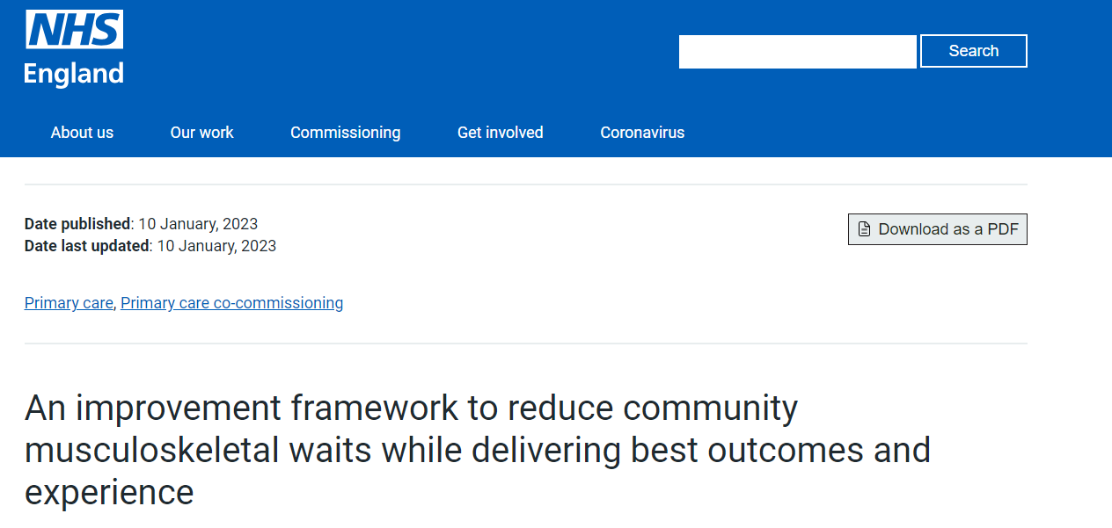
NHSE MSK Community Improvement Framework

Slide 15
Group Discussions - 3 Breakout Sessions:
Integration/Interface with community and secondary care
Digital solution/Self-management/Shared Decision Making (SDM)
Access/Triage/Referral Optimisation/FCP role – Table 1 Rhiannon Rogers Commissioning Manager Planned Care
Integration/Interface with community and secondary care - Table 2 Doreen Murray MSK Transformation Programme Director
Digital solution/Self-management/Shared Decision Making (SDM) – Table 3 Ted Mollart Associate Director, Planned Care
Johan Holte and Andrew Bennet - NHSE South East MSK Leads (circulate between breakout session tables)

Slide 16
Wrap up and next steps
Lyn Darby - Director of Acute Care
Hampshire and Isle of Wight ICB

