Slide 1
TARGET – Safer Prescribing
Medicines Optimisation Team
March 2024

Slide 2
Overview
Competency framework for prescribers
Prescribing is a system
Overprescribing and risks
High risk medicines
Local incidents
Tools to support safe prescribing
HIOW Joint Formulary
Optimise Rx
Hampshire and IOW Medicines Optimisation website

Slide 3
"As a prescriber, you are personally accountable and responsible for your prescribing and clinical decisions. It’s all about patient safety, so it’s important you understand the legal and ethical implications".
Royal Pharmaceutical Society – Prescribing safely and confidently
Notes:
Prescribing safely and confidently | RPS (rpharms.com)

Slide 4
Notes:
Image taken from "The Royal Pharmaceutical Society Competency Framework for all Prescribers" 1. Royal Pharmaceutical Society, 2020. A Competency Framework for all Prescribers. London: RPS

Slide 5
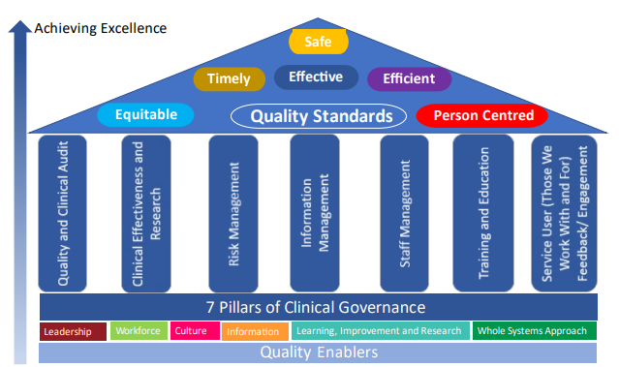
Notes:
Clinical governance is the system through which NHS organisations are accountable for continuously improving the quality of their services and safeguarding high standards of care by creating an environment in which clinical excellence will flourish (Department of Health).
Image : phw.nhs.wales/about-us/policies-and-procedures/policies-and-procedures-documents/clinical-governance-and-infection-control-policies/clinical-governance-framework/

Slide 6
Prescribers are responsible for practicing within their own scope of practice and competence:
delegating where appropriate
seeking support when required
using their acquired knowledge, skills and professional judgement.

Slide 7
Prescribing safely through personal development and
improving practice:
Personal development
Improving practice
Personal formulary
Portfolio of evidence
Notes:
Prescribing safely and confidently | RPS (rpharms.com)

Slide 8
A person taking ten or more medications is 100% more likely to be admitted to hospital because of an adverse drug reaction.​
True or False?

Slide 9
Overprescribing
Overprescribing refers to situations where patients are prescribed medicines:
that they do not need or want
where potential harm outweighs the benefit of the medication
when a better alternative is available but not prescribed
where the medicine is appropriate for a condition but not the individual patient
when a condition changes and the medicine is no longer appropriate or required but is still prescribed
Notes:
Good for you, good for us, good for everybody: a plan to reduce overprescribing to make patient care better and safer, support the NHS, and reduce carbon emissions (publishing.service.gov.uk)

Slide 10
The top 4 drug groups that commonly cause hospital admissions are : antiplatelets, diuretics, NSAIDs and anticoagulants
True or False ?

Slide 11
Overprescribing risks
The National Overprescribing Review (2021) identified the following key points:
8.4m people in England are regularly prescribed 5 or more medicines
1 in 5 hospital admissions in over-65s are caused by the adverse effects of medicines
the more medicines a person takes, the higher chance there is that one or more of these medicines will have an unwanted or harmful effect.
10 % of prescription items dispensed through primary care in England are inappropriate for that patients’ circumstances and wishes, and they could be better served with alternative treatments.
Notes:
Good for you, good for us, good for everybody: a plan to reduce overprescribing to make patient care better and safer, support the NHS, and reduce carbon emissions (publishing.service.gov.uk)

Slide 12
Acute kidney injury greatest risk: the triple whammy
ACEi/ARB + Diuretic + NSAID
True or False ?

Slide 13
High risk medicines
These are some medications associated with serious medication errors:
Insulins
Opioids
Methotrexate
Anticoagulants (heparin,warfarin, DOACs)
Lithium
Diuretics
Amiodarone
Notes:
Good for you, good for us, good for everybody: a plan to reduce overprescribing to make patient care better and safer, support the NHS, and reduce carbon emissions (publishing.service.gov.uk)

Slide 14
Black triangle drugs : Report ALL suspected adverse reactions
True or False ?

Slide 15
Examples of medication incidents
MMR vaccine to immunocompromised patient
Lithium and Priadel duplication (Lithium toxicity)
Depo Provera- on "repeat" - Self-dosing for 2 years without review
Denosumab – missed doses- after discharge from hospital
Transfer of care eg to care home from hospital- High source of errors
Report MEDICINES-RELATED ERRORS
via LFPSE ( Learn from patient safety events)

Slide 16
Tools to support safe prescribing
Optimise RX
Ardens - we can influence/localised
Local formularies on EMIS (greyed out) and S1
SPS – supply tool, monitoring, pregnancy and breastfeeding,
www.sps.nhs.uk
NEWT guidelines (username: tripod64 password: buzzard)
www.newtguidelines.com
PrescQIPP- bulletins, clinical webinars, data analysis
www.prescqipp.info
Medicines Optimisation Bulletin – DSU, MHRA alerts, NICE guidance
Notes:
Medicines Optimisation :: Hampshire and Isle of Wight ICS (hantsiowhealthandcare.org.uk)

Slide 17
The HIOW Formulary
www.hiowformulary.nhs.uk
Joint formulary across primary and secondary care
HIOW prescribing committee
Links to guidance
Ensures fair access across HIOW
RAG status
RED, Amber (I) (R), Green, Blue etc

Slide 18
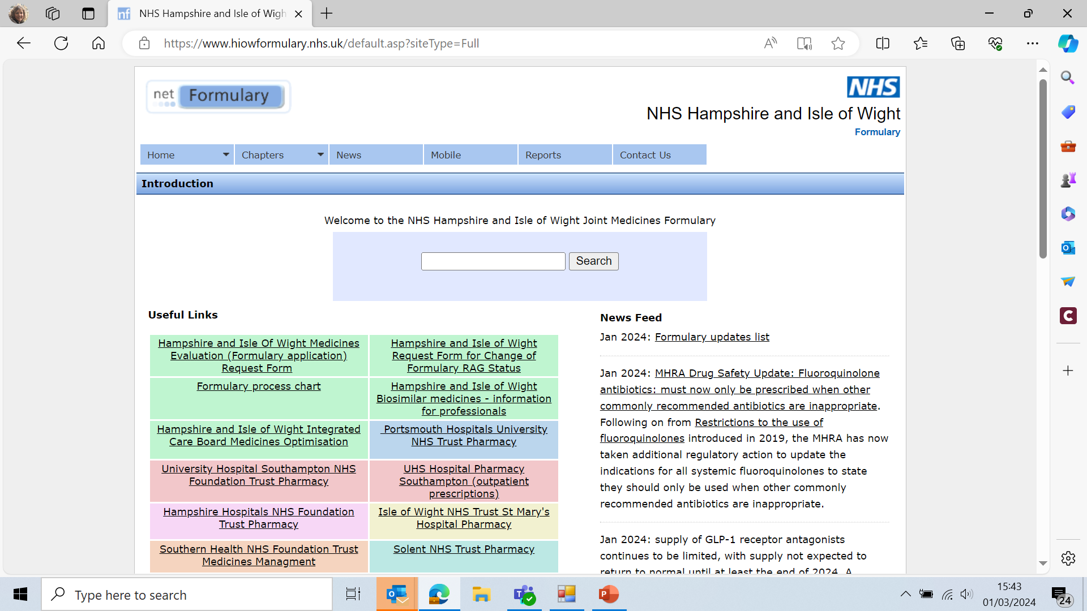

Slide 19
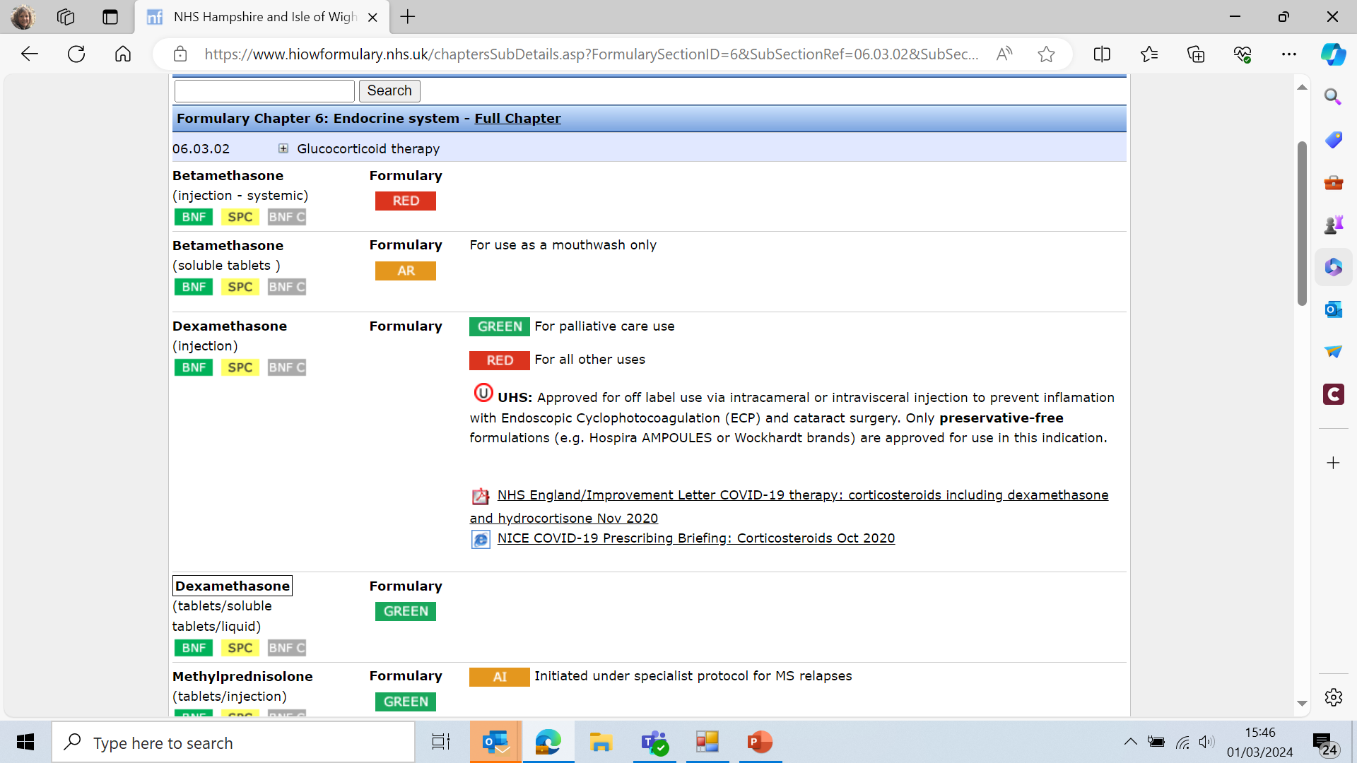

Slide 20
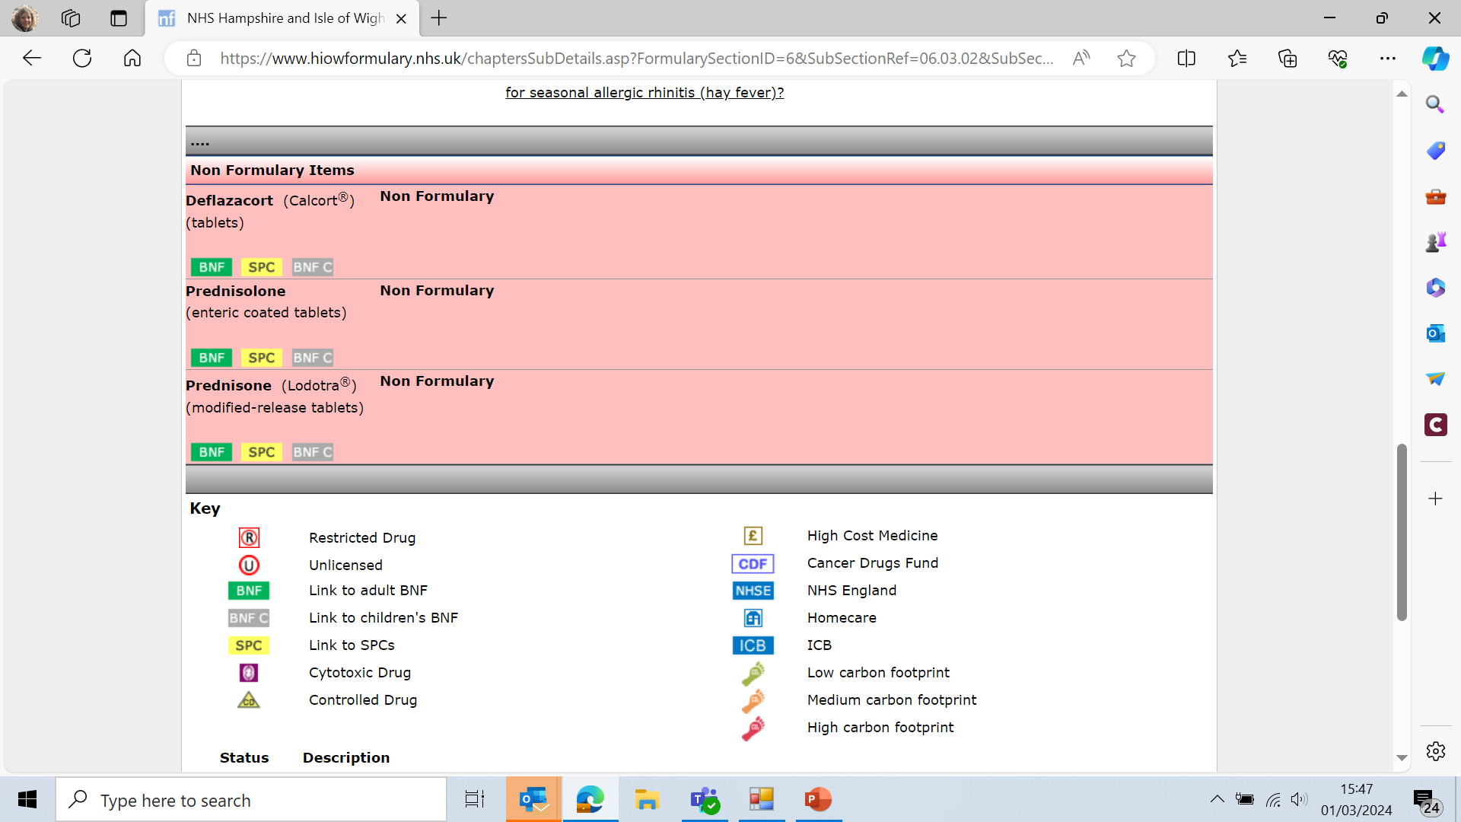

Slide 21
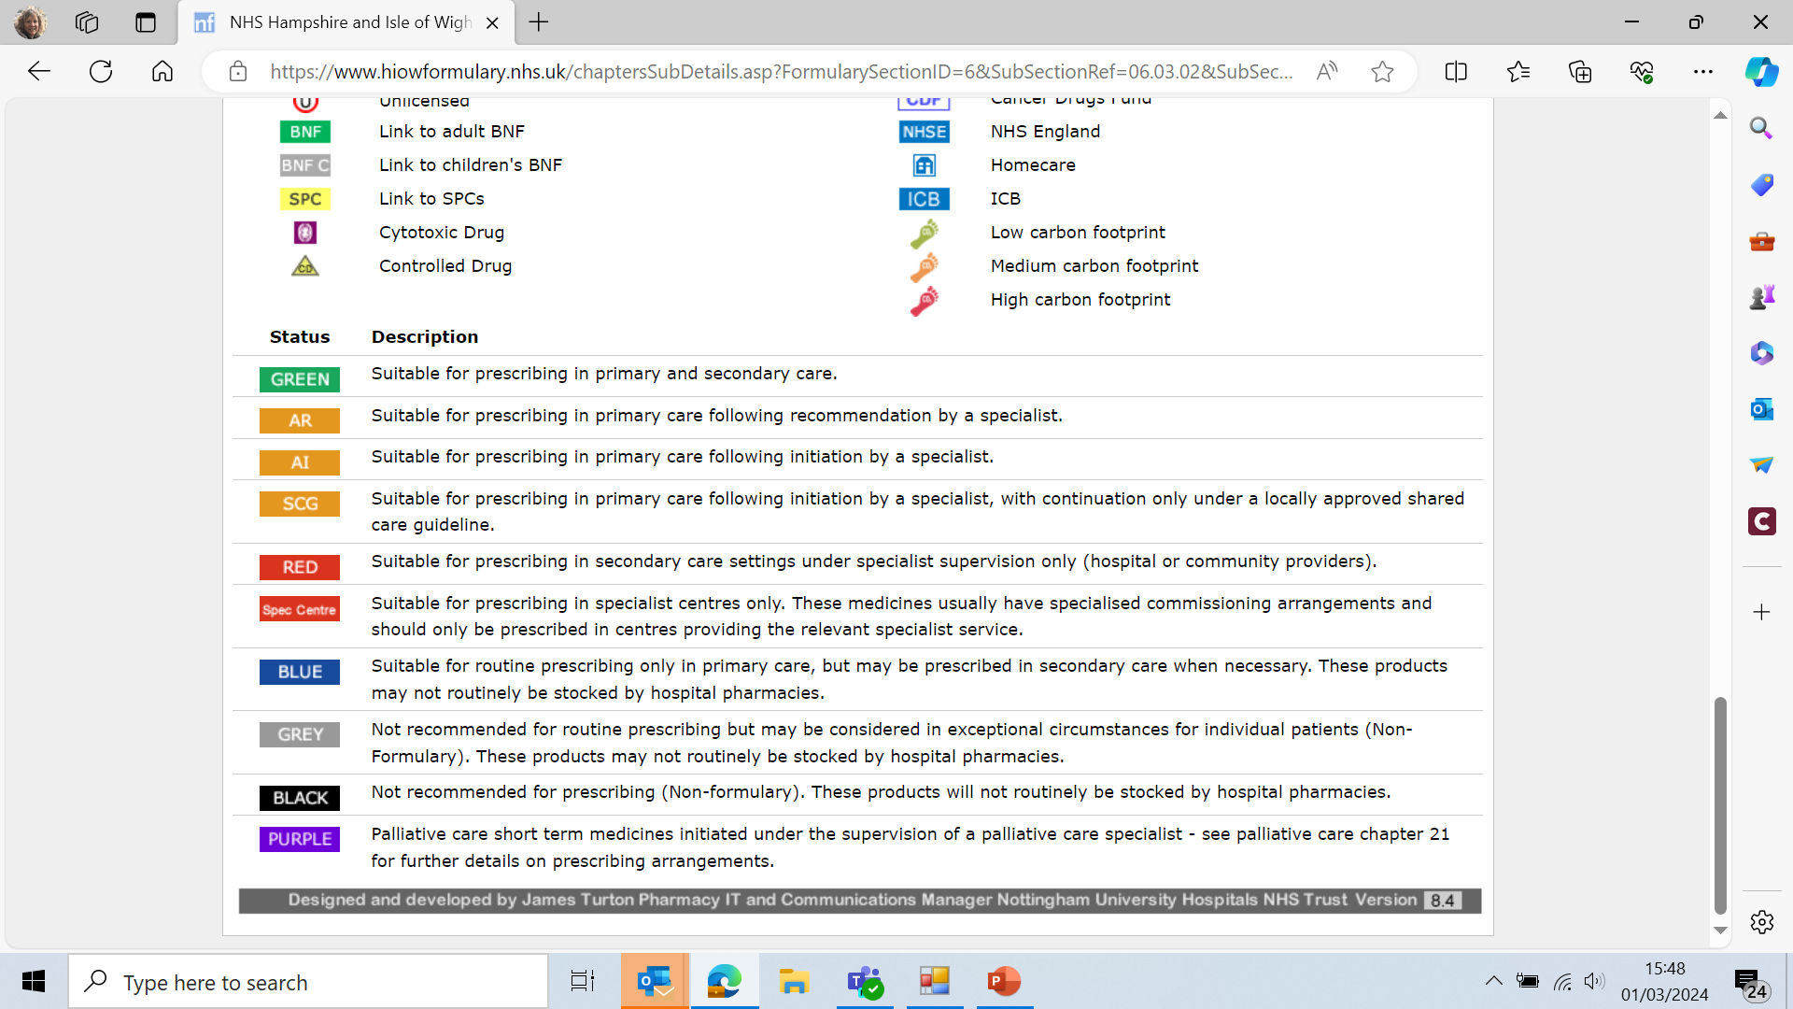

Slide 22
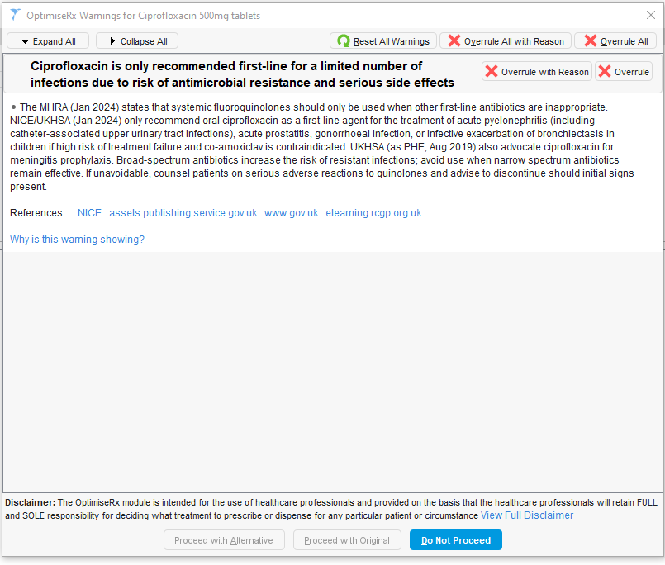
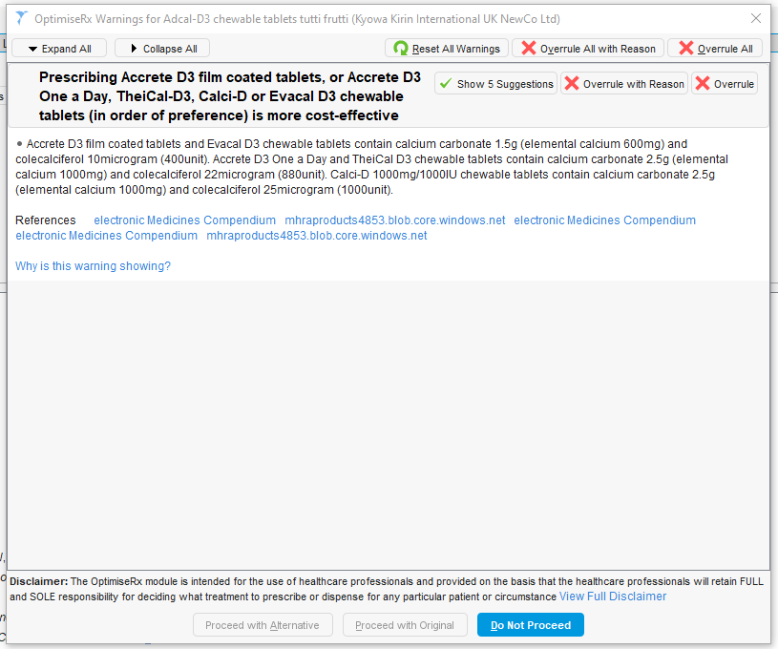
Optimise Rx

Slide 23
Optimise Rx– best practice and safety
Optimise Rx is a primary care clinical decision support tool to promote
cost-effective prescribing
formulary compliance
evidence-based prescribing
Behaviour change

Slide 24
Optimise Rx– best practice and safety
Core content
created and maintained by First data bank team of clinical pharmacists, technicians, clinical informaticists and researchers,
uses the latest published best practice guidance as reference source e.g NICE, MHRA, NHSE
content Team can prepare bespoke messages to support adherence to local prescribing guidance
messages developed nationally but local HIOW profile
Reports – practice level
Acceptance rates
Cost avoidance

Slide 25
Optimise Rx– best practice and safety
During 2023, a total of 835 best practice messages were active across Hampshire & Isle of Wight practices,
Best practice message example:
Co-prescription of an additional nephrotoxic drug in patients already at risk of acute kidney injury was avoided on 5405 occasions by presenting to prescribers just as they were about to issue a potentially harmful drug.
Message: Antimotility agents should be avoided in C. difficile due to longer retention of C. difficile toxins in the gut and risk of worsening the disease. Trigger: Patients recorded with C. difficile infection within 31 days, prescribed antimotility drugs.

Slide 26
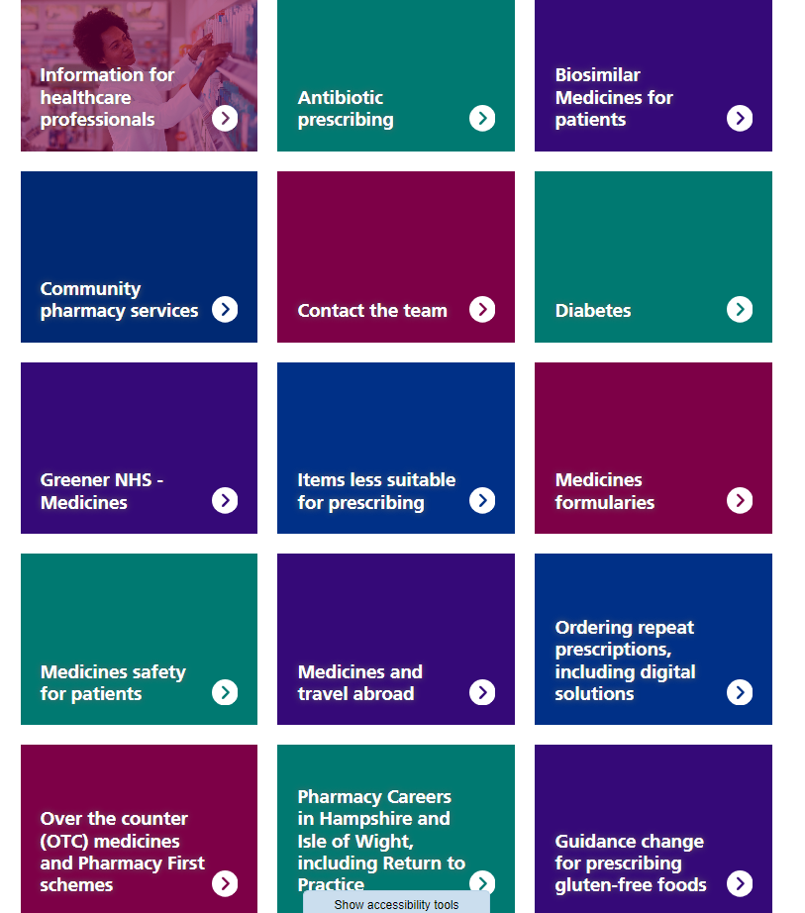
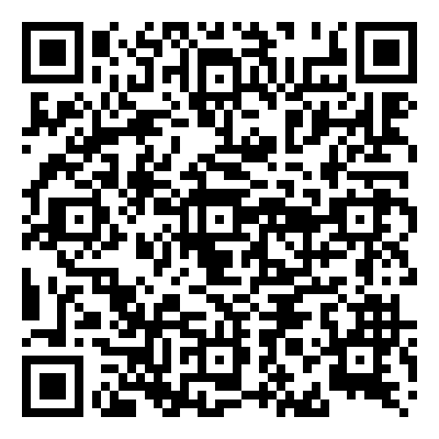
Hampshire and IoW Medicines Optimisation Website
https://www.hantsiowhealthandcare.org.uk/ your-health/medicines-optimisation
Patient Resources

Slide 27
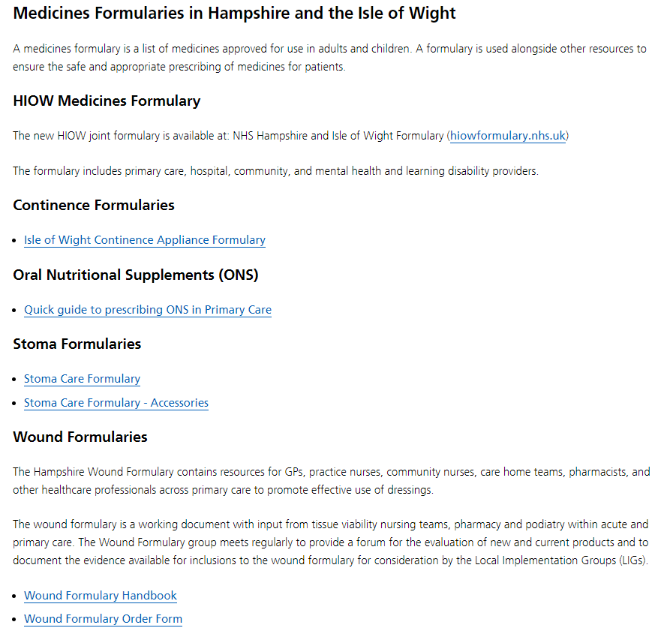
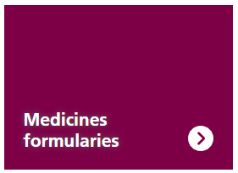
Formularies
Notes:
Wound formulary handbook- most up to date will be kept here.

Slide 28
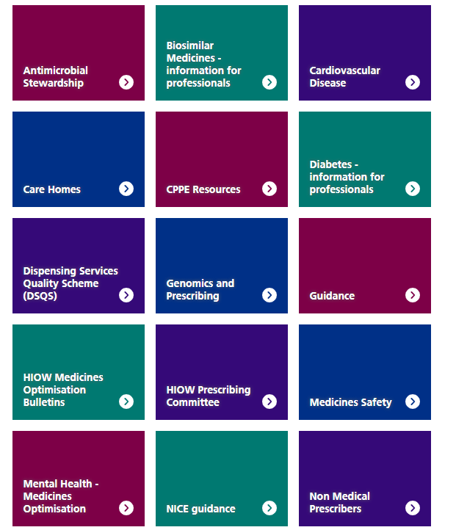
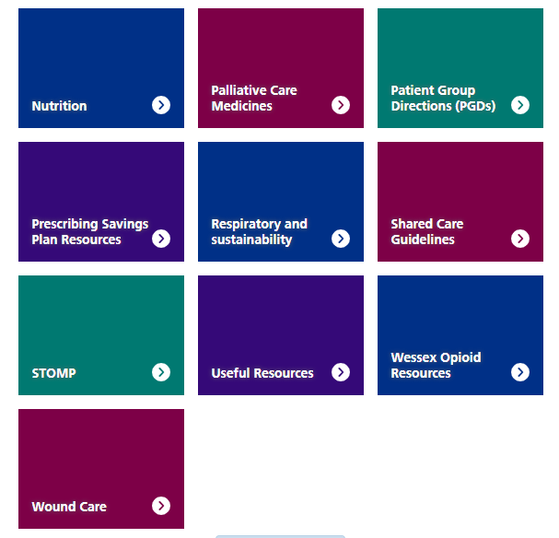
Information for Healthcare Professionals
Notes:
Bulletin – search function, monthly summary from NICE and safety, in FYI Friday, distribution list, meds op newsletter

Slide 29
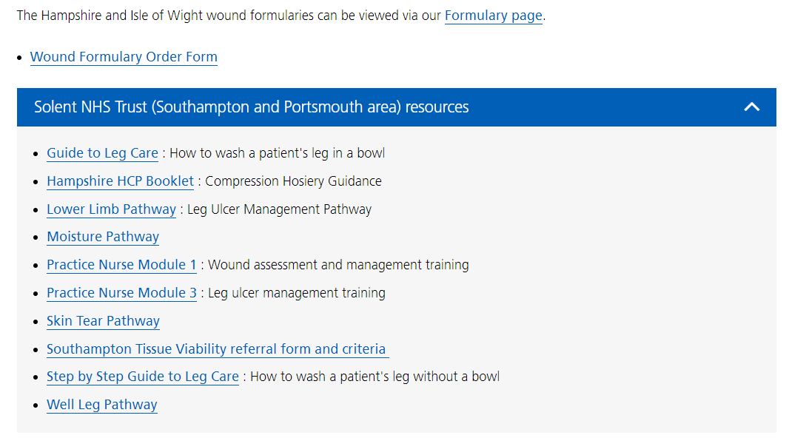
Wound Care

Slide 30
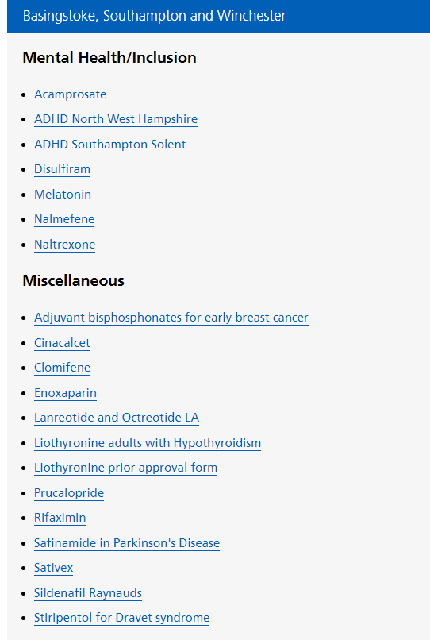
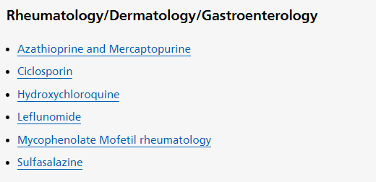
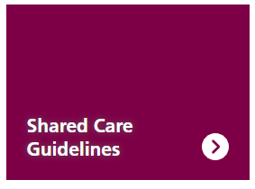
Shared Care Guidelines

Slide 31
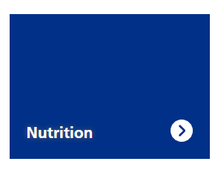
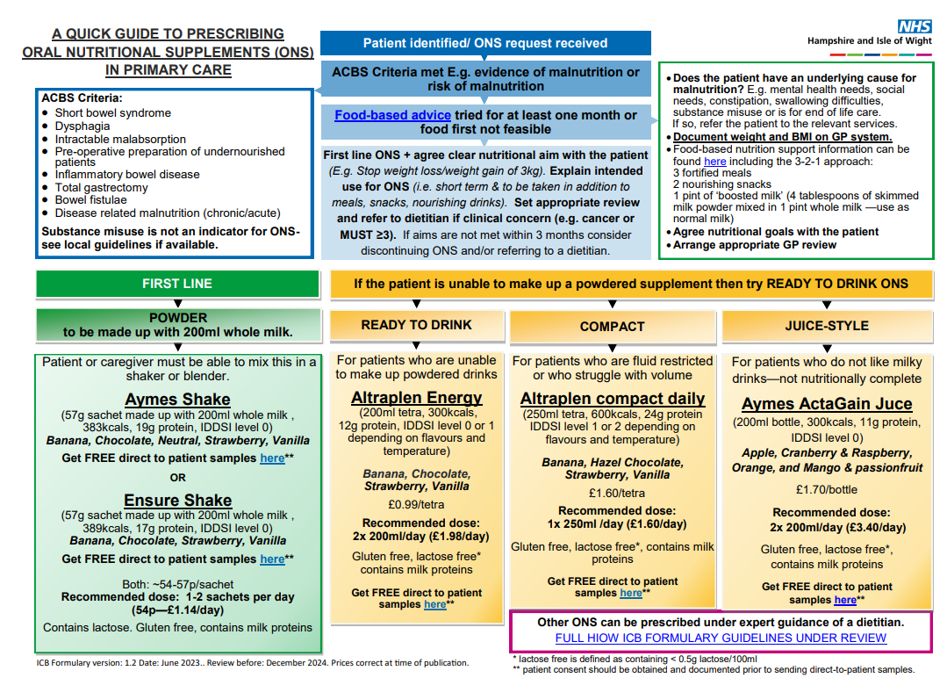
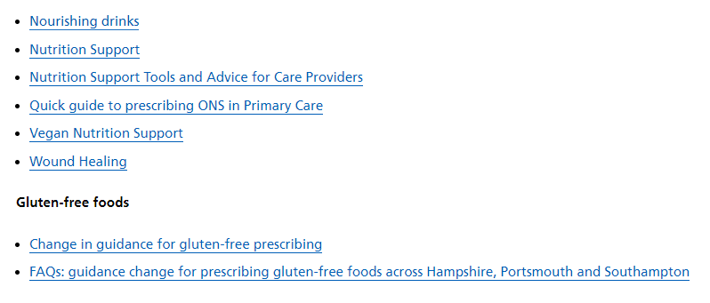
Notes:
Can you promote the ACBS indications • Short bowel syndrome • Intractable malabsorption • Pre-operative preparation of patients who are undernourished • Proven inflammatory bowel disease • Following total gastrectomy • Dysphagia • Bowel fistulae • Disease related malnutrition
ONS are very much a short-term temporary measure which need monitoring. They should be used after food fortification has been encouraged for a reasonable length of time as per the guidance.
Monitoring should include weights where possible and mid upper arm circumferences if not possible. People should stick to the ones below, and if they feel further supplements are needed to refer to the local dietetic department.

Slide 32
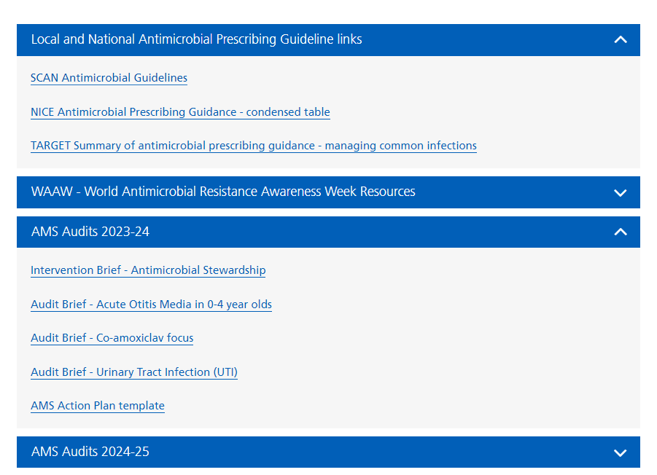

Slide 33
Southampton Medicines Optimisation Team
Andrea White – Head of Medicines Optimisation
Sue Wakelin – Medicines Optimisation Lead Pharmacist
Vicki Rowell – Pain Medicines Management Pharmacist
Fran Branford – Pharmacist
Tin Orchel – Pharmacist
Kerry Gregory – Pharmacy Technician
Vicky Newman – Pharmacy Technician
Carol Glen – Pharmacy Technician
Nicki Avenell –Care Home Pharmacy Technician
Michelle Sutcliffe – Dietician
Generic Email: hiowicb-hsi.so.medicinesmanagement@nhs.net

