Slide 1
Nurse Plenary Session
Southampton Target
Thursday 7th March 2024
Helena Blake, Holly Hartley
Primary care quality team HIOW ICB Hampshire place.

Slide 2
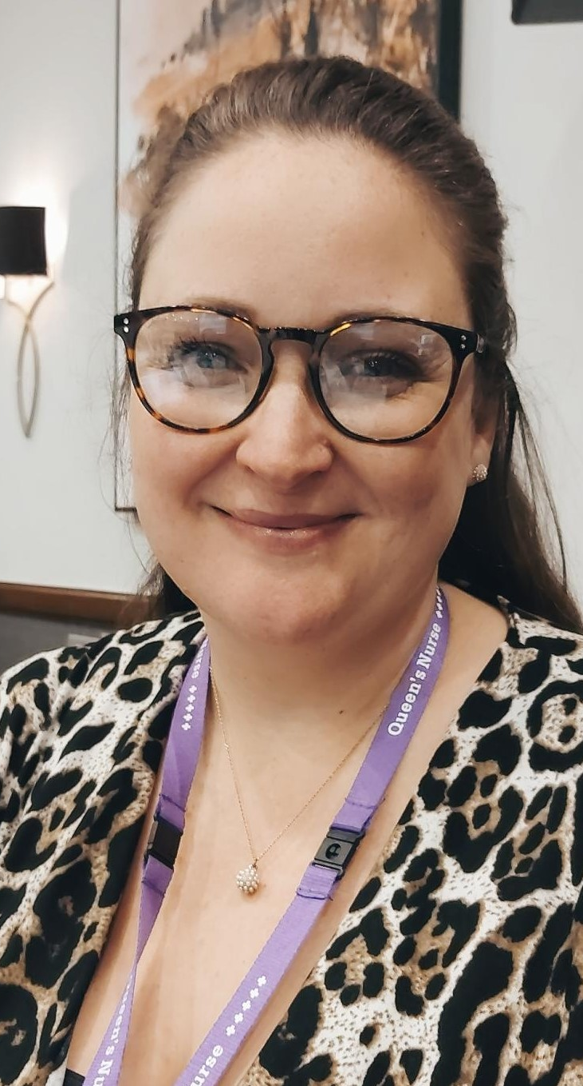
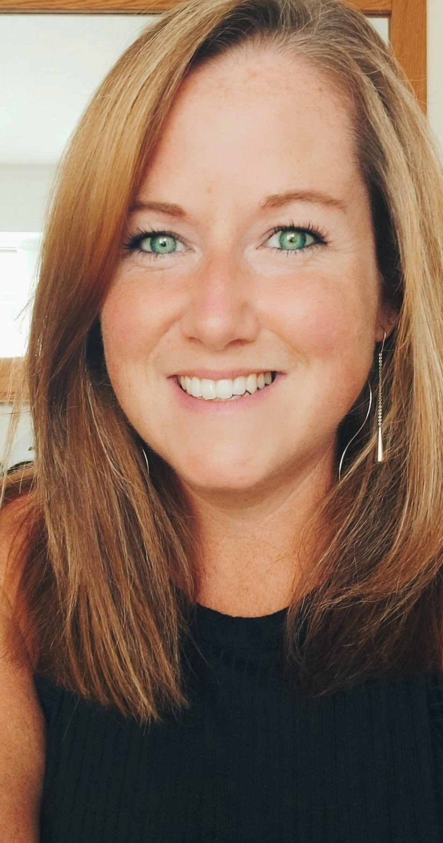
Primary Care Quality Hampshire Place
Helena Blake RN, BSc (Hons), Queens Nurse
Quality Manager – Primary Care
Holly Hartley RGN (adult) Queens Nurse
Clinical Quality Nurse Facilitator for Primary and Community Care

Slide 3
Important Date for the diary
GPN/HCA Network Forum Tuesday 12th March 1300-1400 MS Teams
Denise Woodd RN, BSc (Hons), NDN, Independent Clinical Nurse Specialist, Leg Ulceration & Woundcare+ NHS Portsmouth ICB
Discussion regarding recent LCS, and NICE guidance re automated dopplers.

Slide 4
Quality standards for emergency management in primary care

Slide 5
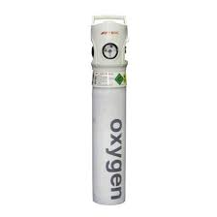
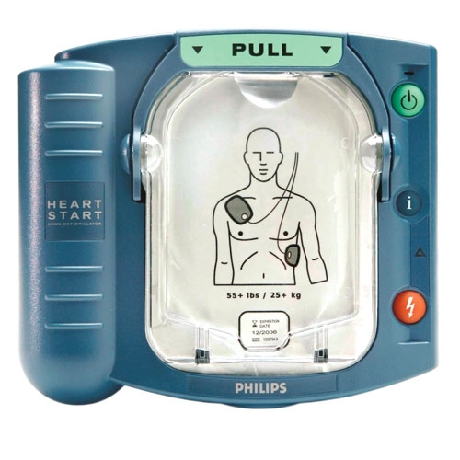
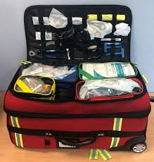
How often should you be checking your defibrillator, oxygen and emergency drugs?
Who should be checking it?

Slide 6
Who should be BLS trained in your practice?
How often should this be updated?

Slide 7
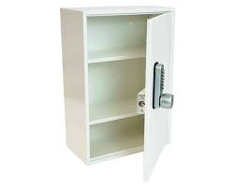
Should your emergency drugs be locked away?

Slide 8
A member of the public comes to reception and asks to use your defib for a person who has collapsed down the road. What do you do?
Say no, the equipment is expensive and may get lost or damaged but offer to call an ambulance.
Hand over the defib without delay. Asking them to return it.
Take the emergency drugs trolley, including the defib and assess the situation yourself.

Slide 9
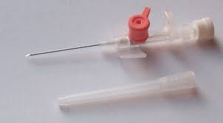
You used to cannulate in your old role 3 years ago. A patient now requires IV fluids in an emergency.
Should you cannulate?
What other factors need to be
considered?

Slide 10
Aside from a CPR emergency situation. What other emergency situations may arise in practice and are you prepared?

Slide 11
Quality Standards: Primary Care
Quality Standards: Primary care | Resuscitation Council UK
Quality standards
Practices should have:
immediate access to appropriate resuscitation equipment and drugs when needed
a way for all staff to call for help
staff who are trained to use equipment according to their roles
local risk assessment overseen by a designated resuscitation lead
personal protective equipment (PPE) and sharps boxes
a reliable system to check and replace equipment that follows the manufacturer's instructions.
GP mythbuster 1: Resuscitation in GP surgeries - Care Quality Commission (cqc.org.uk)
GP mythbuster 9: Emergency medicines for GP practices - Care Quality Commission (cqc.org.uk)

Slide 12
Training of staff
All GP surgeries must be equipped to deal with a medical emergency, including resuscitation.
Resuscitation Council UK recommends primary staff (including non-clinical staff) All staff should be trained in adult and child resuscitation as appropriate and understand their responsibilities in an emergency, including recognising a cardiorespiratory arrest, call for help, where to find equipment and medicines, start CPR with defibrillation as appropriate and receive annual updates that include assessment.
Staff should undergo such training at induction and at appropriately frequent, regular intervals thereafter to maintain knowledge and skills.
All training must be recorded (training database).
A system must be in place for identifying any resuscitation equipment that requires special training, and for ensuring that such training takes place.
Hands-on training and updates should use simulation including assessment is recommended for clinical staff.
Quality Standards: Primary care | Resuscitation Council UK
CQC 2022 & Resus Council UK 2021

Slide 13
Primary Care equipment and drugs lists
Primary care providers must under a risk assessment to determine what resources are required in their local circumstances. Factors to consider:
Patient Groups.
Likelihood of cardiopulmonary arrest
Training of staff available at any specific location.
Ambulance response time to provide more advanced equipment and life support skills.
The risk assessment should be overseen by a designated resuscitation lead (usually GP partner). Expert advice should be sought from those involved frequently in resuscitation (resus officers/ED/ambulance).
Quality Standards: Primary care | Resuscitation Council UK
CQC 2022 & Resus Council UK 2021

Slide 14
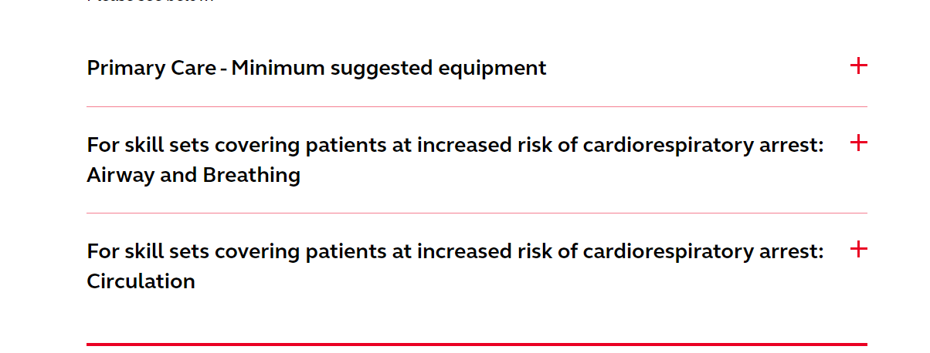
Emergency equipment
Minimum suggested equipment
The following items should be available for immediate use:
automated external defibrillator (AED)
adhesive defibrillator pads – spare set also recommended
oxygen, including cylinder with key and tubing where necessary
pocket mask (adult) with oxygen port – this may be used inverted in infants
protective equipment where necessary
stethoscope
absorbent towel – to dry chest if necessary
razor – to shave chest to apply pads if needed
GP mythbuster 1: Resuscitation in GP surgeries - Care Quality Commission (cqc.org.uk)
https://www.resus.org.uk/library/quality-standards-cpr/primary-care-equipment-and-drug-lists
There is also a list of equipment for clinicians trained to deal with patients at increased risk of cardiorespiratory arrest.

Slide 15
Emergency drugs
Drug | Indication
Adrenaline for injection | Anaphylaxis or acute angio-oedema
Antiemetic – for example cyclizine, ondansetron, metoclopramide or prochlorperazine | Nausea and vomiting
Aspirin soluble tablets | Suspected myocardial infarction
Atropine for practices that fit and remove intrauterine devices or perform minor surgery | Bradycardia / vasovagal syncope
Benzylpenicillin for injection | Suspected bacterial meningitis
Dexamethasone 5mg/2.5ml oral solution- requires date opened stick and new expiry once seal broken (or soluble prednisolone – NOTE off-label use) | Croup (children)
Diclofenac (intramuscular injection) | Analgesia
Glucagon (needs refrigeration. GlucaGen® Hypokit® has an 18 month expiry out of fridge - should be labelled with new expiry date) or alternative medicine to treat hypoglycaemia. | Hypoglycaemia
Glyceryl trinitrate (GTN) spray or unopened in date GTN sublingual tablets | Chest pain of possible cardiac origin
Midazolam (buccal) or diazepam (rectal) | Epileptic fit
Naloxone (see section below) | Opioid overdose
Opiates – diamorphine, morphine or pethidine ampoules for injection. (Water for injection may be required to reconstitute) | Severe pain including myocardial infarction
Salbutamol either nebules with a nebuliser or inhaler with Volumatic and ipratropium bromide (children) - consider strengths stocked. | Asthma
The list of medicines is not exhaustive or mandatory. We expect practices to use this as a baseline. Practices should be able to show they have considered the risk and local context when deciding which medicines to stock, including emergency medicines which may be used in remote triage first approaches. Any assessment of risk should include the reasons why a particular medicine on the suggested list is not required or a substitute used. This should be kept under review.
GP mythbuster 9: Emergency medicines for GP practices - Care Quality Commission (cqc.org.uk)

Slide 16
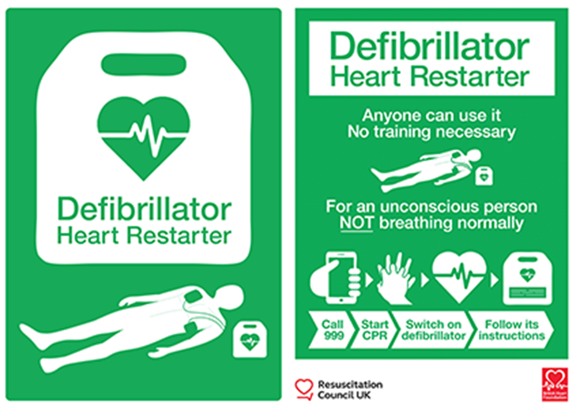
Other considerations.
Signage must be used in order to reduce any delays in locating a defibrillator and emergency equipment/drugs in an emergency. Guidance: Standard sign for AEDs | Resuscitation Council UK
All staff must have means of calling for help (mobile/landlines/alarm bell/panic button).
Equipment should be single use and latex free and have a decontamination procedure for non-disposable equipment.

Slide 17
Resuscitation Council UK has received queries following inspections by the Care Quality Commission (CQC), regarding the storage and availability of emergency drugs on resuscitation trolleys.
Resuscitation trolleys should not be locked or kept in locked rooms or cupboards.
Resuscitation trolleys should contain all drugs and equipment recommended for immediate access in the event of an emergency such as cardiac arrest.
All resuscitation drugs must be stored in tamper-evident containers.
A systematic check of the contents of all resuscitation trolleys must be performed at least daily, with documentation of the findings, of any resulting action needed, and of that action being completed.
All healthcare provider organisations should have a robust system to ensure that evidence of theft or tampering is reported immediately, a prompt and appropriate investigation is instigated, and remedial action taken if required.
The potential vulnerability of resuscitation trolleys must be recognised by healthcare provider organisations; this should be included in their risk register, and appropriate policies and procedures to manage the risk should be in place.

Slide 18
Oxygen and Pulse Oximetry
Oxygen is a treatment for hypoxaemia, not breathlessness, and should be prescribed according to a target saturation range with monitoring.
Pulse oximetry must be available in all locations where emergency oxygen is used.
Staff who administer oxygen should be suitably trained.
Practice need appropriate pulse oximeters for adults and paediatric patients.
Asthma/COPD
The BTS/SIGN British Guideline on the management of asthma states:
Controlled supplementary oxygen should be given to all hypoxemic patients with acute severe asthma titrated to maintain a SpO 2 level of 94-98%.
For patients with known hypercapnic respiratory failure (CO 2 retainer), aim for oxygen saturation of 88% to 92%.
https://www.brit-thoracic.org.uk/quality-improvement/guidelines/asthma/

Slide 19
What CQC Inspect
Regulations
We use these regulations when we review if the practice is safe, effective, responsive, caring and well-led. This guidance relates to:
Regulation 12 (Safe care and treatment)
Regulation 18 (Staffing)
Resuscitation in GP Surgeries
We consider how practice staff respond to emergencies, and how they recognise and manage patients who are:
critically ill
at risk of deterioration
in cardiac or respiratory arrest.
We expect each GP practice to have a named resuscitation lead to make sure:
staff have access to resuscitation advice, training and practice
quality standards are maintained
equipment is checked regularly.
Emergency Medicines in GP Practices
We would expect to see evidence that an appropriate risk assessment has been carried out. This is to identify a list of medicines that are not suitable for a practice to stock, and how this is kept under review. There should be a process and system in place to check that drugs are in date and equipment is well maintained.
It is part of our key lines of enquiry (KLOEs). In particular:
S2: Managing risks
S3: Safe care and treatment
S4: Medicines management
GP mythbuster 1: Resuscitation in GP surgeries - Care Quality Commission (cqc.org.uk)

Slide 20
All organisations providing primary care should have appropriate equipment and drugs for managing other life-threatening emergencies.
Choking
Sepsis
Hypoglycaemia
Anaphylaxis

Slide 21
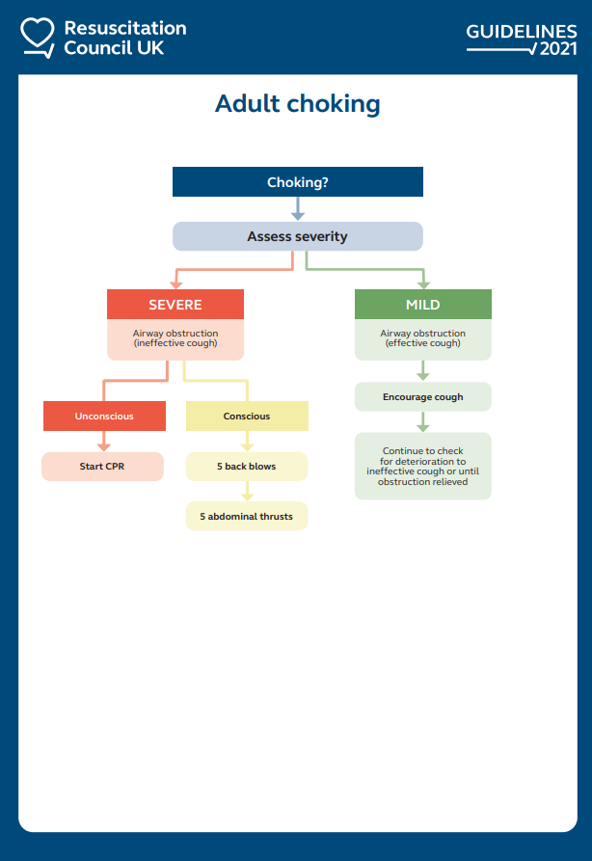
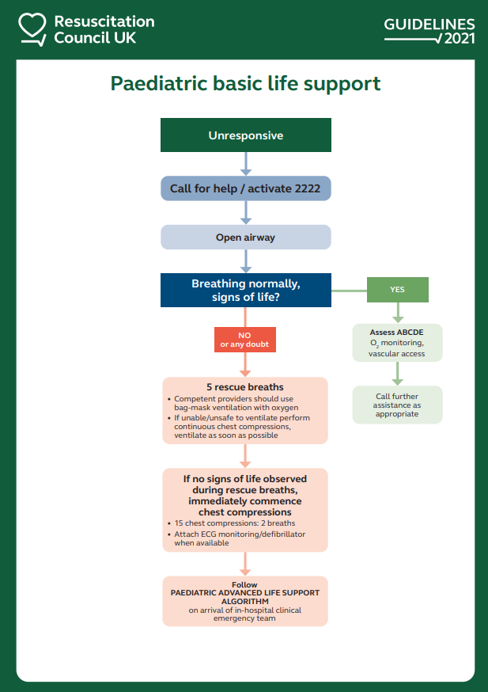
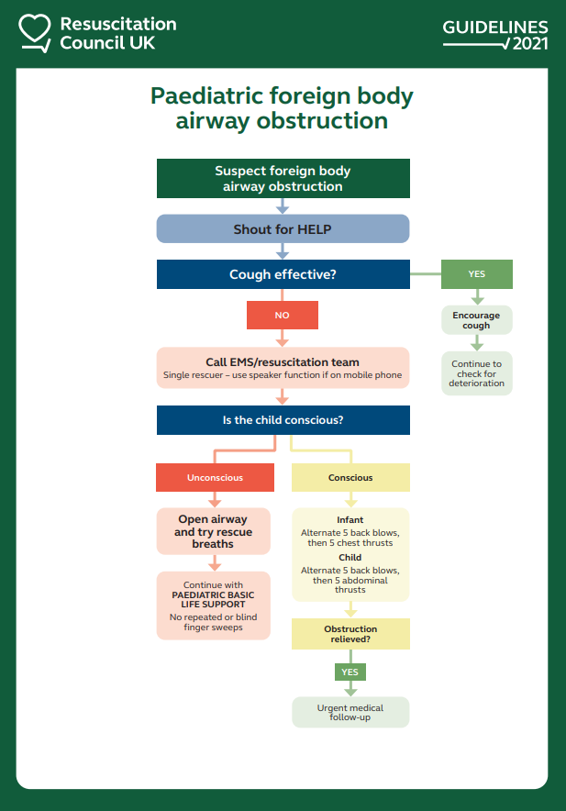
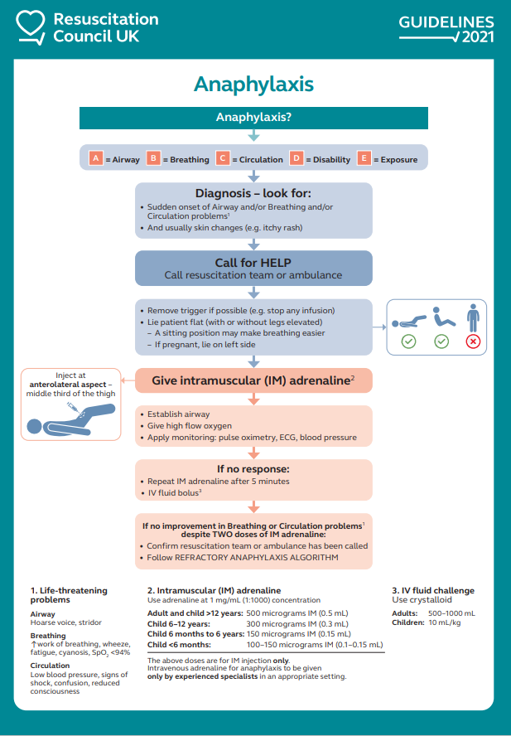
Resuscitation Algorithms
2021 Resuscitation Guidelines | Resuscitation Council UK
MANAGEMENT OF ANAPHYLAXIS IN THE VACCINATION SETTING Guidance Aug 2021.pdf

Slide 22
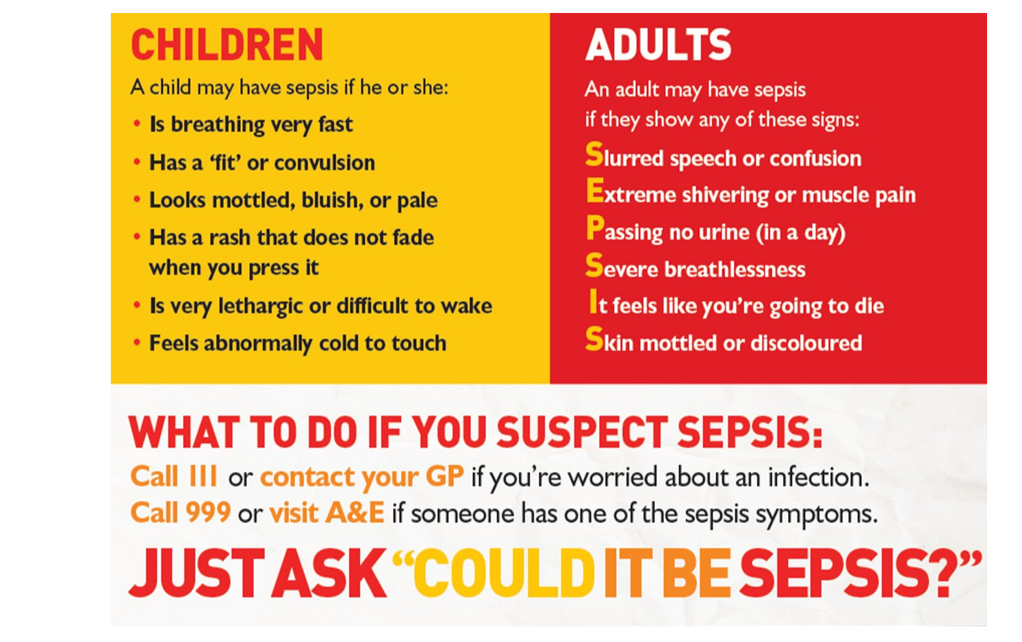
Sepsis
Early detection of sepsis is vital and therefore it is important that all practice staff can identify sepsis and act appropriately.
All staff (clinical and non-clinical) need to be able to act appropriately, this includes on reception desk, triage, admin contacts as well as clinical contacts.
Sepsis toolkit: Clinical resources and guidance for practices (rcgp.org.uk)
GP mythbuster 88: Identifying and responding to sepsis - Care Quality Commission (cqc.org.uk)

Slide 23
Key messages
Know the guidance/quality standards.
Is your resus trolley fit for purpose? Accessible? Movable? 3 separate bags? Is it all together?
Are all staff familiar with the resus equipment? Do they know what they are grabbing?
Do you have a local risk assessment for emergency equipment and drugs you need/do not need?
Have you considered simulation in your practice?
Do you know where your panic buttons are? Is it easy to get help?
Do you have a robust process for checking the emergency equipment and drugs weekly and is this documented?
If any advanced equipment or drugs are required, how do staff maintain/evidence skills/competence to use them?
The lists are not exhaustive. Local experts should be consulted to ensure that appropriate equipment and drugs are available when they are needed, to enable provision of high-quality attempted resuscitation.

Slide 24
Any Questions?

