Slide 1
Healthier You
Xyla Health & Wellbeing
NHS Diabetes Prevention Programme - Target
Presented by Clare Kavanagh
Contact details:
Clare.kavanagh2@nhs.net
07855 973359

Slide 2
What is the Healthier You: NHS Diabetes Prevention Programme (NDPP)?

Slide 3
What is the NDPP?
Diabetes UK
Office for Health Improvement & Disparities (OHID)
NHS England & Improvement (NHSE&I)
Reduce incidence of Type 2 Diabetes-Mellitus (T2DM)
Reduce weight in overweight/obese individuals or maintain a healthy weight
Reduce blood glucose parameters

Slide 5
Eligibility criteria
✔️18 to 80-years old*
✔️Registered with a GP practice
✔️Previous history of Gestational Diabetes Mellitus (GDM) and normoglycemia
✔️Non-diabetic hyperglycaemia (NDH)
HbA1c of 42-47 mmol/mol (6.0 –6.4%) or a Fasting Plasma Glucose (FPG) of 5.5 –6.9 mmol/l within the 12 months
HbA1C <42 mmol/mol within the past 12-months
Please also bear in mind the motivation to change and commitment level of patients when referring!
*GPs of service users (SUs) >80-years-old must provide written confirmation that they perceive the benefits to attending outweigh the risks

Slide 6
Exclusion criteria
❌ Previous diagnosis of T2DM
❌ Active eating disorder
❌ Severe/moderate frailty
❌ Undergone bariatric surgery in the last 2 years
❌ Pregnant…
❌ <18-years-old

Slide 7
Gestational Diabetes - Post birth
Post birth diabetes testing
7x Increased risk in women with gestational diabetes developing type 2 diabetes in later life.
(Diabetes UK)
50% of women diagnosed with gestational diabetes develop type 2 diabetes within 5 years of the birth.
(NICE)
Recommendations: FPG at 6 weeks post-partum OR a HbA1c 13 weeks post-partum - to check Normoglycaemia status.
Refer patient to the National Diabetes Prevention Program
https://preventing-diabetes.co.uk/gestational-diabetes/
Notes:
Statistics from Diabetes UK state that there is a seven-fold increased risk in women with gestational diabetes developing type 2 diabetes in later life. NICE state that up to 50% of women diagnosed with gestational diabetes develop type 2 diabetes within 5 years of the birth.
Breast feeding – 13 weeks.

Slide 8
GDM Eligibility Criteria
✔️18- 80 years *
✔️Registered with a GP practice
✔️Previous history of Gestational Diabetes Mellitus (GDM)
✔️Non-diabetic hyperglycaemia (NDH)
✔️GDM Referral
Normoglycaemic
<42 mmol/mol within the past 12-months
No Blood Test
HbA1c of 42-47 mmol/mol (6.0 –6.4%) or a Fasting Plasma Glucose (FPG) of 5.5 –6.9 mmol/l within the past 12 months
(Normal Referral Pathway)
✔️ If currently pregnant
(placed on hold 1 month –post birth)
*If you are over the age of 80, please request a referral from your GP
Notes:
For gestational diabetes, you will have been informed of this by your midwife team.

Slide 10
What are the key benefits of the NDPP to the practice and patients?

Slide 11
Why is NDPP Important?
Reduced Pressure on the NHS
HbA1c Changes
Diabetes care and management cost the NHS 10% of its annual budget, approximately £14 billion a year
Annual saving of £1,800 - £2,500 per patient
Fewer GP appointments
Less unnecessary hospital admissions
Reduces the need to prescribe medication to patients
76% reduce HbA1c (initial assessment to end of programme review)
Average reduction of 2.4 mmol/mol
EWMS Applicable service
£11.50 per referral
QOF benefits

Slide 12
Service user outcomes
70%
39%
<5%
-4kg
Of service users who are overweight or obese lose weight
Of completers lose a minimum of 5% of their body-weight
Difference in completion rates between ethnic minority groups compared to white ethnic groups
Mean weight change from programme start to MS4

Slide 13
Case Studies – HIOW specific case study now available
88%
94%
96%
99%
Of patients said the NDPP helped them to improve their exercise habits
Of patients said the NDPP helped them to improve their diet and eating habits
Of patients said they feel more positive for having attended the NDPP
Of patients said they would recommend the NDPP to other people who are identified as being at risk of Type 2 Diabetes

Slide 14
How is the NDPP delivered?

Slide 15
NDPP service model
If an SU misses a F2F session they are invited to a remote catch up so they don’t miss out.
12-month support package
Discharged from service
Fortnightly group sessions
1-6 followed by monthly group sessions 7-13 (F2F)
Patient triaged based on choice and individual need
Initial Assessment
(IA)
Same as above, but on Microsoft Teams
End of programme review
One-to-one phone-based coaching through smartphone apps and telephone calls
Notes:
At Xyla we believe in patient choice and our triage process ensures that you find the correct delivery option that will work for your preferences and individual needs.
We have three delivery options available.
Our primary offer is a face to face service, you will have an initial assessment followed by 6 fortnightly and 7 monthly group sessions. There is also a final end of programme review to ensure you have all the support you need for success after the programme. In the event you miss a session we offer remote catch up sessions over MS Teams. This ensures you don’t miss out on important content and keep up your momentum.
For those who may have additional needs such as needing a language group or groups tailored for those with visual or hearing impairment we have our tailored remote service which is held over MS Teams. We also provide a tailored group for those with a history of gestational diabetes. These sessions allow use of accessibility features to aid learning and enhance the programme experience. These sessions also include an initial assessment and end of programme review as with the face to face service.
Finally we have our digital 1-1 service, support is provided via the us of an app and telephone sessions.
It is extremely important that we support you for continued success after the programme. For our programmes we have developed an extended support package which includes 12 months of unique webinars with our expert Dietitians, Clinical Psychologists and Physical Activity Leads, covering topics such as:
Disordered eating and comfort eating
Body image
Addressing barriers to physical activity
Weight maintenance and managing fluctuations

Slide 16
What does the NDPP cover?
Risk factors for T2DM
Impact of mental and physical stress on the body and how this causes elevated levels of blood glucose
Beneficial long-term behaviour changes
Factors contributing to elevated blood glucose levels
What to eat to achieve nutritional balance for optimal health
The required amount of daily movement for optimal health and how this can be achieved
The impact of poor quality or insufficient amounts of sleep on your health

Slide 17
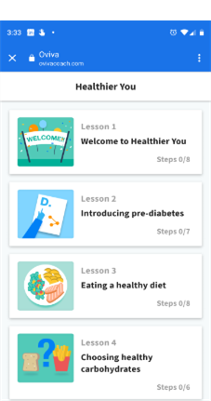
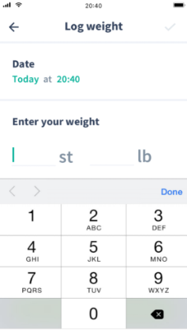
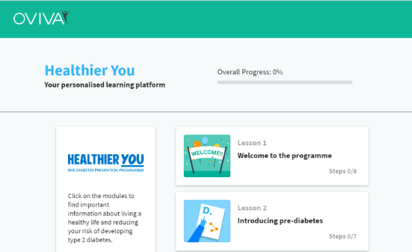
The Digital Service
Delivered by Oviva
1:1 approach
Access to a personal coach
Flexible and convenient appointments
Access to secure app
Xyla Health & Wellbeing
Notes:
T2Day work 18-39

Slide 18
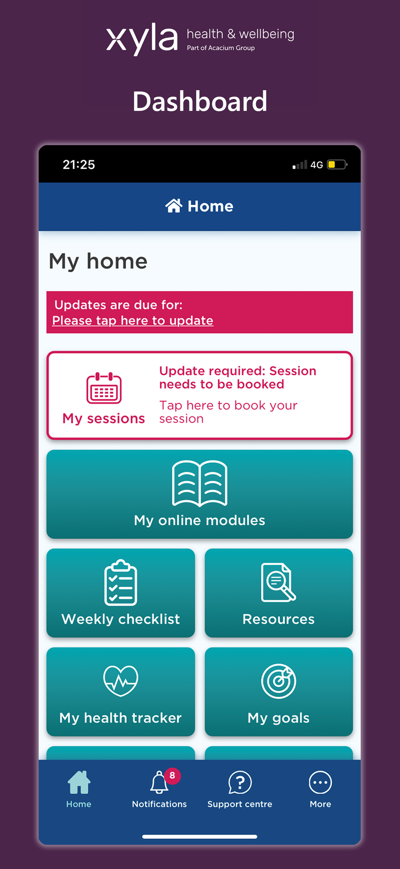
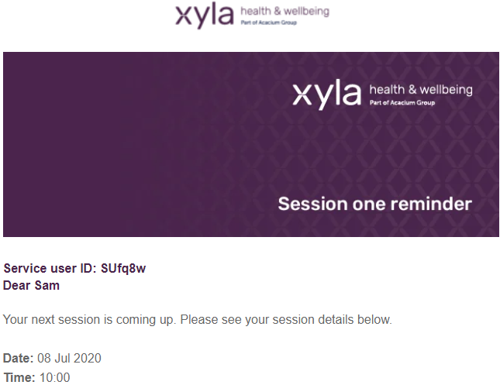
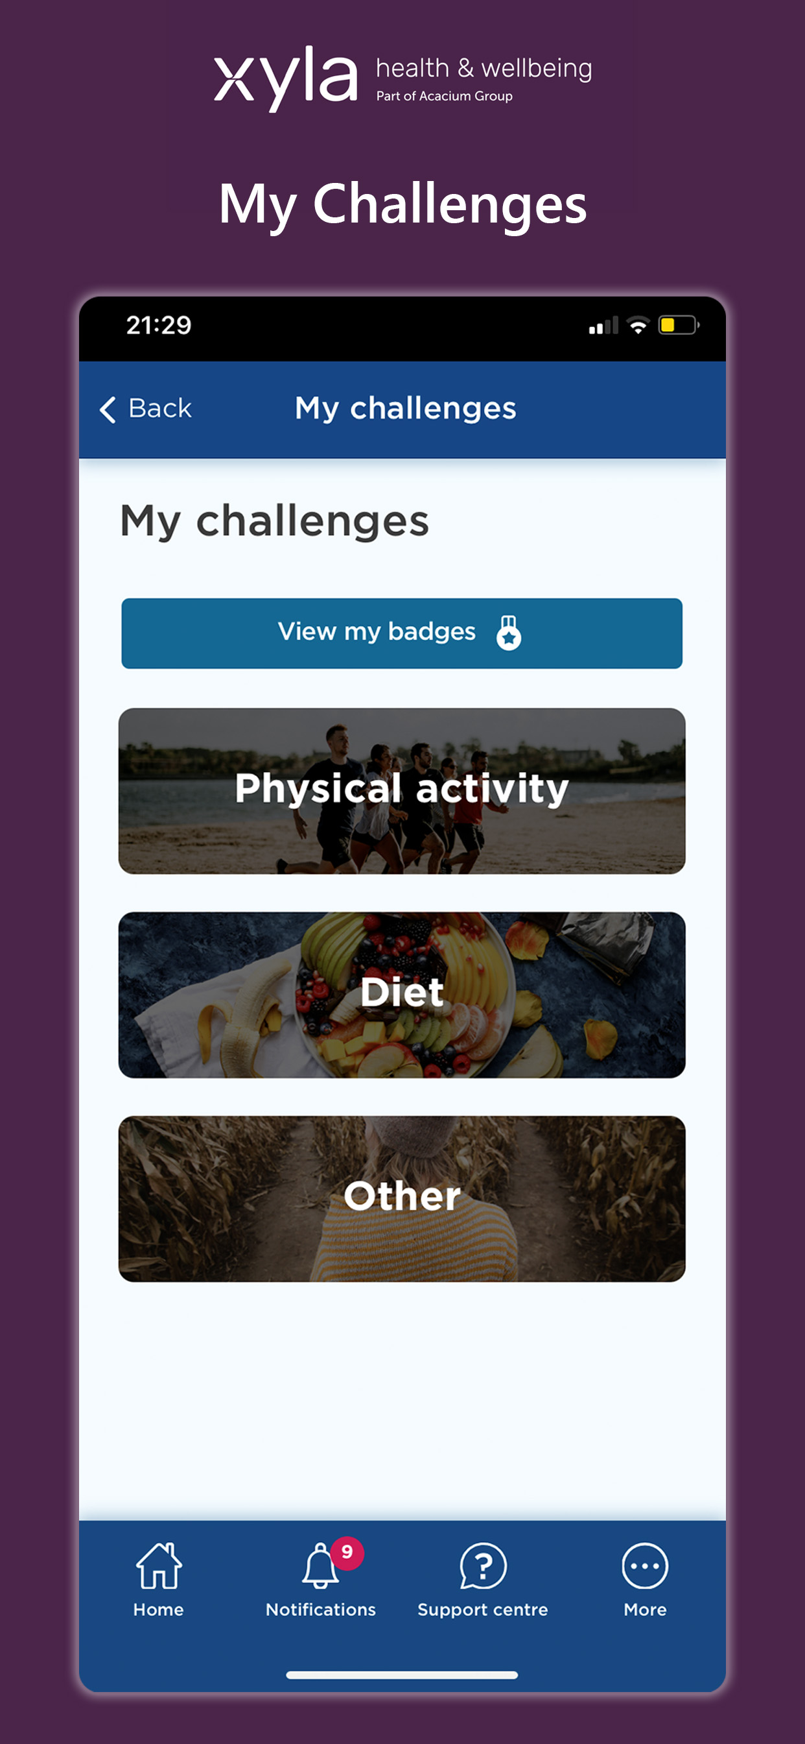
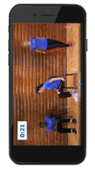
Service users have access to
E-learning platform
SMS/email reminders
H&W app
5 handbooks available in 16
different
languages
Local signposting pack
Physical activity video

Slide 19
How can I promote the NDPP in my role/practice?

Slide 20
Patient Information Sessions
We offer patient information sessions via Microsoft Teams* to provide patients with an overview on what to expect from the programme. Each session lasts approximately 30minutes and cover topics such as:
What is the Programme/Eligibility criteria/What are the different delivery models?
Which one is right for me/Stages of the programme and what next?
Session topics and resources/Support you will receive on the programme
Patient stories/Frequently asked questions
Q & A
Eventbrite link to share with your patients: https://bit.ly/PatientInformationSessionNDPP
Please note attending this session does not mean a patient has been referred to the programme and we will not cover any medication changes that may be required to begin the programme. If they wish to be referred once attending this session patients will need to contact their practice.
*Sessions can be delivered in GP practices - please speak to Xyla Health and Wellbeing if you wish to arrange this

Slide 21
Support for staff Learning opportunity for practices NDPP Lunch & Learn Sessions are always every third Thursday of the month 12.30 – 1pm on Teams, so if you can't make this next one hopefully you can join us at a later date… https://bit.ly/LunchLearnNHSDPP

Slide 22
NHS Diabetes Prevention Programme Best Practice Guide
Identification
Proactive, opportunistic identification of eligible patients via health check or general check-up, requesting HbA1c test where prediabetes is suspected. Staff groups that could do this are GP, Nurse, Pharmacist, Physicians Associate …
Regular review of clinical systems searches – to identify those who may be at risk. Our guide will assist you to run and cleanse your report. Staff groups that could do this are GP, Nurse, HCA, Pharmacist, Physicians Associate and Administrator

Slide 23
How to utilize staff more effectively
GP, Nurse, Pharmacist and Physicians Associate can review the blood test result
Clinician can task the nurse to invite the patient onto the programme and code them as NDH
Clinician or nurse tasks reception team to submit the referral
GP, Nurse, HCA, Pharmacist, Physicians Associate and Administrator can conduct a monthly cleanse of the at-risk register using the search built by LHIS
Social prescriber or non-clinical healthcare professional can use the Know Your Risk Questionnaire for patients that may be at risk
You can contact ME to discuss further how you can implement this within your practice
Notes:
Here are some examples of how practices have utilised their whole team more effectively
NDH – help support you with achieving QOF targets

Slide 24
Supportive Tools/self registration:
Example Text/Letter Wording. Please make sure to manually input the details highlighted in red for each patient
NHS DPP Support Guide
This guide contains information on:
How to submit a direct referral via PRISM
What SNOMED codes to add to patient’s record
Where to find patient leaflets
Patient progress emails format
Search information for prediabetes and GDM
Templates for bulk letter invitations
SystmOne Example
Text 1
A recent blood test shows you have an increased risk of developing Type 2 Diabetes and are eligible to join the NHS Diabetes Prevention Programme. To self refer, please visit the link: https://preventing-diabetes.co.uk/referral/ or call Xyla on 0333 577 3010. Please use the information in the following text
Text 2
Your latest results are:
HbA1c level: XXmmol/mol
Sample date: XX/XX/XX
NHS Number: XXX XXX XXXX
If you would like to book a consultation/or call with a member of the practice team to discuss this further, please contact the surgery
Patient Leaflet
Notes:
These resources will be shared after the session

Slide 25
NHS Diabetes Prevention Programme Best Practice Guide
Following Up
1
2
Make sure that any patient updates from Xyla are coded in the patient record. This helps you identify remaining eligible patients more easily and to record their progress. Updates will be sent from xylahealth@nhs.net to your generic practice email and any other nominate email (to add nominated email, please contact Clare)
Once a patient complete the programme, book them in for a blood test to review the patient’s progress and to motivate them to continue their positive lifestyle changes long-term

Slide 26
How can we support?
What support can we provide to Primary Care?

Slide 27
Supporting Primary Care – eg HCA Pilot etc
Resources
Additional Support
Advice
Clinical Systems support guide
How to complete direct referral
How to keep patient coding up to date
Where to find leaflets
SystmOne Protocol
Waiting room poster
Waiting room video
PDF leaflets
Group Consultations
Support in overcoming barriers
Share best practice – what's worked well in other practices
Overcoming barriers
What's worked well in other practices
Common patient objections
Notes:
https://vimeo.com/manage/videos/783238403
PDF leaflets can be located using the steps in the systmone /EMIS guide but we’ll circulate all the resources after the session
Attach leaflet to text

Slide 28
Thank you for attending. I hope you found this useful.
Any Questions?
Notes:
Any feedback pop it in the chat. Respond to you directly. Leave name and email in the chat

Slide 29
Feedback️​
Please scan the QR code to provide feedback on your training today
Thank you for helping us improve our training
Notes:
Post https://www.surveymonkey.co.uk/r/T8KQ7JW in the chat box too

Slide 30
Southampton City Target Presentation Referrals to date (30.01.24)
Referrals by Locality per/1000
Locality | Highest by Surgery % Per/1000 | Average by locality % Per/1000
IOW | 13.9 | 7.5
North Mid | 17.9 | 10.9
Portsmouth | 12.5 | 5.7
South East | 17.7 | 7.9
South West | 24.9 | 7.4
Southampton | 10.7 | 6.0

Slide 31
NHS – T2DR Path to Remission

Slide 32
T2DR Video Resources:
Service intro video
https://vimeo.com/894458417
Case study video
https://vimeo.com/804191347
De-prescribing video (8.35 min Medication Adjustment Guidance)
https://vimeo.com/901079758

Slide 33
NHS Type 2 Diabetes Path to Remission Programme – Commencement Date 1st April. Next steps: Signpost to a T2DR information session Would you like to hear more about the NHS Path to Remission Programme and how we could support you? Then why not sign up to one of our upcoming Patient Information Sessions. This programme is a free service commencing on the 1st April in HIOW. Information sessions are available to join for now: https://bit.ly/PatientInformationSessionT2DR NHS Staff Lunch & Learm information session T2DR sessions are always every third Tuesday of the month, 12:30–1pm on Teams, and will cover a programme overview and referral process, so if you can't make this next one hopefully you can join us at a later date: 19th March https://bit.ly/LunchLearnT2DR
Notes:
Please note attending this session does not mean a patient has been referred to the programme and we will not cover any medication changes that may be required to begin the programme. If they wish to be referred once attending this session patients will need to contact their practice.
*Sessions can be delivered in GP practices - please speak to Xyla Health and Wellbeing if you wish to arrange this

Slide 34
T H A N K Y O U
Facebook: https://www.facebook.com/xylahealth/
LinkedIn: https://www.linkedin.com/company/xyla-health-and-wellbeing/mycompany/
Twitter: https://twitter.com/xylahealth/
clare.kavanagh@xylahealth.com
07855 973359

