Slide 1

Living, dying, remembering

Slide 2
Mountbatten Awareness Session
Duncan Fleming
Director of Quality, Data & Information
Living, dying, remembering

Slide 3
Agenda:
Background to Hospices
Mountbatten today
Some challenges and some solutions
Services
Where does the money come from?
Feedback
Living, dying, remembering

Slide 4
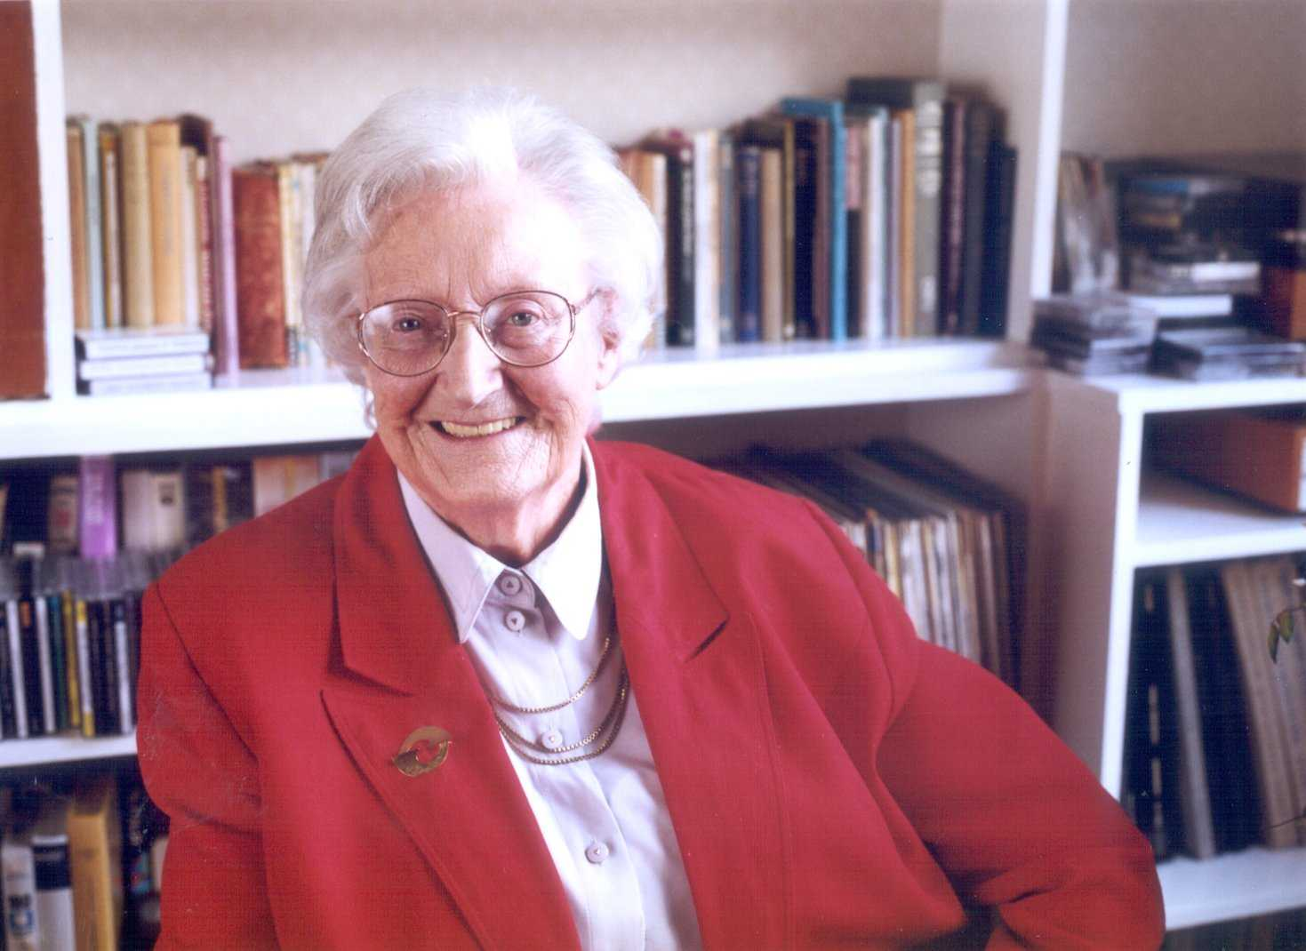
Background
A Revolution
Dame Cicely Saunders, OM, who founded St Christopher’s Hospice in 1967 and whose vision continues to influence the work of UK hospices (1918 – 2005)
Living, dying, remembering

Slide 5
Background – Components of pain (WHO)
Cancer
Non cancer pathology
Side effects of therapy
Symptoms of debility
Chronic fatigue
PHYSICAL SOURCE
Bureaucratic
bungles
Friends – let down
Delays in
diagnosis
Unavailable doctors
Therapeutic
failure
Loss of:
Social position,
Job,
Income
Role in family.
Helplessness
Disfigurement
Insomnia
DEPRESSION
Total pain
ANGER
ANXIETY
Fear of pain; hospital, death
Loss of dignity; control, bodily function
Uncertainty – future
Worry about family
Guilt, sadness, spiritual unrest

Slide 6
Mountbatten today
Vision
Our vision is of a world where all dying people and those close to them have access to expert compassionate and cost-effective care of the highest quality, whatever the illness, whoever they are and wherever they happen to be
Living, dying, remembering

Slide 7
Mountbatten, Hampshire
Merger April 2019
Two separate charities – one SMT and governance structure
NHS run for over 40 years
Challenges
Funding – costs around 11m per annum
Southampton City and West Hampshire (includes Eastleigh, Romsey, Winchester, Bishop’s Waltham, Hamble etc.)
Rebranded from Countess Mountbatten Hospice to Mountbatten, Hampshire April 2020
Living, dying, remembering

Slide 8
Where the money comes from?
NHS | 30%
Legacies | 30%
Voluntary donations & fundraising | 25%
Mountbatten Shops | 6%
Other | 9%
Living, dying, remembering

Slide 9
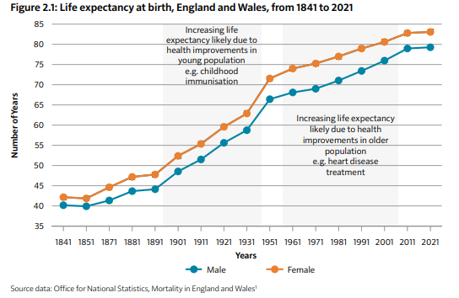
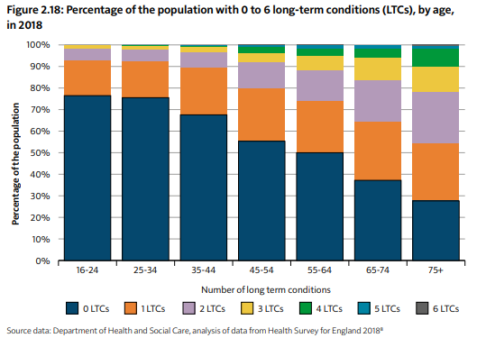
Mountbatten’s challenges
Living, dying, remembering

Slide 10
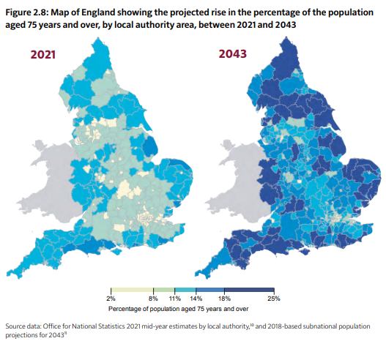
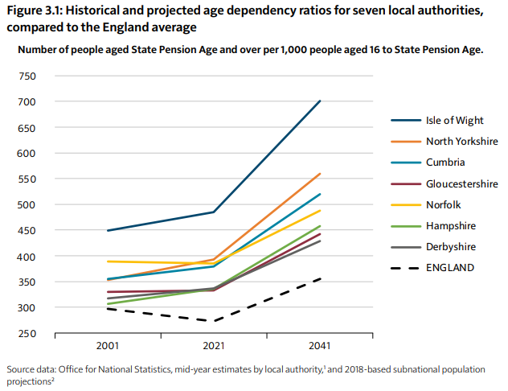
Mountbatten’s challenges
Living, dying, remembering

Slide 11
People needing Palliative Care (CSI 2017)
If figures continue to rise the same as during 2014 – 25.4% rise in need by 2040
If figures continue to rise at same rate as between 2006 – 2014 – 42.4% rise by 2040
Dementia – 59,199 in 2014 to 219,409 in 2040
Cancer – from 143,635 in 2014 to 208,630 in 2040
Although numbers with co-morbidities unknown
Living, dying, remembering

Slide 12
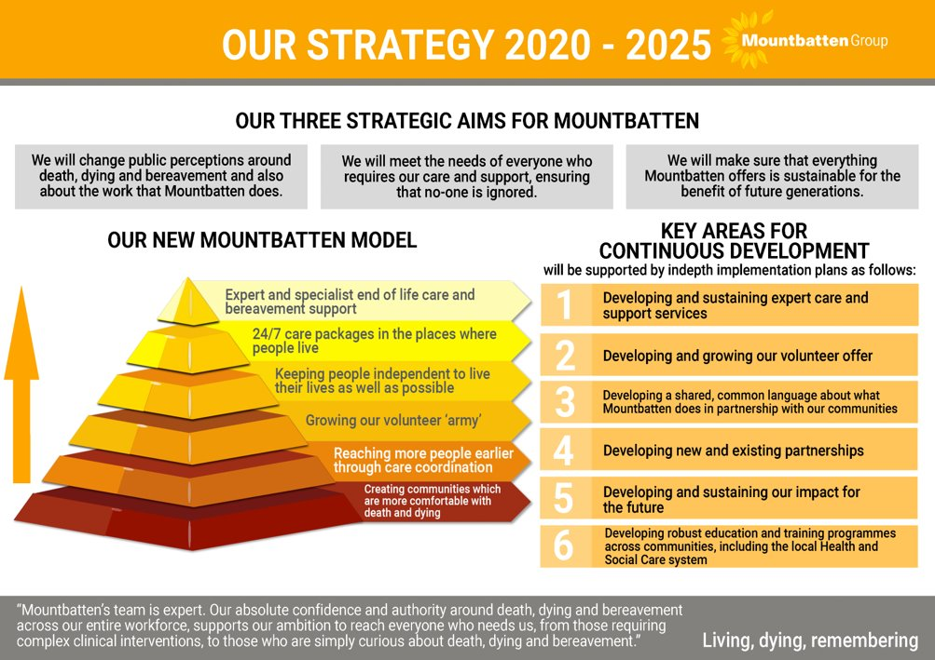

Slide 13
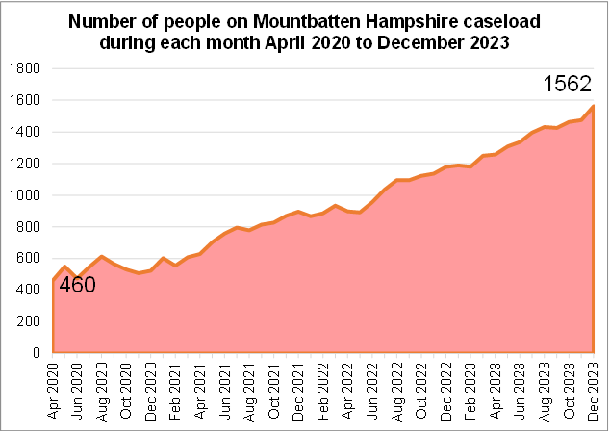
The future is now…
Living, dying, remembering

Slide 14
Multi-professional Team
Volunteers
Nursing
Rapid Response
Personal Care
Hospital
Team
Food
catering
Pharmacy
Spiritual care
Medicine
In-patient
Unit
Hazel Centre
Arts &
Complementary
Therapies
Community
(incl. Hospital)
Education
Sharing knowledge, skills and values
Allied Health
Professions:
Occupational therapy
Physiotherapy
Social Work
Administration:
Finance
HR
Reception
Records
Transport
Retail/
shops
Fundraising
Communication
Psychology
and
bereavement

Slide 15
Services: Community
Supporting over 1300 people at any one time in the places that they live
Generalists and Domiciliary Care
Care Coordination – last 5 years of life (last phase of life)
24/7
Rapid Discharge Coordination
Advance Care Planning
Living, dying, remembering

Slide 16
Services: Inpatient Care
21 beds for adults
Support for families
Nurse led beds – change in focus
Discharge Co-ordinator at UHS
Living, dying, remembering

Slide 17
Services:
Hazel Centre
Day and Outpatient Services
New Café
Social Programme
Open 5 days, 9-5, with plans to increase opening times
Christmas Day
Living, dying, remembering

Slide 18
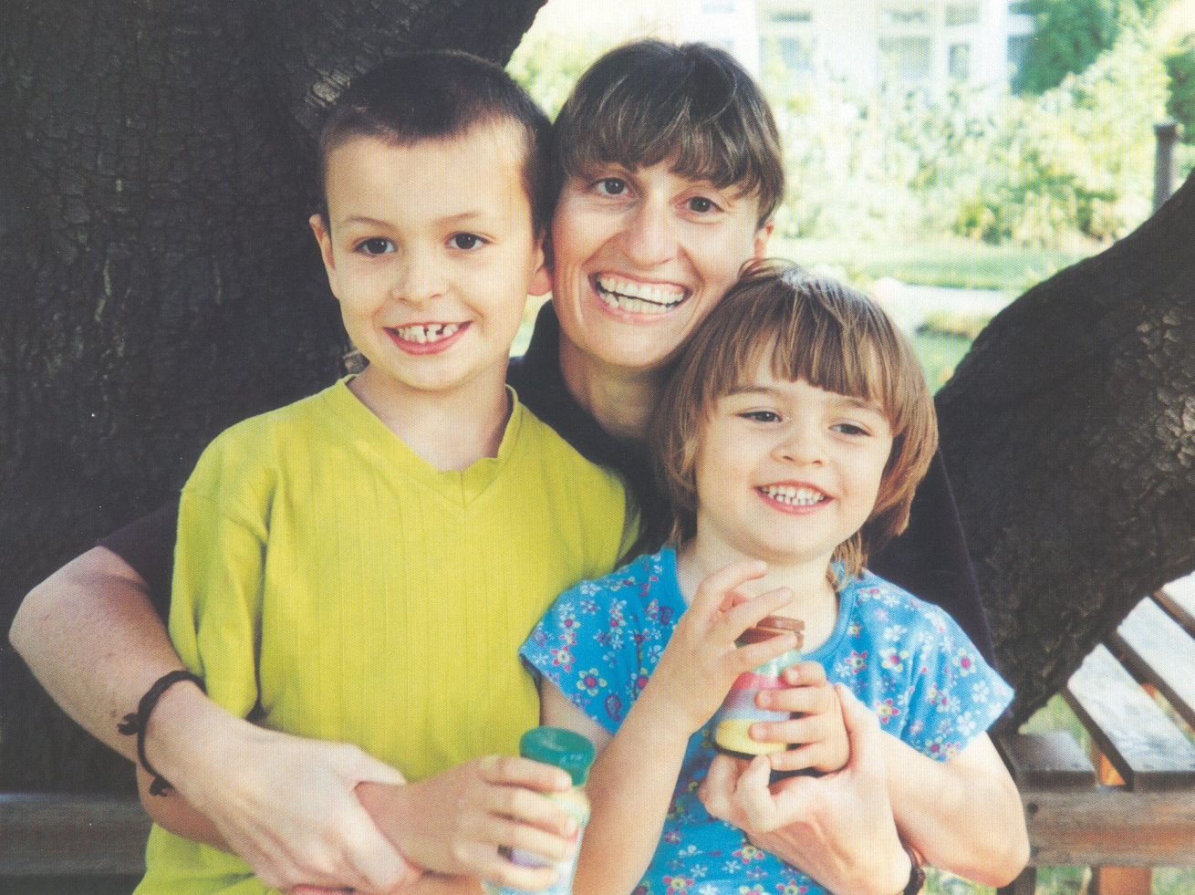
Services: Bereavement
Including children, family and adult service
Anyone who has suffered a bereavement can be referred
Groups and family focussed
Virtual/Telephone advice
Training to others
Living, dying, remembering

Slide 19
Feedback
“We were in hell. In and out of hospital, meeting so many different professionals, nurses, doctors, carers etc. We couldn’t work out who was who… you (Mountbatten) arrived and this all changed. One expert team, all from the one place… relief, clarity, understanding and hope… it sounds strange to say, but because of this, the last weeks of my brother’s life were some of the best we ever had with him… thank you…’
Sister of a Mountbatten at Home patient
Living, dying, remembering

Slide 20
Feedback
‘Thank you for visiting when you said you would, you turned up every time we expected you. Thank you for coming in the middle of that last night and staying until the morning. Thank you for making sure we were all comfortable and for the encouragement to eat at a time when we could not think to take care of ourselves. Thank you for washing my husband and helping us to dress him in his favourite pyjamas, to comb his hair and to clean his teeth. Thank you that we have such good memories of the last night of his life, where all was calm and contentment. Thank God for the kindness of your team and thank God for the kindness of this community who continue to support what you do and what we need; without you and them we would not have got through this…’
Wife of a Mountbatten at Home patient
Living, dying, remembering

Slide 21
…It has been said that history alternates between charisma and routinisation. In this context, charisma refers to the ability of exceptional individuals to act as a
catalyst for social change, and acknowledges the impact of personality in bringing about radical innovation in institutions and established beliefs. The question for us today is: Is palliative care in danger of moving from the creative and disruptive influence of charisma to the cosy ambiance of routinisation? Palliative care services, even in Britain, generally have not yet reached their full holistic potential. But movements tend to become monuments. So the best tribute we can give…is to make sure that hospice, that palliative care remains a movement
with momentum…
Robert Twycross 2006
The Revolution continues…
Living, dying, remembering

Slide 22
Mountbatten Stories
Your Mountbatten Stories (youtube.com)
Living, dying, remembering

Slide 23

Contact
Duncan Fleming
Director of Quality, Data and Information
Mountbatten
D. 01983 217302
E. duncan.fleming@mountbatten.org.uk
Living, dying, remembering

