Slide 1
Community Pharmacy Integration
Hinal Patel, Community Pharmacy Clinical Integration Lead, HIOW ICS
Email: Hinal.patel13@nhs.net

Slide 2
Hypertension Case Finding Service (HCFS)
Service live since 1st October 2021, 247 pharmacies ( 87%) signed up across HIOW
The service aims to:
Identify people with high blood pressure aged 40 years or older (who have previously not had a confirmed diagnosis of hypertension), and to refer them to general practice to confirm diagnosis and for appropriate management;
At the request of a general practice, undertake ad hoc clinic and ambulatory blood pressure measurements for adults of any age . These requests can be in relation to people either with or without a diagnosis s of hypertension and
Provide another opportunity to promote healthy behaviours to patients.
The service has two stages:
The first is identifying people at risk of hypertension and offering them blood pressure measurement (a ‘clinic check’).
The second stage, where clinically indicated, is offering 24 hour ambulatory blood pressure monitoring (ABPM). The blood pressure test results will then be shared with the patient’s GP to inform a potential diagnosis of hypertension.
Contractors opting to provide the service must undertake both stages of it, where clinically required, i.e. it is not possible to just undertake clinic BP readings and not ABPM.
Notes:
Hypertension case-finding service which was commissioned as an Advanced service from 1st October 2021. Currently 247 community pharmacy across ICB signed up to this Advanced Service

Slide 3
Inclusion Criteria for the service
Recruited by the pharmacy:
For the service to be a success, potential patients who meet the opportunistic inclusion criteria should be proactively identified. The inclusion criteria for opportunistic blood pressure checks are as follows:
• Adults who are 40 years old or over, who do not have a current diagnosis of hypertension.
• Patients, by exception, under the age of 40 who request the service because they have a recognised family history of hypertension may be provided the service at the discretion of pharmacy staff.
• Patients between 35 and 39 years old who are approached about or request the service may be tested at the discretion of the pharmacy staff.
The inclusion criteria for patients referred from the GP are as follows:
• Adults, of any age, with or without a prior diagnosis of hypertension, specified by a general practice for the measurement of blood pressure (clinic and ambulatory blood pressure checks). This process should be agreed locally with general practices.

Slide 4
Current data for HIOW
Eligible referrals that can be made into the Community Pharmacy HCFS
CVD Prevent data September 2023

Slide 5
Current data for Southampton
CVD Prevent data September 2023

Slide 6
Expansion of existing services
Recent announcement
There was relaunch of Blood Pressure check service from community pharmacy as off 1st December 2023.
Blood pressure check service ( Hypertension Case Finding service ) :
This service will be relaunched, and expansion of the service will mean pharmacies will deliver an additional 2.5 million blood pressure checks a year by Spring 2025.
It will be possible to use the wider non-registered pharmacy team members where staff have the appropriate training, are competent to deliver the service, and where this is legally possible.
All pharmacy contractors offering the services should ensure their pharmacy profile on Profile Manager is up to date to indicate that they provide the services.

Slide 7
Service finder update for HCFS
A service finder that allows people to search for and find pharmacies that offer free blood pressure checks has now been released on NHS.UK.
The finder can be accessed at the following link: Find a pharmacy that offers blood pressure checks
It takes people to a 'start page' that explains who is eligible to go to a pharmacy to get their blood pressure checked. This then takes users into the pharmacy finder where they enter a postcode, and they will get a set of results with the nearest pharmacy to them listed first.
There are also a few conditions pages on NHS.UK that have been updated to signpost to the blood pressure pharmacy finder. This will allow users to navigate to the finder if they are reading information about blood pressure. These pages are as follows:
High blood pressure (hypertension) - Overview and Diagnosis pages
Blood pressure test
What is blood pressure?

Slide 8
Post event messaging into General practice
Current process
Expected IT integration
In the recent announcement the IT changes that have been announced will mean that the service post event messaging will sit directly into patient records with the use of GP connect for the service provided into community pharmacy . This will provide opportunity for practices to work will their local pharmacies on the monitoring of BP for diagnosed hypertensives.

Slide 9
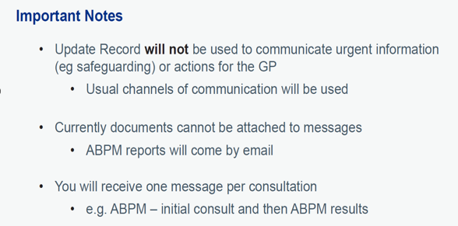
Digital Update
Expected to go live shortly

Slide 10
Digital Update
Expected to go live shortly

Slide 11
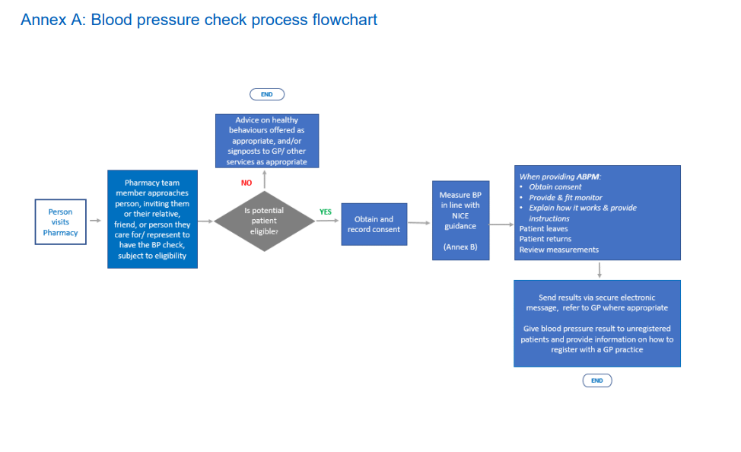

Slide 12
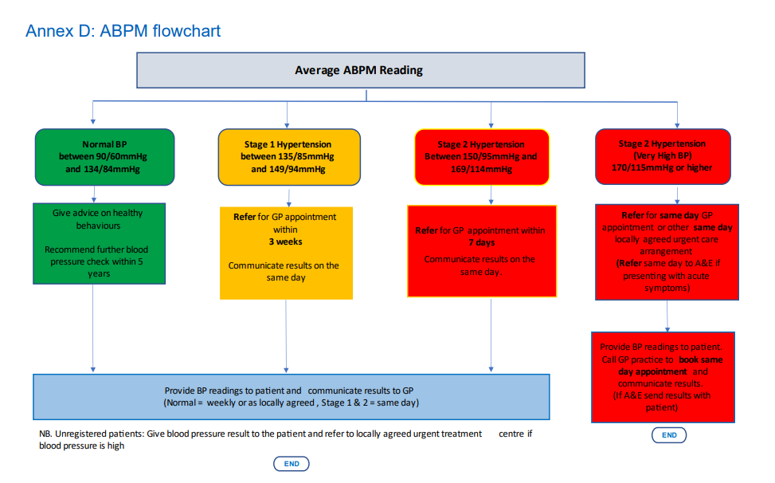

Slide 13
Useful Resources
Advanced service specification: NHS community pharmacy hypertension case-finding advanced service (NHS community pharmacy blood pressure check service) (england.nhs.uk)
Briefing 037/23: The Community Pharmacy Hypertension Case-Finding Service - A briefing for general practice teams - Community Pharmacy England (cpe.org.uk)
EMIS GP Connect Update Record - EMIS Web - GP Connect Update Record (emisnow.com)
TPP GP Connect Update Record - TPP SystmOne and Pharmacy First – TPP (tpp-uk.com)
The finder can be accessed at the following link: Find a pharmacy that offers blood pressure checks

Slide 14
Questions and Next Steps

