Slide 1
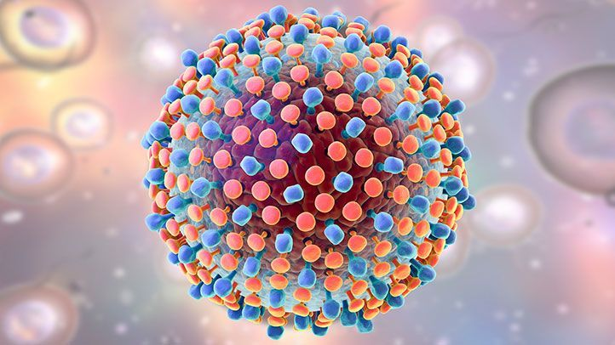
The Elimination of Hepatitis C in Southampton City Ryan Buchanan Associate Professor of Hepatology University of Southampton Honorary Consultant at UHS Hepatitis C Operational Delivery Network Lead Wessex

Slide 2
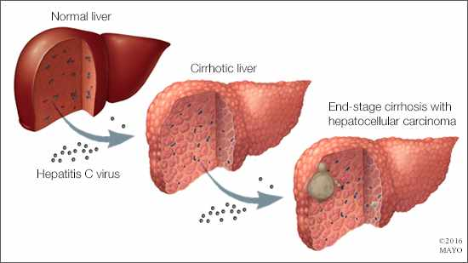

Slide 3
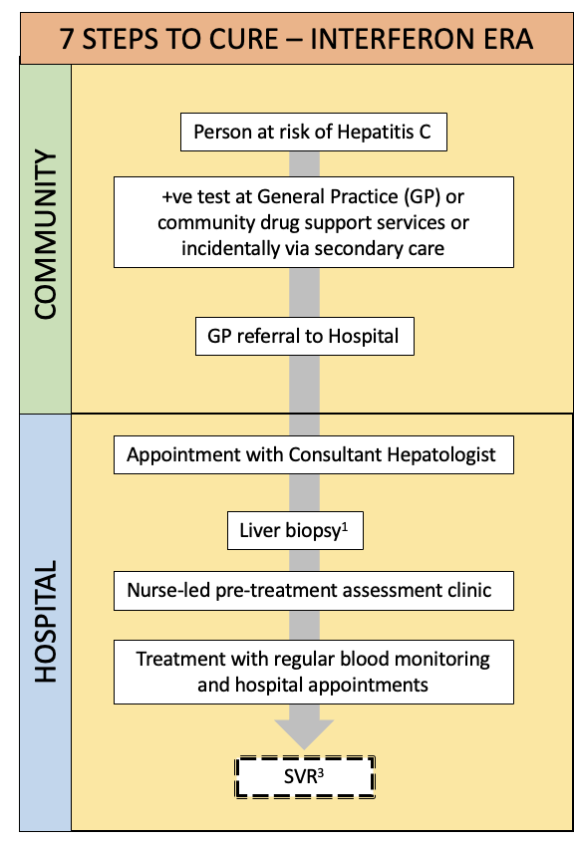
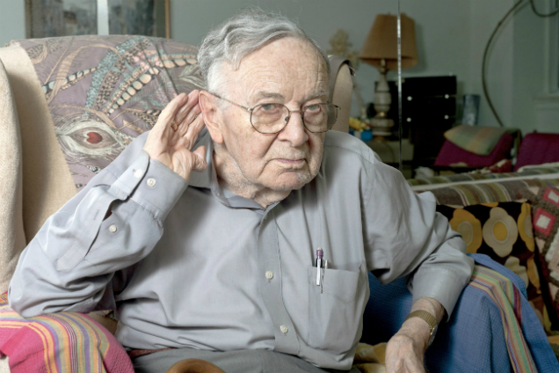
Buchanan, Kim & Nash. Clin Med. 2023

Slide 4
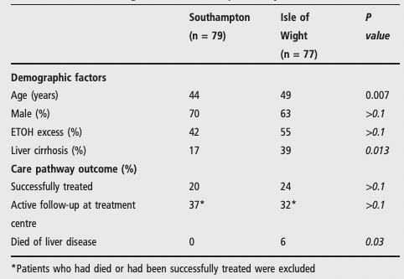

Slide 5
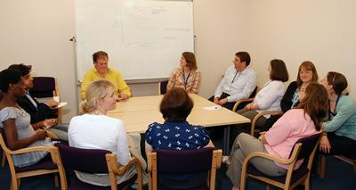
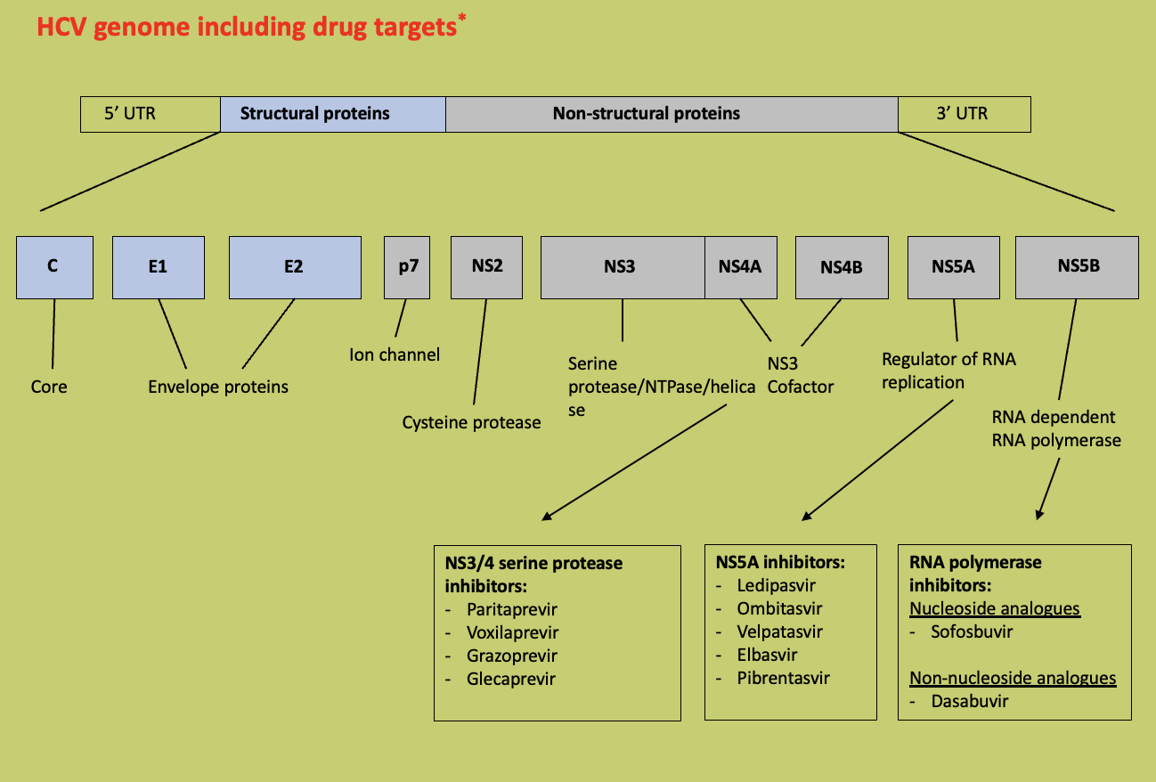
Then 4 things happened…

Slide 6
What does elimination actually mean?
Elimination = Eradication
Technical definition:
Identification of 90% of cases
Treatment of 80% of these
‘Very low’ rate of new cases

Slide 7
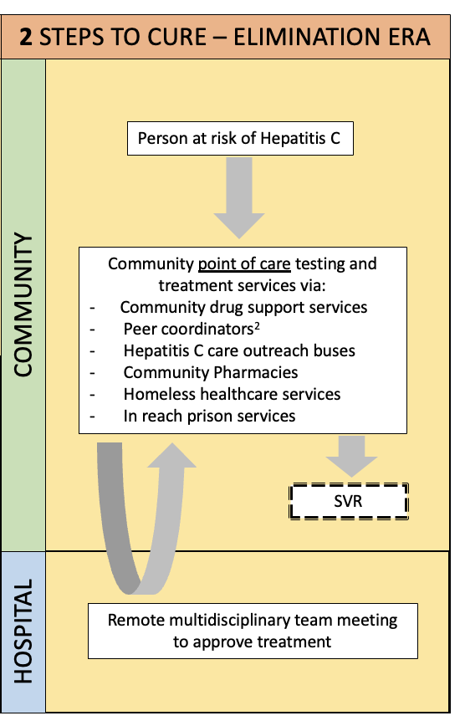
2 STEPS TO CURE – ELIMINATION ERA
Person at risk of Hepatitis C
Money
Drugs
Inclination
Clear mission statement
Community point of care testing and treatment services via:
- Community drug support services
Peer coordinators²
Hepatitis C care outreach buses
Community Pharmacies
Homeless healthcare services
In reach prison services
SVR
Remote multidisciplinary team meeting to approve treatment
Buchanan, Kim & Nash. Clin Med. 2023

Slide 9
What has happened in Southampton
UoS

Slide 10
GP case finding project
Aim
To identify patients registered with primary care in Southampton with a previous diagnosis of Hepatitis C but whom have not had any follow up or treatment.
To identify patients with risk factors for HCV and to arrange testing.

Slide 11
GP case finding project
Southampton GP Hepatitis C Elimination Project
Work completed so far
Meetings with Solent GP surgery, Homeless Health care and Living Well Partnership
Run a GP record search query
Re-coding records for treated patients with ‘Hepatitis C Resolved ’- 761381000000102
Identified patients who need repeat testing and engaging with care
RNA testing available at the surgery, at the patient’s home or on the Wessex clinical van.
We can offer peer support to engage with care.
The project team will then update and code the GP records.

Slide 12
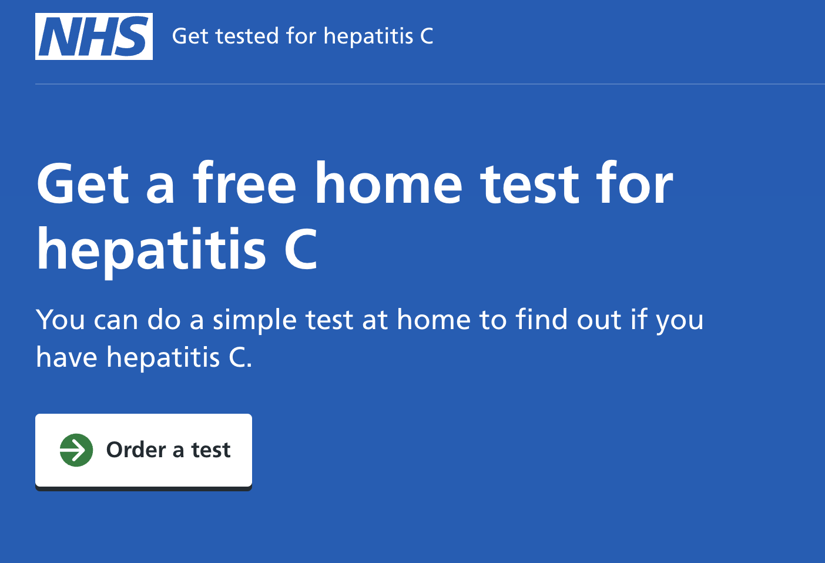
Take aways
Southampton is getting close to the elimination of HCV
Use the community liver pathway for high ALT (includes HCV testing)
Look and listen for risk factors & direct to testing
Keep records updated

