Slide 1
SOLENT NHS PODIATRY
Thomas Delpierre

Slide 2
Podiatry Talk Outline
1. Diabetes foot check 2. Foot care 3. Common diabetes foot problems and non-diabetes foot problems 4. Management of foot problems 5. How and when to refer 6. Local foot referral pathway

Slide 3
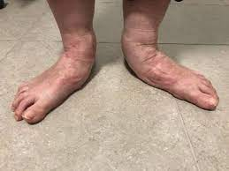
Diabetes Foot Health Reviews
NICE NG 19
Children under 12: advice on basic foot care
Young People: 12- 17: review foot health at annual review
Adults: at 1st diagnosis and annually
Unless foot health changes
On admission to hospital and if deterioration
What?
neuropathy (use a 10 g monofilament as part of a foot sensory examination)
limb ischaemia
ulceration
callus
infection and/or inflammation
Deformity e.g. hallux valgus, Adult Acquired Flat Foot
gangrene
Charcot arthropathy.

Slide 4
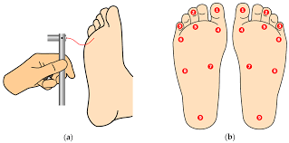
Monofilament Test
Use of monofilament:
Longevity and recovery testing suggest that each monofilament will survive usage on ∼10 patients before needing a recovery time of 24 hours before further use. (Booth et al. 2000)

Slide 5
Diabetes Foot Health Classification
Low risk:
no risk factors present except callus alone.
Moderate risk:
deformity or
neuropathy or
peripheral arterial disease.
High risk:
previous ulceration or
previous amputation or
on renal replacement therapy or
neuropathy and peripheral arterial disease together or
neuropathy in combination with callus and/or deformity or
peripheral arterial disease in combination with callus and/or deformity.
Active diabetic foot problem:
ulceration or
infection or
chronic limb-threatening ischaemia or
gangrene or
suspicion of an acute Charcot arthropathy, or an unexplained hot, swollen foot with a change in colour, with or without pain.

Slide 6
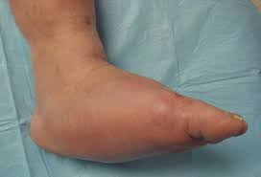
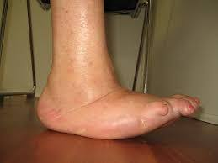
Charcot osteo-arthropathy
Acute
Chronic

Slide 7
Foot Care
Basic foot care advice and the importance of foot care.
Low risk – encourage self-care and self-management
Moderate risk – assess need for Podiatry intervention – e.g. presence of callus and/or deformity
High risk – refer to podiatry for assessment and management
Active foot disease – refer to podiatry as urgent
Foot emergencies and who to contact.
Urgent referral – with photographs, if possible, to podiatry: podiatry@solent.nhs.uk
If suspecting systemic infection, please arrange urgent admission under vascular team at UHS
Signs of sepsis – A&E
Footwear advice.
No slip-on shoes/slippers (hard sole, supportive – not loose fitting or soft)
Check footwear for debris prior to putting on shoes
Ensure enough room in shoes for feet
Dorsal toe wound usually a result of narrow toe box or digital deformity

Slide 8
Common Foot Pathologies:
Ingrown toenails
Callus
Corns
Biomechanical/musculoskeletal problems – e.g. PTTD, HAV, foot pain, AAFF
Toenail pathologies – requiring minor surgery or short-course treatment
Wounds
Paediatrics – developmental problems
*list not exhaustive

Slide 9
Diabetic Foot Pathway
https://www.solent.nhs.uk/media/4892/uhs-diabetic-foot-referral-pathway-v9-2023-whccg-and-sccg.doc
Flow chart for referral to designated foot team/podiatry
https://www.solent.nhs.uk/media/5294/podiatry-referral-form-west.docx
For referral to podiatry Solent West team
PHOTOGRAPHS of foot problem beneficial

Slide 10
HOW/WHEN to refer?
Non-wound referrals
Podiatry referral form
Will be triaged for level of urgency and seen in chronological order and urgency, please give as much information as possible to help us triage- photographs can be really helpful.
Wounds:
Email referral form to podiatry @solent.nhs.uk
The more information the better, any recent blood tests or imaging help to review. Photographs are always helpful
Podiatry | Solent NHS
useful links on to help people self care and wait well for their podiatry appointment

Slide 11
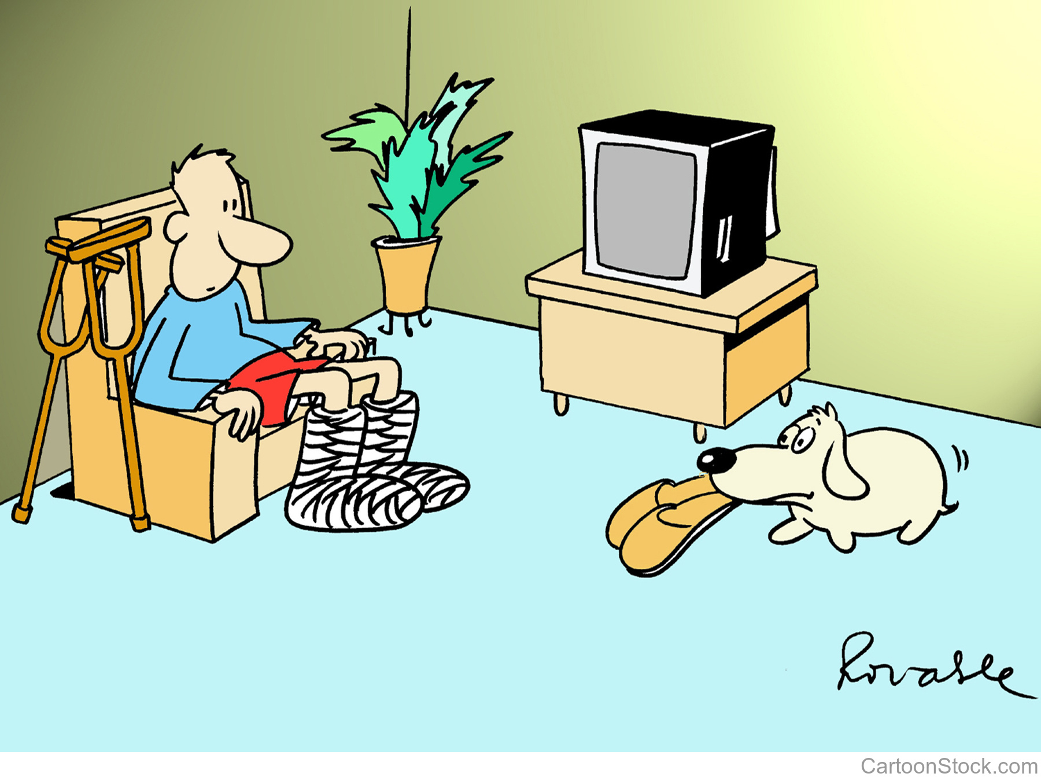
Any Questions?

