Slide 1

Primary Care Management of CKD
Dr Kristin Veighey
NIHR Academic Clinical Fellow in General Practice
Consultant Nephrologist

Slide 2
Chronic Kidney Disease
Common long-term condition
Doesn’t cause symptoms in early stages
No cure, but we can intervene to try to slow or halt progress
Impact upon morbidity and mortality
Progression to dialysis
  Huge impact upon patient quality of life
  Huge economic burden on the NHS

Slide 3
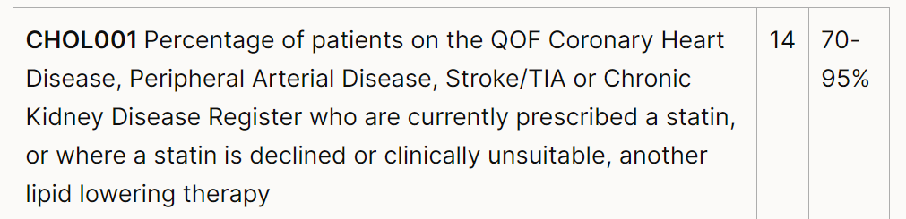
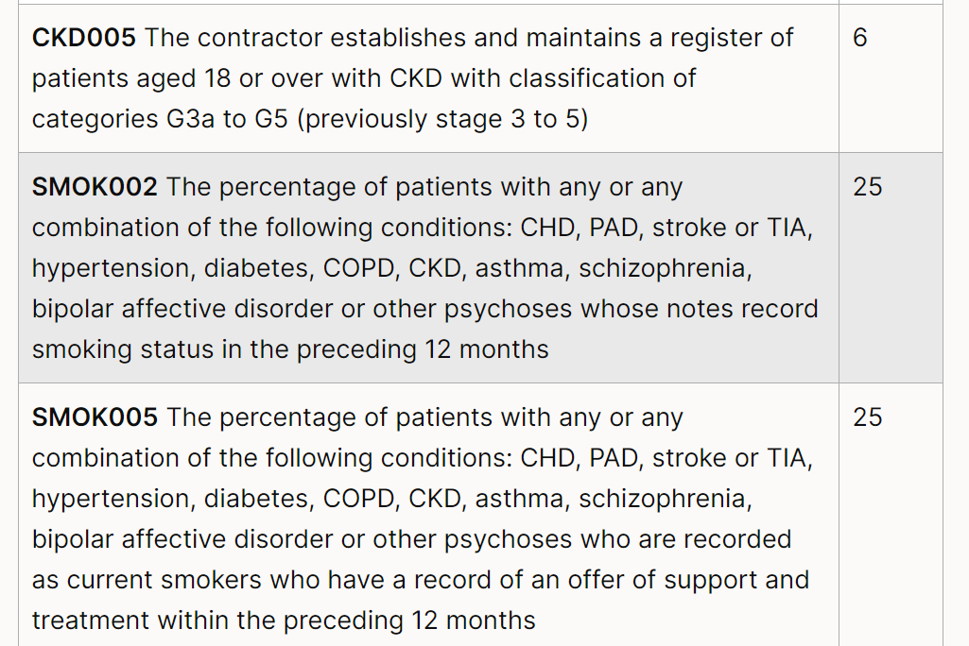
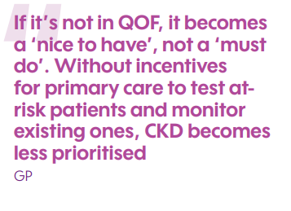
What's on the QoF?

Slide 4
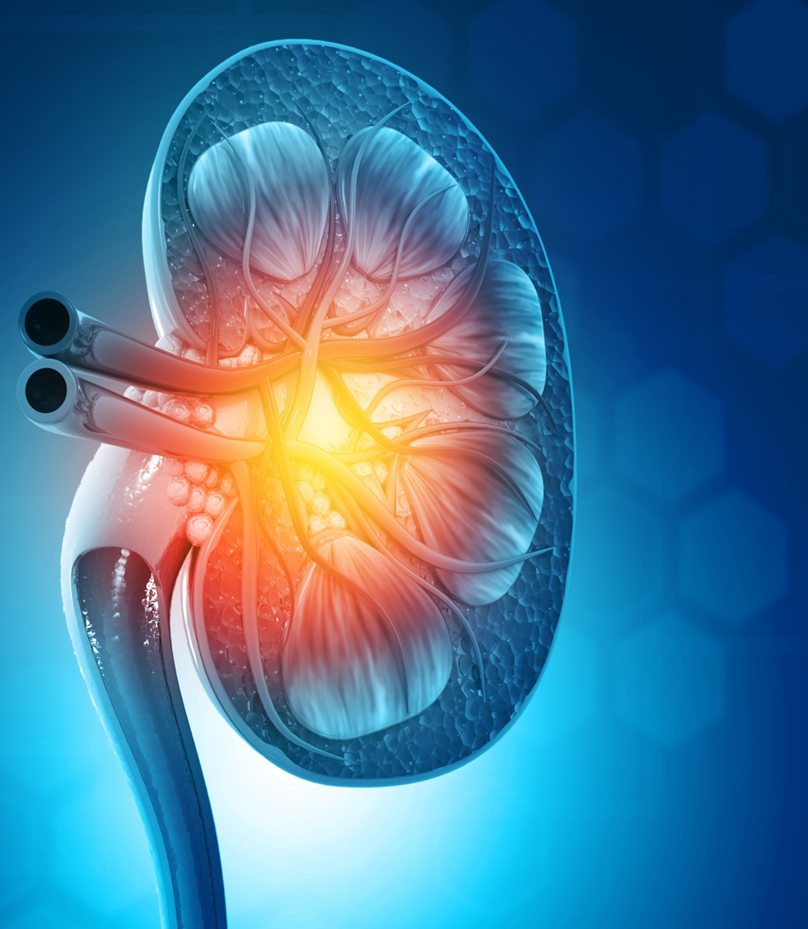

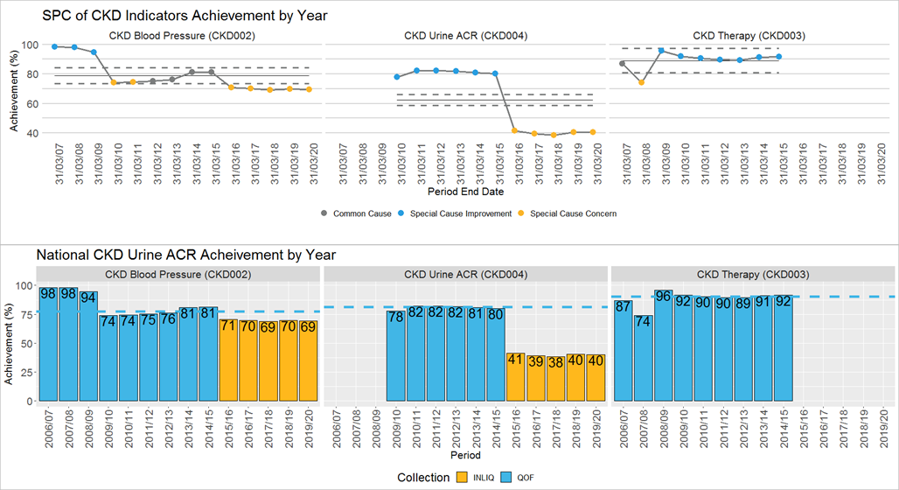
Renal Service Transformation Programme (RSTP) Webinars
Improving detection of early CKD - QOF
CKD indicators in QOF (uACR, eGFR, Blood pressure, prescribing ACE/ARB) until 2014/5
QOF achievement of CKD indicators fallen significantly
Need to reinstate CKD indicators
Figure 1 Data sources: QOF = Quality and Outcomes Framework - NHS Digital; INLIQ = PRODNHSESQL101, NHSE_UKHF.GP_Contract_Services_Eng.vw_Indicators_No_Longer_In_QOF1

Slide 5
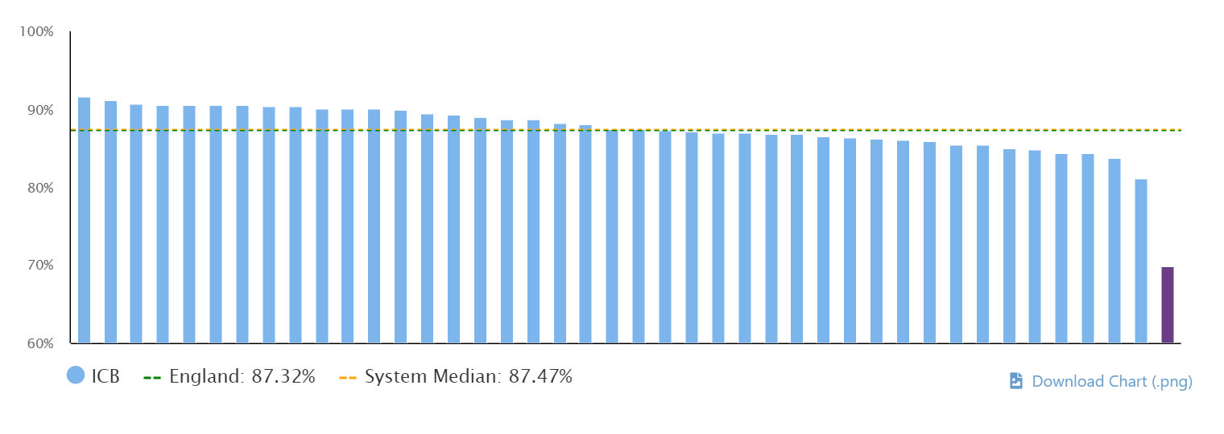
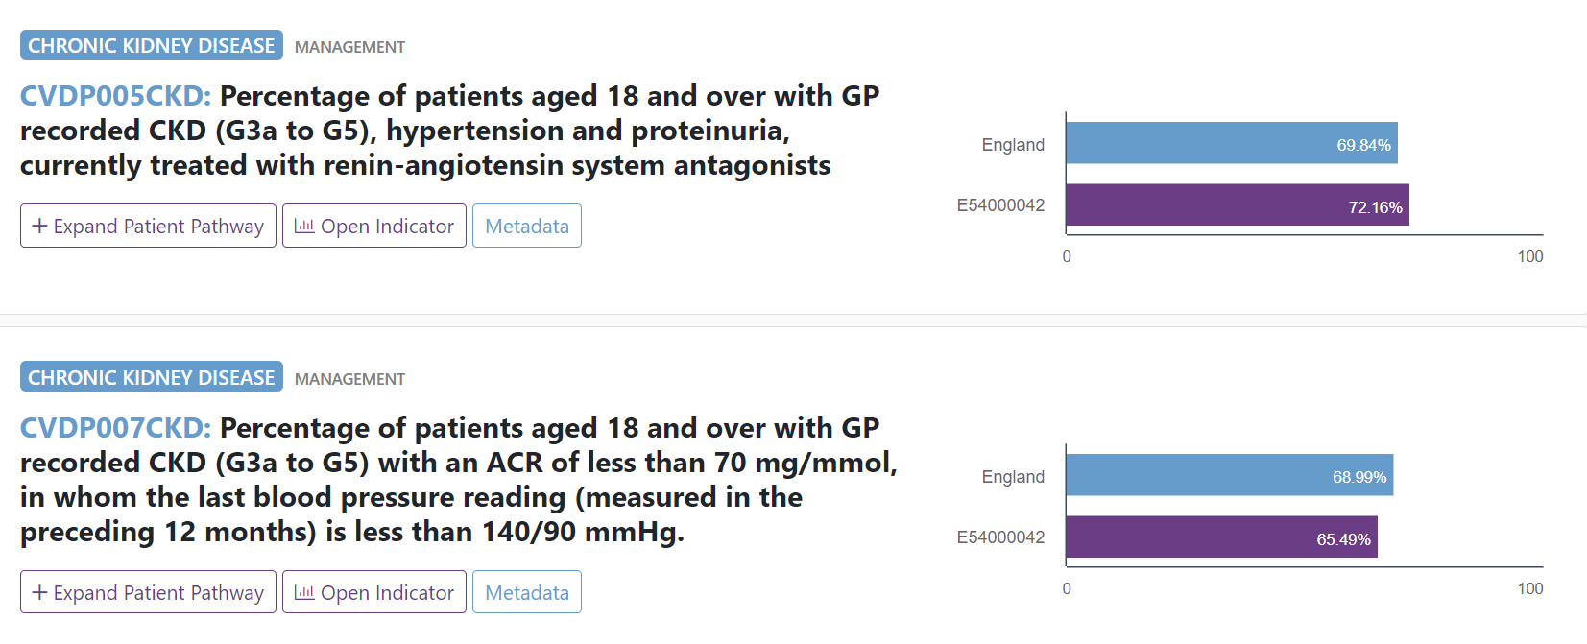

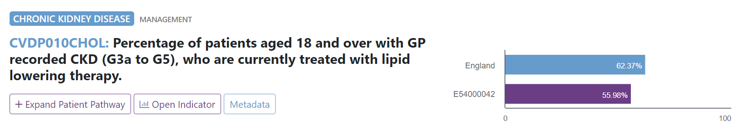
How are we doing in HIOW?

Slide 6
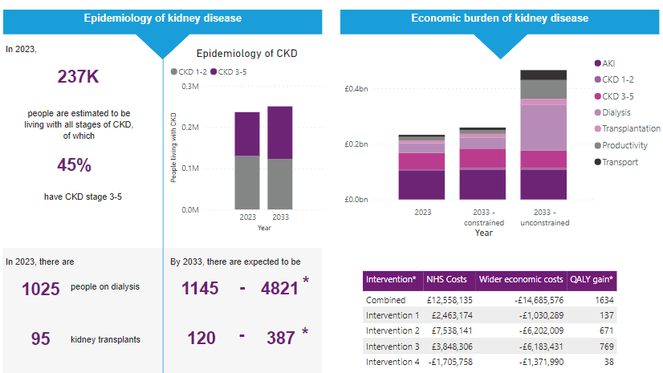

Slide 7
Early/improved diagnosis: This intervention targets ethnic minority groups and other underserved populations through outreach programmes to improve screening opportunities and increase early diagnosis
Improved CKD management: This intervention targets eligible patients with chronic kidney disease who are either untreated or not receiving standard care according to clinical guidelines (e.g. adequate blood pressure management)
Use of SGLT-2 inhibitors: This intervention aims to increase uptake of new medications such as SGLT-2 inhibitors (e.g. dapagliflozin) to reduce CVD events and slow progression to ESKD
Increased rates of transplantation

Slide 8
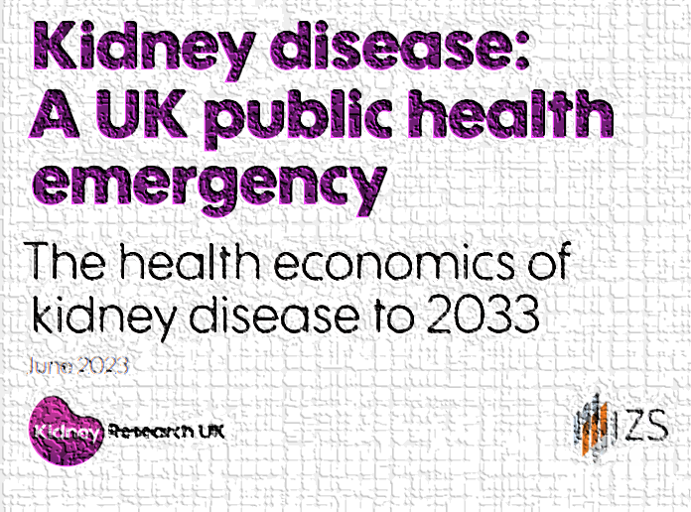
What is the role of primary care in management of CKD?
Identification and monitoring of patients at risk
  Of CKD
  Of progression and needing RRT
  Of complications
Diagnosis
Coding
Information-giving to patients
Cardiovascular risk management
New CKD (not disease specific) medications

Slide 9

Primary Care
BP (ACE/ARB)
Lipid management
Diabetes
Lifestyle
CKD treatments
Identification
of those at risk
Secondary Care
CKD treatments
Diagnostics
Disease treatments
RRT – dialysis/Tx
Advanced kidney care
Complications
CKD treatments
Advanced kidney care
Shared care

Slide 10
What are the symptoms of CKD?
Nothing in initial stages
Tiredness and lethargy, shortness of breath
Fluid retention
Nausea, indigestion, hiccups
Itching
Poor appetite
Anxiety, depression and reduced QoL

Slide 11
Who to test for CKD?
Diabetes
Hypertension
Vascular disease
Previous AKI (monitor for 3 years – longer if AKI3)
Multisystem disease eg lupus
Gout
Family history of ESRD/hereditary kidney disease (*ADPKD*)
Incidental detection or haematuria or proteinuria

Slide 12
Diagnosis of CKD
Creatinine and eGFRcreatinine (CKD-EPI)
Requires 2x eGFR 90 days apart
Less reliable in:
AKI
Pregnancy
Oedema
Muscle wasting/high muscle mass
Protein supplements
Not well validated in certain ethnic groups – remember EPI 2021
Beware in range changes, trimethoprim

Slide 13
Proteinuria
ACR/PCR
ACR as this is more sensitive in low levels of proteinuria
If between 3-70 mg/mmol confirm in subsequent early morning sample
Over 3 is clinically significant
Arguably dipstick positive – PCR – recommended for over 70
If incidental dipstick positive – eGFR and ACR

Slide 14
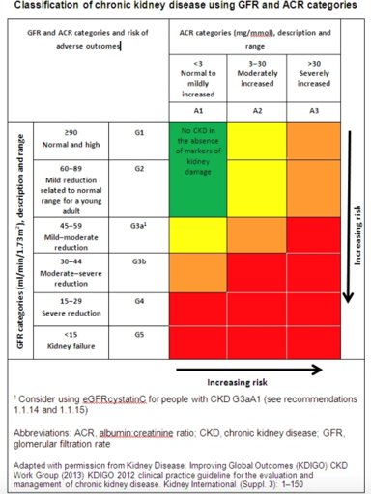
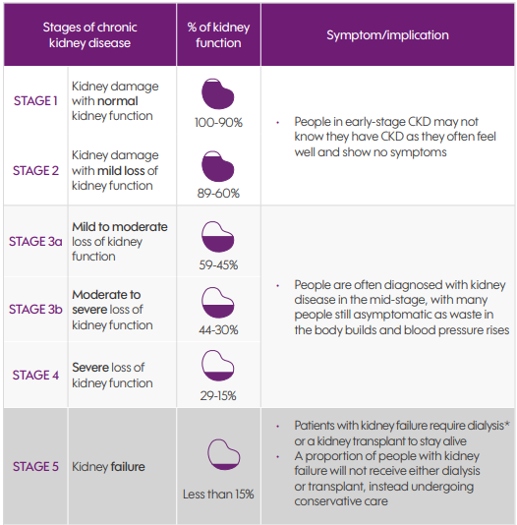
CKD Stages

Slide 15
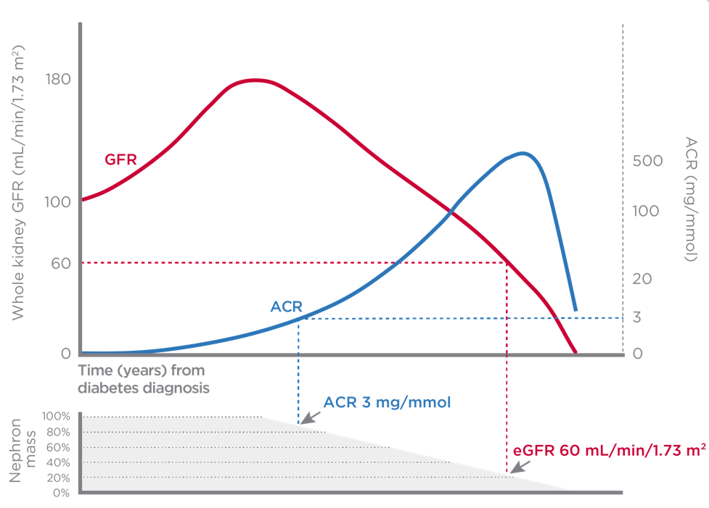
Renal Service Transformation Programme (RSTP) Webinars
ACR testing can detect early signs of Diabetic Kidney Disease(DKD) before significant nephron loss has occurred - why wait?
Tonneijck L, et al. J Am Soc Nephrol 2017;28:1023-39

Slide 16
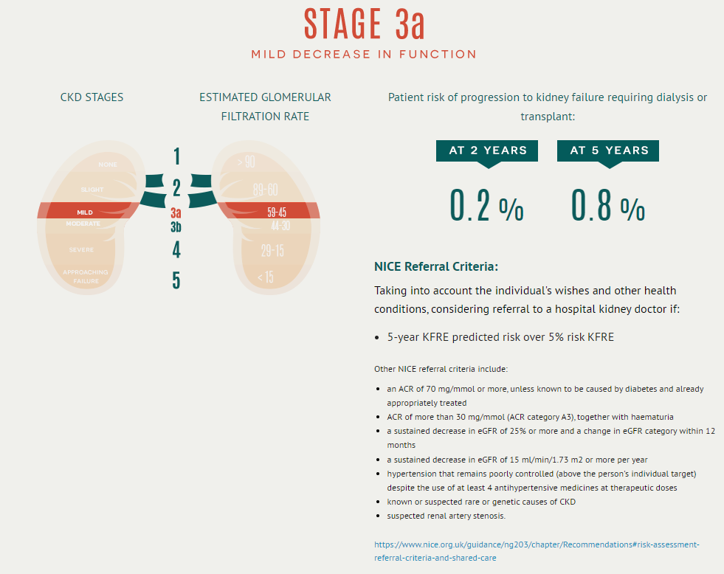
The 4-variable Kidney Risk Score (KFRE)
4 variable risk score includes sex, age, eGFR, urine ACR
5% at 5 years = refer
www.kidneyfailurerisk.co.uk

Slide 17
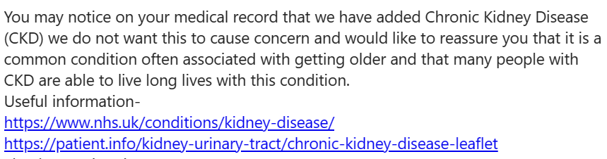

How do we tell people?
Group consultation
Health & wellbeing coaches
Social prescribers
Pharmacist
Dietitian

Slide 18
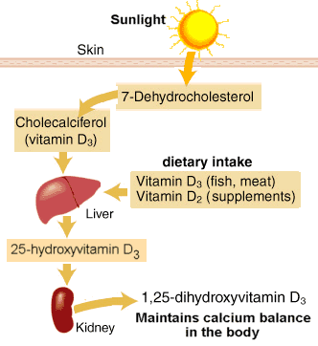
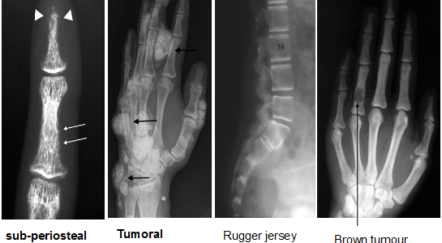
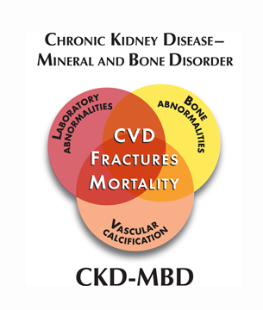
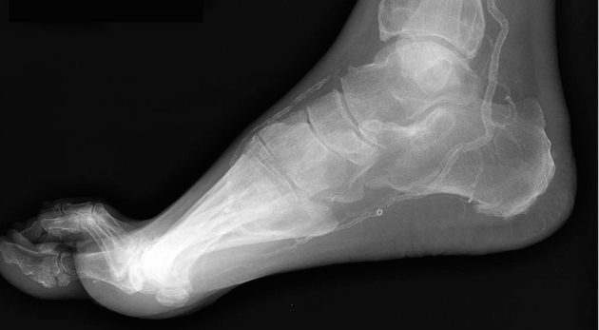
CKD-MBD
Soft tissue calcification
Arterial stiffening
Left ventricular disease
Increased cardiovascular morbidity and mortality

Slide 19
Calcium, vitamin D, phosphate, PTH
If calcium low (or low n), check and replace native vitamin D (cholecalciferol)
Measure PTH – late CKD3 onwards – if raised despite 25D replacement seek specialist advice – or if Calcium high - may need further treatment
Diet is a big problem in late CKD – low appetite, malabsorption
  Phosphate is a key component of lots of fast/ready meals
  Phosphate contributes to arterial stiffening
  Treated with diet restriction and sometimes phosphate binders

Slide 21
Renal Anaemia
Chronic anaemia leads to:
  Symptoms for the patient
  Physiological sequelae – LVH
Anaemia is multifactorial in CKD
Ferritin targets are higher
Also check B12/Fol - diet
EPO – eGFR typically <20
IVFe is better tolerated than oral

Slide 22
Potassium
Acidosis
Leads to bone resorption
Hyperkalaemia may be associated
Treat with oral bicarbonate if bicarbonate <20
Sodium zirconium silicate (Lokelma) or Patiromer (Veltassa)
Medications – ACE/ARB

Slide 23
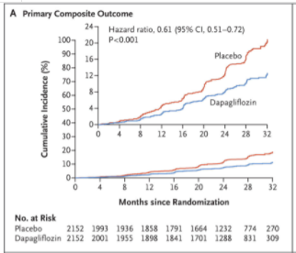
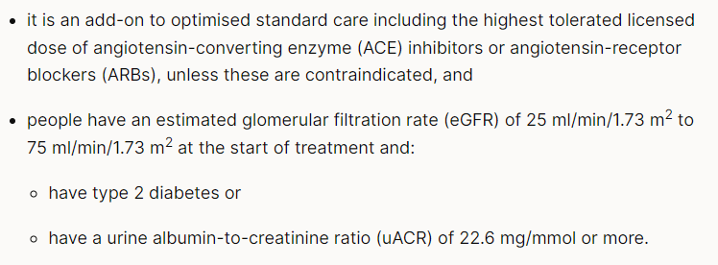
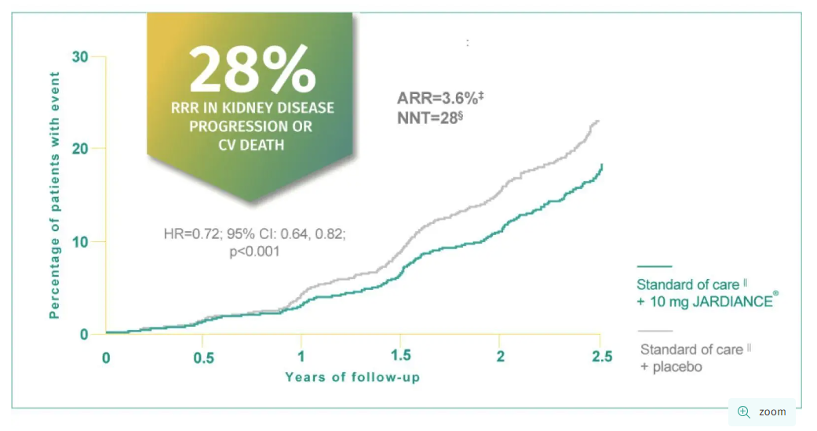
CKD Treatments - SGLT2i
Dapagliflozin (Forxiga) and Empagliflozin (Jardiance)

Slide 24
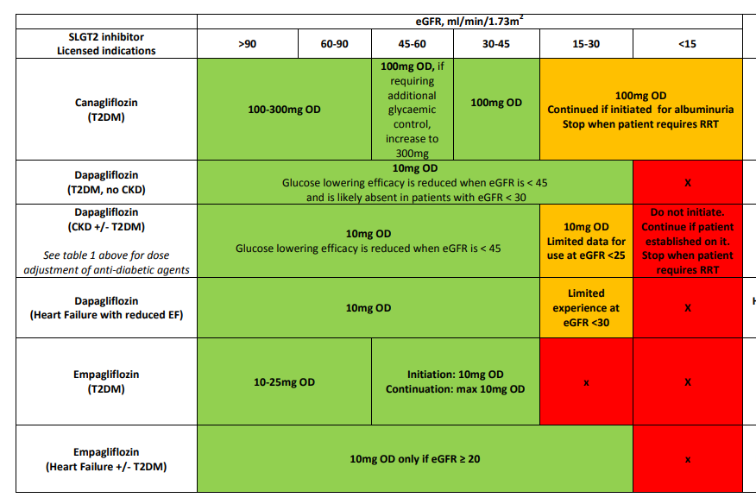

Slide 25
Side effects and Sick day rules
Counsel patient against risk of side effects:
eGFR dipping – monitor after 4-6 weeks
Diabetics: Euglycaemic DKA
All: increased risk of infection
Fournier’s gangrene
Weight loss
200 cal sugar loss/day
Stop if unwell (and ACE/ARB!)

Slide 26
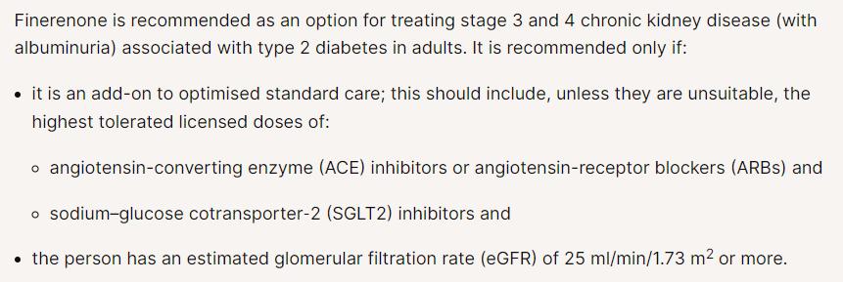
Finerenone
Finerenone is a non-steroidal mineralocorticoid receptor antagonist that inhibits receptor-mediated sodium reabsorption and decreases receptor overactivation, thereby reducing the inflammation and fibrosis that lead to kidney damage

Slide 27
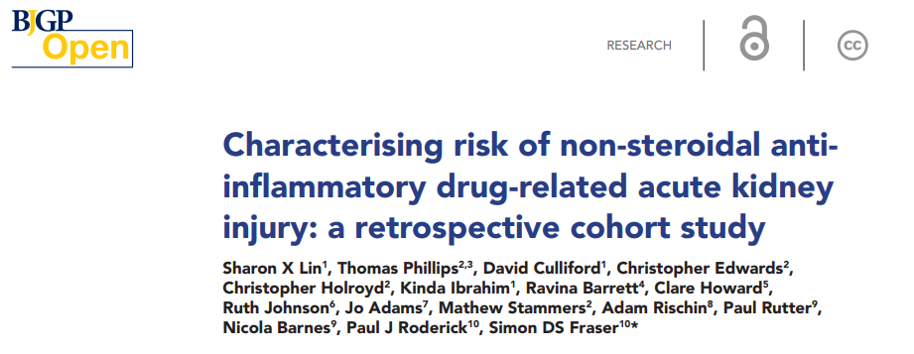
Prescribing issues & AKI
Trimethoprim
Renal doses of antibiotics
Remember interactions with immunosuppression
  Erythromycin
NSAIDs
ACE
Statins
PPI
Bisphosphonates

Slide 28

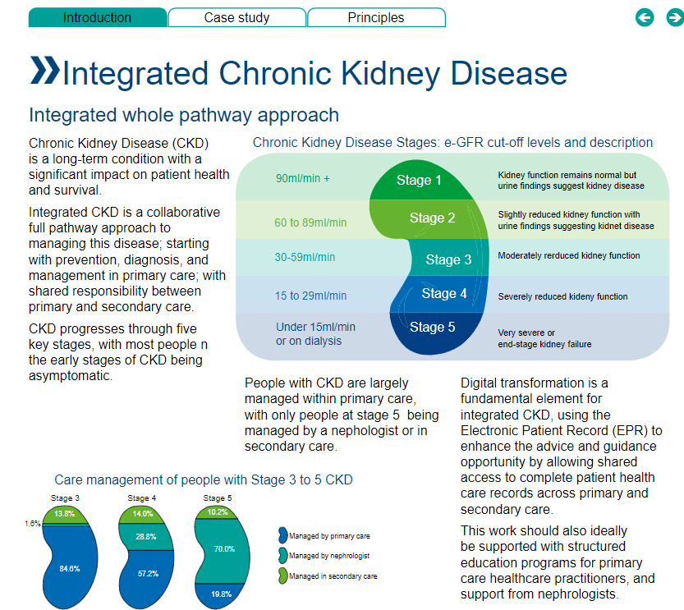



Renal Service Transformation Programme (RSTP) Webinars
Integrated CKD
Notes:
Smeeta
- Require Smeeta’s photo

Slide 29





Renal Service Transformation Programme (RSTP) Webinars
CKD in primary care – how?
Team approach - multi-faceted, multi-disciplinary workforce
  Pharmacists, practice nurses, ANPs – opportunity to identify CKD /perform ACR
Use of the Kidney Failure Risk Equation (KFRE)
  Primary care is well versed on use of scoring systems to determine risk and guide practice
Integration with clinical systems
Long term condition/multiple QoF review clinics, virtual clinics, community clinics
Huge potential to alter the course of disease, reducing burden for patients, and save resource, by early identification and intervention
Notes:
Kristin

Slide 30


Southampton GPwER pilot
Funded by D&G from Bayer
Funds a GP for 1 session/week @LivingWell Partnership PCN
Supported by practice pharmacist, ARRS pharmacist and Astra Zeneca interface pharmacists
Nephrologist MDT support
  To allow one-stop assessment and planning
  To avoid unnecessary A&G
Patients offered MK&Me
Group education sessions planned
Roche-EMIS pathways partnership to increase KFRE also planned

Slide 31



Questions?

Slide 32
