Slide 1
Changing the narrative
Steve Plenderleith & Jo Hurd February 2024

Slide 2
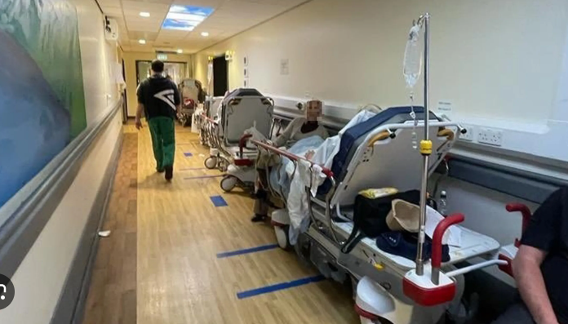
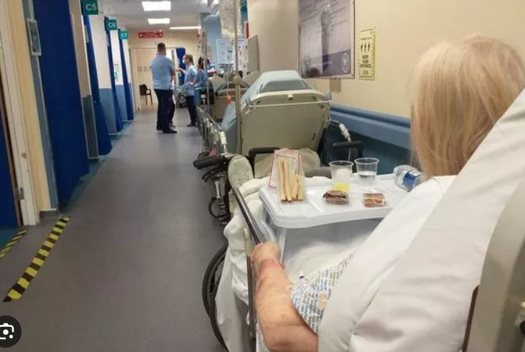
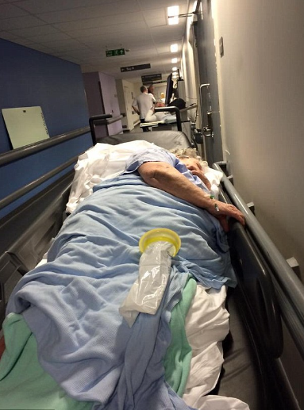
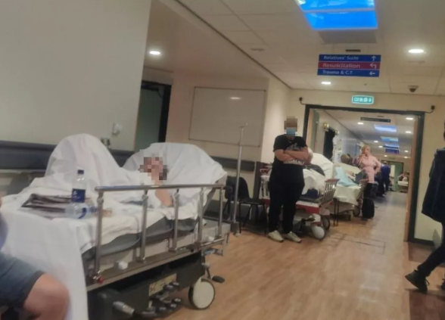
Not the ideal place to be pronounced “dead.”

Slide 3
Admission, often ends badly for . . .
Frail multi-morbidity patient;
on anticoagulant with head injury
with dementia or early memory loss
NEWS2 over 6 from LRTI or UTI (you are now forbidden from dying of “sepsis” )
Clearly dying oncology patient, no matter their age where;
Oncology offering one more treatment if PS improves
Haematology offering one more transfusion
Organ Failure – lung, liver, dialysis, heart
when not considering the effect of one treatment on another
AND, what about choice?

Slide 4
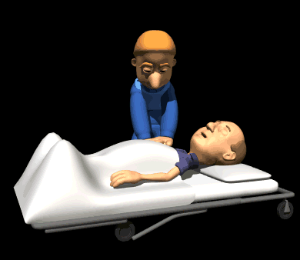
“Patient is palliative, please discuss DNACPR.”
Notes:
Let’s focus on all the other stuff before we ask about an intervention that quite frankly doesn’t make the difference between life and death.

Slide 5
Future Planning animation for clinicians
https://vimeo.com/814261172

Slide 6
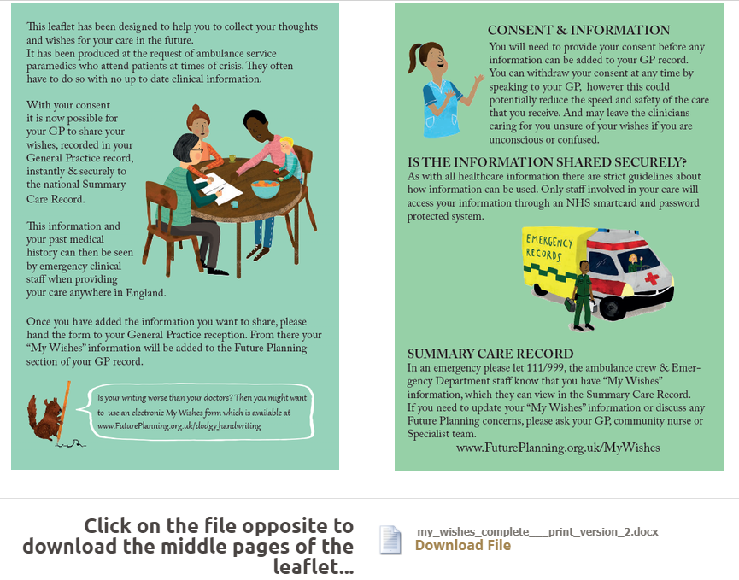
My Wishes
A contract with the patient ?

Slide 7
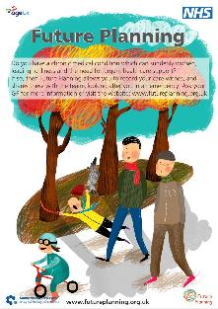
Resources
A3 Future Planning posters (4 different designs) available to order. And patient video.
My Wishes booklets available to order.
Patient, clinician and family resources
available at: www.futureplanning.org.uk
Future Planning fridge magnets and Care Plan covers.

Slide 8
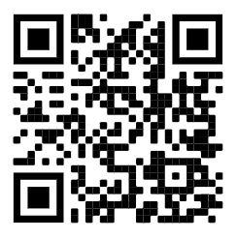
Future Planning website

Slide 9
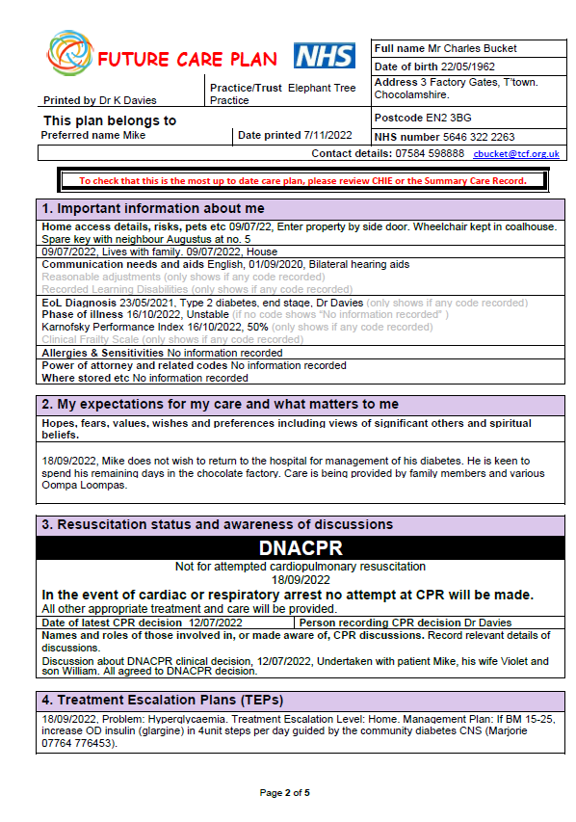
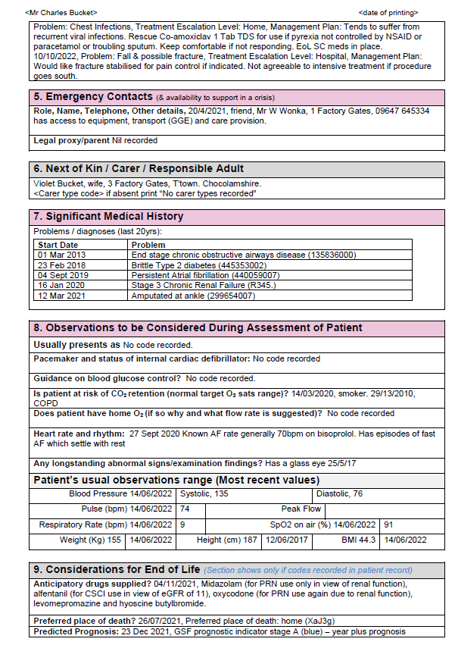
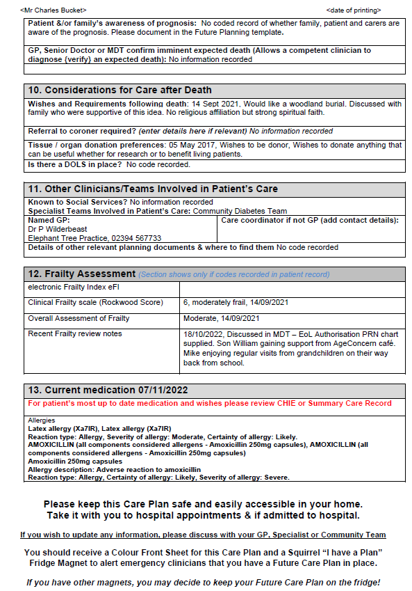
Future Care Plan

Slide 10
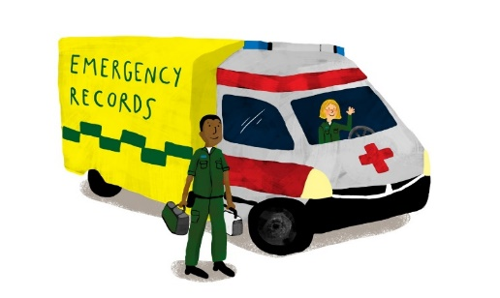
Future Care Plan - Urgent/Emergency Care Plans
Brief.
Discussed and agreed in advance. Helpful, but not binding. Not LEGAL.
Information about me - Communications, Next of Kin, Lasting Power of Attorney.
In an emergency - Emergency contacts, access details, allergies, medical history.
My expectations of my care & What matters to me
- “Patient preferences for care” - values, hopes,
fears, wishes, religion, culture etc.

Slide 11
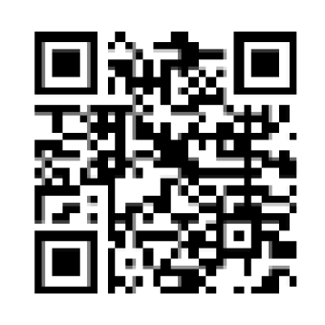
Future Care Plan - Urgent/Emergency Care Plans
Treatment Escalation Plans (TEPs) -
Give enough information to let OOH services know what they are dealing with.
How to manage each anticipated problem/s, written in a structured way.
Problem TEP Level Management Plan
Needs to be visible to clinicians providing care at 3:17am. Times may vary……! CHIE, SCR and Paper
Useful for those living with Long Term Conditions, Frailty and/or those at the End-of-Life.

Slide 13
E-learning – Solent, Southern & soon Practice Index, Bluestream, Ardens
SHFT Rio Future Planning training can be accessed on LEaD at eLearning – Rio Future Planning and is recommended for clinicians at Band 5 and above who care for patients 18 years + with physical health needs.
Systm1 Future Planning training also live on the Solent LMS.
New Community of Practice sessions LEaD Course Code -VC-23021 or email Jo Hurd for details.

Slide 14
How you can help
Culture change - starts now, commitment to long-term.
Support staff to learn and develop skills in Future Planning.
Allow time for staff to listen and talk to patients to better understand, record and act on ‘what matters most’ to them.
Endorse Future Planning Programme, promote regional and national use
Provide resources to promote Future Planning and enable programme development.
Encourage collaborative working, research and conference attendance in order to continuously develop and share good practice.

Slide 15
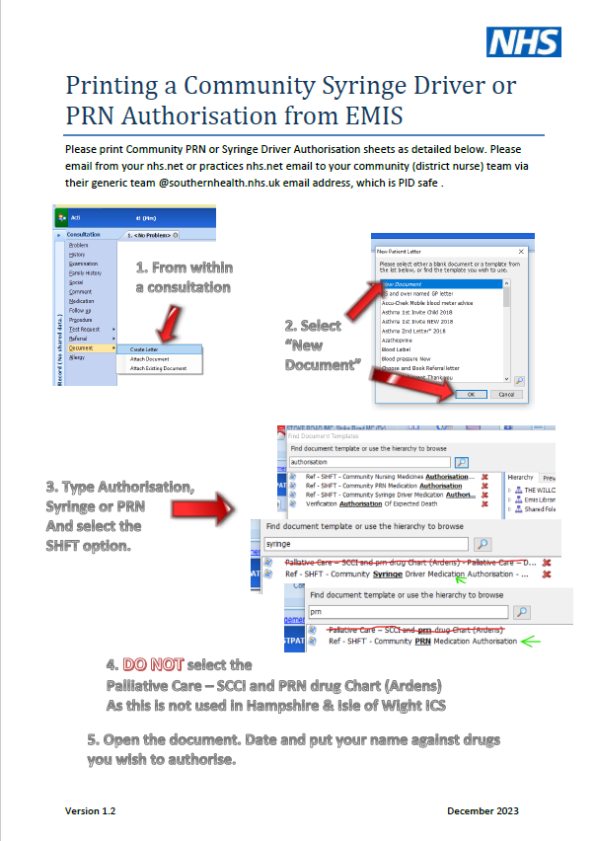
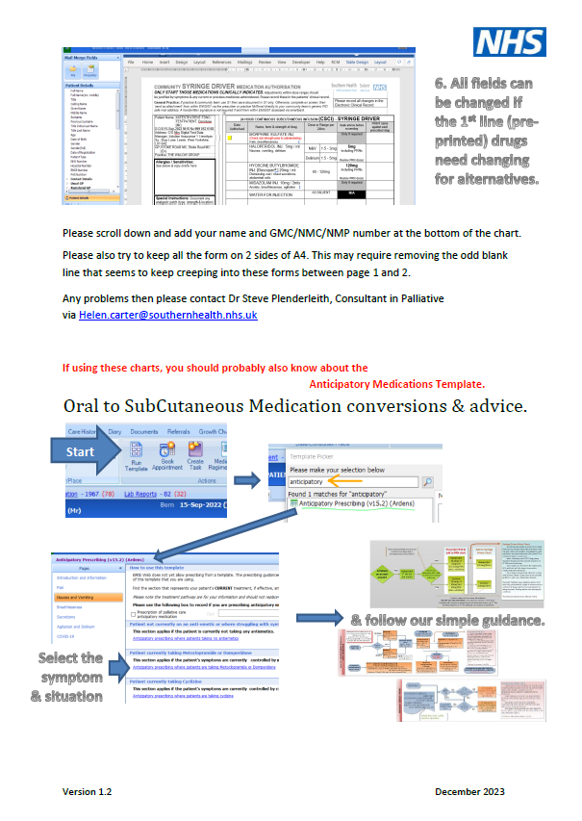

Slide 16
Questions and feedback
We are always very interested to receive questions, and to hear about experiences, challenges and suggestions.
Jo Hurd: PSEH Treatment Escalation Plans Programme Manager Jo.Hurd@SouthernHealth.nhs.uk
Steve Plenderleith: Consultant in Palliative Medicine, Steve.Plenderleith@SouthernHealth.nhs.uk
Julia Lake: Deputy Director of Nursing (Physical Health),
Julia.Lake@Southernhealth.nhs.uk
www.futureplanning.org.uk;

