Slide 2
Content
National Bundle of Care for Children and Young People with Asthma
Diagnosis of asthma in CYP
Wessex Asthma Guidelines 6-11 (paediatric)
Wessex Asthma Guidelines 12+ (adolescents)

Slide 3
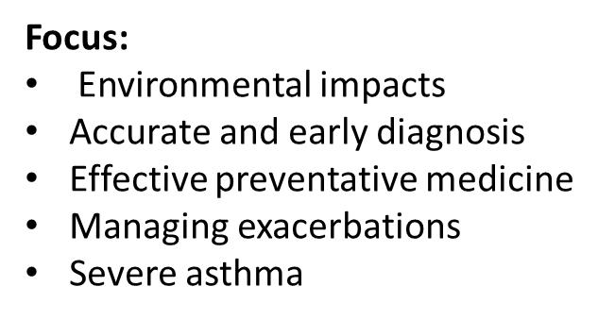
National Bundle of Care for CYP
NHS long term plan – respiratory priorities 2019
Improve care and outcomes for CYP with asthma
Hampshire and Isle of Wight region – Professor Gary Connett and Emma Ray
Notes:
What is the NBC for CYP with asthma
It stems from the NHS long term plan
Which put respiratory medicine at the heart of NHS priorities
The care bundle work has been devolved to all the ICBs across the country
So for HIOW professor Gary Connett is the clinical lead for paediatric asthma
He is a paediatrician with a specialism in respiratory medicine and he is also an academic
I work alongside him and the asthma teams based in primary and secondary care to support ongoing education
So the care bundle has a number of focusses and this includes
Environmental impacts
Accurate and early diagnosis
Effective preventative medicine
Managing exacerbations
And severe asthma

Slide 4
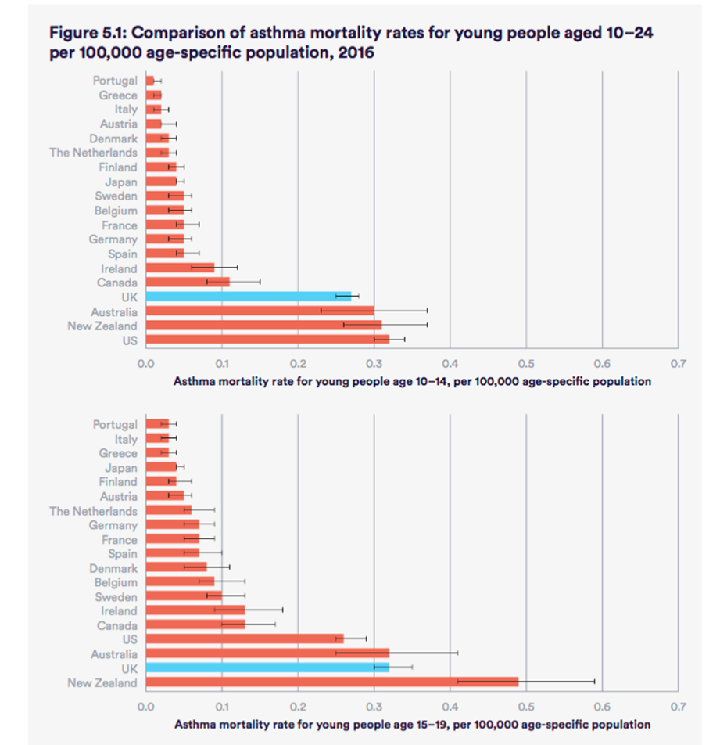
Notes:
Why is the care bundle important to us?
We have the highest death rates and hospitalisation rate for the whole of Europe and compared to the rest of the world we are not doing very well either.
This is despite having some of the highest care and treatment costs in the whole world for asthma.
So we are getting it right.

Slide 7
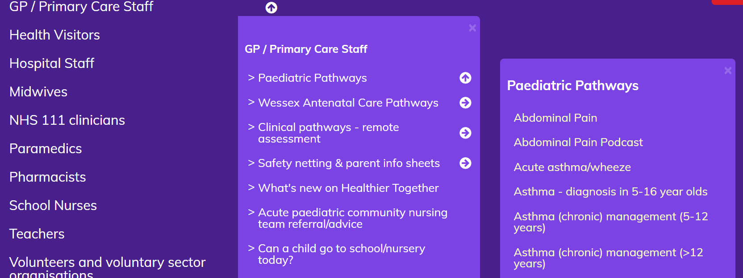
https://www.what0-18.nhs.uk/

Slide 8
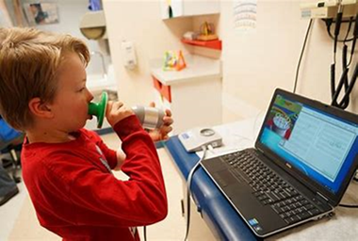
Asthma diagnosis is children
Population based studies, in GP primary CYP reviewed
Under diagnosis UK 33% (Kaur B 1998 BMJ)
Consequences: poor control/QOL, time off school, asthma attacks
Over diagnosis 20% (Cornish R 2014 BMJ Open)
Consequences: missed diagnosis, side effects, cost, environmental impact
Notes:
So making sure we have right diagnosis in first place is really important
so that our patients get the right and education and treatment
so that they have no or minimal symptoms and know what to do in an emergency
In the UK it is recognised that we poorly identify and treat asthma
Barriers to more objective testing
- Money and priorities
- Most children frown out of asthma
- Spiroemtry is difficult to perform in CYP
- Interntaional guideliines do not recommend it
- Nobody dies
Consequence of under treatment:
Sitting on fence
Poor medication management
Poor QOL/time off school
Potential for severe asthma and attacks
Consequence of over diagnosis:
Inappropriate treatments
Side effects
Increased health cost
Environmental impact
Missed diagnosis

Slide 9
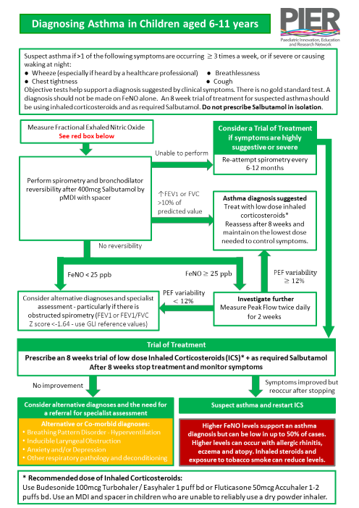
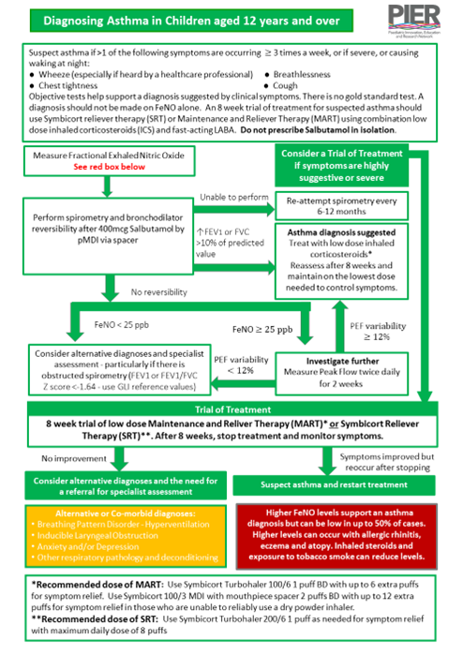

Slide 10
When to suspect Asthma
History
Variable symptoms
Multiple triggers – not just virus induced symptoms
Ask about triggers – school and home
If >1 of the following symptoms are occurring ≥ 3 times a week, or if severe or causing waking at night:
Wheeze (especially if heard by a healthcare professional)
Breathlessness
Chest tightness
Cough
Notes:
Inflammatory disease of airways with bronchoconstrictions
Multiple triggers, rather than just viruses – if you had a small child who had a wheeze with cold then this would be a viral induced wheeze rather than asthma
If they wheeze inbetween colds this might point towards asthma
Wheeze – check parents understanding – should be high pitched respiratory sound on expiration
Cough at night common on children with asthma

Slide 11
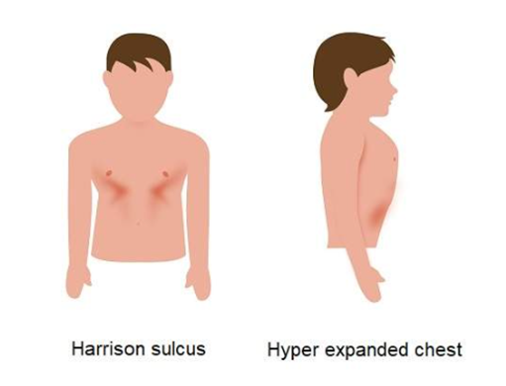
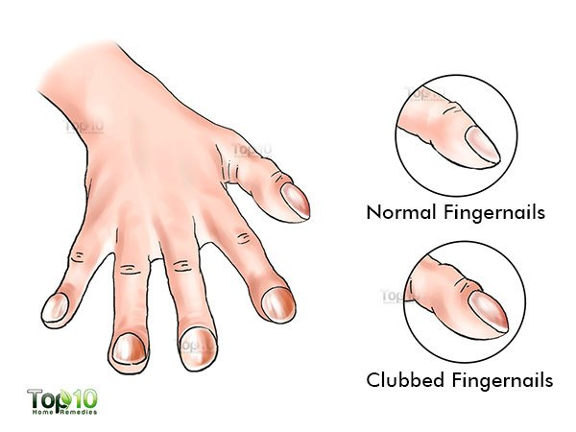
Taking a history
Eczema
Allergies/hayfever
FH atopy/asthma
Birth history
Previous lung disease/surgery (pneumonia/whooping cough)
Maternal stress
Emotional stress
Triggers
Physical examination
Auscultation
Chest shape
Finger clubbing
Mouth breathing
Signs of rhinitis

Slide 12
Alternative diagnoses
Viral induced wheeze – wheeze action plan
Upper respiratory tract infections
Gastroesophageal Reflux
Obesity
De-conditioning
Dysfunction breathing Physiotherapy for breathing pattern disorders resources for physiotherapists (physiotherapyforbpd.org.uk)
Anxiety/stress
Inducible Laryngeal Obstruction
Bronchiectasis
Primary Ciliary Dyskinesia
Cystic Fibrosis
Protracted bacterial bronchitis
Notes:
VIW – common in pre school child, up to 50% of all preschooler will have experienced VIW
ILO – transient closing of the vocal chords, usually happens during exercise, patient can have stridor, can co-exist with asthma
PCD – cilia malfunction, mucus production and cough, associated with frequent ear infection

Slide 13
Diagnostic Testing
BTS/SIGN, ERS and GINA position:
Diagnosis should not be based on symptoms alone
Objective tests must be used to support a history
Asthma is a variable disease and therefore tests may be normal on the day of the test
Spirometry is preferred in making an accurate diagnosis
FeNO alone is not recommended for diagnosis
No evidence peak flow testing is useful in diagnosing asthma
If a diagnosis is suspected but not clear there should be an initiation of treatment with careful review
Notes:
All these guidelines differ and as clinicians we use them interchangeable depending on experience, background and confidence
They all agree that objective test must be used to support
Spirometry is the preferred disgnostic test
As asthma is variable please be aware on the day of the test 30% people may have normal spirometr
No evidence that peak flow testing is helpful in diagnosing asthma

Slide 14
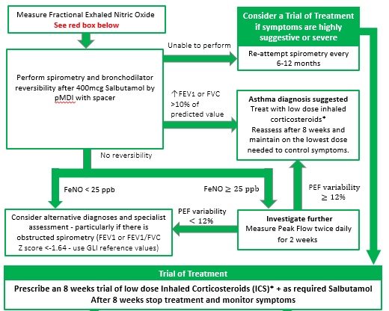
Asthma diagnostic guidelines
Asthma is a variable disease and therefore tests may be normal on the day of the test
Notes:
Improvement of FEV1>10% of predicted value
FeNO >25ppb
Consider Trial of treatment if symptoms are highly suggestive or severe
8 week trial of low dose inhaled steroids
After 8 weeks stop treatment and monitor symptoms
Since 2021, Gina now no longer recommends treatment with SABA alone in adolescents. Instead, it children age 6+ should always use an ICS if they are using a SABA, either symptom driven if symptoms are mild or regularly. This is because there is good evidence that SABA only use does not protect patients from severe exacerbations.

Slide 15
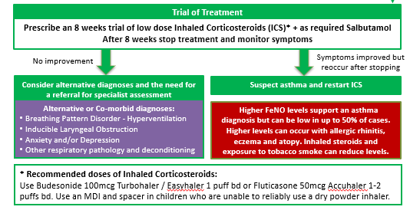
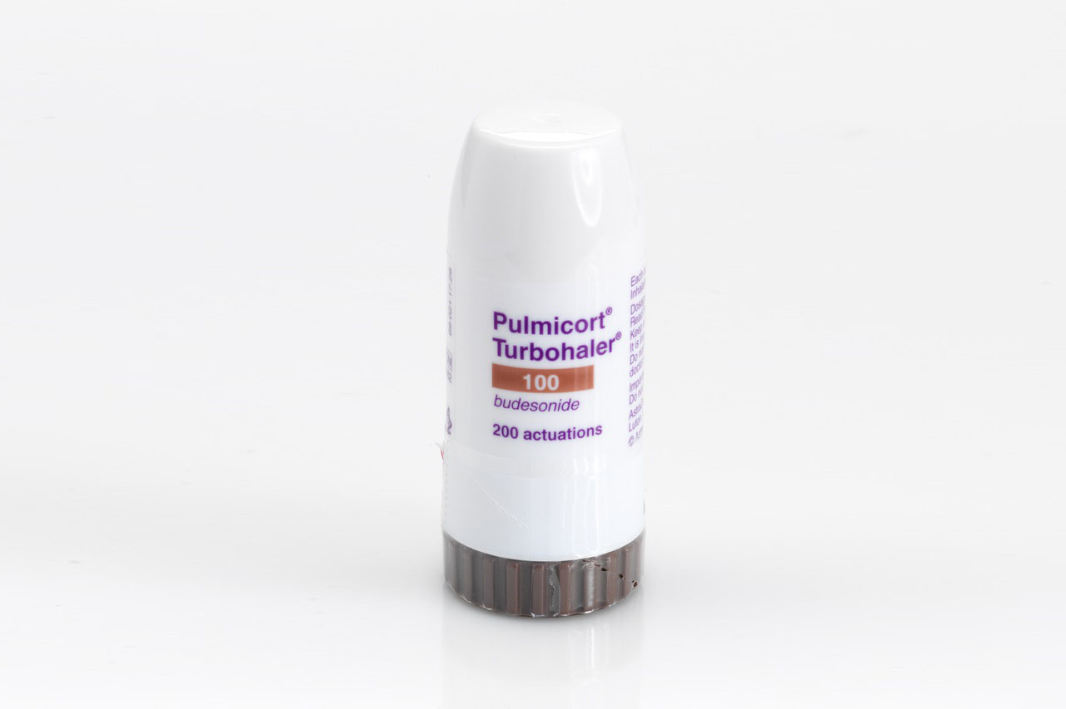
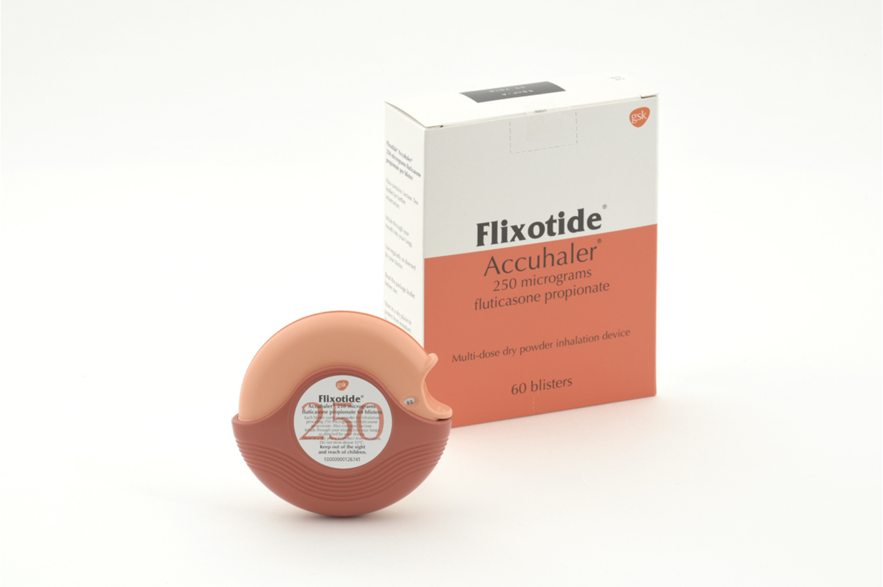
Trial of Treatment: 6-11 years - Draft
Recommended doses of Inhaled Corticosteroids:
Budesonide 100mcg 1 puff BD Turbohaler
Fluticasone 50mcg 1-2 puffs BD Accuhaler
Use an MDI and spacer in children who are unable to use a dry powder device

Slide 16
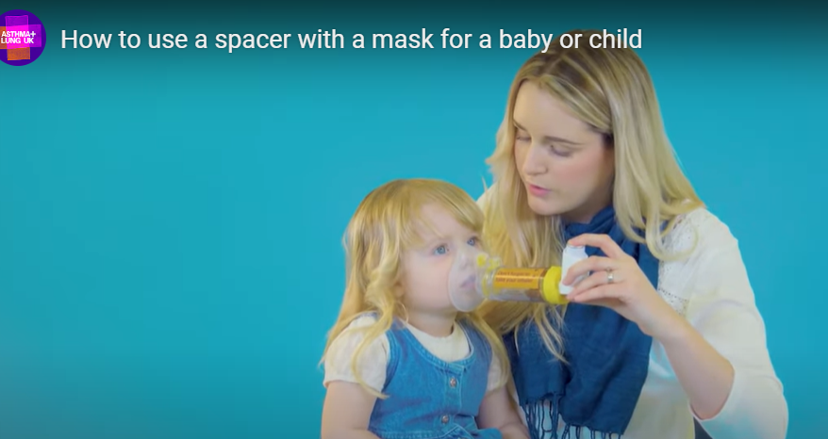
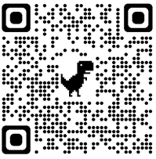
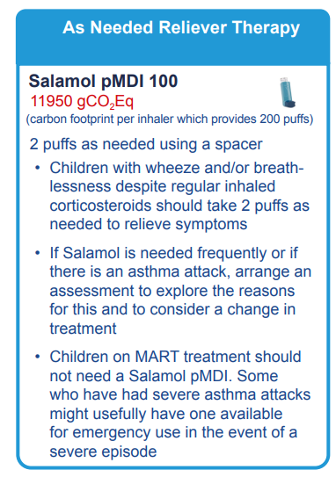
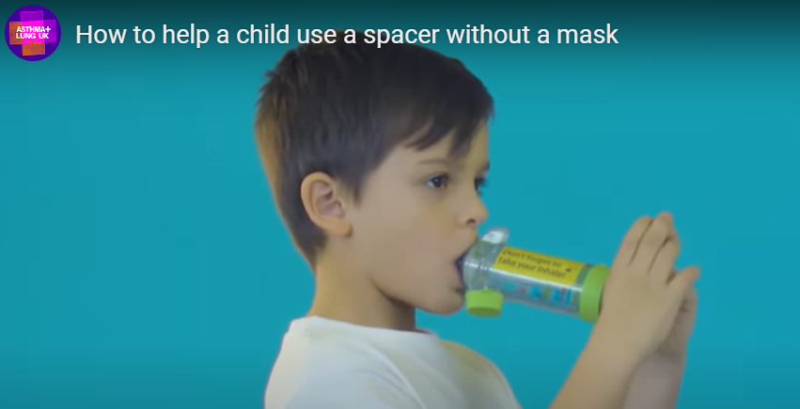
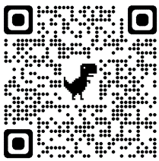

Slide 17
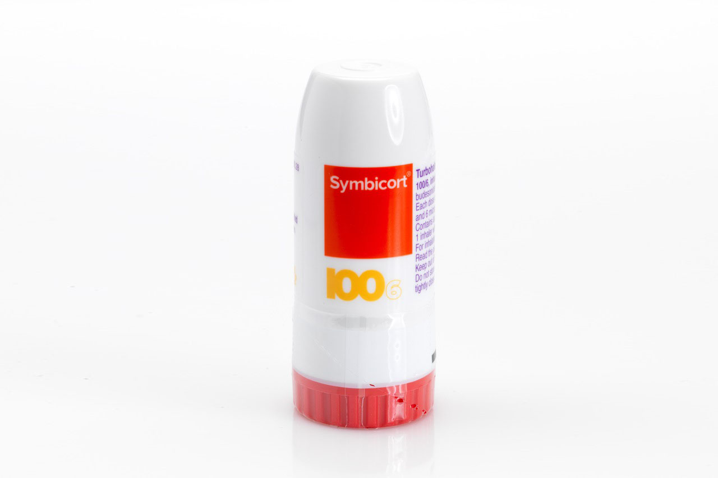
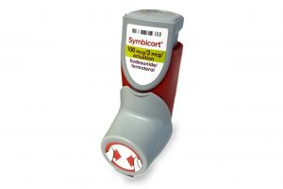
Trial of Treatment: 12+ years
Recommended dose of MART:
Symbicort Turbohaler 100/6 1 puff BD, with up to 6 extra puffs for symptoms relief
Symbicort MDI 100/3 with mouthpiece spacer 2 puffs BD with 12 extra puffs for symptom relief for those unable to use a DPI
Recommended dose of Symbicort Reliever Therapy (SRT):
Symbicort Turbohaler 200/6 1 puff as needed for symptoms relief with a maximum daily dose of 8 puffs

Slide 18
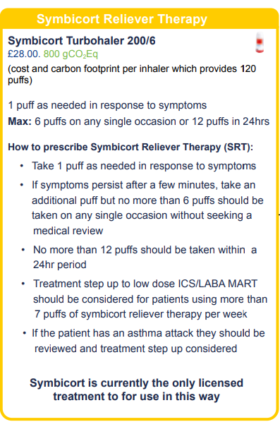
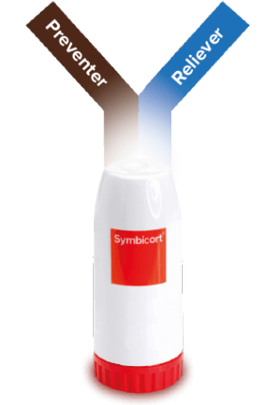
Key features:
Only Symbicort is licensed for SRT
One inhaler only
Easy to use
Straight forward regime
Step-up or step-down treatment
Dose counter
Better for the environment
Evidence based treatment
Less exacerbations
Less hospitalisations
Less deaths

Slide 19
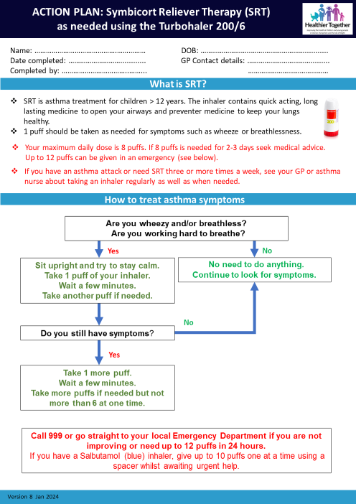

Slide 21
Separate ICS and saba regime are not recommended in this age group
Start with MART
SRT for those with very mild disease

Slide 22
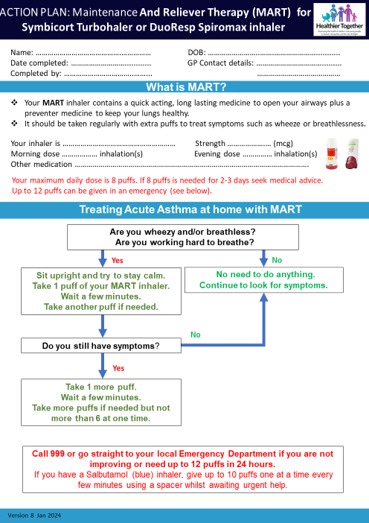

Slide 23
Annual Asthma Reviews - Face to face asthma reviews for children yearly or more frequently if needed - Review treatment/symptoms/expectations - Check Asthma Control Test Score - Triggers – indoor and outdoor air pollution - Check adherence/inhaler technique at every visit - Check diagnosis - Education - Asthma plan – for school and home Digital Health Passport | Digital Health Passport Fit to care | Primary Care Respiratory Society (pcrs-uk.org)

Slide 24
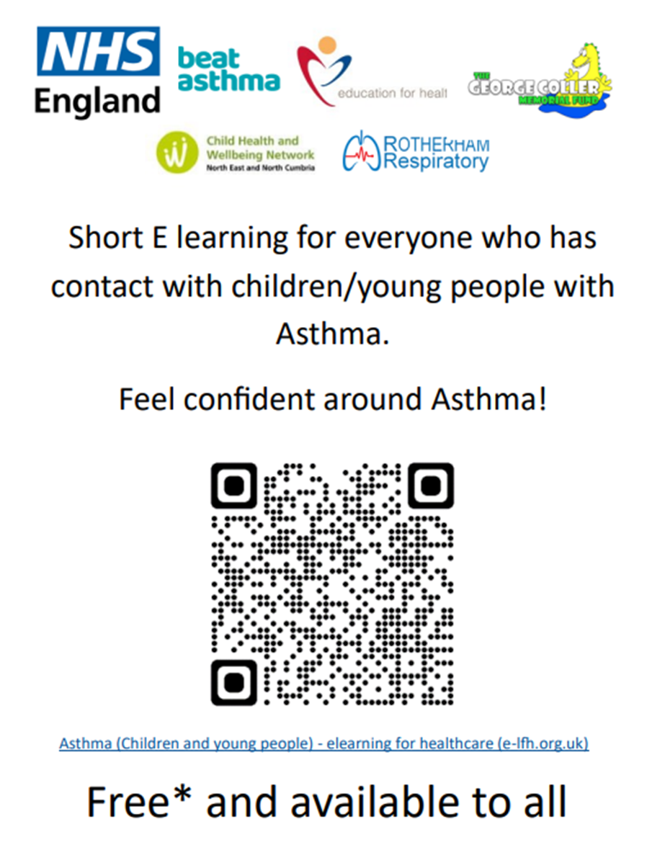
Any questions?
Emma.ray@uhs.nhs.uk
Training on:
Spirometry
Asthma medications/guidelines
Asthma management
Provision of:
Mentorship
Individual/group training
Asthma (Children and young people) - elearning for healthcare (e-lfh.org.uk)

