Slide 1
Primary Care vision and approach 2024/25

Slide 2
The wider context
National
Politics and influence within Primary Care ( i.e. RCGP/BMA)
Upcoming general election
Primary care access
Urgent and emergency care
Productivity: waiting lists
Money
Industrial action
Growing inequalities: CVD
Safe winter
Lack of clarity re future GP contract and contract not keeping pace with demand and inflation.
Regional
Urgent and emergency care
Safe winter
Workforce
Money
Opportunities:
Prescribing
Digital
Service transformation
Pharmacy first
ICB
Organisational redesign
Board Seminar outcomes
Strategic projects:
Project Fusion
INTs and Same Day Access
In development:
Clinical strategy framework
Primary care: modern General Practice
POD strategy
Investment proposals
Clinical considerations for planning
Primary-secondary care interface improvement work
Supporting the business model in General Practice

Slide 3
The role of a GP
Reflections from the Professional Leaders Workshop December 2023
What does the job of GP feel like today ?
Unmanageable demand and long days.
A constant battle to marry rising patient expectations with a real time reduction in funding.
Increasing clinical and operational risk.
Caseload is becoming more complicated, complex and frail.
Probably the most challenging it has been in my career.
Acute demand swamps everything – no time for preventative work and continuity.
Random, kind of fun, relentless and intense.
But still love it …
How do you see the role of a GP changing ?
Needs to be less fragmented with a focus on wrapping Integrated Teams around General Practice.
To become the professional who oversees a team but also delivers continuity to the most complex.
The traditional business model of General Practice is out of the date and will need radical change.
More focus on prevention and proactive care.
Supervising AHPs and wider MDT.
Need for targeted investment to deliver long term sustainable change.
Focus on developing the next generation of clinical leaders and resource the complexity i.e. Consultant GPs.

Slide 4
The Fuller Stocktake report set out a future vision for primary care centred around the creation of ‘integrated neighbourhood teams’ (INTs) that would deliver 3 ‘offers’
The Fuller Stocktake Report
The Fuller Stocktake Report, “Next Steps for Integrating Primary Care” outlines a new vision for primary care that orientates the health and care system to a local population health approach through building neighbourhood teams, streamlining access and helping people to stay healthy
One of the key opportunities to streamline access to urgent care for those that need it, more personalised care from a team of professionals for those with complex care needs and a proactive approach to prevention at a greater scale
What do the ‘offers’ mean for patients?
Improved access to urgent care, meaning:
Being able to get through to your GP team when you need to
Being seen on the same day when you need to
Getting the same advice and service no matter where you go
Improved continuity of care for those with complex needs, meaning:
Having a co-ordinator/single point of contact for your care
Being looked after by an integrated team who can support you holistically
Seeing the same healthcare professional when needed
Reduced health inequalities and improved prevention, meaning:
Helping people live longer and healthier lives
Ensuring those living in most deprived areas get the support they need

Slide 5
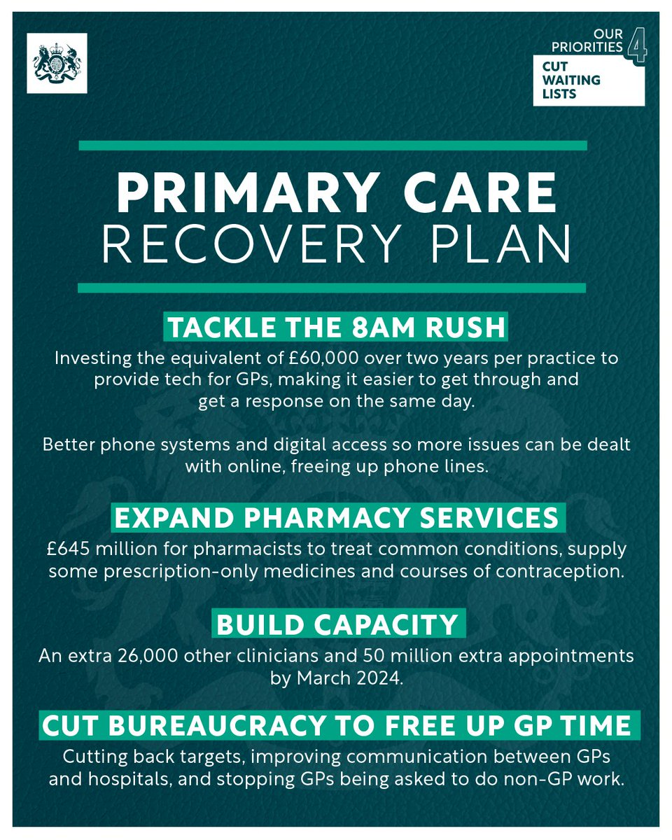
Primary Care Access Recovery Plan
The plan centres on four key areas to support recovery:
Empower patients to manage their own health including using the NHS App, self-referral pathways and through more services offered from community pharmacy. This will relieve pressure on general practice.
Implement Modern General Practice Access to tackle the 8am rush, provide rapid assessment and response, and avoid asking patients to ring back another day to book an appointment.
Build capacity to deliver more appointments from more staff than ever before and add flexibility to the types of staff recruited and how they are deployed.
Cut bureaucracy and reduce the workload across the interface between primary and secondary care, and the burden of medical evidence requests so practices have more time to meet the clinical needs of their patients.
These four areas of focus are steered by two main ambitions:
To tackle the 8am rush – meaning patients should be able to not only contact their practice easily but be able to book an appointment (not necessarily on the same day as when they ring) when they ask for it.
For patients to know on the day they contact their practice how their request will be managed.
If their need is clinically urgent it should be assessed on the same day by a telephone or face-to-face appointment. If the patient contacts their practice in the afternoon they may be assessed on the next day, where clinically appropriate.
If their need is not urgent, but it requires a telephone or face-to-face appointment, this should be scheduled within two weeks.
Where appropriate, patients will be signposted to self-care or other local services (e.g., community pharmacy or self-referral services).

Slide 6
Developing our strategy

Slide 7
Vision
Primary care of the future
Improvement of the population health
Maximising investment and resource
Shifting from transaction to transformation
Primary Care at scale
(Place, INT and PCN)
Evidence and experience informed
Integration and collaboration
Levels of integration
Primary care at the interface of acute, specialist and community care.
Physical and mental health.
Health with social care.
Integrated Urgent Care
Strategic themes
Patient safety & addressing variation
Professional development & representation
Shift from gatekeeper to gateway
Workforce
Business intelligence
System Delivery
Population health Profiles
“Size of the prize”
Infrastructure
(Estates and digital)
Personalised care with most appropriate HCP
Primary Care Networks
Continuous quality improvement
Integrated Neighbourhood Teams
Quality & Outcomes
Improved care experience
Enhanced same day access
Reduced health inequalities
Enhanced working experience

Slide 8
Refreshing the Model of Care (Shift to proactive care )
The need to shift the balance to chronic disease management and focus on prevention and community health and wellbeing
To be successful we need to actively articulate the direction of PCNs as they develop into neighbourhoods:
the organisational building blocks for the delivery of local care transformation: workforce planning, training and development infrastructure, e.g., clinical placements, backfill
the configuration for agreed model of care delivery and outcomes for patient care
the basis for specialist support from our providers
To deliver this there are important system and change management building blocks that need to be put into place
An acceptance and agreement that for several key specialities specialist clinician time is spent out of hospital
Practices do need to work together and with others, including patients public and the voluntary sector within their PCNs and neighbourhoods across multiple purposes beyond the DES to further develop the ethos of co-production and maximising resources beyond the traditional commissioned services.
To outline and endorse the service offer from Community Hubs and outline timeline for implementation, linking practices and PCNs to the Community Hubs for long term condition management, prevention, health and wellbeing.
Formal alignment of resource in line with mandating of commissioning priorities.

Slide 9
Integrated Neighbourhood Teams Triple Aim
Improving Access
Primary Care Resilience
Addressing Health Inequalities
"Building on making PCNs stronger, give them the opportunity to integrate more with other services and not just at practice level. Workforce, time, funding are essential elements to enable us to work differently and provide more proactive care Empowering patients to look after themselves and good communication with the public is a key element "

Slide 10
Vision of a high performing health and care system
Highly motivated workforce
Thriving colleagues
Care for workforce
Data driven decisions
Single patient / clinical care record
Efficient electronic medical records that communicate
Respect for clinicians
Respect for primary care
Respect between different parts of the system for each other
Equal outcomes for whole population
Focus on equity of outcomes not same mechanisms
Money and resources shift to keep people well
Funding follows patients – long term planning for future
Funding distributed appropriately around the system
Prevention and early intervention
All parts of the system focused on population health
Health promotion
Empowered patients who understand what is available
Patients taking responsibility for health and wellbeing
Work in partnership with patients
Taking a whole system view, not separate silos
Patient centred care pathways and prompt referral pathways
No primary, secondary, tertiary barriers
Simplified patient flow, right person at right time
Less bureacracy & waste
Remove duplication
Involve primary care clinical leaders in decisions
Accountability for implementing improvement and transformation

Slide 11
Building the Case for Investment

Slide 12
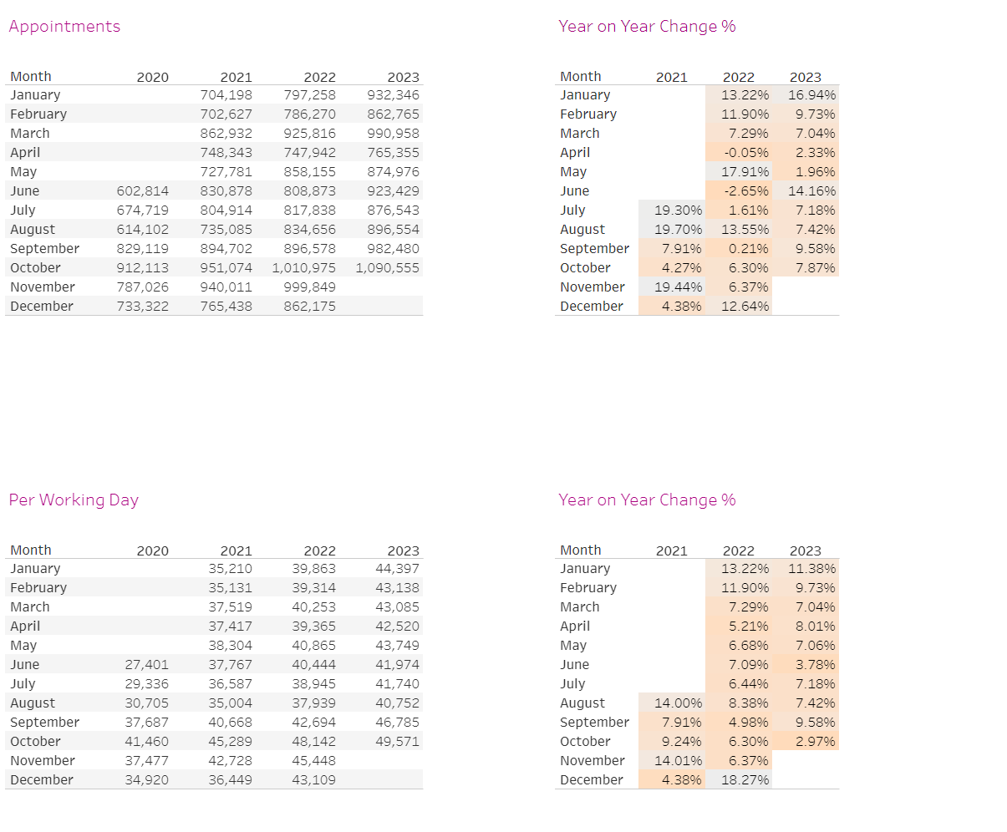
What could additional investment deliver
Currently invest 8% of total ICB budget into primary care*
Annually HIOW Primary care offers 10.5 million appointments
A 1% increase of ICB spend could increase activity by 12.5% or 1.3 million appointments per annum
ARI delivery shows there is a workforce that can stand up rapidly – other areas have invested annually into scaled contracts (e.g. Urgent Care centre in Aldershot by Frimley ICS)
ICB Board have asked for an updated Strategy for Primary Care with underpinning investment plan.

