Slide 1



Neurodiversity Awareness
& Employee Support
Developed by
in collaboration with the EDNA Service from Hampshire and Isle of Wight ICS and NHS England Regional Staff Experience Team
November 2023

Slide 2

What’s in this package
To raise awareness of neurodivergence, particularly for line managers with neurodivergent team members.
Helping organisations to create neuro-inclusive cultures
Genius Within is a neurodivergent led and owned business. The team of highly qualified Occupational Psychologists, workplace coaches and HR experts draw on lived experience, as well as decades of research and experience with clients.
Their evidence-based approach and consistent results have made them leaders in our industry, helping neurodistinct individuals access their inner genius and be at their best at work.
They have worked with several leading UK employers to support their employees, raise awareness of neurodiversity, and help them to embed neurodiversity and talent strategies into their business.
Included:
Crib Sheets for Managers
Bitesize e-learning modules and evaluation questionnaire
2 recorded sessions with a Genius Within Occupational Psychologist and EDNA Advisors

Slide 3
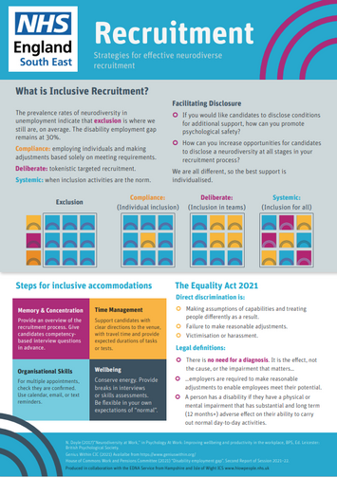
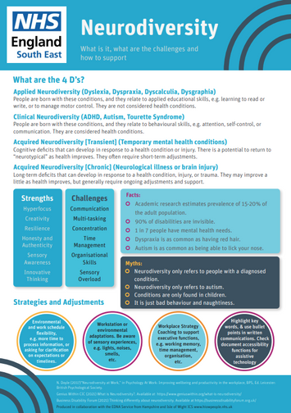
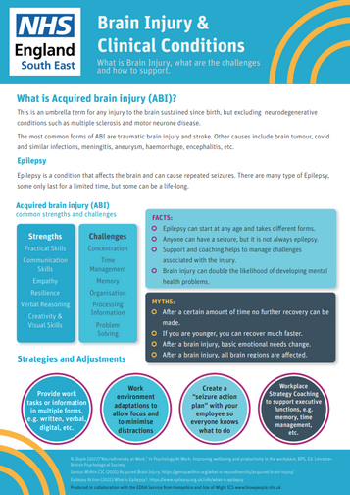

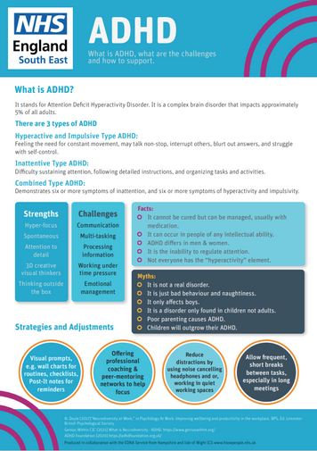
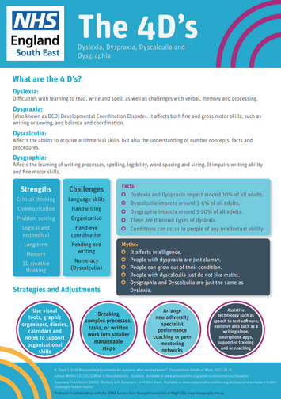
Manager tip sheets
Distribute to all managers in your Trust
Developed with Genius Within, theses training resources are designed to support staff and their managers across SE Region.
Share on your Intranet
Click on the images below to view the PDFs, which you can download.

Slide 4

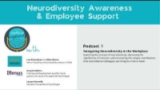
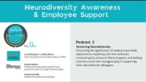
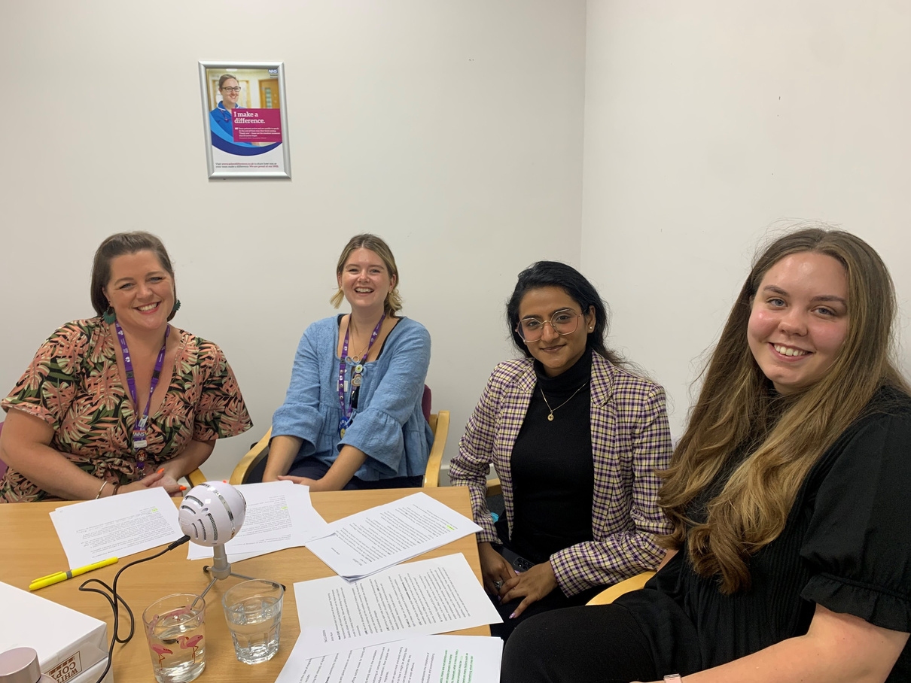


Podcast
listen here
Distribute to all managers in your Trust
Share on your Intranet
Podcast 1
Navigating Neurodiversity in the Workplace
Exploring the concept of neurodiversity, discussing the significance of inclusion, and uncovering the unique contributions that neurodiverse colleagues can bring to a role or team.
Podcast 2
Nurturing Neurodiversity
Discussing the significance of making reasonable adjustments, exploring cost-free solutions, uncovering the Access to Work program, and delving into the crucial role managers play in supporting their neurodiverse colleagues.
with

Slide 5



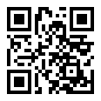
Manager Training
Coming early 2024
For your learning management system
Contact us at HIOWWellbeing@solent.nhs.uk and request access to the e-learning
There are 5 modules in total, with each module taking about 15 minutes. Learners have full control and can watch chapters multiple times.
Module 1
How to have the conversation – disclosure and asking the right questions.
Module 2
Reasonable adjustments
Module 3
Communication techniques and strategies
Module 4
Performance management
Module 5
Creating Neuroinclusive culture
Ask ask staff and managers to complete e-learning feedback form after completing modules
https://bit.ly/475mIfW

