Slide 1
Reasonable Adjustment Digital Flag
Notes:
Standard title slide

Slide 2
Information Standard Notice

Slide 3
Reasonable Adjustment Digital Flag (RADF) Information Standards Notice (ISN): Summary
What is an ISN?
Information standards are rules which tell people how they should share and organise information. For example, standards may specify which format and structure should be used when exchanging data, so that the information can be used and understood more easily. Information Standards Notices (ISNs) are published to announce new or changes to information standards. ISNs include details about the standard, when the standard will be implemented, whether it is mandated or voluntary, the legal or contractual basis upon which the data are being requested and details of key contacts.
What does the Reasonable Adjustment Digital Flag Information Standard mandate?
Under the Equality Act 2010, organisations have a legal responsibility to make reasonable adjustments to their provision, so that people with disabilities can access their services as easily as people who do not have disabilities.
The Reasonable Adjustment Digital Flag (RADF) has been built by NHS England in the NHS Spine and aims to ensure that health and care professionals can record, share, and view and review details of the reasonable adjustments that an individual needs. The flag may also include details of a person’s significant impairments and underlying conditions, on an optional basis.
Aims of the flag:
• Clearly identify patients who need reasonable adjustments when accessing services.
• Identify patients with impairments, including learning disability or autism, and other significant impairments.
• Identify and share the adjustments needed to ensure that an episode of care can proceed positively for that person.
• Ensure that the information is presented consistently and is accessible wherever and whenever patients seek care.
• Promote tailored and personalised care by identifying and updating reasonable adjustments, shared via the reasonable adjustment digital flag, in conjunction with the wishes of patients and carers.
What does this mean for organisations?
The Reasonable Adjustment Digital Flag (RADF) ISN applies to all health and publicly funded social care. It applies across the NHS and independent providers, social care (as providers) as well as independent contractors such as GPs and dentists. It also impacts all health and care IT system suppliers. Commissioners need to be mindful of these requirements in their contracts to ensure they enable and promote the Standard’s requirements. The ISN sets out the dates by which organisations must implement the RADF ISN (please see key dates below). Typically, GPs will create reasonable adjustment flags, but they can also be created by a range of health and care professionals such as nurses and therapists from learning disability teams, and it is expected that it will be everyone’s responsibility to view and create reasonable adjustment digital flags where appropriate.

Slide 4
Reasonable Adjustment Digital Flag (RADF) Information Standards Notice (ISN): Summary
Phase one – local first
Requires organisations to identify those that may need reasonable adjustments and then to complete a six-step process, as set out below, using defined & specified codes, in their own setting.
Phase two – national
The Fast Healthcare Interoperability Resources Application Programming Interface - FHIR API - is currently being tested. This will enable information and data to be passed effectively between each organisation’s own clinical IT systems and the Reasonable Adjustment Digital Flag on the NHS Spine, thus sharing locally recorded information between different organisations. The Flag can also be accessed directly via the National Care Record Service (NCRS) portal. Information can be both received and uploaded by each organisation, ensuring that the information held is relevant, up to date and best meets the needs of the disabled person.
Key dates
RADF ISN Implementation date: 12 September 2023
Organisations must conform to phase 1 requirements by: 31 March 2024
Organisations must conform to full conformance (phase 2) by: 30 June 2024
Post implementation review date: 30 June 2025
Useful links
Information Standards Notices - NHS Digital
https://digital.nhs.uk/binaries/content/assets/website-assets/isce/4019/4019772020isn.pdf

Slide 5
Reasonable Adjustment

Slide 6
Identify who might need Reasonable Adjustments
The need for Reasonable Adjustments is based on impairment and not on diagnosis, when creating a Flag
A person may be entitled to Reasonable Adjustments if they have:
A physical or mental impairment
that has a
substantial and long-term
negative effect on ability to do normal daily activities.
‘substantial’ is more than minor, e.g., it takes much longer than it usually would to complete a daily task like getting dressed
‘long-term’ means lasted for, or will last for,12 months or more. Examples include: life-long conditions such as a learning disability, progressive conditions such as MS, physical conditions such as significant loss of hearing, sight or mobility, fluctuating conditions such as clinical depression or dementia
Please note that to create a Flag, the person’s need for an adjustment must be as a result of their disability or impairment.

Slide 7
The Six-Step Process
Identifying and recording reasonable adjustments is the responsibility of all organisations and all those that work within them.
“I have identified someone who needs Reasonable Adjustments. What next?”
Once you have identified a person who may have Reasonable Adjustment needs, you should follow the six-step Reasonable Adjustment Digital Flag process. We will cover each of these over the coming sections, and how best to do each step.
1. Identify Reasonable Adjustments
2. Record Reasonable Adjustments
3. Flag Reasonable Adjustments
4. Share Reasonable Adjustments
5. Meet Reasonable Adjustments wherever possible
6. Review and update Reasonable Adjustment information where needed
Identify
Record
Flag
Share
Meet need
Review

Slide 8
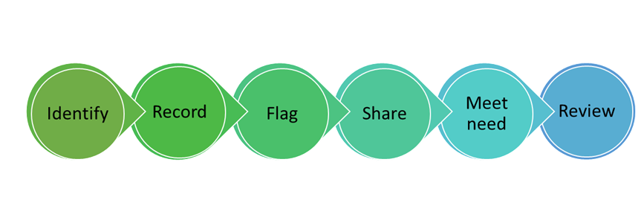
The Six Step Process
As we go through this training, we will look at each step and how this applies to you and your role
Identify – Who needs adjustments and what are they?
Record – Use your local system to record CONSENT and the ADJUSTMENT(S) needed
Flag – make sure there is a HIGHLY VISIBLE marker on the record
Share – make sure you share any recorded Reasonable Adjustments in ALL communications you use, if the patient has consented, this information will be shared via the RADF
Meet – make your best EFFORT to meet the adjustment – it’s only fair to do so
Review – ASK if any changes need to be made and record that a review has taken place

Slide 9
The Six Step Process (2)
Everyone should check if a Flag is in place and act on what has been recorded
Which steps you will then need to undertake on the Six Step process will depend on your role. You may not be involved at every step, but it is your responsibility to make sure that, if it is not appropriate for you to do a certain step, you have ensured that this is being done by someone else.
For example:
A receptionist or administrator asks at check-in if reasonable adjustments are needed. The person feels they might have some reasonable adjustment needs so the receptionist provides an information sheet or questionnaire to be completed by the patient or carer.
A patient might tell a receptionist or administrator that reasonable adjustments are needed. The receptionist alerts the clinician the patient is seeing at their appointment, so that a reasonable adjustment conversation can take place in the consultation
A clinician sees a patient in an out-patient clinic and discusses reasonable adjustments and consent. Paper notes are used in the clinic. The clinician completes a form, which is passed to an administrator (for example a coder) to enter the information digitally on the central system.
A clinician sees a patient in a Learning Disability Annual Health Check and notices that no flag is present. Computer notes are used in the clinic. They complete the Six-Step process, including gaining consent, and creates a Flag using the computer system

Slide 10
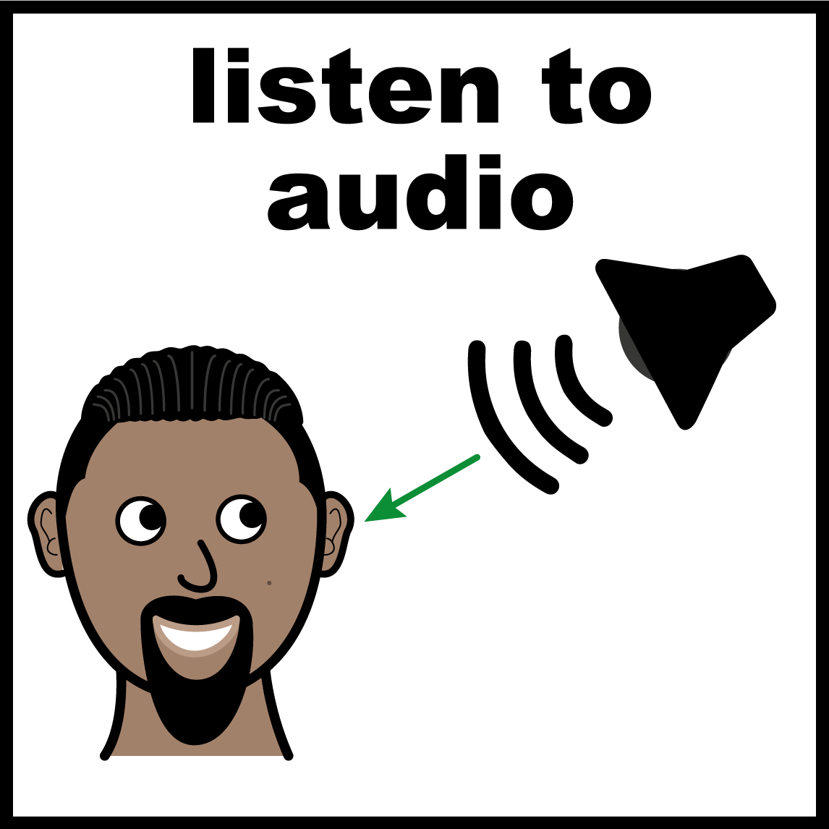
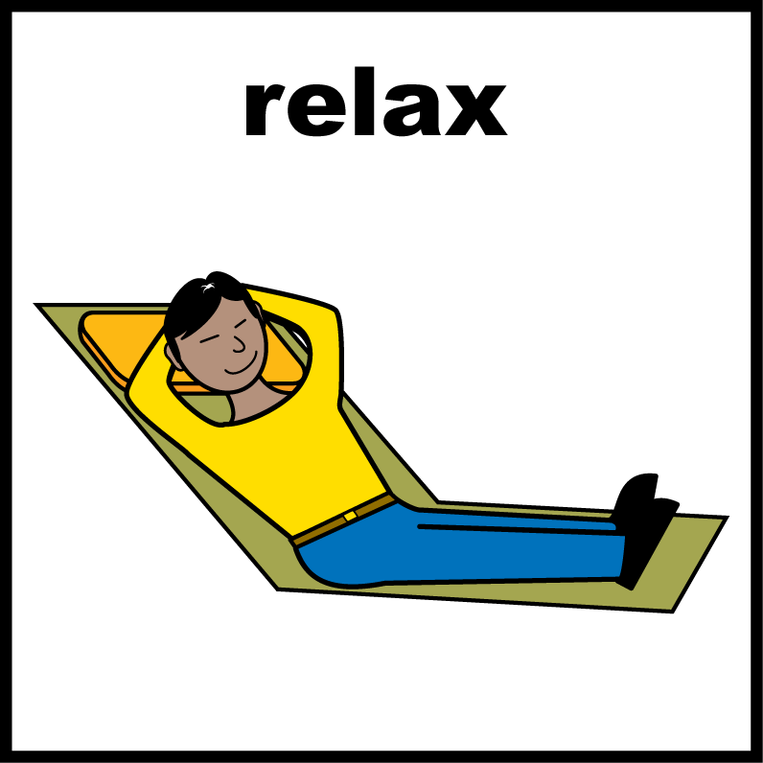
Case Study Example
all images/resources copyright @LYPFT
This is an example of best practice.
Jo has a moderate learning disability and is autistic. He had to go in for an MRI scan. He was anxious about this appointment. ​
Jo has Reasonable Adjustments identified and flagged on his record. This includes his need to avoid waiting, reducing surrounding noise (as this causes him more distress), and that he has a hospital passport which gives more information about the things that really help Jo.
The hospital team were aware of the Flags and made simple changes. The appointment team invited him in for the first appointment of the day to avoid him waiting, as per his hospital passport, which the Learning Disability Liaison Nurse had shared. They gave him a quiet area to wait for his scan. They played the Star Wars theme tune as he went into the scan (Star Wars is his absolute favourite) so that he was more comfortable and relaxed. ​
The staff were amazing, but these weren’t significant adjustments, just small things that made his experience better, much less anxiety provoking and more importantly, enabled him to have the scan.​

Slide 11
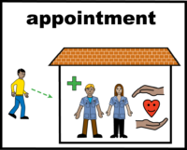
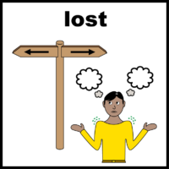
Case Study Example
all images/resources copyright @LYPFT
This is an example of where things could be improved.
Katie has a moderate learning disability and severe visual impairment. She saw her GP with abdominal pain and bloating, who decided she needed to be referred to hospital for a specialist outpatient assessment.
Katie has Reasonable Adjustments: she needs information in EasyRead and information in large font. She also needs instructions or directions given verbally as she can understand and retain this information well.
These adjustments were not identified or flagged on her record, so the hospital team were not aware of the reasonable adjustments Katie needed. She was sent a standard appointment letter from the hospital for a scan, but she was not able to read this or fully understand the information and therefore was unable to attend the appointment.
Her GP referred her again. The same standard process was followed by the hospital appointment centre, and the same standard letter was sent out. This time, Katie phoned the hospital and was told when her appointment was, but when she tried to find the scan department in a hospital she had never been to, she got very lost, distressed and ultimately went home before the scan could be done. Two months had now passed since the original referral.
Katie became much more unwell shortly after the second missed appointment and she was admitted as a medical emergency. She was in hospital for some time. The medical team who cared for her thought it was likely she might not have needed to be admitted if she had been able to have her scan when she was first referred. This may have been possible if a Flag had been present on her records; the hospital appointment team could have made some simple changes such as sending a letter in large font and phoning Katie to give her verbal instructions. This may have resulted in a more positive outcome for Katie and reduced cost to the organisation (through missed appointments and an extended hospital stay).

Slide 12
Technical Overview
The following slides show how the ADD, GET and UPDATE functions of the API work in practical terms.

Slide 13
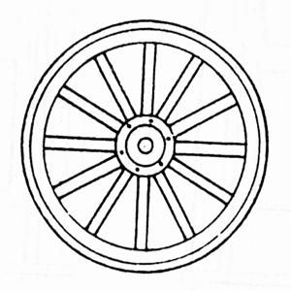
The hub and spoke model
The hub and spoke model.
A, B & C represent organisations
The centre is the national spine
Spine
A
B
C

Slide 14
ADD Application Programming Interface API
ADD API
Organisation A realizes the need for a reasonable adjustment
The ADD function allows them with consent to share this with the spine
Spine
A
ADD
B
C

Slide 15
GET Application Programming Interface (API)
GET API
Organisation B is reviewing a patient and checks the spine to see if anyone has recorded an adjustment
In this scenario organisation B will have the information organisation A added
Spine
A
Get
B
C

Slide 16
Update Application Programming Interface
(API)
Update API
Organisation B realizes there is an additional adjustment needed. The UPDATE function allows the central record to be iterated with the additional detail
Spine
A
Get
UPDATE
B
C

Slide 17
Summary
Summary
Organisation C now using the GET API will get the adjustments recorded by orgs A & B
Spine
A
B
Get
C

