Slide 1
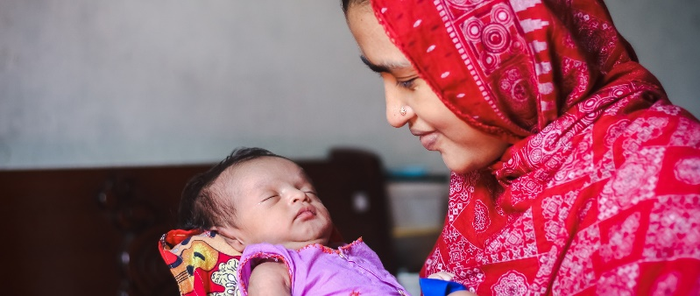
Vulnerable migrants, including refugees and asylum seekers, are at greater risk of poorer maternity and neonatal outcomes.
These Pregnancy Care Transfer Cards have been adapted with thanks from a concept developed by Surrey Heartlands Local Maternity and Neonatal System and are available in 28 languages.
They aim to:
Improve safety by supporting pregnant women and pregnant people to access maternity care as soon as possible after they move
Facilitate the sharing of pregnancy records between healthcare professionals to ensure seamless care
We recommend that use of these cards is ideally discussed with pregnant women and pregnant people in conjunction with a suitable interpreter.
We hope you find these resources helpful and please share widely with your networks.

