Slide 1




It's time to put your wellbeing first. Join the new series of Work Well Webinars in 2023/24
Join our Work Well Webinar Series
For Healthcare Teams Under Pressure
Are you fed up of waiting for “things to calm down” before you can feel calm and confident at work again?
Would you like to know how to actually enjoy work, let go of guilt and handle stress - even though things are busy and there’s never enough time?
Starting November 2023, Hampshire and Isle of Wight Primary Care Training Hub is offering a monthly series of wellbeing webinars to ALL staff. At these free sessions you’ll discover practical strategies on how to beat burnout, handle stress, set boundaries and support your colleagues more effectively.
These online trainings take place in the evenings, so you can watch from home live (or catch up with the recording whenever you like)
Listen to the
latest podcast @ youarenotafrog.com
I’m Dr Rachel Morris, GP, Coach, host of the You Are Not A Frog podcast, and creator of the Shapes Toolkit.
I am a former GP and team coach with a background in Medical Education and I specialise in resilience at work.
I designed the Work Well Webinars for doctors and other busy healthcare professionals to make a deliberate choice about how they will live and work, so they can thrive not just survive, even through challenging times.
www.shapestoolkit.com | admin@shapestoolkit.com

Slide 2

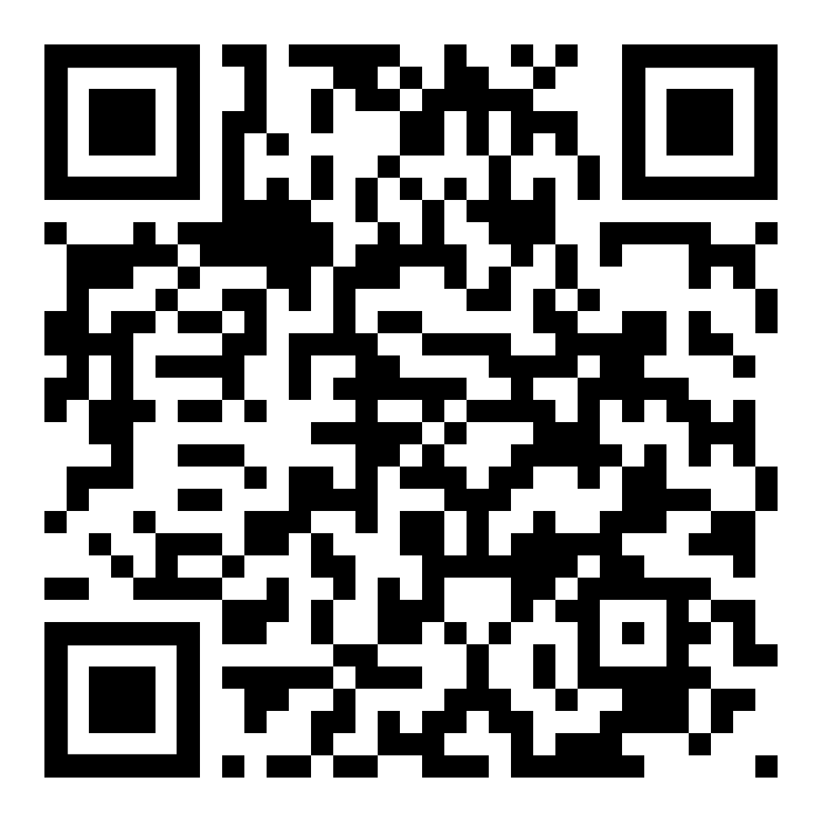
NEXT SESSION:
14 NOVEMBER 7:30-8:30PM
“How to support your colleagues without burning out yourself” with Annie Hanekom, Leadership and Team Coach
Work Well Webinar Future Topics Include
How to beat burnout in challenging times
How to deal with your inner critic and overcome imposter thinking
How to have healthy conflict conversations
How to embrace your limits, say no and deal with pushback
Working well through menopause
Bonus
*BONUS: You’ll also get access to a Practice Wellbeing QI Toolkit containing all the tools and resources you need to do a Quality Improvement project in your practice – and meet the QoF targets.*
Scan the QR code and
book your place today!
REGISTER FOR YOUR
FREE PLACE TODAY
www.shapestoolkit.com | admin@shapestoolkit.com

