Slide 1
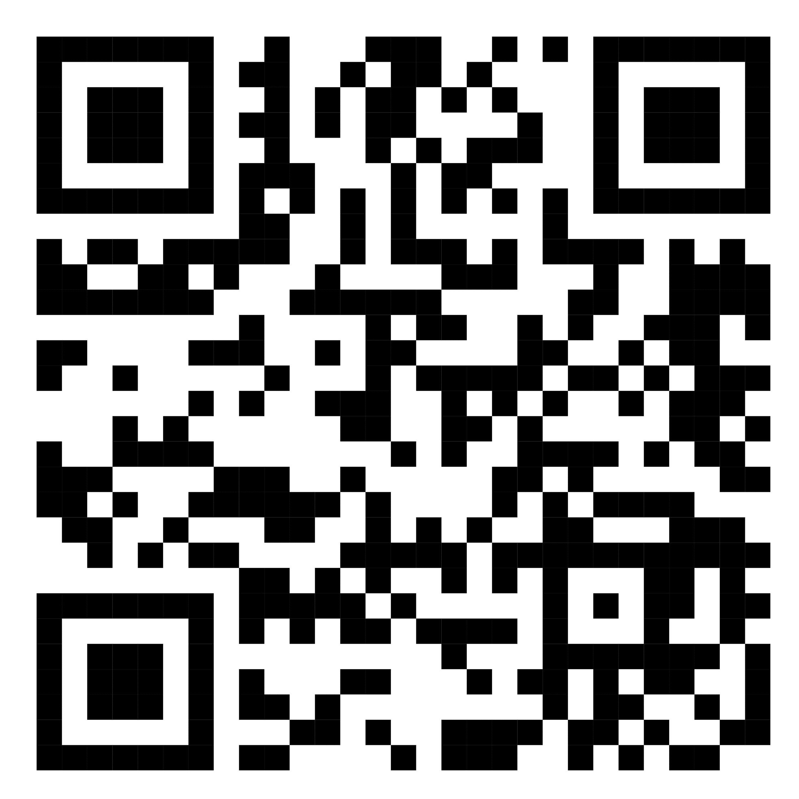
National Bundle of Care for Children and Young People with Asthma
Emma Ray RN, BSc (Hons), MRes, ARTP
Clinical Practice Educator: Hampshire and the Isle of Wight
National Bundle of Care for Children and Young People with Asthma
Respiratory Nurse Specialist
Please complete
our quick survey

Slide 2
Aims
The National Bundle of care for children and young people with asthma
Training resources and help available
Update on progress on main themes
Questions

Slide 3
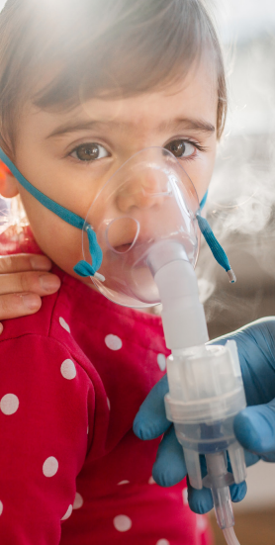
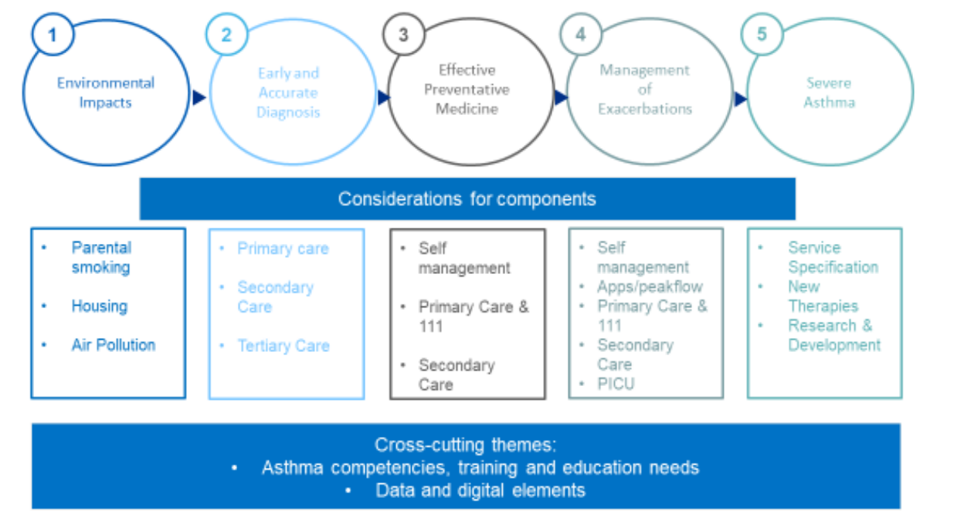
National Bundle of Care Children and Young People with Asthma
NHS long term plan – respiratory priorities 2019
Improve care and outcomes for CYP with asthma
Hampshire and Isle of Wight region – Professor Gary Connett and Emma Ray
Notes:
NHSE and NHS Improvement have worked with key stakeholders and patients and carers to develop the care bundle to support systems to better care for CYP with asthma.
5 key area with cross cutting themes, one being early and accurate diagnosis
Pilot site
What the bundle involves
Who we are
We want to work with you
Lung disease is the 3rd biggest cause of death in England
Costs the NHS £13.8 billion in direct in-direct costs per year
Respiratory admissions have risen and increase by 80% in the winter
Incidence and mortality rates of lung disease are higher in deprived areas
Highest rates of asthma deaths for the whole of Europe
Respiratory diagnosis is often made on admission
Medications costs are substantial
Estimated 30% don’t have the correct diagnosis in asthma
Why do we need a care bundle
Higher asthma attacks for CYP with asthma than most other countries
Poorest asthma outcomes in the whole of Europe
Despite NRAD avoidable asthma deaths in CYP continue to occur

Slide 4
What we can offer you
One to one education
Group training/updates
Mentorship
Wessex Paediatric Asthma Network (WRAN)
WRAN face to face educational event next year

Slide 5
Spirometry services
Reinstating spirometry services for CYP not just adults
Spirometry update in peads for those experienced in spirometry in CYP or support with training
Consider doing a joint course (paediatric and adult) if you are new to spirometry

Slide 6
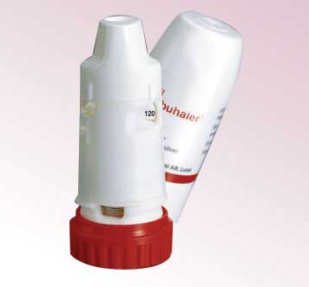
What will be coming
Wessex asthma guidelines – diagnostic guidelines for 12+
Anti-inflammatory and reliever medication
Maintenance and Reliever Therapy (MART)
Diagnostic pathway in the 6-11 range
Self-management plans
Emergency Guidelines

Slide 7
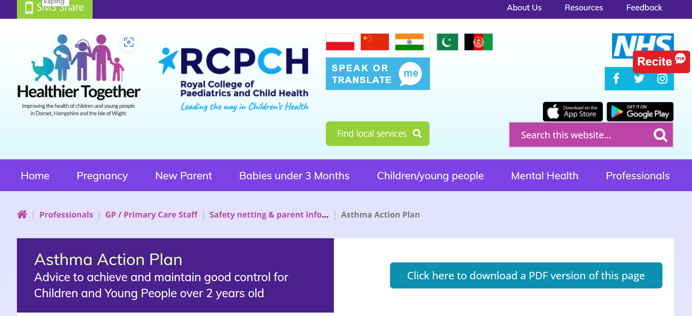
Healthier Together website Home :: Healthier Together (what0-18.nhs.uk)
Available as an app
Not just about asthma
Health resources
Asthma plans
Emergency asthma advice
Health care proffesionals advice

Slide 8
Asthma Friendly Schools
School deaths
Lack of school nurse provision
Resources housed on Healthier Together Website
Accreditation involves:
School asthma policy
School asthma champion
Maintaining a list of children with asthma
Emergency asthma inhaler and spacer
Personalised asthma action plan (PAAP)
85% of school staff will need to complete training (e-learning, recorded webinar, me)

Slide 9
Environmental Impacts
Indoor air pollution: Smoking
Healthier Together update
Training available: Very Brief Advice training
Very Brief Advice training module (ncsct.co.uk) - Solutions4Health (Hants/IOW not Portsmouth)
Direct referrals to stop smoking service via EMIS and System 1
In-house stop smoking service
Pharmacy stop smoking service
Nicotine replacement therapy, vaping to stop smoking, zyban

Slide 10
Indoor air pollution: Housing
Awab Ishaak died aged 2 on 2020 as a result of exposure to damp and mould
Awabs Law – Housing Ombudsman new powers. Decent homes standard to be applied to rented sector, professional standards for housing officers.
Direct parents to: the Environment Centre (tEC) – Bringing the benefits of sustainability to everyone (Hampshire only)
Letter templates for housing

Slide 11
Outside air pollution
Urgent public health emergency
Causes up to 36,000 deaths, 20,000+ respiratory and cardiovascular hospital admissions and 6 million sick days every year in the UK
Estimated total social cost of £22.6 billion per annum.

Slide 12
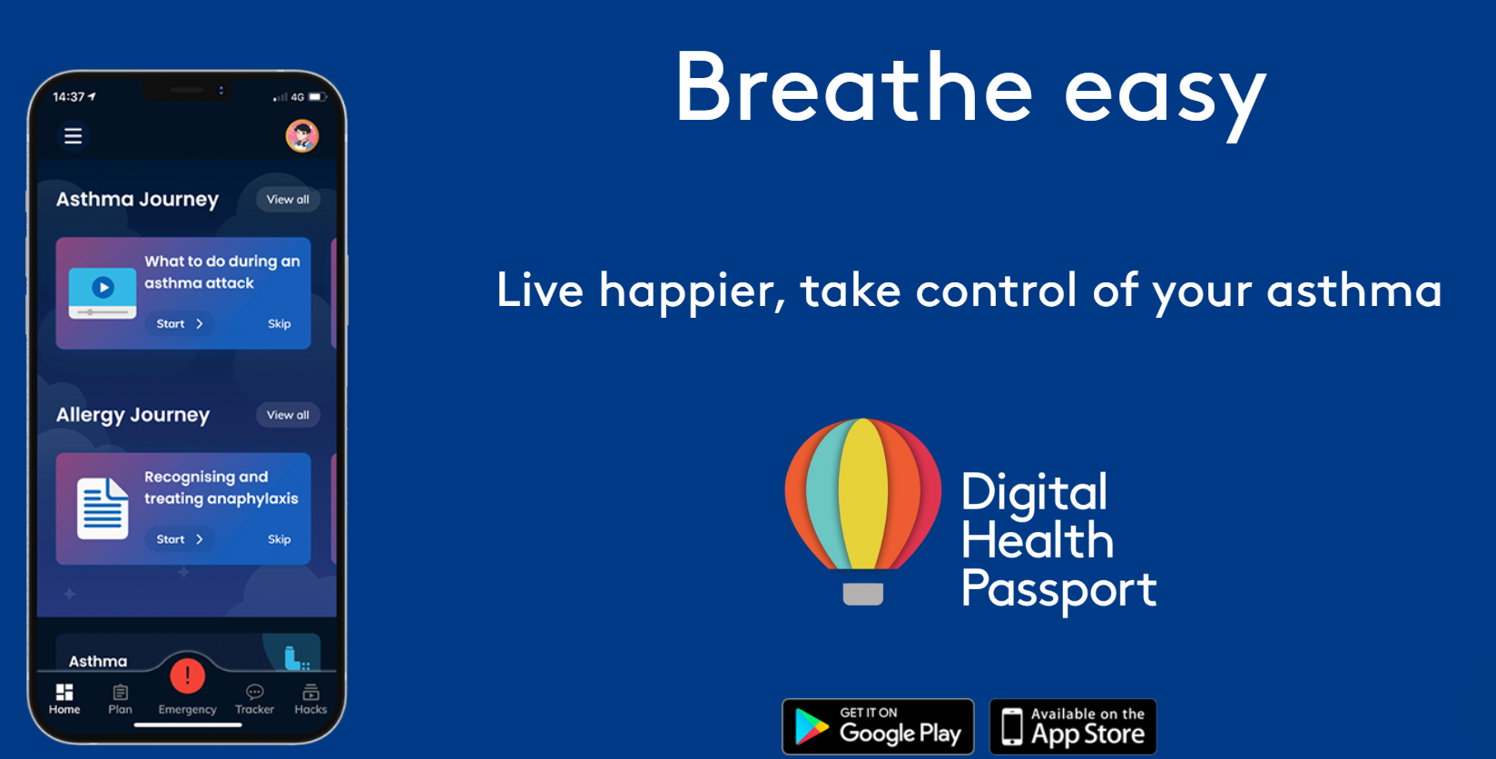
Digital Health Passport – Asthma and allergy Digital Health Passport – Digital Health Passport
Available for age 13-25 years
Under 13 parents can download it
Downloadable app
Air pollution and pollen alerts
Advice and education
Everything in one place – asthma plan
Alerts and emergency advice
Anaphylaxis and allergy advice
Transitioning from childrens to adult services

Slide 13
Thank you Any questions? emma.ray@uhs.nhs.uk

