Slide 1
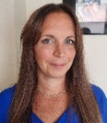
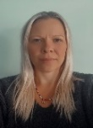
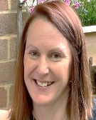
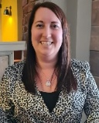
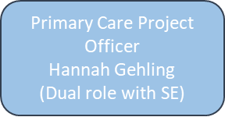
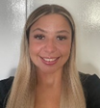
Our Team – Primary Care and Long-Term Conditions Southampton
Quality Team
Sarah Rochford
Sue Kingsbridge
Medicines Management
TBC
Deputy Director - Primary Care
Josie Teather-Lovejoy
(1 WTE)
Senior Commissioning Manager - LTC
Genevieve Ryan
(0.9 WTE)
Primary Care Access & Resilience Lead
Emma Barnard
(0.8 WTE)
Primary Care Contracts & Integration Lead
Hannah Beauchamp (0.8 WTE)
Commissioning Manager - LTC
Tracy Blake
(0.9 WTE)
Commissioning Manager - LTC
Hannah Murphy
(0.6 WTE)
Primary Care Development Manager
Katy Collins
(1 WTE)
Primary Care Development Manager
Emily Penfold
(0.6 WTE)
Primary Care Development Officer
Matthew Buck
(1 WTE)
Vacant
Primary Care Contracts Public Health (PH Funded)
Associate Commissioning Manager - LTC
Matthew Davies
(Secondment to PMO)
Primary Care Contract Support Officer
Freya Kennedy
(1 WTE)

Slide 2
Southampton Primary Care & Long-Term Conditions Team Roles and workstreams
Job Title | Name |  | Workstream | Area Covered
Deputy Director – Primary Care | Josie Teather-Lovejoy | 07392272175 josie.teather-lovejoy@nhs.net | Strategic Lead and budget holder | All Areas across Southampton
Primary Care Access & Resilience Lead | Emma Barnard | 07341844650 ebarnard@nhs.net | Workforce, GP Resilience, PCN DES Monitoring, Extended Access, PCN Workforce, OD Plans, PCN Managers Forum, Premises Improvement Grants, Digital and IT, CQRS, Demand and Capacity | All Networks, Practice Resilience
Primary Care Contracts & Integration Lead | Hannah Beauchamp | 07900244856 h.beauchamp@nhs.net | Core contracts, Local commissioning, Care Homes, Estates, Acute Visiting service, Core20Plus5, Health Inequalities, One Team | All Networks/ Practices Contracting
Senior Commissioning Manager - LTC | Genevieve Ryan | 07385399008 genevieveryan@nhs.net | Respiratory, Cardiology, Diabetes, BAU Minimisations, Financial efficiencies, LTC Team management | Long Term Conditions
Commissioning Manager – LTC | Tracy Blake | 07766409864 Tracy.blake@nhs.net | Cardiology, Respiratory | Long Term Conditions
Commissioning Manager – LTC | Hannah Murphy | 07920757804 Hannah.murphy19@nhs.net | Diabetes, Podiatry, Stroke | Long Term Conditions
Primary Care Development Manager | Emily Penfold | 07880172342 emily.penfold@nhs.net | Target, Practice Training, Practice Managers Forum, Practice Engagement, SAS contract, Cancer, SMI, CVD, Respiratory and BP@Home | Bitterne, Woolston & Townhill and Living Well PCN
Primary Care Development Manager | Katy Collins | 07880 271692 katy.colins3@nhs.net | Practice Engagement, Winter Assurance, System Resilience, GP Tutorials, PPG, Resettlement Programme, LD, Tackling Health Inequalities, Social Prescribing | West, North and Central PCN
Associate Commissioning Manager - LTC | Matthew Davies | 07517484345 Matthew.davies40@nhs.net | Currently on secondment to PMO | Long Term Conditions
Primary Care Contracting Manager |  | Vacant |  | All areas across Southampton
Primary Care Development Officer | Matthew Buck | MS Teams matthew.buck@nhs.net | Rent Reviews, Digital equipment, Population Health Management, APEX, Practice Data packs | All Networks/ Practices/ Digital
Primary Care Project Officer | Hannah Gehling | MS Teams hannah.gehling@nhs.net | ARRS Workforce, GP Retention, Finances, Network Payments, Maternity/Paternity/Sickness, Boundaries and Maps, transformation & improvement (LD, SMI etc) project support, digital support (Currently in dual role with South East) | Project support, Finance
Primary Care Contract Support Officer | Freya Kennedy | MS Teams freya.kennedy@nhs.net | Ad Hoc queries, Generic mailbox, meeting support, FYI Friday & Practice comms, contract support, Contract Queries, | All Networks/ Practices

