Slide 1
Invitation to Regional Share and Learn Event for Digital Leads in Primary Care
Hosted by NHS England South East
Supported by

Slide 2
Regional Digital Share & Learn Event – 5th October 2023
AGENDA | Introduction
 | Welcome and introductions | 5 mins | Kamal Bahia
 | Purpose of today – objectives and agenda (you said – we heard and did it) | 5 mins | Kamal Bahia
 | Keynote speech – phrase | 15 mins | TBC
 | Journey so far | 5 mins | Amanda Meehan
 | Part 1: Emerging priorities and local networking
 | Emerging priorities – national and ICB | 10 mins | Ash Dwivedi
 | Local showcase (developments) – Digital Transformation Leads | 20 mins | X2 DTL
 | Local share and learn / networking – ICB groups / Combined groups | 30 mins | All
 | Plenary – quick feedback (Menti or verbal) | 5 mins | Amanda Meehan
 | Break – 15 mins
 | Part 2: Showcase
 | Showcase 1: Digital hub (Access, demand and population segmentation, ARRS utilisation) with Q&A | 25 mins | Dr Jeremy Mellins
 | Showcase 2: K&R PAC (data dashboard, patient id, care coordination and outcomes) with Q&A | 25 mins | TBC
 | Part 3: Next steps
 | Plenary – Menti ranking – prioritise areas + forward plan for in drop in sessions |  | Amanda Meehan
 | Summary, next steps and close | 10 mins | Kamal Bahia
 | Don’t forget to do feedback survey ☺ | 5 mins | All

Slide 3
SE Region Share and Learn Event: Digital transformation in primary care
This event is for anyone with a passion or interest in digital transformation in primary care, to share learning, ideas and to network with colleagues and industry experts.
When: Wednesday 20th September 2023
10.00 am – 12.30 pm
Where: Microsoft Teams
Hosted by: Kamal Bahia
SE Region PCN Development Lead
Keynote speaker: TBD
Draft Agenda:
10.00 – 10.10 - Welcome – Kamal Bahia
10.10 – 10.25 - Keynote speech
10.25 – 11.15 – Access models (with breakout rooms)
11.15 – 12.00 – Expert insights
12.00 – 12.20 – Digital solutions
12.15 – 12.30 – Next steps and close
There will be opportunities throughout the event to network with colleagues, please ensure cameras and mikes are working
Supported by

Slide 4
The journey so far……..

Slide 5
Supporting PCNs with digital transformation: The 3-day course
3 cohorts of the 3-day digital transformation course were codesigned in the NHS South East region, delivered by Health Integration Partners in conjunction with INPD. There was good representation from systems within the region. Delegates ranged from new to the NHS, established clinical directors, Digital Transformation Leads and PCN managers.
The course included a mix of theory, best practice and case studies and time for delegates to share ideas.
Course outline:
Methodology for delivery of the course
Day 1
Theory and best practice
Strategic direction of NHS and leading effective teams
Day 2
Developing a strategy for your PCN
Share and learn
Professional insights
Day 3
Change management and action planning
After course wrap around:
Aim to listen to delegates
Support success in project delivery
Join up with other support and resources ( local and national)

Slide 6
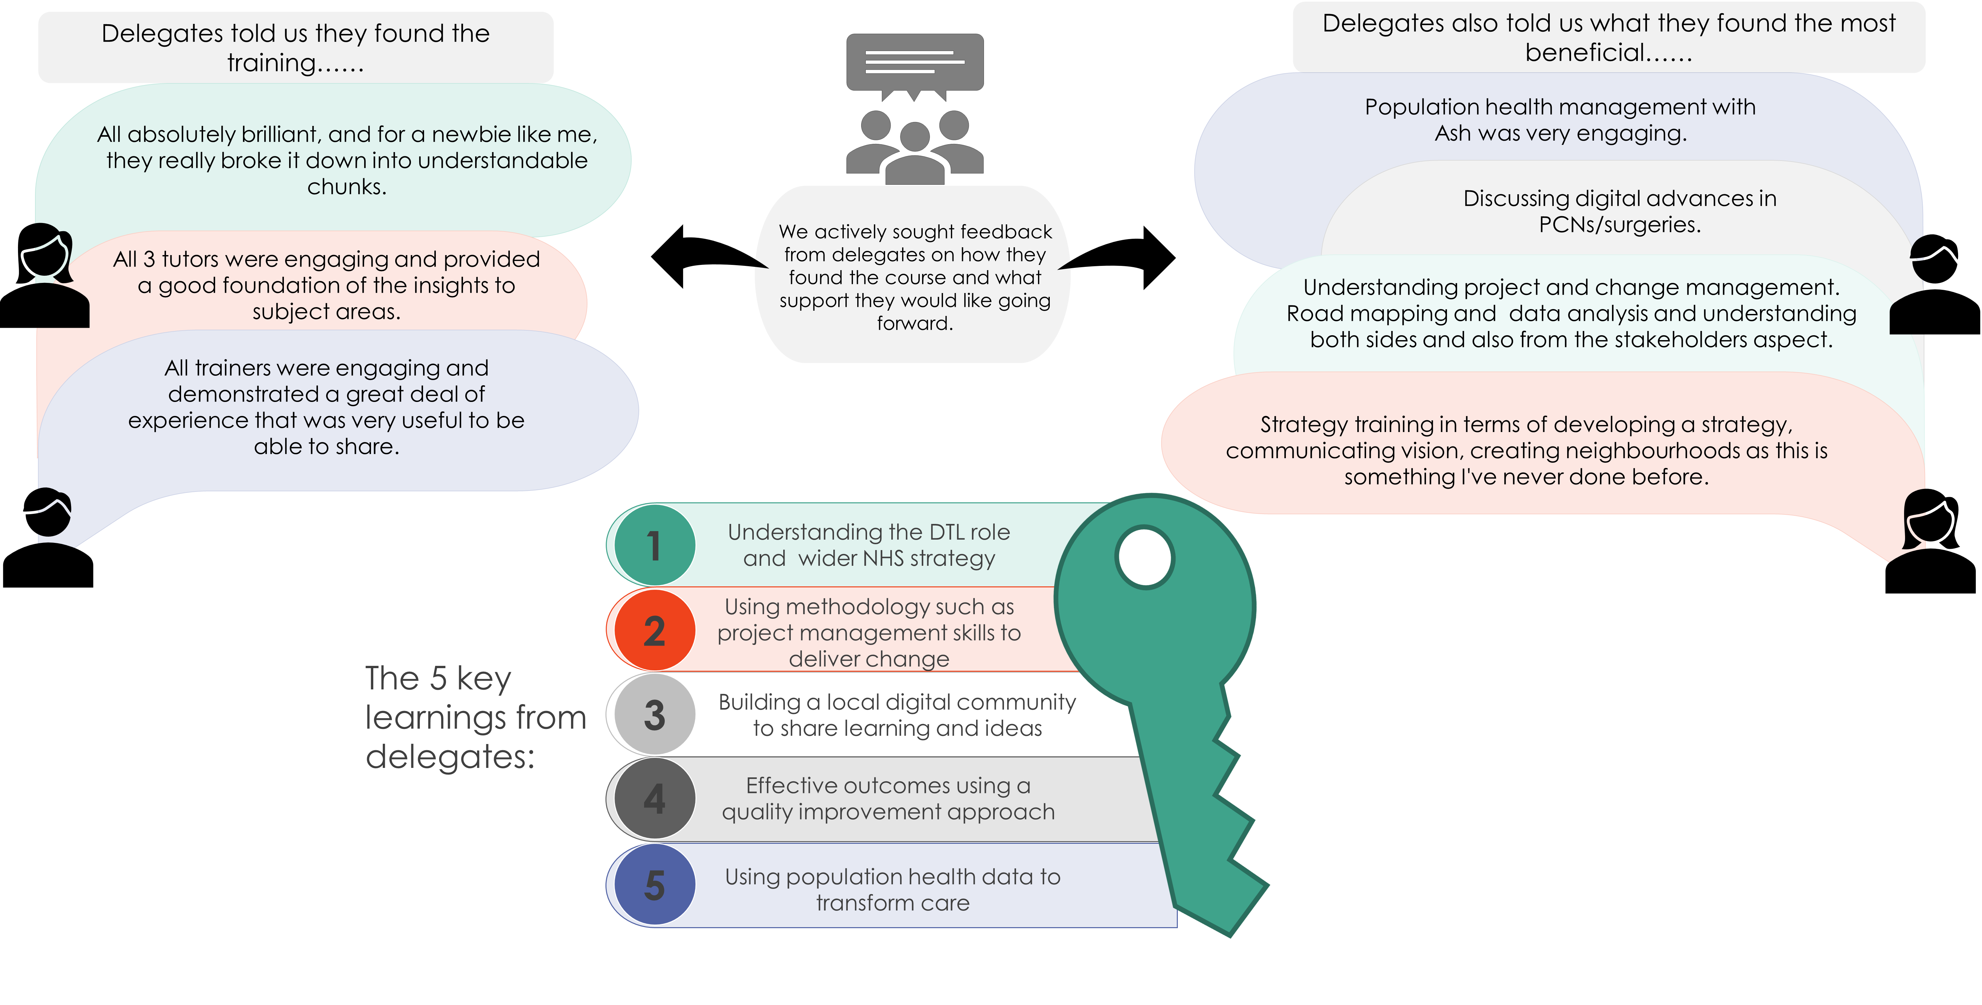
Supporting PCNs with digital transformation Feedback following the course

Slide 7
Supporting PCNs with digital transformation
After course wrap around
1
3
NHSE Primary care team met with the course delegates, Health Integration Partners or HIP (course tutors and transformation experts) on 01 August to plan a share and learn event.
Challenges digital leads are facing……
No informal networking event to get ideas
Managing practice expectations and politics
Getting people to understand the role of DTL
How to access funding
Links with ICB digital teams
2
Next steps
Delegates told us they would like to see at the share and learn event…..
Best practice- Access, total triage models
What has worked elsewhere
Quick wins
Learning around clinical hubs and digital infrastructure
Data dashboards
Reps from digital suppliers
ICB priorities
4
2. Health Integration Partners ( HIP) to meet with ICB digital leads to join up support for delegates
1. Regional Share and Learn Event hosted by NHSE

