Slide 1
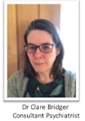
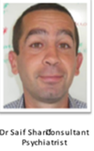
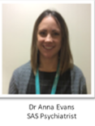
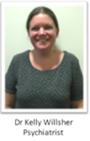
Learning Disability Psychiatry and Primary Care Liaison
Come and meet your local Learning Disability Psychiatrists for South East Hampshire and Southampton
11th July 12.00-13.00
MS Teams
Contact amy.george@southernhealth.nhs.uk to book on
Dr Sharif will also be talking about Dementia in Learning Disabilities
Discussion
Advice
Education

