Slide 1
HIOW Childrens Long Covid Pathway
Dr Mark Alderton – Clinical Lead
Carol Quint – Clinical Team Coordinator Solent

Slide 2
Definitions and incidence
Acute Covid-19
Signs and symptoms of Covid-19
Up to 4 weeks
Ongoing symptomatic Covid-19
Signs and symptoms of Covid-19
Up to 4 weeks
Post Covid-19 syndrome
Signs and symptoms that developed during or after infection
Ongoing more than 12 weeks
Clusters of symptoms, can fluctuate and change , can affect any system in the body
Post Covid-19 can be considered prior to 12/52 while alternate underlying disease investigated.

Slide 3
What does Covid-19 look like for children?
NHS & NHS I Long Covid and Children webinar 2021

Slide 4
Paediatric Inflammatory Multisystem Syndrome
Fever, rash, abdominal pain, diarrhoea, vomiting, headache, conjunctivitis
Low lymphocytes, high neutrophils, v high CRP, low albumin, high fibrinogen, high trophin, high NT-BNP
30-40% severe, shock myocardial dysfunction ECG, abnormalities coronary artery dilation bowel inflammation

Slide 5
Persistent symptoms in non-hospitalised children
Energy levels 83.3%
Mood 58.8%
Sleep 56.3%
Appetite 49.6%
Multi-system condition
Headaches
Fatigue
Joint pain
Sore throat
Gastrointestinal issues
Nausea
Rashes
Dizziness
Mood changes
Chest pain
Brain fog

Slide 6
COVID-19 our local response
1. Acute COVID-19 - Signs and symptoms of COVID‑19 for up to 4 weeks. Managed in primary and/or secondary care.
2. Ongoing symptomatic COVID-19 - Signs and symptoms of COVID‑19 4 -12 weeks.
Managed in primary and/or secondary care.
3. Post-COVID-19 syndrome / Long COVID - Signs and symptoms that develop during or after an infection consistent with COVID‑19, continue for more than 10 weeks and are not explained by an alternative diagnosis.
Referral to Childrens Long Covid syndrome service
MDT triage
Face / face if required
Joint working with primary / secondary and specialist services
Provide therapy services as indicated – review at 12/52
Signpost and support self help / community resources.
Notes:
References the London Childrens ong Covid Model – but adapted to meet our local need
Secondary care for urgent / further investigations
f/f if clinically required / no reliable access to digital consultations

Slide 7
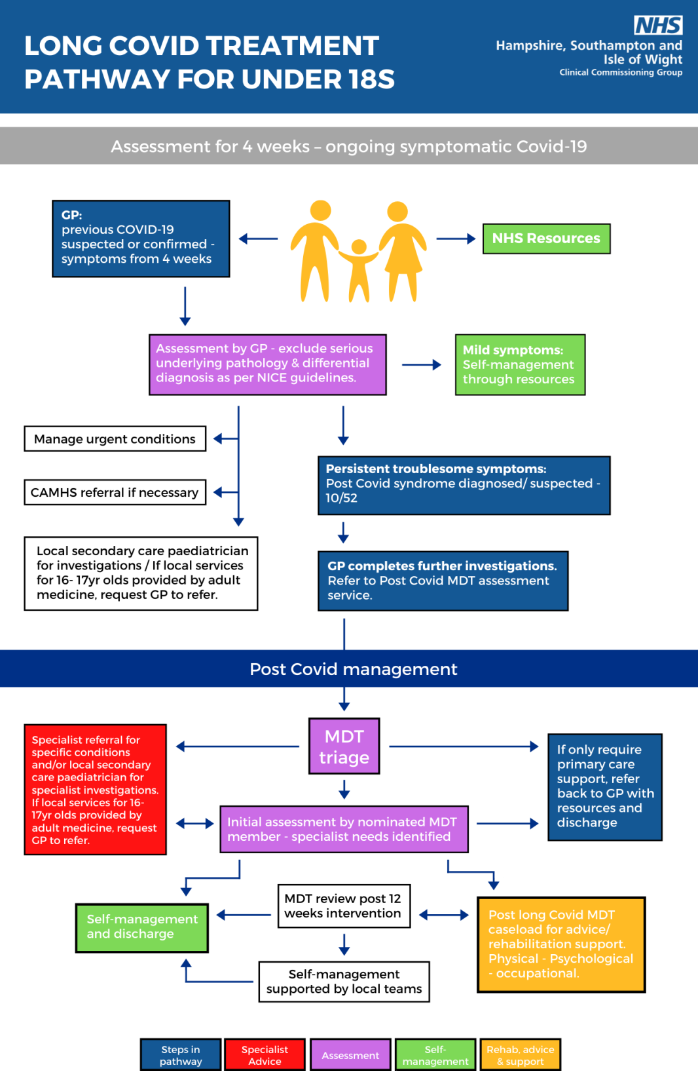

Slide 8
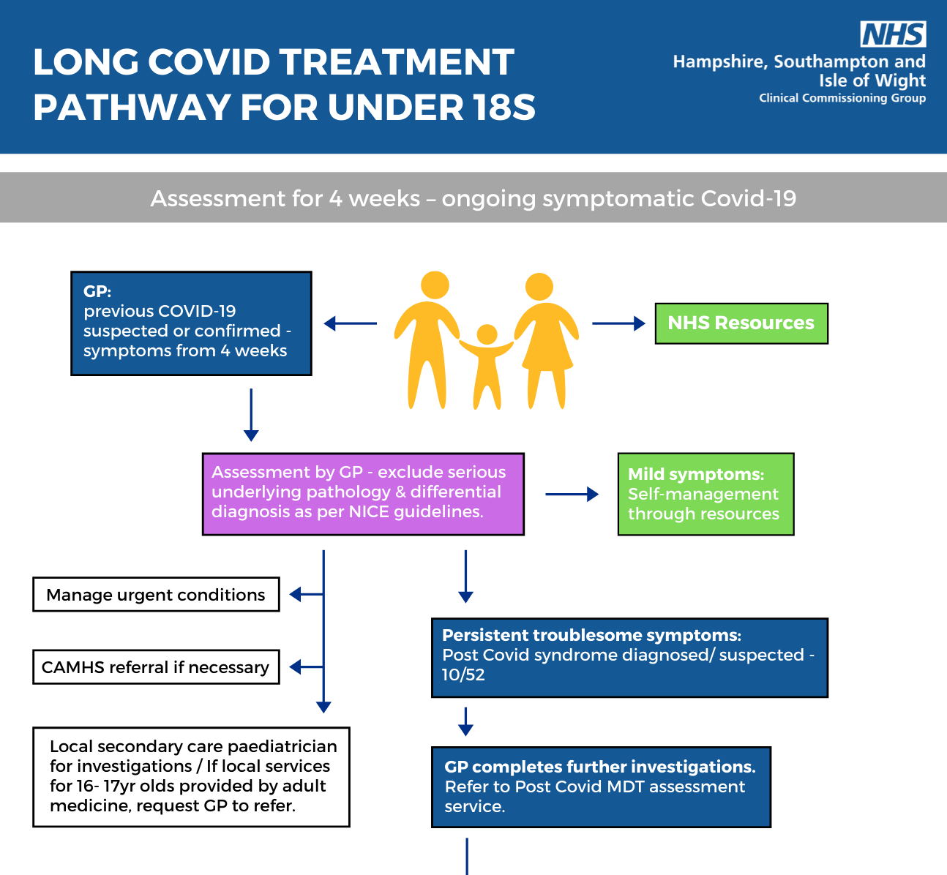

Slide 9
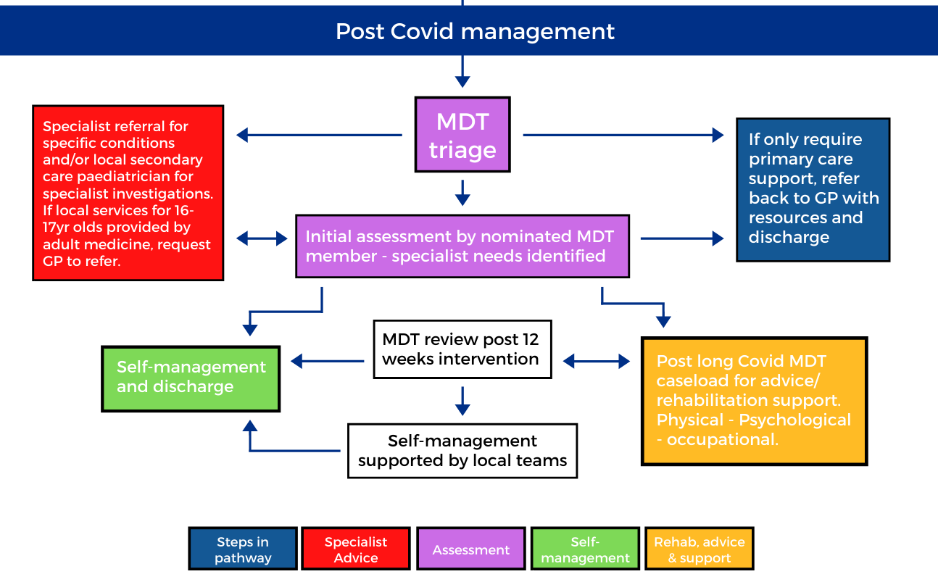

Slide 10
Prior to referral
Must have GP F2F assessment to consider the following investigations
To complete Baseline O2 sats, BP and HR
Baseline bloods
Other tests/ excluded diagnoses
Action abnormal findings via usual secondary care routes - cardiology, respiratory etc
Self management resources to be given early

Slide 11
Referral form
Notes:
Do not need to have had a positive Covid test

Slide 12
Referral form - sections specific to long Covid pathway
Clinical Overview
History of suspected Covid-19 infection with one of the three criteria below:
Previous PCR positive for SARS-CoV-2 Date? | Y/N
COVID antibody positivity Date | Y/N
Clear close epidemiological link to be determined on a case by case basis (school/family etc) Date | Y/N
Date of previous positive COVID-19 swab (if performed)
Does the individual have one or more of the following as a predominant symptom? Please detail.
(i) Severe fatigue that is preventing ADLs – e.g. going to school /activities/nursery/ play dates/ regression
(ii) Change from baseline that is unacceptable to referring Dr/Pt
(iii) Temporally associated persistent unexplained physical symptoms

Slide 13
History (including potential fluctuating symptoms and trends) Please rate on scale 0-10 ( 0= no symptoms 10 = severe)
Symptom | Score 0-10
Fatigue
Abdominal pain
Anxiety / low mood
Sleep
Pain
Respiratory
Brain fog
Headache
How many days of school /education has the individual missed in the last 2 weeks? (Write N/A if holidays)
Does the individual have a history of PIMS-TS? |  | Y/N | If Yes refer to secondary care team

Slide 14
Bedside Tests (required)
Test | Result
Heart rate (resting level)
Oxygen saturations (resting level)
Temperature
Blood pressure
Result of sit/stand assessment
Blood sugar.
Blood Tests (required)
Test | Result
Full blood count
Blood Film
CRP
Blood Glucose
Urea and electrolytes
LFT
TFT
ESR
Coeliac Screen
CK
Ferritin
Vitamin D
Vitamin B12
Other
Other Tests (performed within the last 4 weeks)
Test | Result
If GI symptoms a faecal calprotectin must be sent Y/N
MRI Brain/CXR

Slide 15
HIOW Childrens Long Covid
Physical, functional, cognitive and psychological assessments, with the aim of improving health outcomes and quality of life.
Clincal Lead secondary Care paediatrician (UHS)
OT, Physio and Psychology input at assessment and interventions
advice, support and structured goal setting, with AHP support.
Signposting to national resources
Liaison education - universal information and child specific

Slide 16
Outcome from MDT assessment
Advice, reassurance and referral back to primary care
Interventions with MDT – review at 12 weeks
Self management and support from local teams

Slide 17
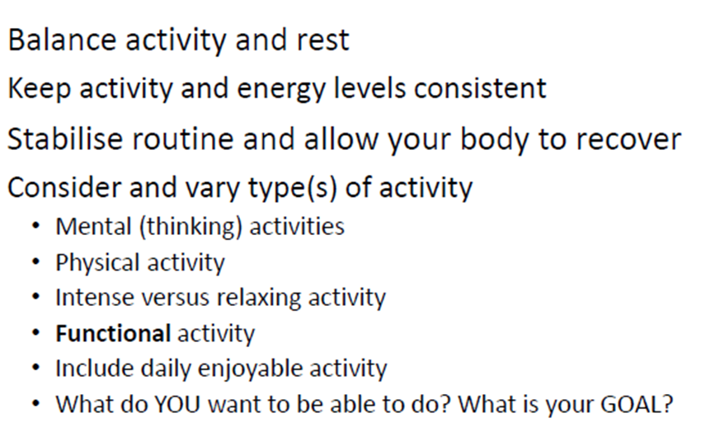
Management strategies
Pacing
Notes:
Can start strategies early

Slide 18
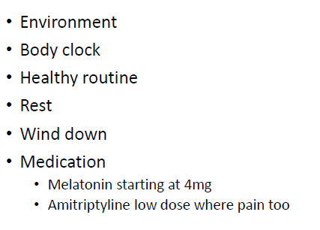
Management strategies
Sleep and rest

Slide 19
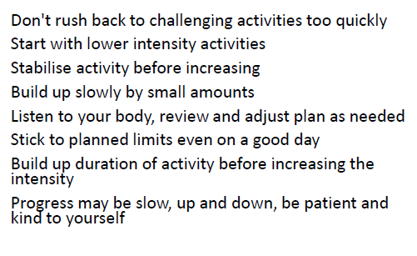
Management strategies
Activities and sport

Slide 20
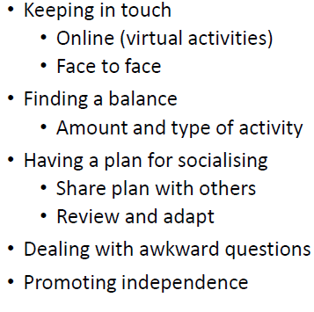
Management options
Friends

Slide 21
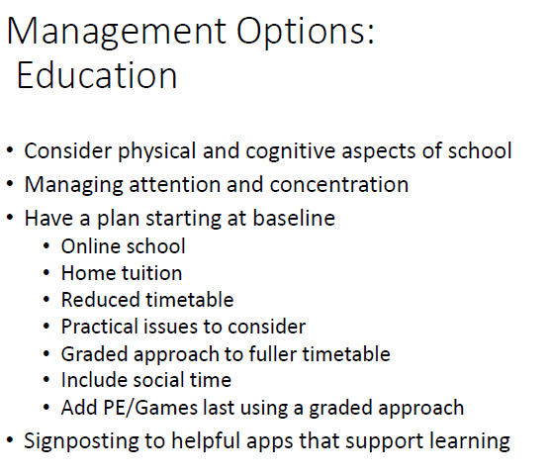
Management strategies
Education

Slide 22
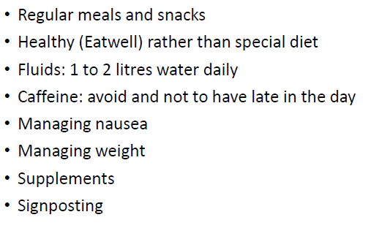
Management strategies
Diet

Slide 23
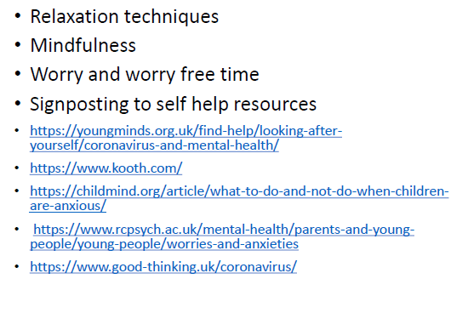
Management strategies
Emotional wellbeing

Slide 24
What can Health Care Professionals do?
Listen
Believe
Manage expectations
Diagnostics- symptom driven
Basic self management advice
Signposting / onwards referral
Caution with exercise – cardiac, respiratory, fatigue
Overdoing seems to lead to flare ups
Refer to Childrens Long Covid Pathway if indicated.

Slide 25
Useful resources…
FutureNHS Collaboration platform. Long Covid and children webinar 23.4.21. https://future.nhs.uk/L_C_N/view?objectId=99036901
https://www.physio-pedia.com/30_Seconds_Sit_To_Stand_Test
BMJ Management of post-acute covid-19 in primary care
Published: 11/08/2020
BMJ Webinar Long Covid: How to define it and how to manage it
Published: 07/09/2020
PHE Guidance COVID-19: long-term health effects
Published: 07/09/2020
RCGP Management of the long term effects of COVID-19 V1
NIHR: Living with Covid Second Review 16/3/21
https://www.ons.gov.uk/peoplepopulationandcommunity/healthandsocialcare/conditionsanddiseases/bulletins/prevalenceofongoingsymptomsfollowingcoronaviruscovid19infectionintheuk/1april2021
Royal Society Long Covid: an unfolding story 8 April 2021 accessed at https://royalsociety.org/science-events-and-lectures/2021/04/long-covid/

Slide 26
Childrens Long Covid Pathway
Contact details
Solent Childrens Therapy SPA 0300 300 2019
SNHS.Solentchildrenstherapyservice@nhs.net

