Slide 1


Rapid Investigation Service
Service Highlights

Slide 2
Presentation contents
Overview: Rapid Investigation Service Overview
Referral Criteria & Process:
Roles and responsibilities:
Rapid Investigation Service contact points:
Diagnosis and Onward referrals
Discharge

Slide 3
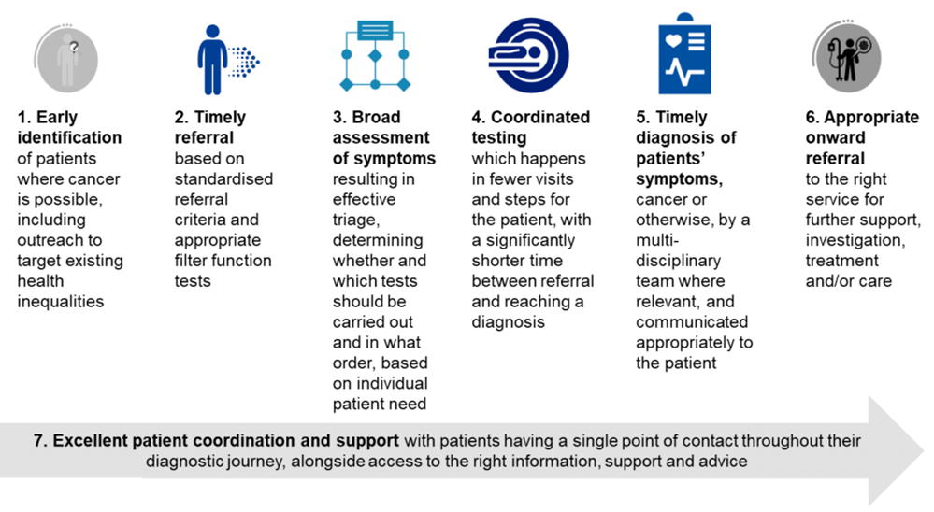
Overview: Rapid Investigation Service
The Wessex RIS is a new cancer referral pathway for patients in whom there is concern about cancer, but who do not fit other site-specific NG12 (fast track) referral criteria. The RIS is works in partnership with acute trusts in Wessex to provide timely access to appropriate investigations to exclude cancer in patients with concerning non-specific symptoms. These investigations will take place in a trust local to the patient.
The National Rapid Diagnostic Centre (RDC) project has specified that all Cancer Alliances must establish a Rapid Diagnostic Centre(s) by 2020. Wessex Cancer Alliance has developed a specification for a single Wessex-wide Rapid Investigation Service (RIS) initially providing faster investigation for patients presenting with non-specific symptoms that may indicate cancer.
7 RDC Principles

Slide 4
Referral Criteria & Process
Referral Criteria:
The referring GP should assess the patient face to face to ascertain that the referral criteria is met.
The RIS Clinicians are always happy to discuss a case with a GP ahead of referral if there are any questions.

Slide 5
Referral Criteria & Process
All the mandatory filter tests must be requested and reported prior to referral. The tests are have been carefully considered to ensure the non-specific pathway is the correct referral route for the patient to avoid any unnecessary delay.
Incomplete filter tests and inappropriate referrals will be returned to the practice to complete all missing tests or offering advice regarding the correct referral route. Patients are notified of the return so they are able to contact the Practice to follow up.
The non-specific symptoms pathway is different to the CUP pathway.
REQUIRED TESTS | Timeframe - Within
Physical examination | 3 Months of referral
URINALYSIS | 2 Months of referral
FBC | 2 Months of referral
ESR | 2 Months of referral
CRP | 2 Months of referral
RENAL PROFILE (U&E’s) | 2 Months of referral
LIVER FUNCTION (LFT’s) | 2 Months of referral
THYROID FUNCTION (TFT’s) | 2 Months of referral
HbA1c or fasting glucose | 2 Months of referral
BONE PROFILE | 2 Months of referral
PSA OR CA125 | 2 Months of referral
FIT | 3 Months of referral
Faecal elastase - if Hba1c raised. | 2 Months of referral
CXR - Desirable | 3 Months of referral

Slide 6
Referrals to RIS that are inappropriate for the service
2WW CUP referrals - Patients who have had a diagnostic test(s) that demonstrate metastatic disease .
2WW IDA referrals- Unexplained Iron Deficiency should be referred directly or considered as per NG12 guidance to Colorectal
Referral with positive FIT test to be referred 2WW Colorectal
Referrals where full Diagnostic screening has already been completed and cancer excluded.
Referral with positive FIT test to be referred 2WW Colorectal
Patients who has previously been investigated under a different speciality and do not display different symptoms . Initial consideration should be given to refer back to the original specialty

Slide 7
Referral Criteria & Process
Referral Administration
Referrals must be submitted through the Electronic referral system.
To locate us:
Fast Track – 2WW – Non-specific symptoms – wessex rapid investigation service – location Aldermoor surgery
The hub team will be happy to guide you if you are having any difficulties in identifying the correct service.
The referral will not be received by the RIS and completed until a booked date/time slots has been confirmed.
There should always be slot availability. Please contact the Hub immediately if there are no available slots as there may be a system error
The booked slot is a “Dummy” slot. The patient must not be advised of this date and time or instructed to booked the slot themselves.
The RIS clinical team need to assess the referral for completeness and appropriateness. This will usually be within 2 working days. Practices will be informed via NHS.net of any actions they need to complete prior to referring the patient.
We are a completely virtual service.
Patients must not be advised to attend for a physical appointment. There is no guarantee that a clinician will be available if this occurs.

Slide 8
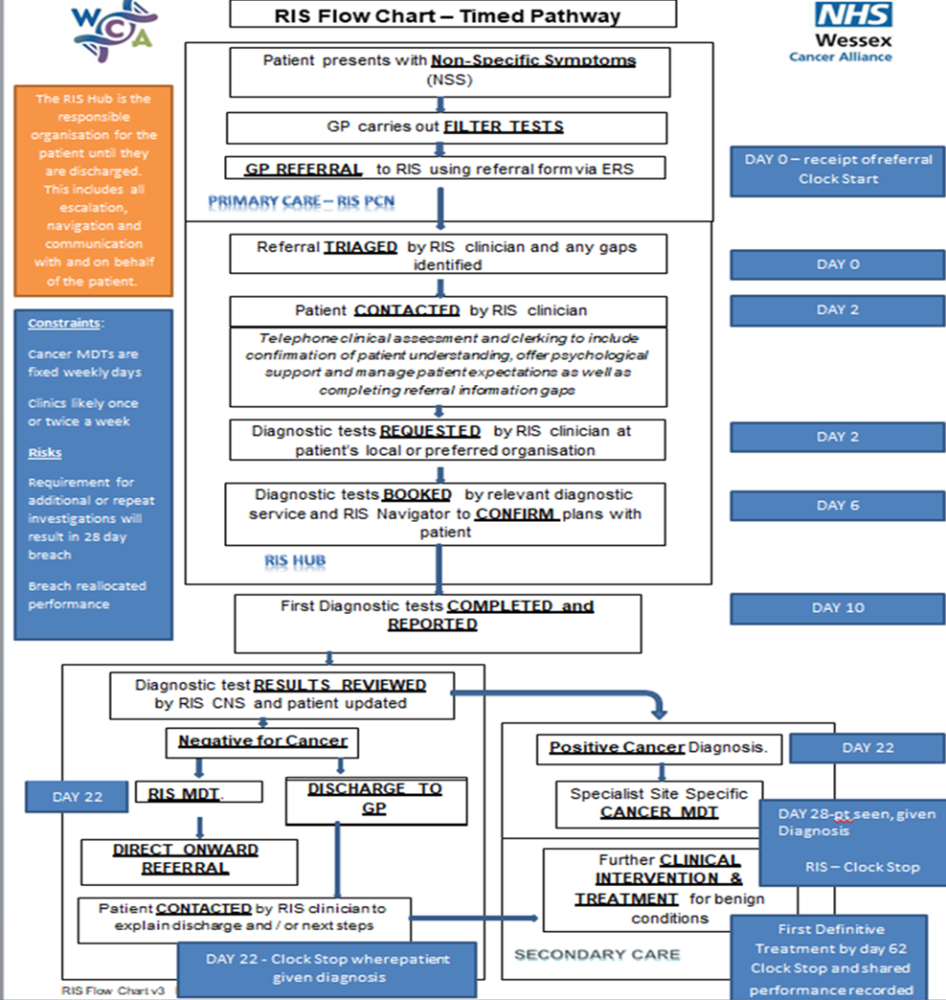
Referral Criteria & Process

Slide 9
Referral Criteria & Process
Primary care must clearly communicate to the patient that:
They are being referred/ investigated for suspected cancer.
Explain what to expect from the referral/ investigation.
Make reasonable adjustments - consider written information.
Inform that most people referred urgently will not have cancer.

Slide 10
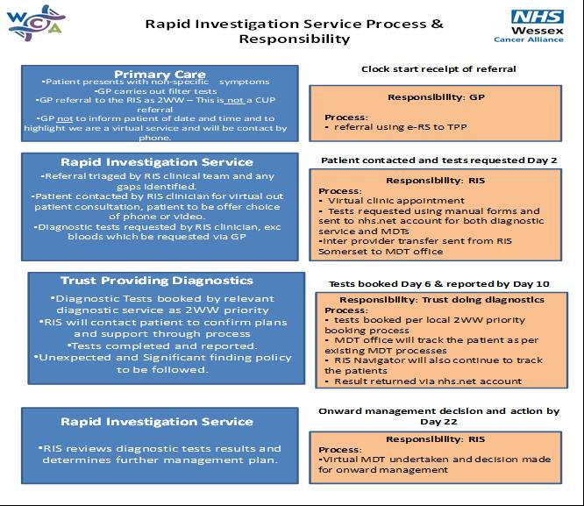
Roles and responsibilities

Slide 11
Rapid Investigation Service contact points
The Rapid Investigation Service will make contact with the referring practice at a number of stages throughout the patients journey.
All retuned referrals
Accepted referrals post clerking with booked date of diagnostic tests
Any onward referral letters
At Discharge
Any additional tests needing completing via GP request

Slide 12
Diagnosis and onward referrals
2WW Referrals
Patients with a confirmed or likely confirmed cancer will be referred directly on to the specialist team at the patient’s local providing Trust for onward management. RIS will keep sight of the patient until such time onward care has commenced.
Routine Referrals
For any non-urgent findings the RIS will recommend for the GP to refer on to the local specialty team.
Urgent Non-Cancer Referrals
RIS will directly refer to specialty team patients who have been identified with anything that is deemed urgent. (examples – pericardial effusion, aortic aneurysm etc).

Slide 13
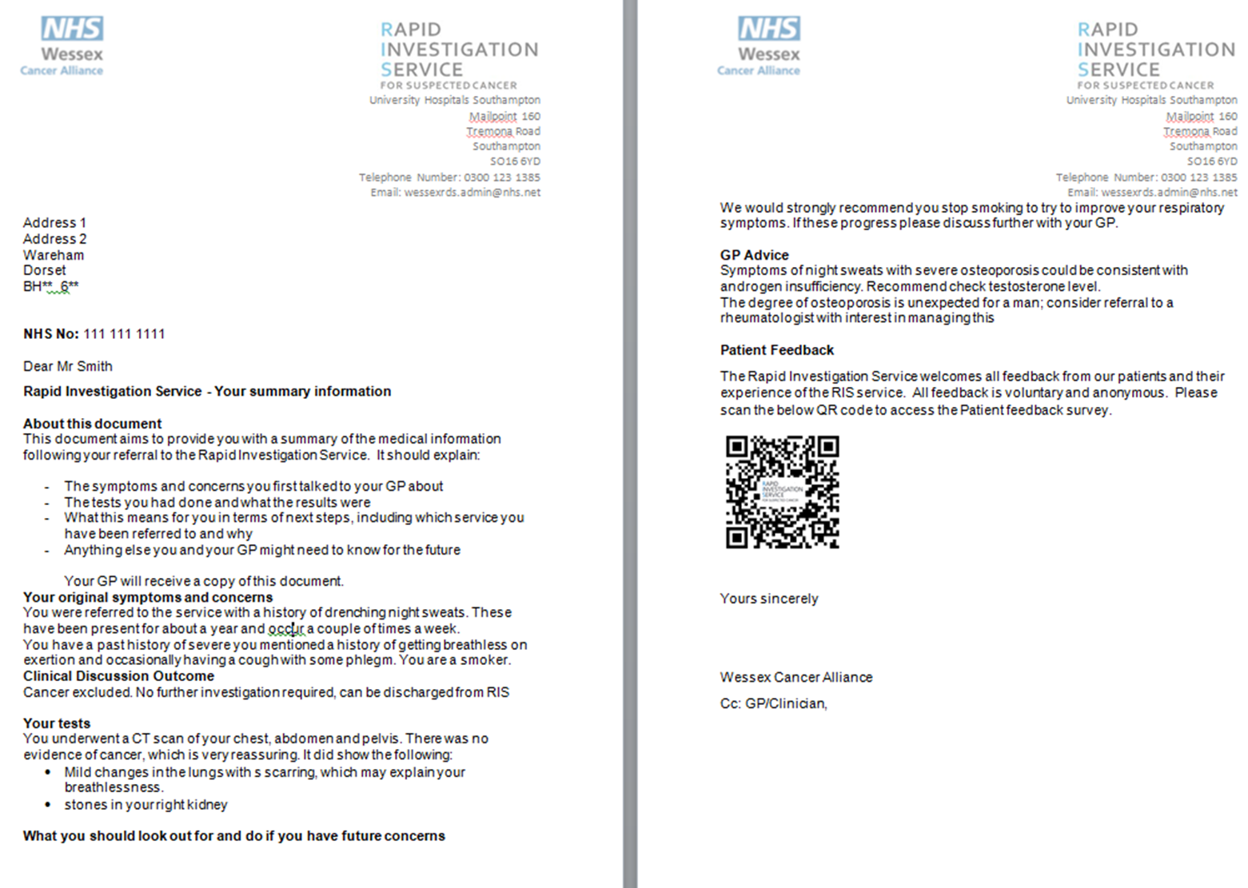
Discharge
Every patient and practice will receive a Discharge Summary at the end of the RIS pathway.
The summary will be sent to the surgery via their NHS.NET account.
The summary may include actions for the GP to complete or ongoing advice as to onward management of the patient.
An example of a patient Discharge summary

Slide 14
Patient Feedback
The RIS work with Wessex Voices and invites all patients to feedback.
Feedback can be given through an array of platforms including, post, email, web and QRcode.
All feedback is reviewed and service processes are actioned accordingly.
The end of year feedback will be published:
Wessex Voices Rapid Investigation Service Report - Welcome to Wessex Cancer Alliance
RIS encourages any feedback/comments from our primary care colleagues.
Feedback can be provided via our generic email: wessexrds.admin@nhs.net
Your comments will be considered and included with the RIS end of year report.
Primary care Feedback

Slide 15
Additional Info
Patient Leaflet:
https://wessexcanceralliance.nhs.uk/wessex-rapid-investigation-service-leaflet/
NHSE RDC Specification:
https://www.england.nhs.uk/wp-content/uploads/2019/07/rdc-vision-and-1920-implementation-specification.pdf

