Slide 1
COVID-19 Vaccination programme Core training slideset for healthcare practitioners

Slide 2
Note to trainers
This slide set contains a collection of core slides for use or adaptation during the delivery of COVID-19 immunisation training. Trainers should select the slides required depending on the background and experience of the immunisers they are training and according to the role they will have in delivering the COVID-19 vaccine programme.
The information in this slide set was correct at time of publication. As COVID is an evolving disease, a lot is still being learned about both the disease and the vaccines which have been developed to prevent it and the knowledge base is still being developed. For this reason, some of the information may change. Updates will be made to this slide set as new information becomes available. Please check online to ensure you are accessing the latest version. Trainers may need to update data and any information that changes between republications of this slide set.
Slides containing vaccine specific details (such as storage and reconstitution) on the first COVID-19 vaccine to receive regulatory approval have been added to the end of this slide set. Details for other vaccines will be added here as they receive regulatory approval. They are available at the end of the slide set so that trainers can specifically select those they need for the vaccine they are providing training about.
Notes:
Further information on the SARS-Cov-2 virus and COVID-19 disease, epidemiology and the currently authorised vaccines in the COVID-19 chapter of the Green Book.

Slide 3
Content
Learning objectives, pre-requisites, key messages and introduction
International and UK COVID-19 timeline
Coronavirus
COVID-19 epidemiology
Developing a COVID-19 vaccine and vaccination programme
Introducing a new vaccination programme
COVID-19 vaccination programme
The immune response
Consent
Legal requirements for the supply and administration of COVID-19 vaccine
Vaccine storage
Vaccine administration
Anaphylaxis and adverse events following vaccination
Documentation and record keeping
Addressing concerns and providing information to those being vaccinated
Knowledge and skills
Supervision, accountability and delegation
Improving vaccine uptake
Further information, action plan and sources of advice
Specific details for vaccines which have received regulatory approval

Slide 4
Learning objectives
By the end of this session, you should be able to:
explain what COVID-19 is and be aware of the UK epidemiology
understand the policy behind the COVID-19 vaccination programme
describe how vaccines work and how they are developed and trialled
identify the groups who are at high risk for COVID infection and who should be prioritised to receive the COVID-19 vaccine
describe the process of consent and how this applies when giving vaccines
understand the legal mechanisms by which immunisers can supply and administer COVID-19 vaccine
recognise the differences between a prescription, a PSD, a PGD and a Protocol and understand which staff can use each of these
describe the key principles of how to correctly store, prepare and administer COVID-19 vaccines
communicate key facts in response to questions from patients and direct them to additional sources of information

Slide 5
Pre-requisites to administering COVID-19 vaccine
Before administering COVID-19 vaccine, you should have:
undertaken training in the management of anaphylaxis and Basic Life Support as specified by policy for your local area
undertaken any additional statutory and mandatory training as required by your employer
received COVID-19 vaccine training through attending a taught session and/or the eLearning for Healthcare COVID-19 vaccine elearning programme
received practical training in COVID-19 vaccine preparation and administration
completed the COVID-19 vaccinator competency assessment tool
an appropriate legal framework to supply and administer COVID-19 vaccine in place e.g. patient specific prescription, Patient Specific Direction (PSD), Patient Group Direction (PGD) or Protocol
accessed and familiarised yourself with the following key documents: Green Book COVID-19 chapter and the PHE ‘COVID-19 immunisation programme information for healthcare practitioners’ document

Slide 6
Key messages
the ongoing global COVID-19 pandemic continues to cause millions of infections and over a million deaths across the world
a vaccine to prevent COVID-19 is the most effective way to control the pandemic
scientists across the world have worked to develop vaccines which have then been rigorously tested for safety and efficacy
it is crucial that the COVID-19 vaccine is safely and effectively delivered to as many of those eligible as possible
those with a role in delivering the COVID-19 vaccine programme need to be knowledgeable, confident and competent in order to promote confidence in the vaccination programme and deliver the vaccine safely
Notes:
https://coronavirus.jhu.edu/map.html

Slide 7
Introduction
a new virus emerged in Wuhan, China during December 2019
this virus, which causes respiratory disease, was identified as being part of the Coronavirus family and it rapidly spread to many other countries around the world
by 01/12/20, 1,643,086 people had tested positive for the virus and 59, 051 people had died within 28 days of a positive test in the UK
common symptoms of COVID-19 include a high temperature, a continuous dry cough and loss or change to sense of smell and taste
about 80% of infected people have no or mild symptoms; 1 in every 6 people who gets COVID-19 becomes seriously ill
older people and those with underlying medical problems are more likely to develop serious illness or die from COVID-19
measures to contain the virus have included the introduction of social distancing measures, travel restrictions, closure of public spaces and the wearing of face coverings in shops
despite these measures, the number of positive cases and deaths have continued to increase on a daily basis
Notes:
Latest data can be obtained from https://coronavirus.data.gov.uk/

Slide 8
International and UK COVID-19 timeline – the first 7 months
31/12/19 | 27 cases of pneumonia of unknown aetiology reported in Wuhan
13/01/202 | First case outside China (Thailand)
21/01/2020 | 293 cases in mainland China, including 15 healthcare workers and 6 deaths
25/01/202 | First confirmed case in Europe (France)
30/01/2020 | WHO declares Public Health Emergency of International Concern (PHEIC)
31/01/202 | UK nationals repatriated from Wuhan. First two UK cases confirmed in England
01/03/202 | 35 UK cases in total
05/03/20 | CMO of England announced first UK death
11/03/2020 | WHO declares COVID-19 as a pandemic
12/03/20 | UK Government announce move from contain phase into delay. UK CMOs raised the risk to UK population from moderate to high
23/03/20 | FCO asks all British travellers to return to the UK and advises against non-essential international travel for 30 days. UK Government introduces new social distancing measures. i) all persons to stay at home, except for very limited purposes; ii) all non-essential businesses and venues to close; iii) no gatherings of more than two people in public
16/04/20 | Decision to maintain social distancing measures for further three weeks
13/05/20 | UK Government announce 5 level COVID-19 alert system. UK CMOs set alert to level 4
18/05/20 | Loss of or change in normal sense of taste or smell added to case definition
19/06/20 | UK CMOs lower the UK COVID-19 alert level to 3 following recommendation of Joint Biosecurity Centre
04/07/20 | Further relaxation of national restrictions (travel restrictions, social distancing, closure of public spaces updates)
24/07/20 | Face coverings are now compulsory for customers in shops in England

Slide 9
COVID-19 and Coronavirus
COVID-19 is the disease that is caused by infection with the SARS-CoV-2 virus which belongs to the Coronavirus family
SARS-CoV-2 stands for Severe Acute Respiratory Syndrome (SARS) and CoV for coronavirus
COVID-19 stands for Coronavirus Disease and 19 is from the year 2019 when it was first seen
Coronaviruses may cause illness in animals or humans and they are responsible for causing infections ranging from the common cold to more severe disease such as Severe Acute Respiratory Syndrome (SARS) and Middle East Respiratory Syndrome (MERS) which have been responsible for two outbreaks during the last twenty years
SARS-CoV-2 virus is the most recently discovered coronavirus and has now affected many countries globally
because of the global spread and the substantial number of people affected, the World Health Organisation (WHO) declared COVID-19 as a pandemic on 11/03/2020 (Pan (all) demos (people))

Slide 10
Viral infection
viruses are much smaller than bacteria and consist of a small amount of either DNA or RNA surrounded by a protein coat called a capsid
viruses cannot replicate themselves, but need to seek out the replication mechanism contained within a host cell
examples of vaccine preventable viral diseases include measles, mumps, rubella, influenza, hepatitis A and B
Influenza viruses, which are RNA viruses, are constantly mutating into slightly different forms, which is why we need to produce and give different flu vaccines every year
SARS-CoV-2 is an RNA virus

Slide 11
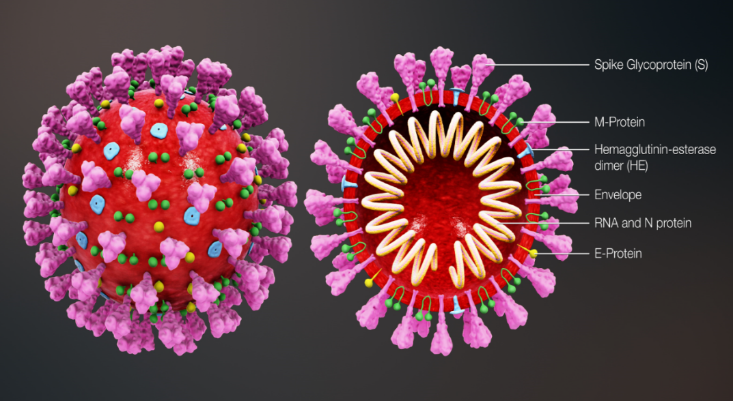
Coronavirus structure
the key parts of the coronavirus are the RNA and the spike proteins
the RNA is surrounded by an envelope which has different roles in the life cycle of the virus. These may include the assembly of new virus and helping new virus to leave the infected cell
the spike proteins (S) are anchored into the viral envelope and form a crown like appearance, like the solar corona, hence the name coronavirus. The spike proteins attach to the target cell and allow the virus to enter it
the RNA is inside the envelope and acts as a template so that once it is inside the host cell, the coronavirus can replicate itself and be released into the body
the spike protein and the RNA have been used to develop and make different vaccines to protect against SARS-CoV-2
Notes:
Diagram of coronavirus virion structure showing spikes that form a "crown" like the solar corona, hence the name
https://commons.wikimedia.org/wiki/File:3D_medical_animation_coronavirus_structure.jpg

Slide 12
Transmission of COVID-19 infection
For transmission to occur, the SARS-CoV-2 virus needs to be transported to a susceptible person. To do this, it needs to have:
a portal of exit (from the place where it is living and replicating)
a mode of transmission (such as coughing or sneezing) and
a portal of entry (to the susceptible host)
COVID-19 spreads primarily from person to person through small droplets from the nose or mouth which are expelled when a person with COVID-19 coughs, sneezes, or speaks.
These droplets can also survive on objects and surfaces such as tables, doorknobs and handrails.
People can catch COVID-19 if they breathe in these droplets from a person infected with the virus or by touching contaminated objects or surfaces, then touching their eyes, nose or mouth.

Slide 13
COVID-19 Chain of infection
Infectious microbe
SARS-CoV-2
Reservoir
Place where the virus lives and replicates: people, animals
Susceptible host
Non-immune person
The chain of infection refers to the interaction between the pathogen, the host and the environment.
Portal of exit
How the virus leaves the reservoir
Mouth or nose through coughing, sneezing or talking
Portal of entry
Mucous membrane of the nose and mouth
Modes of transmission
Person to person, airborne, direct contact with virus on a contaminated surface

Slide 14
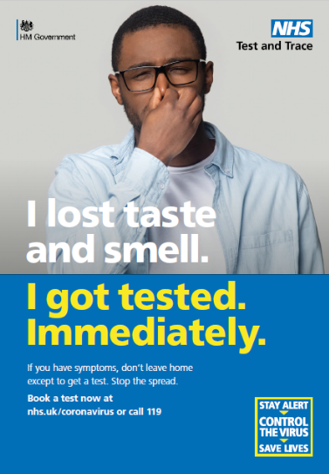
COVID-19 symptoms
The estimated incubation period is 3 to 6 days but can vary between 1 and 11 days.
Symptoms may vary by age but the main symptoms of coronavirus are:
a new, continuous cough – coughing for more than an hour, or 3 or more coughing episodes in 24 hours
a high temperature
a loss or change to sense of smell or taste
Other symptoms reported include:
fatigue and lethargy
shortness of breath
headache
sore throat
aching muscles
diarrhoea and vomiting

Slide 15
COVID-19 symptom progression
Symptoms may begin gradually and are usually mild.
the majority of people (around 80%) have asymptomatic to moderate disease and recover without needing hospital treatment
around 15% may get severe disease including pneumonia
older people and those with underlying medical problems such as high blood pressure, heart and lung problems, diabetes, or cancer are more likely to develop serious illness
around 5% become critically unwell. This may include septic shock and/or multi-organ and respiratory failure
The infection fatality rate (the proportion of deaths among all infected individuals) is estimated to be 0.9% but it varies according to age and sex. It is lower in younger people (0.5% for those 45-64 years) and higher in those over 75 years of age (11.6%).
Notes:
https://www.bmj.com/content/bmj/368/bmj.m800.full.pdf

Slide 16
Complications of COVID-19 disease
Complications from COVID-19 can be severe and fatal.
The risk of developing complications increases with age and is greater in those with underlying health conditions.
The type of complication that can develop may include:
venous thromboembolism
heart, liver and kidney problems
neurological problems
coagulation (blood clotting) failure
respiratory failure
multiple organ failure
septic shock
Notes:
https://bestpractice.bmj.com/topics/en-us/3000168/complications

Slide 17
COVID-19 complications in pregnancy
maternal morbidity is similar to that of other women of reproductive age and the outcome for women infected during pregnancy is usually good
however, pregnant women with pre-existing comorbidities such as chronic hypertension or diabetes, those with higher maternal age, and high body mass index may experience severe COVID-19 disease
they may also require intensive care unit admission and invasive ventilation and around 6% of pregnant women may experience a spontaneous pre-term delivery
neonates born to mothers with COVID-19 have an increased risk of admission to a neonatal unit
although stillbirths have been reported, perinatal deaths are rare and occur in less than 1% of cases
Notes:
https://bestpractice.bmj.com/topics/en-us/3000168/complications
https://www.bmj.com/content/370/bmj.m3320

Slide 18
Symptoms in children and young people
children comprise only 1 to 2% of cases of COVID-19 worldwide and are more likely to have mild symptoms or asymptomatic infection
a study of children and young people aged less than 19 years admitted to hospital with laboratory confirmed SARS-CoV-2 reported that the median age of those enrolled in the study was 4.6 years
other clinical features included age, sex and ethnicity: 35% (225/651) of them were under 12 months old; 56% (367/650) were male; 57% (330/576) were white; 12% (67/576) were South Asian and 10% (56/576) were Black
of the 651 children and young people in the study, 42% had at least one other medical condition (co-morbidity). These included neurological conditions (11%), haematological, oncological or immunological conditions (8%) and asthma (7%)
Notes:
In one study, 11% of children and adolescents presented with fatigue, headache, myalgia, sore throat, lymphadenopathy and a low platelet count.
Clinical characteristics of children and young people admitted to hospital with covid-19 in United Kingdom: prospective multicentre observational cohort study
Olivia V Swann,1,2 Karl A Holden,3,4 Lance Turtle,5,6 Louisa Pollock,7 Cameron J Fairfield,8 Thomas M Drake,8 Sohan Seth,9 Conor Egan,9 Hayley E Hardwick,5 Sophie Halpin,10 Michelle Girvan,10 Chloe Donohue,10 Mark Pritchard,11 Latifa B Patel,12 Shamez Ladhani,13,14 Louise Sigfrid,15 Ian P Sinha,3,12 Piero L lliaro,15 Jonathan S Nguyen-Van-Tam,16,17 Peter W Horby,15 Laura Merson,15 Gail Carson,15 Jake Dunning,18,19 Peter J M Openshaw,19 J Kenneth Baillie,20,21 Ewen M Harrison,8 Annemarie B Docherty,8,21 Malcolm G Semple,4,5

Slide 19
Complications from COVID-19 in children and young people
an extremely rare but severe multisystem inflammatory syndrome (MIS-C) occurring 2 to 4 weeks after the onset of COVID-19 has been identified in children and adolescents
cardiac complications were documented in 57% (21/37) of MIS-C cases. These were more frequent in post-acute / antibody positive cases (75% 15/20) than in the acute phase 35% (6/17)
of the children admitted to hospital, 18% required critical care. This was associated with:
age, particularly for those less than one month old and for those age 10 -14 years
black ethnicity and
admission to hospital for more than five days before symptom onset
other complications from COVID-19 in children and young people include fever, cardiac symptoms (myocarditis, heart failure) and GI symptoms (abdominal pain, diarrhoea, vomiting)
Notes:
MIS-C shares features with Kawasaki disease and toxic shock syndrome and can present in both the acute and convalescent phases of COVID-19 infection.
https://bestpractice.bmj.com/topics/en-us/3000168/complications

Slide 20
Coronavirus (COVID-19) epidemiology
The current UK epidemiology can be seen on the GOV.UK website at: https://coronavirus.data.gov.uk/
This UK COVID-19 dashboard shows current trend information for:
virus testing capacity
virus tests processed
people tested positive
deaths within 28 days of positive test
death from COVID-19 on death certificate
patients in hospital
patients in ventilator beds
patients admitted
Notes:
https://coronavirus.data.gov.uk/?_ga=2.258492298.1207688930.1604066233-1632845157.1577466264

Slide 21
UK Coronavirus (COVID-19) positive tests by nation
1,643,086 people tested positive for Coronavirus (COVID-19) in the UK between 14/01/2020 and 01/12/2020
Notes:
Early cases were first seen at the end of January and over February, the majority of which were imported. Numbers were low until the end of February with most associated with travel from Europe. From early March case numbers had started to increase exponentially, and social distancing measures had been introduced. Advice from 12 March (week 11) introduced measures such as self-isolation of those with symptoms and cancelling school trips. Enforceable social distancing measures were introduced from 23 March (week 13) and included school closures and remaining indoors.
https://coronavirus.data.gov.uk/details/cases

Slide 22
UK deaths within 28 days of a positive test
59,051 deaths within 28 days of a positive test by date of death were recorded between 05/03/2020 and 01/12/2020
Notes:
https://coronavirus.data.gov.uk/details/deaths

Slide 23
COVID-19 vaccine taskforce
as the majority of the population are still susceptible (non-immune) to the SARS-CoV-2 virus and the virus spreads easily, it is clear that a safe and effective vaccine is needed to prevent further cases
a COVID-19 vaccine prepares the immune system so that in the event of an exposure to the virus, it is able to respond and prevent or reduce the severity of infection
during April 2020, a UK vaccine taskforce was set up to support the development of a SARS-CoV-2 vaccine
the taskforce supported research and industry to rapidly develop and scale up the manufacture of a vaccine to protect the population

Slide 24
COVID-19 vaccine development
scientists, industry and other organisations have worked collaboratively across the globe to complete the different phases of vaccine development in parallel, rather than sequentially to make a safe and effective vaccine available as soon as possible
by knowing the genetic code for the SARS-CoV-2 virus, various methods to create vaccines can be used such as using the code itself (mRNA vaccines) or inserting part of this code into existing viruses (viral vector vaccines)
by December 2020, over 270 different COVID-19 vaccines were in early development, over 50 of these were being given to people in clinical trials and 11 were being trialled in large phase 3 trials
some vaccines have been made using currently used vaccine technology, others have been made using new approaches or methods used during previous emergencies such as the SARS pandemic and west African Ebola
Notes:
For more information about COVID vaccines in development, see the LSHTM COVID-19 vaccine tracker https://vac-lshtm.shinyapps.io/ncov_vaccine_landscape/.

Slide 25
Properties of an ideal vaccine
Ideally, a vaccine will:
produce the same immune protection which usually follows natural infection but without causing disease.
generate long lasting immunity so that the person is protected if they are exposed to the antigen several years after vaccination.
interrupt the spread of infection by preventing carriage of the organism in the vaccinated person
Vaccines need to be safe and the risk from any side effects should be much lower than the benefit of preventing deaths and serious complications of the disease.
For the COVID-19 vaccines, many of these properties can be confirmed from the clinical vaccine trials.
Longer term ongoing surveillance of the disease and of those vaccinated will show whether:
vaccine protection is long lasting or booster or annual doses are needed
the vaccine prevents a vaccinated person from carrying and spreading the virus

Slide 26
Stages of vaccine trials
Vaccines are extensively tested through several different phases of trials.
pre-clinical studies using tissue-culture, cell-culture or animal studies. At this stage, safety and immunogenicity (the ability of the vaccine to produce an immune response) are assessed. If pre-clinical studies are successful, the vaccine then goes through several different phases of vaccine trials in humans
phase I clinical trials are small-scale trials in healthy adult volunteers (generally 20-100) to assess whether the vaccine is safe in humans and type and extent of immune response it induces
phase II clinical trials are larger (several hundred healthy volunteers) and usually carried out in the target age group(s) the vaccine is likely to be used in. They are looking mainly to assess the efficacy of the vaccine against artificial infection and clinical disease. Vaccine safety, side-effects and immune response are also studied
phase III clinical trials involve the vaccine being studied on a large scale in many hundreds or thousands of subjects across several sites to evaluate efficacy under natural disease conditions and make sure that there are no unintended side effects not detected in phase II studies

Slide 27
Safety
before any of the COVID vaccines can be authorised for widespread use in the population, the manufacturers have to demonstrate that they are safe and effective
tens of thousands of people across the world have already received COVID-19 vaccines in clinical trials
no serious adverse reactions to the vaccines were seen in the trial participants who received them
any reactions reported were similar to those seen following other vaccines such as pain and tenderness at the injection site and fever, headache, muscle aches and fatigue

Slide 28
Effectiveness
manufacturers of the COVID-19 vaccines need to show evidence that they will be effective
they can do this by showing a reduction in virus levels in animal studies where the vaccines were used and that people in the trials have made an antibody response to the vaccine
vaccine effectiveness can be calculated by comparing the number of cases of COVID-19 disease in trial participants who received the COVID-19 vaccine with the number of trial participants who received the placebo or alternative (non-COVID-19) vaccine
Those running clinical trials will also look at antibody response:
after one dose and two doses
at different dosages of the vaccine
with different time intervals between vaccine doses
in different age groups
Over time, they will look at:
how long the antibodies last and the effect on antibody levels if a booster dose is given.
whether the vaccine only stops people from becoming severely ill or if it also stops them spreading the virus too.

Slide 29
Regulatory approval and licencing
in the UK, vaccine manufacturers apply to the Medicines and Healthcare products Regulatory Agency (MHRA) or the European Medicines Agency (EMA) for a product licence but they may issue a temporary authorisation ahead of the full UK product licence
in exceptional situations, the MHRA may enact Regulation 174. This enables them to temporarily authorise the supply of an unlicensed medicinal product in response to certain identified public health risks, such as the SARS-CoV-2 pandemic
the MHRA assess all of the available safety, quality and efficacy data and considers whether the evidence supports the use of the medicine or vaccine under the legal basis of regulation 174 until it can be licensed
the process involves the same level of scrutiny as the usual licensing process and this exception is only used when strictly necessary to speed up access to a potentially life-saving intervention

Slide 30
Post authorisation surveillance
On-going studies of vaccines continue after the vaccine has been authorised for use. These studies aim to assess long term efficacy and to detect any rare adverse effects because in real life administration, compared to pre-licensure trials, there will be:
some variability in preparation of the vaccine as vaccines will come from different batches
possible variability in stability and storage, for example the cold chain may not be as rigidly maintained in practice as it was in a clinical trial
use of the vaccines in different groups than in pre-authorisation studies, for example they will be given to people with underlying medical conditions who would not necessarily have been included in a pre-licensure/pre-authorisation clinical trial

Slide 31
COVID-19 Vaccines
On 2 December 2020, the following vaccine was given authorisation for temporary supply by the UK DHSC and the MHRA:
COVID-19 mRNA Vaccine BNT162b2 (Pfizer-BioNTech) is a messenger ribonucleic acid (mRNA) that contains the genetic sequence of the antigens found on the surface of the SARS-CoV-2 virus
Another COVID-19 vaccine which may shortly be authorised for supply in the UK, subject to regulatory approval, is:
AstraZeneca COVID-19 vaccine which is a non-replicating viral vector vaccine. It uses a weakened adenovirus as a carrier to deliver the genetic sequence for part of the SARS-CoV-2 virus into the body

Slide 32
COVID-19 mRNA Vaccine BNT162b2 (Pfizer-BioNTech)
The COVID-19 mRNA Vaccine BNT162b2 vaccine is a messenger ribonucleic acid (mRNA ) vaccine.
It contains the genetic sequence (mRNA) for the spike protein which is found on the surface of the SARS-CoV-2 virus, wrapped in a lipid envelope (referred to as a nanoparticle) to enable it to be transported into the cells in the body.
When injected, the mRNA is taken up by the host’s cells which translate the genetic information and produce the spike proteins.
These are then displayed on the surface of the cell. This stimulates the immune system to produce antibodies and activate T-cells which prepare the immune system to respond to any future exposure to the SARS-CoV-2 virus by binding to and disabling any virus encountered.
As there is no whole or live virus involved, the vaccine cannot cause disease. The mRNA naturally degrades after a few days.

Slide 33
AstraZeneca COVID-19 vaccine
AstraZeneca COVID-19 vaccine is a viral vector vaccine which uses a weakened adenovirus as a carrier to deliver the SARS-CoV-2 antigen.
The adenovirus has been modified so that it cannot replicate (grow and multiply by making copies of itself) in human cells and therefore cause any disease.
The genes that encode for the spike protein on the SARS-CoV-2 virus have been inserted into the adenovirus's genetic code to make the vaccine.
When the vaccine is injected, it enters the host's cells which then manufacture the spike protein.
This then stimulates the immune system which reacts by producing antibodies and memory cells to the SARS-CoV-2 virus without causing disease.

Slide 34
Additional COVID-19 vaccines
If more COVID vaccines are considered for authorisation in the UK, information about these will be added to this slide set
Further details about presentation, storage and preparation of the Pfizer-BioNTech vaccine are available on slides at the end of this slide set
Further information about the AstraZeneca vaccine presentation, storage and preparation will be added to this slide set when this vaccine has been given authorisation for temporary supply in the UK by the MHRA and DHSC

Slide 35
Vaccine interchangeability
data is not yet available on the interchangeability of different COVID-19 vaccines.
therefore, every effort should be made to determine which vaccine the individual received and to complete with the same vaccine
for individuals who started the schedule and who attend for vaccination at a site where the same vaccine is not available, or where the first product received is unknown, it is reasonable to offer a single dose of the locally available product
this option is preferred if that individual is likely to be at immediate high risk or is considered unlikely to attend again
as the authorised Pfizer-BioNTech BNT162b2 vaccine and the AstraZeneca vaccine which may be authorised for use in the UK are both based on the spike protein of the virus, it is likely that the second dose will help to boost the response to the first dose
further doses of vaccine are not required unless additional information becomes available

Slide 36
Key factors that inform UK vaccination policy
The Joint Committee on Vaccines and Immunisation (JCVI) consider the following before making vaccination policy recommendations to the Department of Health and Social Care (DHSC):
1. Availability of a safe and effective vaccine:
there are currently over 270 COVID-19 vaccines in development and being trialled
vaccines undergo extensive and vigorous testing before they are licensed and authorised for use as they have to be able to demonstrate quality, efficacy and safety
2. Whether there is a need for a vaccination programme:
SARS-CoV-2 has caused a significant public health problem, transmission is widespread and has been sustained despite various interventions
the virus affects all age groups and there have been frequent outbreaks in nursing and residential homes, schools and communities
there is significant morbidity and mortality in certain groups. There are multi-system complications from having the disease and there have been over 59 000 deaths from COVID-19 in the UK

Slide 37
Designing and implementing a vaccination programme
Other national bodies involved in the design and implementation of vaccination programmes include:
the Department of Health and Social Care (DHSC) is responsible for vaccine policy decisions and finance for vaccine programmes
the Medicines and Healthcare products Regulatory Agency (MHRA) is responsible for independent oversight of all aspects of vaccine manufacture and regulation including the licensing of vaccines and the Yellow Card adverse event reporting scheme
Public Health England (PHE) is responsible for the national planning, leadership, procurement and supply of vaccines used for the national vaccination schedule and for on-going surveillance to inform the programmes
the National institute for Biological Standards and Control (NIBSC) is responsible for evaluating the quality and biological activity of vaccines and for official batch release testing as required by EU law before release
NHS England is responsible for the commissioning, implementation and delivery of immunisation programmes through local teams.

Slide 38
Other agencies
Many other agencies have a key role in the design, development and implementation of vaccination programmes at a national, regional and local level to ensure the key components of a successful vaccination programme come together.
These components include:
vaccine development
vaccine supply and delivery
surveillance of vaccine coverage
surveillance of population susceptibility to the disease
surveillance of disease in the population
adverse events and vaccine safety surveillance
monitoring attitudes to vaccination
communication
modelling to predicting the future impact of vaccination programmes

Slide 39
COVID-19 vaccine programme considerations
The overall aim of the COVID-19 vaccination programme is to protect those who are at most risk from serious illness or death.
In order to advise which groups of patients to vaccinate and in which order to prioritise vaccination of these groups, the JCVI consider all the available relevant information on:
• vaccine efficacy and/or immunogenicity and the safety of administration in different age and risk groups
• the effect of the vaccine on acquisition of infection and transmission
• the epidemiological, microbiological and clinical characteristics of COVID-19
From this, they then make recommendations to the DHSC and planning to deliver vaccine and maximise uptake in these groups can begin.

Slide 40
Priority groups for COVID-19 vaccination
JCVI have identified provisional priority groups for vaccination
these groups are under regular review and prioritisation may change as more information about the vaccines becomes available
prioritisation will ensure that those at highest risk of severe illness and death are vaccinated early
the priority groups have been selected based on the epidemiology of the infection observed since the start of the pandemic: their risk of severe disease, mortality and other considerations such as ethnicity, deprivation and occupation
evidence from the UK indicates that the risk of poorer outcomes from COVID-19 infection increases dramatically with age in both healthy adults and in adults with underlying health conditions
those over the age of 65 years have by far the highest risk, and the risk increases with age
full details on vaccine eligibility, with detail on the at-risk conditions, are included in the Green Book COVID-19 chapter
Notes:
JCVI advises that the first priorities for the COVID-19 vaccination programme should be the prevention of mortality and the maintenance of the health and social care systems. As the risk of mortality from COVID-19 increases with age, prioritisation is primarily based on age. The order of priority for each group in the population corresponds with data on the number of individuals who would need to be vaccinated to prevent one death, estimated from UK data obtained from March to June 2020

Slide 41
Vaccine priority groups: JCVI advice 2 December 2020
1 | Residents in a care home for older adults and their carers
2 | All those 80 years of age and over Frontline health and social care workers
3 | All those 75 years of age and over
4 | All those 70 years of age and over Clinically extremely vulnerable individuals (not including pregnant women and those under the age of 16 years)
5 | All those 65 years of age and over
6 | All individuals aged 16 years to 64 years with underlying health conditions which put them at higher risk of serious disease and mortality
7 | All those 60 years of age and over
8 | All those 55 years of age and over
9 | All those 50 years of age and over
Notes:
JCVI advice 2/12/20 available at : https://assets.publishing.service.gov.uk/government/uploads/system/uploads/attachment_data/file/940396/Priority_groups_for_coronavirus__COVID-19__vaccination_-_advice_from_the_JCVI__2_December_2020.pdf
It is estimated that taken together, these groups represent around 99% of preventable mortality from COVID-19.

Slide 42
Older adults resident in a care home
there is clear evidence that those living in residential care homes for older adults have been disproportionately affected by COVID-19
those living in care homes have a high risk of exposure to infection due to their close contact with staff (including bank staff) and other residents including those residents returning to the care home from hospital
the closed setting of the care home also increases the risk of outbreaks occurring as any asymptomatic residents and staff could be potential reservoirs for on-going transmission
given the increased risk of outbreaks, morbidity and mortality in these closed settings, older adults in care homes are considered to be at very high risk
JCVI have advised that this group should be the highest priority for vaccination
vaccination of residents and staff at the same time is considered to be a highly efficient strategy within a mass vaccination programme with the greatest potential impact

Slide 43
Older adults
older adults are considered to be at very high risk if they develop COVID-19 infection
current evidence strongly indicates that the single greatest risk of mortality from COVID-19 is increasing age and that the risk increases exponentially with age
disease severity, risk of hospitalisation and mortality increase from age 50 upwards, with the highest risk in those aged 80 years and above
data indicate that the absolute risk of mortality is higher in those over 65 years than that seen in the majority of younger adults with an underlying health condition
Notes:
https://www.gov.uk/government/publications/vivaldi-1-coronavirus-covid-19-care-homes-study-report/vivaldi-1-covid-19-care-homes-study-report
https://www.thelancet.com/journals/eclinm/article/PIIS2589-5370(20)30277-7/fulltext

Slide 44
Health and Social care workers
frontline health and social care workers are a priority for vaccination as they are at higher risk of acquiring COVID-19 infection and developing serious disease
as well as the risk to themselves, they can carry and transmit the virus to their families, friends and colleagues as well as to vulnerable patients in health and social care settings (including those in residential and care homes)
this group includes those working in hospice care and those working temporarily in the COVID-19 vaccination programme who provide face-to-face clinical care
the Green Book COVID-19 chapter contains details about the different groups of health and social care workers who may be offered COVID-19 vaccine

Slide 45
Clinically extremely vulnerable
people who are defined as clinically extremely vulnerable are considered to be at very high risk of severe illness from COVID-19
there are two ways an individual may be identified as clinically extremely vulnerable:
they have one or more of the conditions listed on the GOV.UK website, or
a hospital clinician or GP has added them to the Shielded patients list because they consider them to be at higher risk of serious illness from COVID-19
many of those who are clinically extremely vulnerable are in the oldest age groups and will be among the first to receive vaccine -the remainder of this group should be offered vaccine alongside those aged 70-74 years of age
the overall risk of mortality for clinically extremely vulnerable younger adults is estimated to be roughly the same as the risk to persons aged 70-74 years
see Green Book COVID-19 chapter for more information about vaccination of this group
Notes:
Many individuals who are clinically extremely vulnerable will have some degree of immunosuppression or be immunocompromised and may not respond as well to the vaccine. Therefore, those who are clinically extremely vulnerable should continue to follow Government advice on reducing their risk of infection. Consideration has been given to vaccination of household contacts of immunosuppressed individuals. However, at this time there are no data on the size of the effect of COVID-19 vaccines on transmission. Evidence is expected to accrue during the course of the vaccine programme, and until that time the JCVI is not in a position to advise vaccination solely on the basis of indirect protection. Once sufficient evidence becomes available the JCVI will consider options for a cocooning strategy for immunosuppressed individuals, including whether any specific vaccine is preferred in this population.

Slide 46
Groups with underlying health conditions
As well as age, other risk factors have been identified that place individuals at risk of serious disease or death from COVID-19. These include groups with certain underlying health conditions and may include people who have:
chronic (long-term) respiratory disease
chronic heart disease
chronic kidney disease
chronic liver disease
chronic neurological disease
diabetes
a weakened immune system due to disease or treatment
asplenia or dysfunction of the spleen
morbid obesity (defined as BMI of 40 and above)
severe mental illness
Detailed information giving examples of conditions in each of the clinical risk groups which would make individuals aged 16 years and over eligible for vaccination is provided in the COVID-19 Green Book chapter.
Notes:
www.gov.uk/government/publications/priority-groups-for-coronavirus-covid-19-vaccination-advice-from-the-jcvi-25-september-2020/jcvi-updated-interim-advice-on-priority-groups-for-covid-19-vaccination#fn:1
When compared to persons without underlying health conditions, the absolute increased risk in those with underlying health conditions is considered generally to be lower than the increased risk in persons over the age of 65 years (with the exception of the clinically extremely vulnerable

Slide 47
Pregnancy
although the currently available data do not indicate any safety concerns or harm to pregnancy, there is currently insufficient evidence to recommend the use of COVID-19 vaccines during pregnancy
given the lack of evidence, it is recommended that COVID-19 vaccine is not given in pregnancy and women should be advised not to attend for vaccination if they are, or may be pregnant, or are planning a pregnancy within three months of the first dose
vaccinated women who are not pregnant should be advised to avoid becoming pregnant for two months after the second dose of vaccine
if a woman finds out she is pregnant after she has started a course of vaccine, she should complete her pregnancy before finishing the recommended schedule
termination of pregnancy following inadvertent immunisation should not be recommended. Surveillance of inadvertent administration in pregnancy is being conducted by the PHE Immunisation Department Please report inadvertent administration in pregnancy to them (Tel: 020 8200 4400)
until more information is available, it is also recommended that women who are breastfeeding should not be vaccinated until they have finished breastfeeding

Slide 48
Deprivation and ethnicity
there is clear evidence that certain Black, Asian and minority ethnic (BAME) groups have higher rates of infection, and higher rates of serious disease, morbidity and mortality from SARS-Cov-2 infection
there is no strong evidence that ethnicity by itself (or genetics) is the sole explanation for observed differences in rates of severe illness and deaths
certain health conditions are associated with increased risk of serious disease, and these health conditions are often overrepresented in certain BAME groups
good vaccine coverage in BAME groups is therefore really important
societal factors, such as occupation, household size, deprivation, and access to healthcare can increase susceptibility to COVID-19 and worsen outcomes following infection
Notes:
https://www.nature.com/articles/s41586-020-2521-4.pdf
The JCVI have advised that NHS England and Improvement, the Department of Health and Social Care, Public Health England and the devolved administrations work together to ensure that inequalities are identified and addressed in implementation. This could be through culturally competent and tailored communications and flexible models of delivery, aimed at ensuring everything possible is done to promote good uptake in Black, Asian and minority ethnic groups and in groups who may experience inequalities in access to, or engagement with, healthcare services. These tailored implementation measures should be applied across all priority groups during the vaccination programme.

Slide 49
How vaccination works
Vaccines deliver components known as antigens. These usually consist of inactivated, attenuated (weakened), modified viruses or bacteria or genetic material from the virus and they are used to prime the immune system against specific infections.
Once a vaccine enters the body, and delivers the antigen, the immune system recognises the antigens as ‘foreign’ to the body and responds to them by making antibodies and memory cells.
When memory cells meet the antigen again (either as a natural infection or in a booster dose of vaccine), specific antibodies are produced much more quickly and in greater numbers than during the first response.
This response is similar to the response made to natural infection but without the risks of the disease itself as the microorganism used in a vaccine is artificially weakened (attenuated), modified or inactivated (killed).

Slide 50
Innate and adaptive immunity
Immunity is generally described as being either innate or acquired.
Innate immunity is the body’s first line of defense. It is present from birth and includes physical barriers, chemical barriers, phagocytic cells and the complement system. Innate immunity has no memory so doesn’t provide protection against future exposure to the pathogen.
Acquired immunity (also called adaptive immunity) is the body’s second line of defense. The immune system learns to recognise specific pathogens and challenge them if they meet them again later on. This capacity is called immunological memory.
A series of short videos has been produced by PHE to help to provide a basic understanding of the immune system and how vaccines work.
These can be accessed at: https://immunologyanimation.phe.org.uk/

Slide 51
PPE and infection prevention and control
health care practitioners should follow the recommendations for Personal Protective Equipment (PPE) that are current at the time of vaccination
hand hygiene is critical to prevent the spread of disease and hands should be cleansed with alcohol-based gel or soap and water before vaccine preparation, between patients, etc
those preparing and administering the vaccine should maintain good hand hygiene throughout and should take care not to touch the vial bung with their fingers

Slide 52
Preparing the vaccine
Some of the COVID-19 vaccines may require reconstitution and are supplied in two parts: the active component and the diluent.
If a vaccine requires reconstitution:
only use the diluent specified by the manufacturer
use the correct volume of diluent
write the date and time of reconstitution on the reconstituted vaccine vial
store and use any reconstituted vaccine within the time period specified by the manufacturer
Before administration, check:
which diluent to use, the amount needed for reconstitution and the ‘use within’ time
that the colour and composition of vaccine is as specified in description in vaccine manufacturer’s instructions
when the vaccine was reconstituted and expiry date
you have drawn up the correct dose
Notes:
.
If too much diluent is added, the dose will be too weak to stimulate an immune response and the vaccinee will not be protected

Slide 53
Before administering a vaccine
Before administering a vaccine, the individual should be assessed to ensure that:
there are no contraindications to the vaccine being given
they or their carer is fully informed about the vaccine to be given and understand the vaccination procedure
they or their carer are aware of possible adverse reactions to the vaccine and how to treat them
they have consented to having the vaccine
Immunisers should ensure that:
they have the appropriate knowledge and legal authority to administer the vaccine
the vaccine has been properly stored and prepared for use and that they know where and how to administer it

Slide 54
Vaccine contraindications and precautions
A contraindication is when an individual has a health condition that increases the likelihood of them having a serious adverse reaction to a vaccine. A vaccine should not be administered when the individual has a valid contraindication.
A precaution to a vaccine is when an individual has a condition that may increase the risk or severity of an adverse reaction following immunisation, that may compromise their ability to make an immune response to the vaccine or that may confuse a diagnosis.
In very few individuals, vaccination is contraindicated or should be deferred. Where there is doubt whether it is safe to give a vaccine, rather than withholding it altogether, seek expert advice.
Vaccines are contraindicated in those who have had:
a confirmed anaphylactic reaction to a previous dose of COVID-19 vaccine,
a confirmed anaphylactic reaction to any components of the vaccine

Slide 55
Temporary vaccine contraindications and precautions
As the COVID-19 vaccine could not be trialled in every patient group, there may be some temporary contraindications or precautions until more is known about the vaccine and it has been given more widely to more people.
COVID-19 vaccines are currently not recommended in pregnancy or for people aged under 16 years of age.
Before administering a COVID-19 vaccine, it is important to check for any relevant medical history including allergies and any previous history of severe reaction to a vaccine.
If any specific contraindications or precautions to a COVID-19 vaccine have been listed in the Green Book COVID-19 chapter or the information provided about the vaccine by the manufacturer, you must check whether any of these apply to the person to be vaccinated before any vaccine is given.
Notes:
.

Slide 56
Consent
Before giving COVID-19 vaccine, immunisers must ensure that they have obtained informed consent from the patient or that a best interest decision has been made if the patient does not have mental capacity at the time of vaccination.
In order to be able to consent to vaccination, the vaccinee should receive an explanation of the treatment and its benefits and risks, either verbally from a clinician, or in the form of a leaflet and letter.
When assessing capacity to consent, the immuniser should be guided by the principles of the Mental Capacity Act.

Slide 57
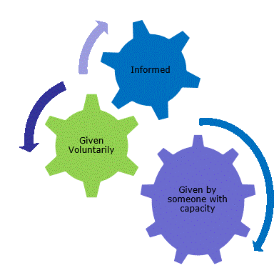
Consent
Consent is a process, not a one-off discussion and must consider three factors:
the person giving consent must be appropriately informed: they must have the necessary information in order to make the decision
consent must be voluntary by the individual without undue pressure or coercion
the person consenting must have the capacity to make the decision

Slide 58
Consent
Information to be given includes:
vaccine to be given and the disease that will be prevented
benefits/risks of immunisation versus risks of the disease
any new information that has become available since consent to previous doses of this vaccine were given if applicable
any possible vaccine reactions and how to treat these
follow-up/information as to any further doses required
how any personal data will be stored and kept (information governance)
How much information should you give?
this will be personal to the individual at the time, and will depend on their previous knowledge and discussions with others.
give people as much information as they need and/or want to make an informed decision
some people will just ‘trust’ what you say while others want lots of information; either is fine
how much each individual needs is up to them, no one is obliged to seek full information

Slide 59
Informed consent
the need for ‘informed consent’ is a legal requirement and the patient’s views must be respected and consent sought
sufficient evidence-based information must be provided to the person to enable them to make a balanced and informed decision about their care and treatment
consent can be given verbally, in writing, or it can be implied
however consent is given, the person must understand what they are consenting to
if there are any issues or uncertainties with seeking or gaining consent, ask for advice from an experienced colleague rather than abandon the offer of immunisation
Notes:
The need for ‘informed consent’ is a legal requirement and the patient’s views must be respected and consent sought
Sufficient evidence-based information must be provided to the person to enable them to make a balanced and informed decision about their care and treatment. As well as a general explanation of the procedure, there is also a duty to explain the risks inherent in the procedure and the risks inherent in refusing the procedure.
Consent can be given verbally, in writing (although there is no requirement for written consent or a particular consent form) or it can be implied (non-verbal consent) but however it is given, the person must understand what they are consenting to.
The consent process should not be an unnecessary barrier to immunising. If there are any issues or uncertainties with seeking or gaining consent, ask for advice from an experienced colleague rather than abandon the offer of immunisation.

Slide 60
Mental capacity and best interest decisions
All adults are considered to have capacity to consent to receiving vaccinations unless there is evidence to suggest that capacity is limited.
If an adult is able to do the following three things, then they should be considered to have capacity and their decision should be respected:
Understand the information that you are giving them about the vaccine and any potential risks from it or from the disease it protects against
Consider the information you have given them and retain it for long enough to make a decision on whether to accept or decline the offer of vaccination
Communicate their decision to you

Slide 61
Actions to support decision making
There are some actions that can be taken to support and optimise a person’s ability to make a decision. These include:
making reasonable adjustments to facilitate decision making or accommodate individual needs
using communication tools such as ‘Easy Read’ leaflets
speaking with them at their best time of day
asking someone who the person knows and trusts to speak to them
If an adult does not have capacity, a best interest decision will need to be made.
This is not the same as consenting on behalf of another adult so
a GP cannot consent on behalf of their patient
a husband or wife cannot consent on behalf of their spouse
a family member cannot consent to a relative’s treatment if they lack capacity

Slide 62
Making a best interest decision
To make a best interest decision, the following must be considered:
the person who lacks capacity should be involved in the decision-making process if possible, particularly if their capacity fluctuates. If capacity does fluctuate, the healthcare professional would accept consent given at the time
any previously expressed wishes or behaviours such as previously consenting to vaccination should be acknowledged
the offer of vaccination should be discussed with those close to the patient such as their carer, relatives or anyone appointed as a Lasting Power of Attorney (LPA) for Health and Welfare, or those named by the person to be consulted on vaccination if practical
the person’s actual interests at the time the vaccine is offered
This process should be documented.
It is good practice to inform nursing or care home management teams of any plans to vaccinate residents in advance of the scheduled date to allow time to address any potential issues.

Slide 63
Documenting informed consent
it is best practice to document on the vaccine recipient’s healthcare record that informed consent has been obtained
providers of an immunisation service may decide, for operational purposes or in accordance with their local consent policy, that written consent should be obtained for each vaccine recipient
operational purposes may include assessing the numbers of vaccines required for a clinic or venue, enabling data capture for patient records or obtaining consent from someone other than the vaccinee (such as a parent or an Attorney)
national consent forms and letters for local adaptation have been provided on the GOV.UK COVID-19 vaccination programme page to support those providers who do wish to obtain written consent

Slide 64
Legal requirements for the Supply and Administration of Vaccines
the regulation of medicines is defined under the Human Medicines Regulations 2012
all vaccines are classified as Prescription Only Medicines (POMs)
this means that they are subject to legal restrictions and in order to give them, there needs to be an appropriate legal framework in place before they can be supplied and/or administered to eligible people
additionally, any person who supplies and administers a vaccine must have a legal authority to do so

Slide 65
Legal requirements for the supply and administration of vaccines
Vaccines are Prescription Only Medicines (POMs). This means a legal framework to supply and/or administer a vaccine must be in place and can be in the form of:
a written patient specific prescription
a Patient Specific Direction (PSD): a written instruction, signed by a doctor, dentist, or non-medical prescriber for medicines to be supplied and/or administered to a named patient after the prescriber has assessed the patient on an individual basis
a Patient Group Direction (PGD): allows some registered specified health care professionals to supply and/or administer a POM directly to a patient with an identified clinical condition rather than needing an individual prescription or an instruction from a prescriber. PGDs are often used for the administration of vaccines
or another process such as a Protocol or Written Instruction
Notes:
A PSD is a written instruction, signed by a doctor, dentist, or non-medical prescriber for medicines to be supplied and/or administered to a named patient after the prescriber has assessed the patient on an individual basis. It must include the dose, route and frequency or appliance to be supplied or administered to a named patient
A PGD provides a legal framework to allow some registered specified health care professionals for the supply and/or administration of a POM directly to a patient with an identified clinical condition rather than needing an individual prescription or an instruction from a prescriber and is often used for vaccines. It sets out the core requisites of those people who can have the medicine under the direction and those who should not. The health care professional working within the PGD is responsible for assessing that the patient fits the criteria set out in the PGD.

Slide 66
Patient Group Directions (PGD)
PGDs set out the core requisites of those people who can have the medicine under the direction and those who should not
the document will also include details of any additional training that should have been undertaken, actions to be taken if the patient is excluded or declines the medicine, a description of the medicine(s), route of administration, doses, frequency, reporting of adverse reactions, recording, storage and disposal
the HCP working under a PGD is responsible for assessing that the patient fits the criteria set out in the PGD. The healthcare professional operating under the PGD may not delegate the role to others
PGDs must be authorised before use by a doctor and a pharmacist and by an appropriate body e.g. NHS E, PHE, NHS Trust, CCG etc
health professionals who will be using the PGD must be named and authorised before they use it to provide care

Slide 67
Using a Patient Group Direction (PGD) to give COVID-19 vaccine authorised under regulation 174
In response to certain public health threats, such as the current pandemic, the MHRA can temporarily authorise the supply of an unlicensed medicine or vaccine for use, under regulation 174 of The Human Medicines Regulations 2012, when it is satisfied that there is robust evidence to show the safety, quality and effectiveness of the medicine/vaccine.
in October 2020, new legislation amending The Human Medicines Regulations 2012 was passed
prior to this, PGDs could only be used for licensed medicines
the change to legislation allows medicines/vaccines which have been temporarily authorised for supply in the UK under regulation 174 to be administered in accordance with a PGD
registered HCPs who are allowed to work to a PGD may supply and administer COVID-19 vaccines, as temporarily authorised vaccines under Regulation 174, using a PGD
the workforce that can administer under PGDs has not changed
PHE will develop and publish PGDs for COVID-19 vaccines

Slide 68
Protocols for the supply and/or administration of COVID-19 vaccine
the changes to the Human Medicines Regulations also brought about a new regulation (247A)
while a disease is pandemic, regulation 247A permits the supply or administration of a medicinal product used for vaccination against coronavirus in accordance with a protocol that is approved by ministers
a national protocol will allow trained and competent non-registered healthcare workers as well as registered healthcare professionals, to administer COVID-19 vaccine
the protocol will specify who can use it and will include information similar to that commonly found in PGDs
it is expected that the protocol will allow flexibility for different COVID-19 vaccine delivery models.
it may be followed wholly from patient assessment through to post-vaccination by a single person. Alternatively, multiple HCWs may undertake different roles or stages in the patient vaccination pathway in accordance with the protocol
the service provider is responsible for ensuring that HCWs are trained and competent to safely deliver the activity they are employed to provide under the protocol

Slide 69
Vaccine storage, preparation and administration
Vaccine storage, preparation and administration are critical components of a successful vaccination programme and are key to ensuring that vaccination is as safe and effective as possible.
If specific requirements are not followed, vaccinees may not make a response to the vaccine and so remain unprotected or, they may be at higher risk of developing a vaccine reaction.
To minimise the risk of vaccine failures and reactions:
the storage conditions of the vaccine should always be checked before administration
the vaccine must be reconstituted according to the manufacturer’s instructions
the correct equipment should be used to prepare the vaccine
the correct technique must be used to deliver the injection and
the vaccine must be administered in the correct anatomical site

Slide 70
Vaccine storage
as vaccines are biological products, they are temperature sensitive so must be stored and transported within the recommended temperature range
the system of transporting and storing vaccines is called the cold chain
a cold chain breach occurs when vaccines have been stored outside of this temperature range
vaccines that have not been stored or transported correctly can lose potency and may not evoke a full or lasting immune response, leaving the vaccinee at risk of the disease the vaccine should have prevented
for vaccines in the national vaccination programme, the recommended vaccine storage temperature range is usually between 2˚C to 8˚C

Slide 71
Vaccine storage (continued)
vaccine storage recommendations are set out by the manufacturer and are part of the licensing conditions
vaccines that have not been stored in the recommended temperature range are outside of those licensing conditions. Any apparent failure of the vaccine and responsibility and liability for their use will therefore lie with the immunisation provider
vaccines that are not stored and transported correctly may need to be disposed of which leads to increased wastage and programme costs
adhering to the temperature recommendations will ensure that vaccines are in optimum condition for those individuals they are given to

Slide 72
General principles of vaccine storage
all vaccines and diluents must be stored in a lockable dedicated vaccine/medicine fridge between 2ºC and 8ºC (unless other storage requirements have been specified)
systems to prevent accidental interruption of the power supply to the fridge must be in place
fridges should be situated away from radiators and other sources of heat that could affect how they work
records should be kept of regular fridge servicing and thermometer calibration
the temperature in the fridge must be continually monitored using a current/minimum/maximum thermometer
fridge temperatures should be monitored and recorded on a designated chart ideally twice every working day
fridge alarm parameters should be set appropriately to alert to any deviations from the 2ºC to 8ºC range
vaccines must be kept upright and stored in their original packaging
vaccines with shorter expiry dates should be placed at the front of the fridge
expired stock should be removed from the fridge and destroyed
take immediate action if the temperature goes outside recommended range

Slide 73
Storage and transportation of COVID-19 vaccines
All those involved in the delivery of the COVID-19 vaccination programme have a professional responsibility to ensure that the cold chain is maintained and must be aware of the recommended storage requirements for the different COVID-19 vaccines.
Be very clear about your specific responsibilities for maintaining the cold chain and at what point e.g. transporting it, receiving a delivery, daily fridge monitoring, reconstitution, etc.
COVID-19 vaccine must not be given if you are not confident that it has been stored or reconstituted as recommended by the manufacturer or as advised by a vaccine expert

Slide 74
Temperature monitoring systems
there should be a named person and a deputy responsible for COVID-19 vaccine storage
those responsible should be familiar with the fridge digital display readings, the functioning of the thermometer reset button and the manufacturer’s user guidelines
data loggers can be useful in the event of a cold chain breach as the data can be used to calculate cumulative exposure to out of range temperatures. However, they should always be used in conjunction with the integral fridge thermometer and should not be used to replace the daily temperature monitoring and recording
a visual check of the actual temperature should also be made each time a vaccine is removed from the fridge

Slide 75
Temperature monitoring equipment
most vaccine and medicine fridges have integral thermometers with a digital display. Ideally, a second thermometer, independent of the main power source (for example, battery operated) should be available to monitor the temperature in the event of a power failure
temperature probes with cables should be correctly positioned in the fridge, ensuring that the cable does not interfere with the door seal and that the probe is not up against the back or sides of the fridge
data loggers are recommended as a back up to visual temperature inspection
vaccines being stored or transported in portable cool bags or refrigeration devices should be monitored to the same standard as vaccines stored in vaccine fridges
vaccine fridges and temperature-monitoring equipment should be regularly serviced and calibrated

Slide 76
Action to take if vaccines are stored incorrectly
If COVID-19 vaccines are stored incorrectly:
label & isolate affected vaccines and do not use until further notice
inform your team leader / manager and other vaccinators in the clinic
make alternative arrangements for immunisation clinics until resolved
seek advice from the manufacturer or a source of expert advice
be able to provide them with the following information:
- what monitoring has taken place (max/min/current thermometer readings)
- when the cold chain was last guaranteed
- what time period/s are involved (hours/days)
- what the temperature range has been during this period
- identify all vaccines stored in the fridge, the time they have been stored there and expiry dates

Slide 77
Portable refrigeration
a medical grade cool box or bag purchased from a medical supplier must be used for storage and transportation of vaccines being used for home visits or community clinics
all vaccines should be kept in their original packaging until use and the cool box or bag should be packed following the manufacturer’s instructions and not overfilled
the minimum and maximum temperatures in the cool box or bag should be recorded
if the temperature has gone out of range, a risk assessment should be conducted before using or disposing of the vaccines

Slide 78
Vaccination site
Giving vaccine into the muscle:
leads to a better immune response to the vaccine (as the muscle contains the appropriate cells necessary to initiate the immune response) and
is less likely to cause local reactions than if the vaccine is given into the skin (subcutaneously)
The needle needs to be long enough to ensure vaccine is injected into the muscle. For this reason, a 25mm needle is being provided for administration of the COVID-19 vaccine. A 38mm length needle is available if required for adults who have more fat covering their muscles.
The COVID-19 vaccine should be injected into the deltoid muscle in the upper arm or, if there is insufficient muscle mass in the area of the deltoid or a particular reason the deltoid muscle is otherwise unsuitable, into the vastus lateralis muscle in the anterolateral aspect of the thigh.

Slide 79
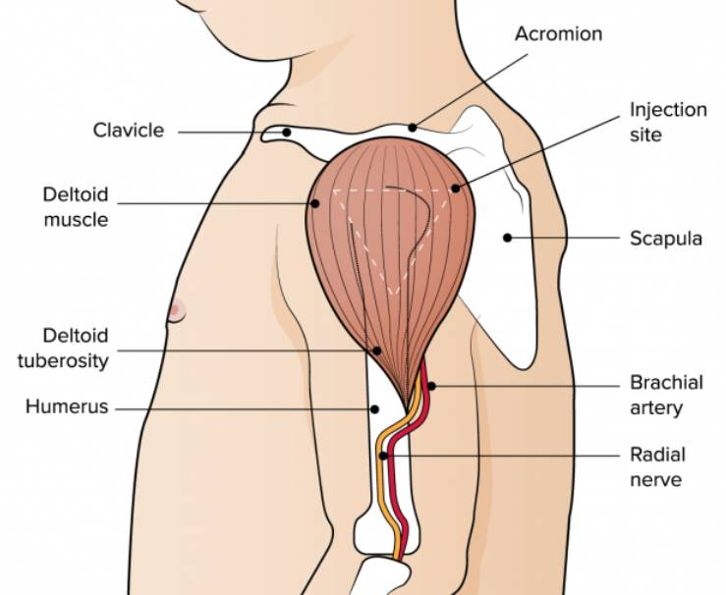
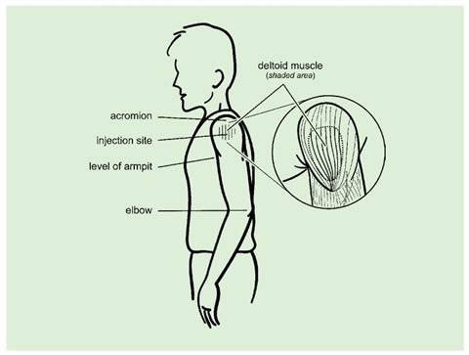
The deltoid muscle (upper arm)
https://immunisationhandbook.health.gov.au/resources/handbook-figures/figure-anatomical-markers-used-to-identify-the-deltoid-injection-site
https://assets.publishing.service.gov.uk/government/uploads/system/uploads/attachment_data/file/147915/Green-Book-Chapter-4.pdf p28

Slide 80
The Vastus lateralis muscle (anterolateral aspect of the thigh)
Infants under one year receive their immunisations into the anterolateral aspect of the thigh because the deltoid muscle is not sufficiently well enough developed at this age.
Although the deltoid muscle is more commonly used in older children and adults as it is quicker and easier to access, the vastus lateralis muscle in the thigh can be used in these age groups if necessary.
www.cdc.gov/vaccines/pubs/pinkbook/vac-admin.html

Slide 81
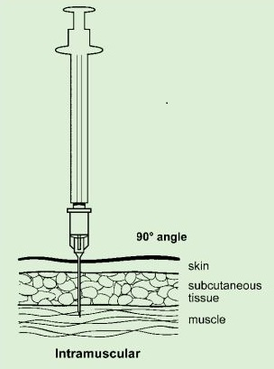
Vaccine administration continued
Skin does not need to be specially cleaned prior to vaccination. If it is visibly dirty then water is sufficient to clean it.
Plasters are not generally needed to cover injection sites but can be used if necessary. Gentle pressure with a gauze swab can be applied following vaccination if bleeding occurs.
Intramuscular process:
identify the correct site for IM injection
stretch the skin at the site
insert the needle at a 90° angle far enough to ensure vaccine is delivered into muscle
depress the plunger
gently remove the needle
apply light pressure using gauze or cotton wool if bleeding occurs
Notes:
https://assets.publishing.service.gov.uk/government/uploads/system/uploads/attachment_data/file/147915/Green-Book-Chapter-4.pdf

Slide 82
Consequences of incorrect injection technique
it is essential that the correct site and injection technique be used to administer vaccines
injecting too high into the upper arm might result in a shoulder injury or a frozen shoulder. This leads to pain, weakness and a limited range of motion that can last for months
injecting too far to the side of the arm or too low on the arm risks injecting into the axillary nerve or the radial nerve
to avoid shoulder injury, always assess the limb before administering the vaccine to identify the correct site for injection
Notes:
It is essential that the correct site and injection technique are used to administer vaccines.
Injecting too high into the upper arm might result in the vaccine being deposited in the shoulder capsule rather than the deltoid muscle. If this happens, inflammation can occur, leading to a shoulder injury or a frozen shoulder. This leads to pain, weakness and a limited range of motion that can last for months.
Injecting too far to the side of the arm or too low on the arm risks injecting into the axillary nerve or the radial nerve. This can cause a burning or shooting pain during the procedure and can lead to nerve damage (neuropathy/paralysis).
To avoid shoulder injury, always assess the limb before administering the vaccine to identify the correct site for injection.

Slide 83
Post vaccination advice and observation
those vaccinated should be observed for any immediate adverse effects whilst receiving any verbal post vaccination information
vaccinees should be given a copy of the patient information leaflet and/or any other relevant written information. Inform them how that they can obtain further advice if required
an appointment should be made for any further doses required
as syncope (fainting) can occur following vaccination, those vaccinated should be advised to wait for 15 minutes post-vaccination before driving. There is no waiting period required for those vaccinated who are not driving
inform the vaccinee that they should continue to follow advice current at the time regarding practicing social distancing, wearing a face mask and washing their hands thoroughly and frequently
Notes:
Individuals should be observed for any immediate adverse effects whilst receiving any verbal post vaccination information (such as possible reactions and what, if anything, to do about these). They, or their parents/carers, should also be informed that they can obtain further advice if they require it following vaccination.
The patient should be given a copy of the patient information leaflet (PIL) and/or any other relevant written information.
If a further dose will be required, an appointment should be made for this and the individual should be given a record card with details the first dose of vaccine and details of the appointment date and time for the second dose.
As syncope can occur following vaccination, those vaccinated should be advised to wait for 15 minutes post-vaccination before driving. There is no waiting period required for those vaccinated who are not driving

Slide 84
Disposal of consumables
needles should not be re-sheathed under any circumstances
the needle and syringe should be disposed of immediately after use in a puncture resistant yellow sharps bin
the yellow sharps bin should be sealed when it is two thirds full and replaced with a new one
paper wrappers should be disposed of in a general waste bin
any blood stained gauze or cotton wool should be placed in a bin for clinical waste
local policy should be followed for the disposal of PPE

Slide 85
Adverse reactions following vaccination
Some people can feel unwell following an injection and some people may experience an adverse reaction.
Vaccinees should be informed of the potential expected reactions to COVID-19 vaccines.
There are three main types of adverse reaction following immunisation:
Local reactions at the injection site such as redness, swelling or pain at the injection site
Systemic reactions (reaction affecting the whole body) such as fever, headache, loss of appetite
Allergic reaction such as anaphylaxis or a severe systemic allergic reaction

Slide 86
Adverse reactions following vaccination
Adverse events following vaccination may occur for various reasons. These include:
inappropriate practices in the provision of vaccinations such as giving the wrong dose of vaccine or poor injection technique
reactions caused by the vaccine or its component parts. These may be a direct effect of the vaccine or due to an underlying medical condition in the individual
An individual may report an event following vaccination that may be coincidental rather than a true adverse event, for example when a vaccinee develops cold-like symptoms after receiving the flu vaccine. The vaccination and the symptoms are linked because of the timing, but the vaccine did not cause the symptoms

Slide 87
Anaphylaxis
common causes of anaphylaxis include food, eggs, and nuts but it can also be caused by medicines or vaccines
anaphylaxis is a rare, potentially life-threatening event
confirmed anaphylaxis following vaccination is extremely rare
data from the UK, Canada and the US indicate rates of 0.65 to 3 anaphylaxis events per million doses of vaccine given
onset is typically rapid, within minutes, with variable severity
although this rate is for vaccines given prior to the introduction of the COVID-19 vaccine, there is no reason or indication from clinical trials that this rate would be any higher for COVID-19 vaccine
however, it is important that immunisers know how to treat anaphylaxis should it occur and equipment for treating anaphylaxis should be available in all vaccination settings
you must have completed Basic Life Support and anaphylaxis training prior to giving any vaccinations

Slide 88
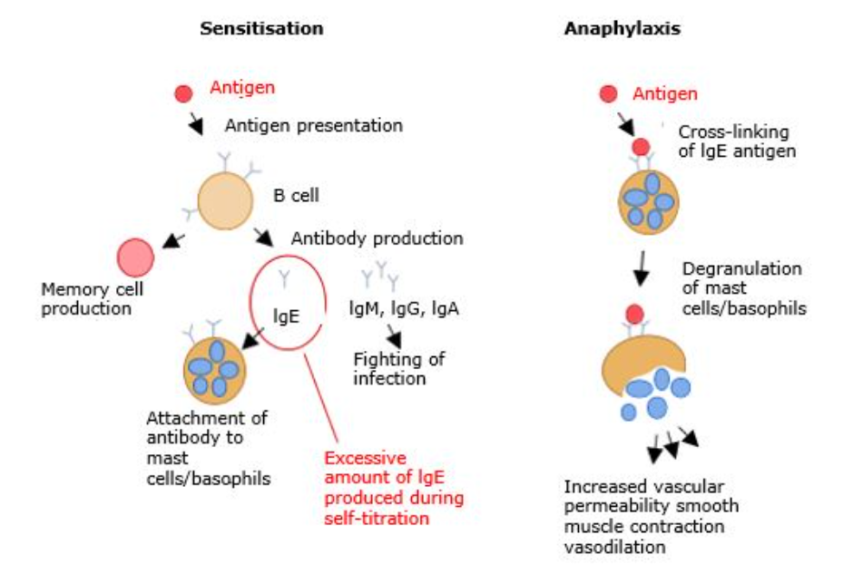
Anaphylaxis
Anaphylaxis occurs as a result of exposure to an allergen to which a person has been sensitised and previously made specific immunoglobulin E (IgE).
On re-exposure to the antigen, explosive amounts of histamine and other chemical mediators are released following the binding of the antigen to IgE coated mast cells.
This causes bronchospasm, angioedema, pulmonary oedema, cardiovascular collapse, and loss of consciousness.

Slide 89
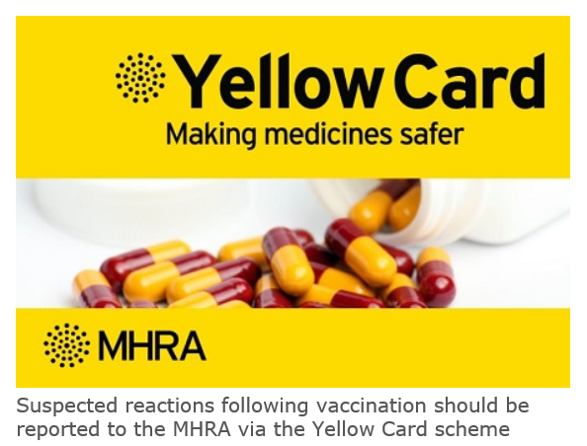
Reporting adverse reactions
Suspected adverse reactions following administration of COVID-19 vaccine should be reported to the MHRA using the specific Coronavirus Yellow Card reporting scheme (coronavirus-yellowcard.mhra.gov.uk/ or call 0800 731 6789). As a new vaccine product, MHRA have a specific interest in the reporting of adverse drug reactions for these vaccines.
vaccines are carefully monitored to ensure they are safe, not causing untoward side effects and are suitable for the immunisation programme
MHRA promotes the collection and investigation of adverse reactions through the Yellow Card scheme which is a voluntary reporting system for suspected adverse reactions
anyone (patients and HCWs) can make a Yellow Card report, even if they are uncertain as to whether a vaccine caused the condition

Slide 90
Documentation and record keeping
it is essential that the information in Box 1 is recorded for all doses of vaccine given to ensure complete and accurate patient vaccination records and to enable extraction of the correct data for surveillance and vaccine coverage purposes
if not administered at the patient's GP surgery, a record of the vaccination given should be sent to the patient's GP to avoid duplicate vaccination and so that data can be submitted to the national COVID-19 vaccine uptake data survey
BOX 1. Following vaccination, the following information should be recorded
vaccine name
product name
batch number
expiry date
dose administered
date immunisation given
route/site used
name and signature of vaccinator
Examples of patient records where vaccination details may need to be recorded
patient's GP record (or other patient record, depending on location)
practice computer system
occupational health record/employer's record

Slide 91
Communicating with patients
There are many sources of information available relating to COVID-19. Since the virus was first identified in January 2020, there have been thousands of publications globally.
When considering the information contained in written materials, there are some key points to consider:
the author and their expertise/background
if the author is not named, or the source is not clear, this should raise your suspicion about the quality of the information
does the author have a vested interest in presenting an unbalanced view?
the way the information is presented
is it presented in an unbiased manner, or is it selected to provide only one viewpoint when there are other equally valid views?
is the information dated? If so, there may be more recent information that is different
if there are any uncertainties, are they mentioned?
is it possible to follow up any information by going to the original data, e.g. a trial of a vaccine?

Slide 92
Addressing concerns and providing information to those being vaccinated
the COVID-19 vaccines are new vaccines. Patient information leaflets will be provided in advance but many patients will want additional verbal reassurance or answers
it is important to read the information being made available to vaccinees so the information you give is consistent with this and so you know what information they have already had
it is also important to know where to direct patients to for further information
if people’s questions and concerns are answered accurately and appropriately, they are more likely to accept vaccination
Notes:
As the COVID-19 vaccines will be new vaccines, it is likely that people will have a lot of questions. Although they will be provided with patient information leaflets in advance of their immunisation appointment, many may not have read this or will want additional verbal reassurance or answers from you.
Undertaking this training should give immunisers a lot of the information they will require to answer some of the questions, for example, how the vaccine is made, whether it has been thoroughly tested, how many people it has been given to in clinical trials and the possible reactions it might cause.
It is important that immunisers read the information being made available to vaccinees so the information they give is consistent with this and so they know what information they have already had. It is also important that they know where they can direct them to for further information or know where they can obtain answers to any questions that they cannot answer. See Resources section for additional sources of information about the COVID-19 vaccine programme

Slide 93
General principles for addressing concerns
give the patient/parent/carer time to ask questions
find out the basis for their concerns
explore the nature and sources of information they have already gathered
check the patient/parents’/carers’ personal experience
provide them with other sources of information such as valid and reliable websites
check their understanding of the information that you provide
ask them if there are any more concerns
if they decline to be vaccinated, suggest talking again in a couple of days/weeks if appropriate
recommend immunisation

Slide 94
Knowledge and skills
a high level of knowledge and a positive attitude to immunisation helps to achieve and maintain high vaccine uptake.
those being vaccinated need to feel confident that the person giving them the vaccine or advising them knows what they are doing and has the appropriate knowledge, skills and ability
immunisers who do not feel confident should discuss their concerns with a mentor or supervisor

Slide 95
Knowledge and skill check
Statutory and mandatory training – should be completed as specified by your employer (including basic life support and anaphylaxis). This may also include additional sessions on infection prevention and control, information governance and other relevant topics to the patient group(s) you will be vaccinating
Vaccine specific training (knowledge) – through elearning, classroom-based training or a webinar
Vaccine specific training (practical) - preparing a vaccine and intramuscular (IM) injection technique
Competency assessment - for formal assessment and sign-off of clinical competency. Supervision is recommended for new immunisers until both they, and their supervisor or trainer, feel confident that they have the necessary knowledge and skills to administer vaccines safely and competently

Slide 96
Competency assessment tool
The competency assessment tool is divided into three areas
Knowledge
Core clinical skills
The clinical process/procedure for vaccine administration
It should be completed by those who are new to or returning to immunisation before sharing with their supervisor. Experienced immunisers can use it as a self-assessment tool.
The supervisor carrying out the assessment should:
review the self-assessment, discussing any areas identified as ‘need to improve’
observe performance in the provision of immunisations/advice and indicate whether each competency is ‘met’ or ‘needs to improve’ in the ‘supervisor review’ column
if improvement is needed, help to develop an action plan to enable the achievement of the required level of competence and plan a further assessment
sign off the section at the bottom of the assessment when competency is agreed

Slide 97
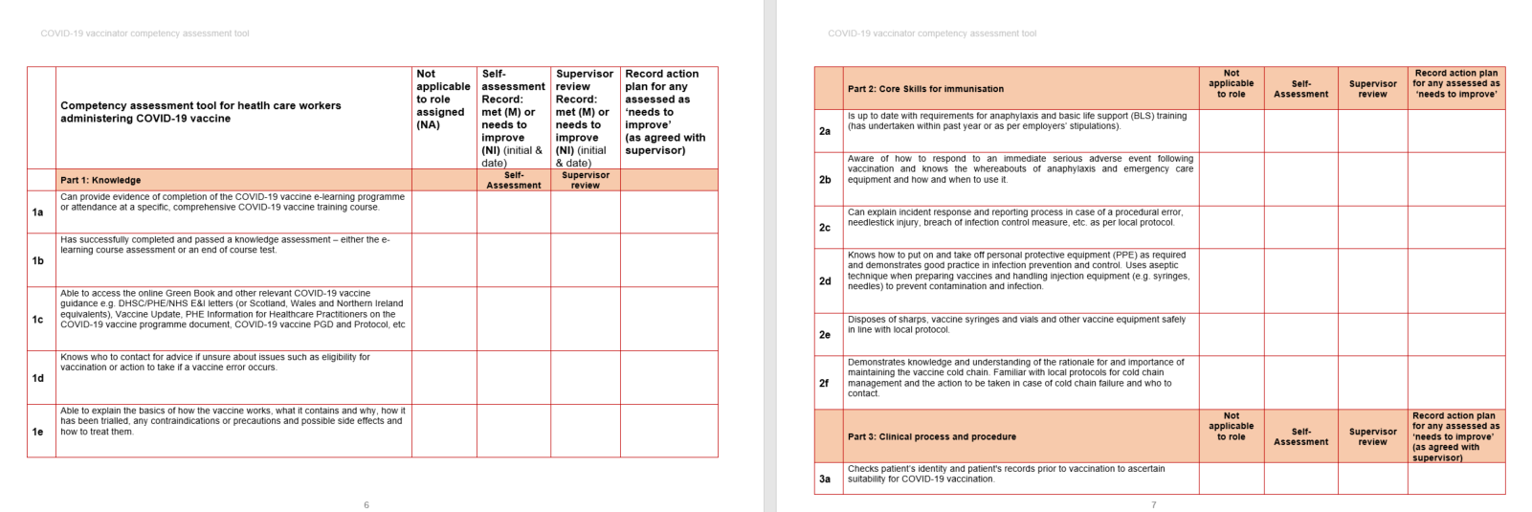
COVID-19 vaccinator competency assessment tool

Slide 98
Supervision and accountability
Supervision
supervision for new immunisers is critical to the safe and successful delivery of the COVID-19 immunisation programme
supervisors must be registered, appropriately trained, experienced and knowledgeable practitioners in immunisation
Accountability
all staff involved in immunisation are accountable for their own practice, both to their employer and to their professional regulator (where applicable)
employers are responsible and accountable for ensuring that employees have the required training and competency and are provided with an appropriate level of supervision to safely and effectively carry out the role they have been contracted to provide

Slide 99
Delegation
If immunisation is delegated, patient safety must be considered and not compromised in any way.
The delegation must be appropriate, safe and in the best interests of the patient
When delegating immunisation, the delegating healthcare professional (whether nursing, medical or other independent prescriber) must ensure that:
the person they are delegating to has undergone training, has the appropriate knowledge, skills and competency
there is adequate supervision and support in place
If these conditions have been met and the role of administering an immunisation is delegated, the delegatee is accountable to the patient for their actions and decisions, and for any errors they make through civil law and to their employer.

Slide 100
Maximising vaccine uptake
As COVID-19 vaccine may be offered in different settings, different methods of promoting the vaccine to maximise uptake may be required.
This may include:
displaying posters in areas of high footfall such as waiting rooms, train stations, shopping centres
having leaflets available for patients to read before their appointment
signposting people to online resources or resources in a suitable format, for example Easy Read, BSL, large text and translated versions
speaking confidently and positively about the vaccines and encouraging others in the vaccination clinic to do so as well
confirming an appointment has been made for the second dose
offering flexible appointments, including evening and weekend clinics
ensuring mobile staff are able to locate patient’s homes

Slide 101
Further information
UK vaccine policy can be found in the online publication commonly referred to as the "Green Book" . This can be found on the Immunisation page of the GOV.UK website
Green Book recommendations are based upon JCVI’s expert opinion and should always be followed, even when they differ from those made by the vaccine manufacturer
PHE COVID-19 immunisation programme Information for healthcare practitioners
This document provides additional information, answers to frequently asked questions and actions to take in the event of inadvertent errors.
It is important to read this document before you start vaccinating and also to refer to the online version regularly as it will be updated as more information becomes available and to address any issues or frequently arising questions as COVID-19 vaccines are delivered more widely.

Slide 102
Vaccine product information
Licensed vaccines have a Summary of Product Characteristics (SPC)
Initially, the COVID-19 vaccines will be given authorisation for temporary supply rather than a product license
This means they will not have an SPC but all the information about the vaccine that would usually be found in an SPC is presented in an “Information for Healthcare Professionals” document
The Information for healthcare professionals document provides a description of the vaccine, how to use it and the conditions attached to its use.
An “Information for UK recipients” document is also available which provides information for patients about the vaccine.
For both of these documents, see: MHRA guidance on coronavirus (COVID-19) www.gov.uk/government/collections/mhra-guidance-on-coronavirus-covid-19#vaccines-and-vaccine-safety

Slide 103
Action plan
To consolidate learning, the following actions should be completed:
undertake the COVID-19 vaccine, vaccine administration, storage and legal aspects elearning sessions if required after this training session
undertake Basic Life Support/anaphylaxis training if not undertaken in the past year
complete any additional statutory and mandatory training required by your employer
undertake practical training in immunisation if required e.g. IM injection technique
complete the COVID-19 competency assessment tool
visit the GOV.UK Immunisation web pages and familiarise yourself with the resources available on this site
read the “COVID-19 immunisation programme Information for healthcare practitioners” document
access the Green Book online and read the COVID-19 vaccine chapter and any other chapters that are relevant e.g. vaccine administration, vaccine storage
subscribe to Vaccine Update to ensure that you receive this free monthly newsletter as it is published. It contains details of immunisation programme updates and changes
find out and make a note of who you can contact if you have an immunisation query or incident. This may be your local NHS England Screening and Immunisation Team or lead consultant (if working in Occupational Health, etc)

Slide 104
Learning objectives
By the end of this session, you should be able to:
explain what COVID-19 is and be aware of the UK epidemiology
understand the policy behind the COVID-19 vaccination programme
describe how vaccines work and how they are developed and trialled
identify the groups who are at high risk for COVID infection and who should be prioritised to receive the COVID-19 vaccine
describe the process of consent and how this applies when giving vaccines
understand the legal mechanisms by which immunisers can supply and administer COVID-19 vaccine
recognise the differences between a prescription, a PSD, a PGD and a Protocol and understand which staff can use each of these
describe the key principles of how to correctly store, prepare and administer vaccines
communicate key facts in response to questions from patients and direct them to additional sources of information

Slide 105
Resources
Green Book COVID-19 chapter www.gov.uk/government/collections/immunisation-against-infectious-disease-the-green-book
Public Health England Coronavirus resources www.gov.uk/government/collections/immunisation
GOV.UK Coronavirus (COVID-19) in the UK https://coronavirus.data.gov.uk/
WHO COVID-19 Worldwide Dashboard https://covid19.who.int/?gclid=EAIaIQobChMInr6P36Dc7AIVBWHmCh3IswIXEAAYASAAEgIPT_D_BwE
LSHTM COVID-19 vaccine tracker https://vac-lshtm.shinyapps.io/ncov_vaccine_landscape/
Royal College of Nursing. COVID-19 vaccination resources www.rcn.org.uk/clinical-topics/public-health/immunisation/covid-19-vaccination
Royal College of Nursing. Immunisation services and large-scale vaccination delivery during COVID-19. www.rcn.org.uk/clinical-topics/public-health/immunisation/immunisation-services-and-large-scale-vaccination-delivery-during-covid-19#planningandriskassessmentprocess
MHRA guidance on coronavirus (COVID-19) www.gov.uk/government/collections/mhra-guidance-on-coronavirus-covid-19#vaccines-and-vaccine-safety

Slide 106
COVID-19 mRNA Vaccine BNT162b2 (Pfizer-BioNTech)
the vaccine contains BNT162b2 messenger RNA embedded in lipid nanoparticles
the vaccine does not contain preservative
no animal products are used in the manufacture of this vaccine
product information about the COVID-19 mRNA Vaccine BNT162b2 is available at https://coronavirus-yellowcard.mhra.gov.uk/productinformation
Notes:
The vaccine does not contain any animal products

Slide 107
COVID-19 mRNA Vaccine BNT162b2 presentation
the vaccine packs contain 195 vials of vaccine (975 doses per pack as each vial contains 5 doses)
the vaccine is contained in a multidose clear glass vial. The vial has a rubber (bromobutyl) stopper, aluminium seal and a flip-off plastic cap. The stopper does not contain latex
each vial contains 0.45 ml of vaccine and should be diluted with 1.8 ml of Sodium Chloride 0.9% Solution for Injection (normal saline). Once diluted, each reconstituted vaccine will supply 5 doses of 0.3 ml (30 mcg)
there will be a small amount of vaccine left in the vial after drawing 5 doses: this should be discarded
a separate ampoule containing a minimum of 2ml of normal saline is required for vaccine reconstitution
each ampoule of diluent is single use and any remaining diluent must be discarded after 1.8 ml has been withdrawn, regardless of the ampoule volume
Notes:
Bromobutyl is a synthetic rubber – it does not contain latex so this vaccine is suitable for people with a latex allergy.

Slide 108
Ordering COVID-19 mRNA Vaccine BNT162b2
COVID-19 mRNA Vaccine BNT162b2 should be ordered via PHE's ImmForm platform
each pack of vaccine ordered should automatically generate an order for the required number of the following for that vaccine pack:
diluent
syringes and needles for dilution
syringes and needles for vaccine administration
vaccination record cards
patient information leaflets
there are no special storage requirements for the diluent and this can be stored with other ambient products (needles and syringes) in a dry environment away from direct sunlight

Slide 109
COVID-19 mRNA Vaccine BNT162b2 dose and schedule
a single dose is 0.3 ml (30 mcgs)
two doses of COVID-19 mRNA Vaccine BNT162b2 are required with a minimum 21-day interval between doses
a 28-day interval can be used for operational purposes
using a consistent interval between all two-dose COVID-19 vaccines simplifies the messaging to the public and arrangements within clinic settings where alternative vaccines may be supplied at short notice
COVID-19 mRNA Vaccine BNT162b2 can be scheduled from 21 days after the first dose where rapid protection is required

Slide 110
Storage and transportation of mRNA Vaccine BNT162b2
the vaccine will be delivered frozen to healthcare facilities with ultra low temperature (ULT) freezers
vaccine packs will be shipped inside isothermic boxes (validated boxes which will maintain a constant temperature for a specified period of time) inside a cardboard box
the isothermic box will also contain dry ice which should be disposed of carefully following local protocols
upon delivery, the vaccine packs should be removed from the isothermic box and transferred to a suitable ULT freezer to ensure ongoing storage between -75ºC and +/-15ºC
the vaccine should be kept upright, in its original packaging and away from prolonged light exposure
the vaccine packs must not be opened until the vaccine is going to be thawed
when required, frozen vials should be transferred to 2ºC to 8ºC to thaw; a 195 vial pack may take 3 hours to thaw
alternatively, frozen vials may also be thawed for 30 minutes at temperatures up to 25ºC for immediate use
once thawed, the vaccine cannot be re-frozen
shelf-life is 6 months at -80ºC to -60ºC

Slide 111
Storage and transportation of COVID-19 mRNA Vaccine BNT162b2 in a thawed state
the vaccine may then be delivered to where it is going to be administered thawed but refrigerated between +2 and +8ºC
refrigerated vaccine must be transferred immediately to a vaccine fridge on arrival and stored in a carefully monitored temperature range of +2 and +8ºC
stability data currently indicates the COVID-19 mRNA BNT162b2 vaccine will remain stable for 5 days (120 hours) when stored in a fridge with a temperature range of +2 and +8ºC before reconstitution and for 6 hours at room temperature after reconstitution
the vaccine pack will have a yellow label on the front stating the time it was removed from the freezer into storage at +2 to +8ºC and the date and time by which it must be discarded 5 days (120 hours) later if it has not been used
vaccine should be stored in the original package to protect it from light. Exposure to room light should be minimised and exposure to direct sunlight and ultraviolet light should be avoided

Slide 112
Storage and use of mRNA Vaccine BNT162b2
the mRNA Vaccine BNT162b2 has very specific storage, reconstitution and 'use within' requirements
all those involved in the delivery of the COVID-19 vaccination programme must be aware of the recommended storage requirements
The vaccine must not be given if you are not confident that it has been stored or reconstituted as recommended by the manufacturer or as advised by a vaccine expert
If the vaccine is stored incorrectly:
Label and isolate affected vaccines in the fridge and do not use until further notice
Seek advice from the manufacturer or a source of expert advice

Slide 113
COVID-19 mRNA Vaccine BNT162b2 reconstitution
The following equipment is required for reconstitution:
one COVID-19 mRNA Vaccine BNT162b2 vaccine multidose vial
one plastic ampoule of Sodium Chloride 0.9% Solution for Injection - this will be supplied in multiple presentations (different manufacturers and different sized ampoules)
an alcohol swab, a green hubbed needle and a 2 ml syringe to reconstitute - needles and syringes will be supplied together in boxes of 100
Reconstituted vaccine can be stored between +2ºC and +25ºC but must be used within 6 hours following dilution

Slide 114
Reconstituting COVID-19 mRNA Vaccine BNT162b2 (1)
clean hands with alcohol-based gel or soap and water
assemble one ampoule of Sodium Chloride 0.9% Solution for Injection, a single use alcohol swab, a needle with a green hub and a 2ml syringe
from cold storage, remove one vial of vaccine
if removing the multidose vaccine vial directly from a ULT freezer, allow the vaccine to defrost for 30 minutes at temperatures up to 25ºC and reconstitute within 2 hours after thawing. Allow the thawed vial to come to room temperature and gently invert 10 times prior to dilution. Do not shake.
if removing the multidose vaccine vial from cold storage between +2 and +8ºC, check that it has not been stored there for longer than 5 days (120 hours)
check the expiry date and the appearance of the vaccine. Prior to dilution, the vaccine should be an off-white solution with no particulates visible. Discard the vaccine if particulates or discolouration are present
connect the needle with a green hub to the 2 ml syringe

Slide 115
Reconstituting COVID-19 mRNA Vaccine BNT162b2 (2)
8. clean the vial stopper with the single use alcohol swab and allow to air dry fully
9. draw up 1.8 ml of Sodium Chloride 0.9% Solution for Injection, then discard the diluent ampoule and any remaining diluent in it. Do not use any other type of diluent
add diluent to the vaccine vial. You may feel some pressure in the vial as you add the diluent. Equalise the vial pressure by withdrawing 1.8 ml of air into the empty diluent syringe before removing the needle from the vial
11. Gently invert the diluted solution 10 times. Do not shake
12. The diluted vaccine should be an off-white solution with no particulates visible. Discard the diluted vaccine if particulates or discolouration are present
13. Dispose of green hub needle and syringe into yellow sharps bin
14. The diluted vial should be clearly labelled with the discard time and date (this will be 6 hours after time of dilution). Reconstituted vaccine can be returned to the fridge/cool box but must be used within 6 hours following dilution
Notes:
Reconstituted vaccine can be returned to the fridge/cool box and stored between 2oC and 8oC (or up to 25°C if not in fridge) but must be used within 6 hours following dilution.

Slide 116
COVID-19 mRNA Vaccine BNT162b2 dose preparation
if the vaccine has previously been reconstituted, check that the time of reconstitution was within the last 6 hours
clean top of vial with a single use alcohol swab and allow to air dry fully
unwrap one of the 1ml combined 23g/25mm blue hub needle and syringes provided (recommended needle length depends on body mass of patient. Longer length (38mm) needles are recommended and being supplied for morbidly obese individuals to ensure the vaccine is injected into muscle).
withdraw a dose of 0.3 ml of diluted product for each vaccination. Ensure correct dose is drawn up
any air bubbles should be removed before removing the needle from the vial in order to avoid losing any of the vaccine dose
there is no requirement to change the needle between the vial and the patient unless the needle is contaminated or damaged

