Slide 1
Background – eConsult/NHS App integration
Development of the eConsult functionality within the NHS App was completed and piloted in December 2019 for 3 months. It comprises a ‘gold’ API integration allowing the user to enter details into the NHS App which are seamlessly passed into the eConsult system resulting in no change to the experience for the GP surgery staff.
This takes the form of 2 new functions for the NHS App:
Triage journey “Ask your GP for advice” - A user answers questions which are collated and submitted to the practice for action by (in most cases) the end of the next day
Admin journey “Additional GP services” - A user can request things which don’t always require an appointment such as sick notes, doctor’s letters etc.
The designs for these functions and where they fit into the NHS App have been tested with users and undergone several iterations.

Slide 2
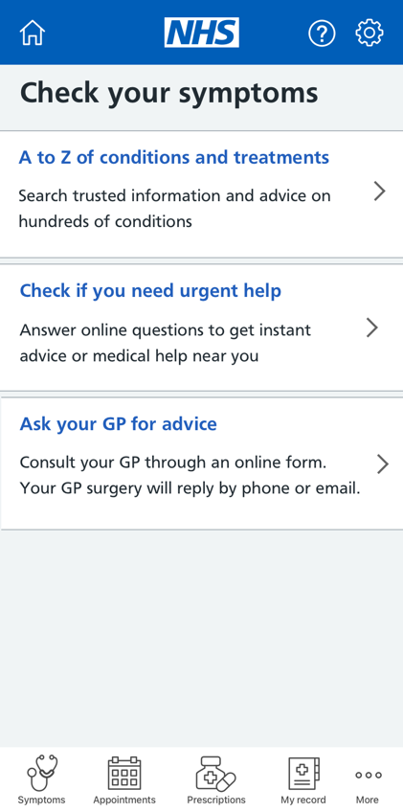
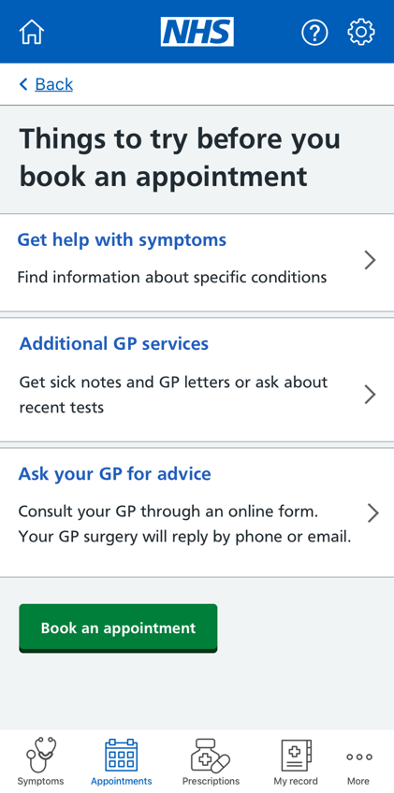
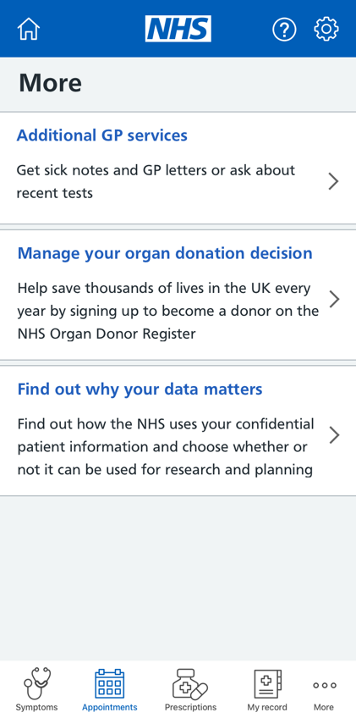
Accessing eConsult functionality within the NHS App
Admin Journey
Triage Journey

