Slide 1
Infection Prevention
Personal Protective Equipment

Slide 2
Personal Protective Equipment
Uniform is part of PPE
It protects you and your patients
No nail varnish
Footwear – fully enclosed, non-slip, fitted
PPE is not a substitute for hand hygiene
Single use – single patient use
Dependant on the mode of transmission and the risk
Remember ‘nothing below the elbow’
No necklaces (choke/scratch risk)
Uniform above elbows
No watches, bracelets, stoned rings

Slide 3
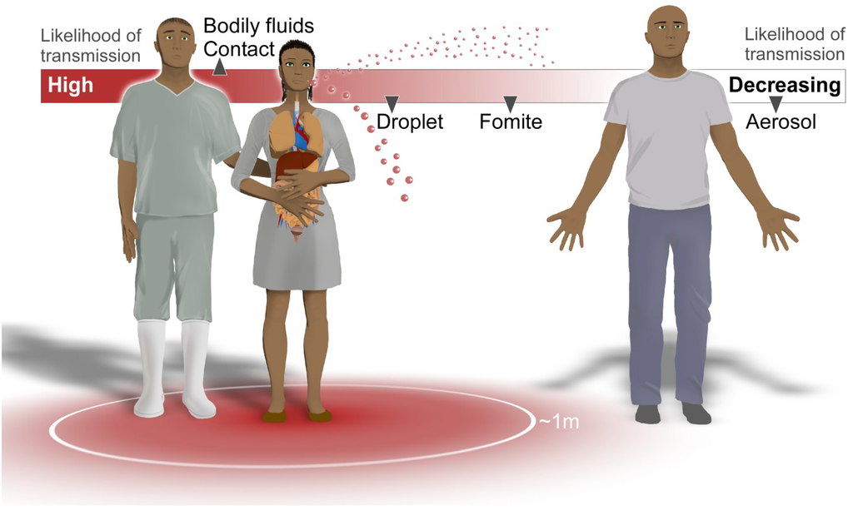
COVID-19 is droplet and fomite spread – not aerosol spread. If you are outside of 2 meters of the patient you do not need PPE – just good hand hygiene
Notes:
ARI – close contact through droplet transmission from coughing and sneezing, direct human to human contact, contaminated surfaces or breathing aerosols – usually generated by medical procedures

Slide 4
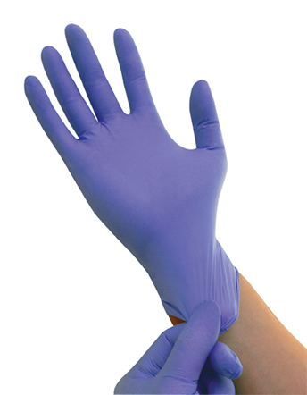
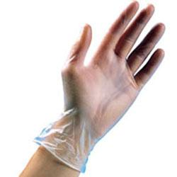
PPE
Assess the risk
Patient is well
No PPE
Patient has temperature of 37.8C or more OR new continuous cough or COVID-19 positive
Non sterile gloves & apron and fluid repellent face protection

Slide 5
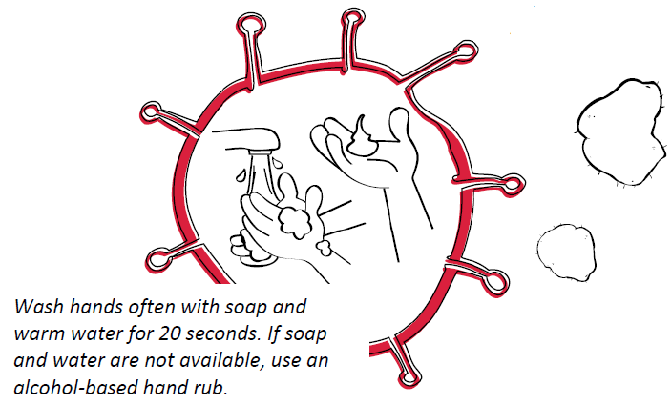
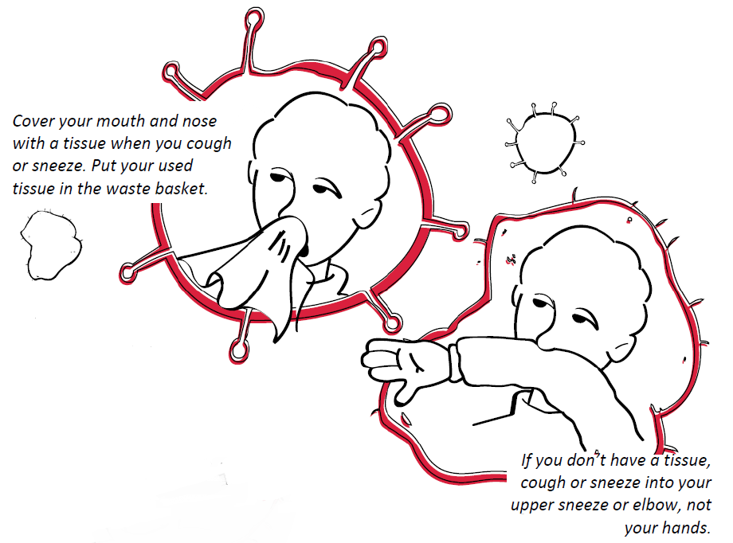
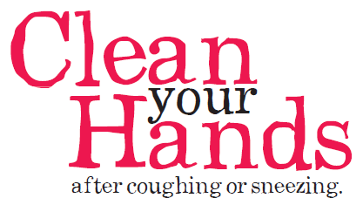
Respiratory Etiquette

Slide 6
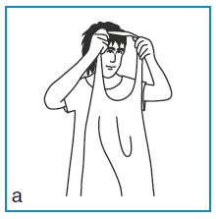
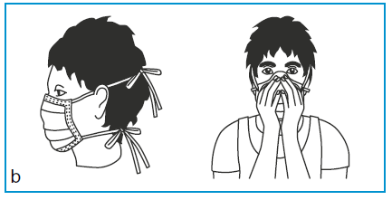
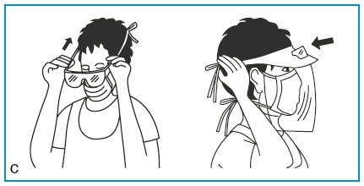
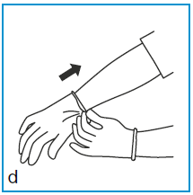
Personal Protective Equipment

Slide 7
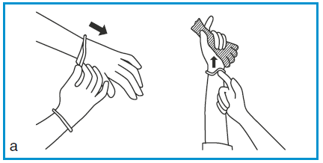
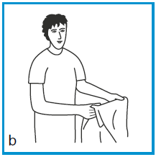
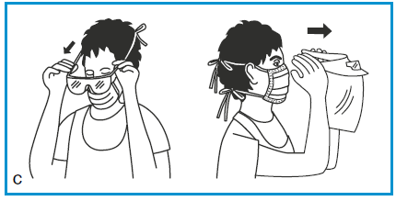
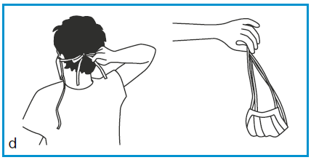
Personal Protective Equipment

Slide 8
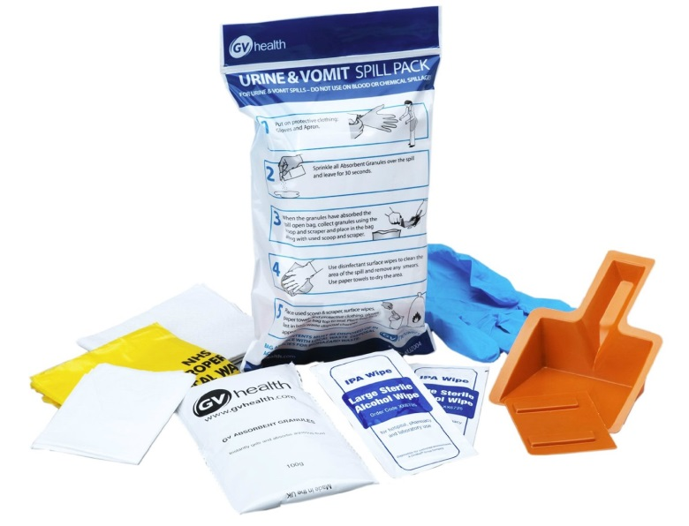
General Cleaning
Equipment must be cleaned between use
Label all equipment – if there’s no label, clean it again
Cleaning wipes – general cleaning
Chlorine – infection cleaning

Slide 9
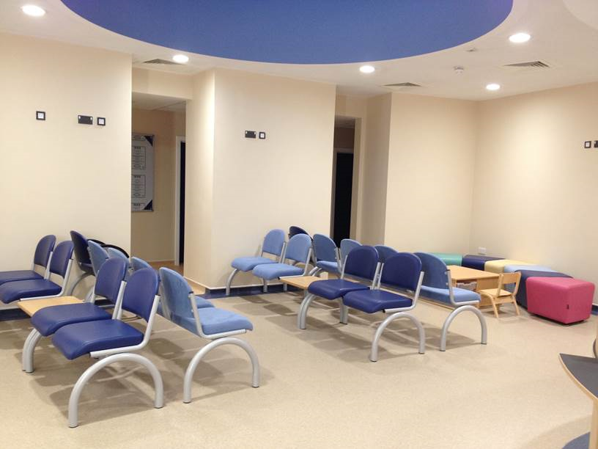
The Importance of Cleaning
Influenza 1-2 days
COVID-19 – 2 hrs
Strep pneumoniae 1-4 weeks
Clostridium difficile 3 months – 2 years

Slide 10
